Slide 1


Slide 2

Aim
I can observe and explain the effects of differing voltages in a circuit.
Success Criteria
I can draw circuit diagrams indicating the voltage.
I can explain the effect of increasing or decreasing the voltage on different parts of a circuit.

Slide 3
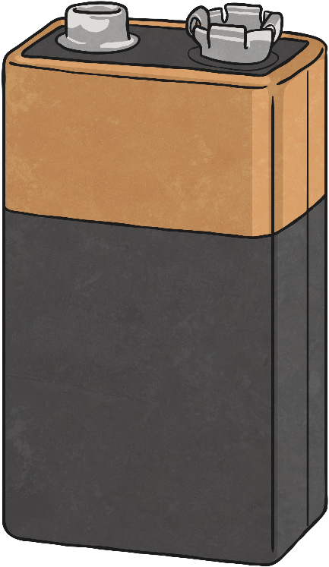
Current and Voltage
Click the battery to view the video.

Slide 4
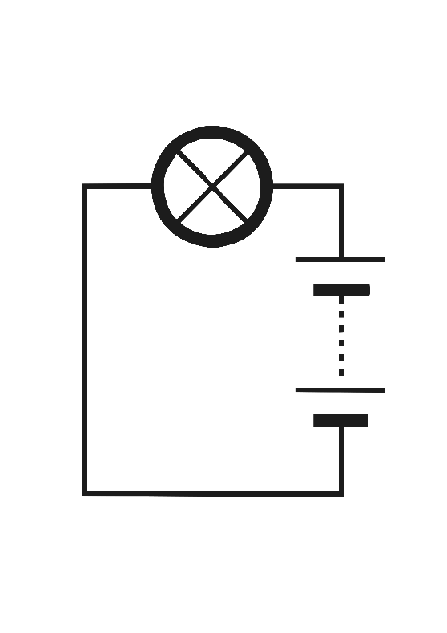
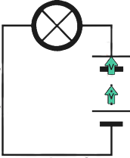
Current and Voltage
Current:
This is the steady flow of electrons.
This is measured in amperes (amps)
Voltage:
This is the force that makes the electric current flow.
This is measured in volts (V)
The greater the voltage, the more current will flow.

Slide 5
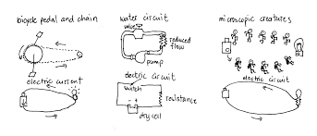
Voltage demonstration.
In this activity you are going to act out the electric current flowing at different voltages.
Mark out a circuit on the ground outside- you could use string, chalk etc.
You will need a container of small objects, such as bean bags. These represent a battery full of electrical energy.
You will also need an empty container. This represents a bulb which needs energy to work.
Walk around the circuit- each time you pass the battery, pick up an object. Each time you pass the bulb, drop it off.
At low voltage, you will walk slowly. At high voltage, you will walk quickly.
What do you notice about how much energy is transferred to the bulb?

Slide 6

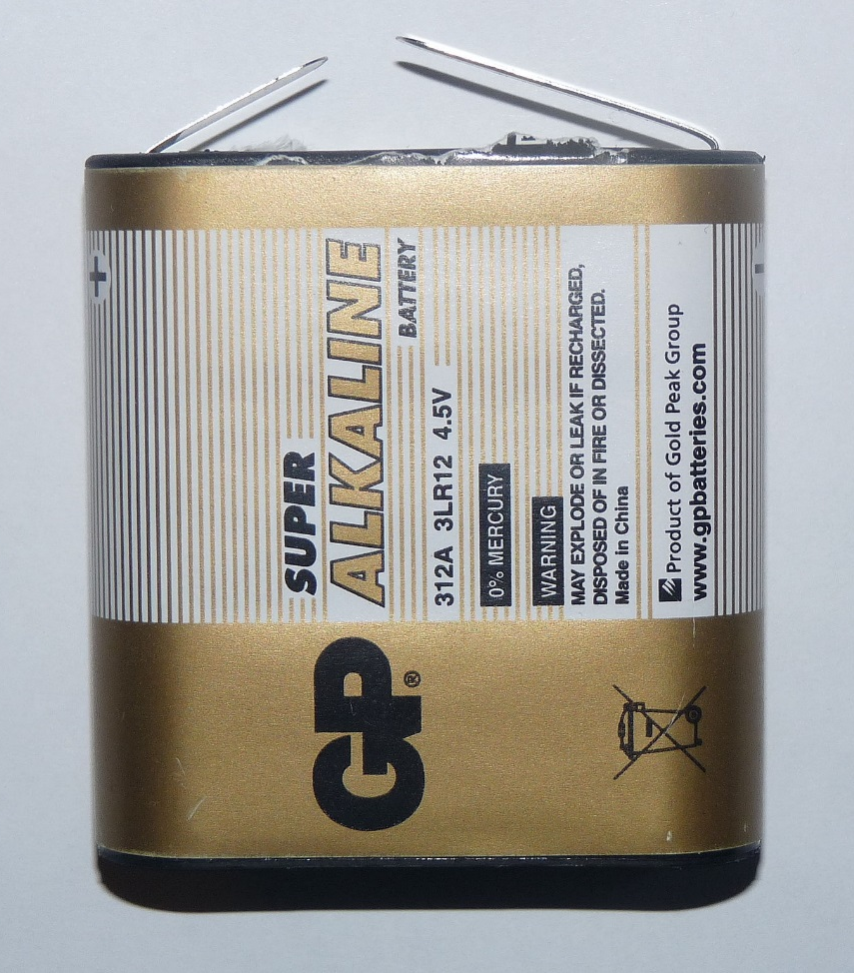
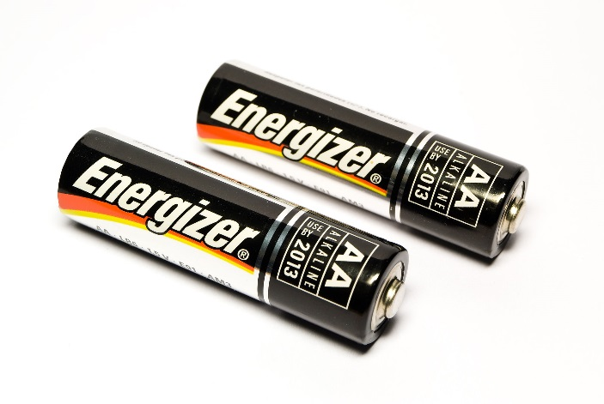
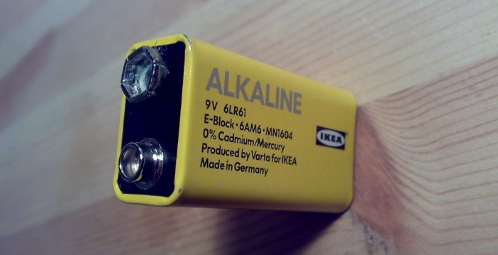
How Many Volts?
Photo courtesy of Asim18 and GFDL (commons.wikimedia.org) - granted under creative commons licence – attribution

Slide 7
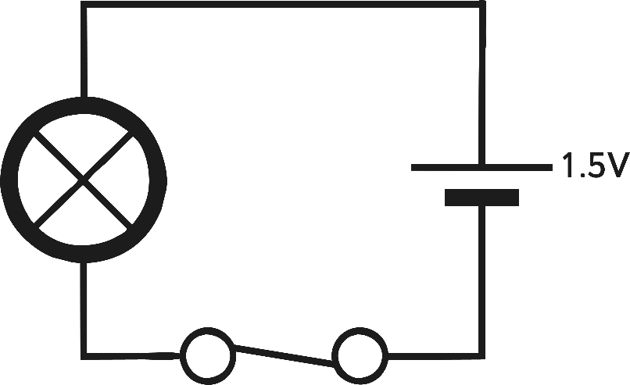
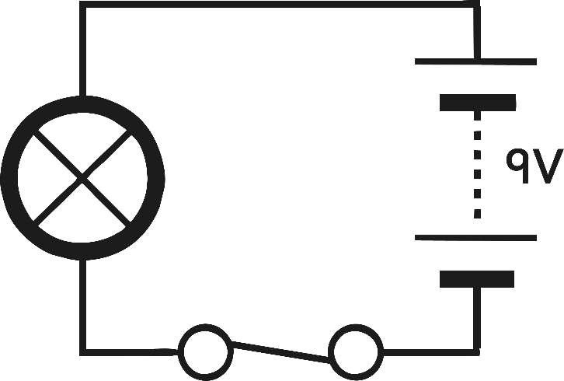
Labelling Volts

Slide 8

What Difference Does the Volt Make?
 | 0V | 1.5V | 3.0V | 4.5V
Prediction
Results

Slide 9

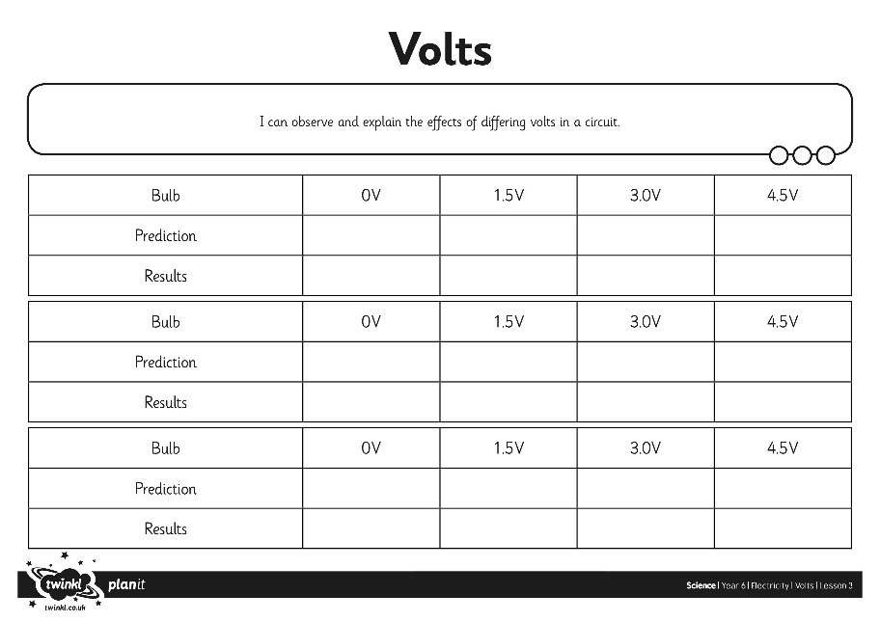
Observing the Effects of Volts
Use a bulb, wires and different batteries to test the effect of different level of voltage on how much light is produced by an electric circuit.
Make your predictions of what you expect to happen first, then test your theory.
If you do not have access to those resources, follow this video link instead.
https://www.bbc.co.uk/bitesize/clips/z6qd7ty

Slide 10
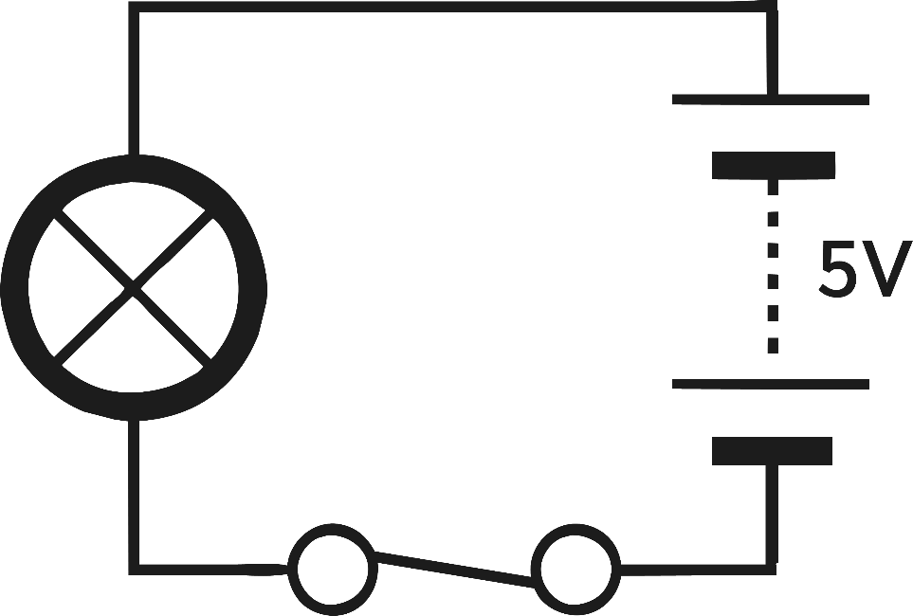
Appropriate Volts
What would happen to an electrical appliance that requires 3V if it were powered by 5V cell or battery?

