Slide 1
Easter Art

Slide 2
Today we will be creating a piece of Easter Art that will be displayed in the church.
Our pieces are going to be focused on negative art silhouette image of the crucifixion. We will be discussing the significance of the Easter story for Christians as we create these pieces.
There will be two elements we are focusing on to create these pieces, this is watercolor for our background and negative art silhouettes. We will then put both together to create our final piece.

Slide 3
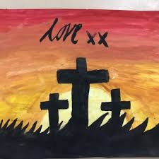
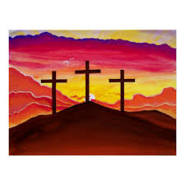
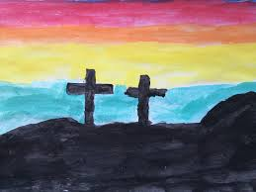

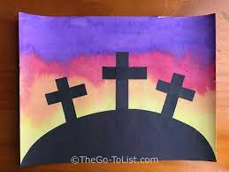

Slide 4
Watercolour

Slide 5
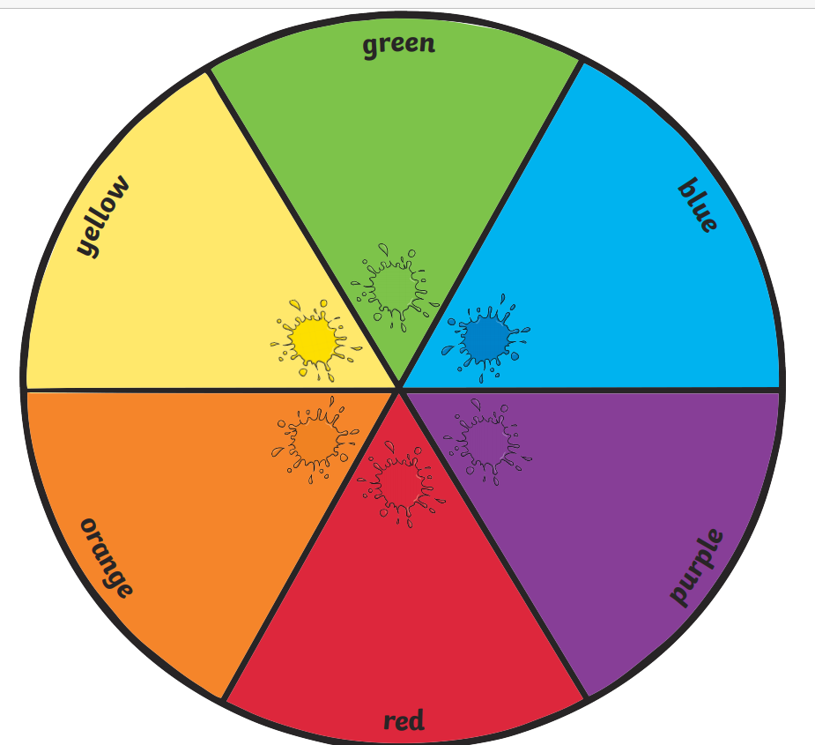
Notes:
Ask chd to remember primary/secondary colours

Slide 6
For our Easter Art piece we need to create a watercolour background that looks like a sunset.
What colours do you think we will be using?
What technique do we need to use or think about when creating these?
Notes:
Try and see if chd can remember tones from our previous lesson.

Slide 7


Have a quick practice in your book seeing if you can blend the colours into each other seamlessly.
Use the colours you will be using in your Easter piece.

Slide 8




Watercolour Wash Step 1
Dip your brush into the water and then into your first colour.

Slide 9




Watercolour Wash Step 2
Sweep your brush from one side of the paper all the way to the other.

Slide 10
Watercolour Wash Step 3
Dip your brush into the water and choose a different colour.

Slide 11

Watercolour Wash Step 4
Sweep your brush across the page under your first line of colour.

Slide 12



Watercolour Wash Step 5
Keep going until the page is covered in colour.

Slide 13
Activity
Using your knowledge of creating tones and how to create a watercolour. You need to create your watercolour background for your final piece.

Slide 14
Negative Shape

Slide 15
LO: To sketch a negative drawing or object.
Must: Explain negative shape.
Should: Observation skills to draw negative shape.
Could: Add shadow using shading techniques.

Slide 16
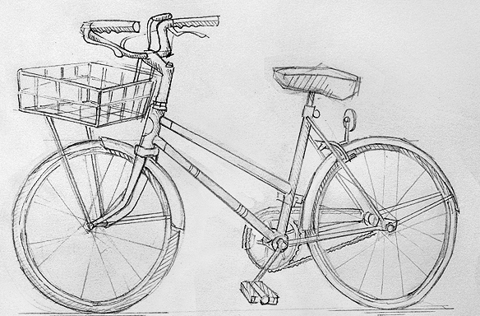
Positive Space
Positive space is the space inside an object.

Slide 17
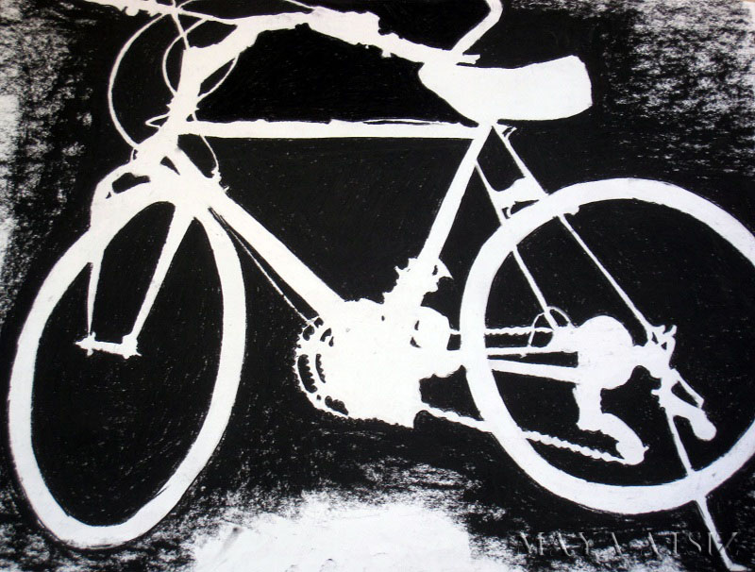
Negative Space
Negative space is the space around an object.

Slide 18
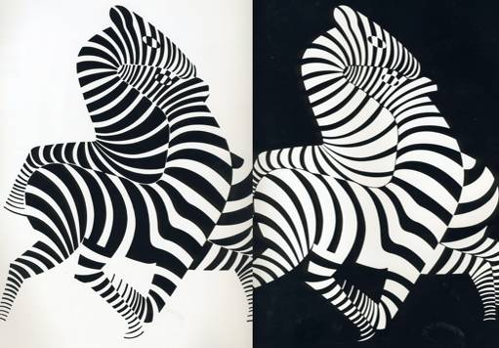

Slide 19
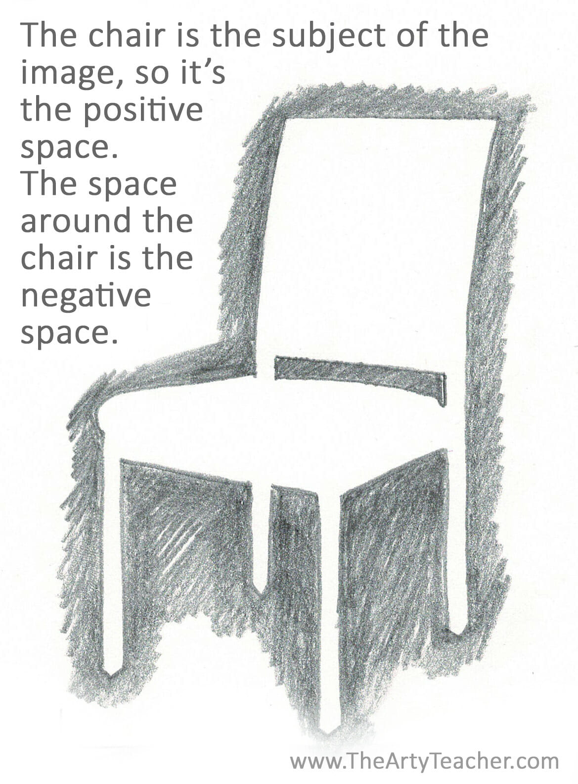
Activity:
In your sketch books, have a go at sketching this picture. Focusing on the negative space.

Slide 20
Silhouette
A silhouette is the black shape of an object.
We can also say, shadow.

Slide 21

Helicopter

Slide 22

Boat

Slide 23

Motorbike

Slide 24
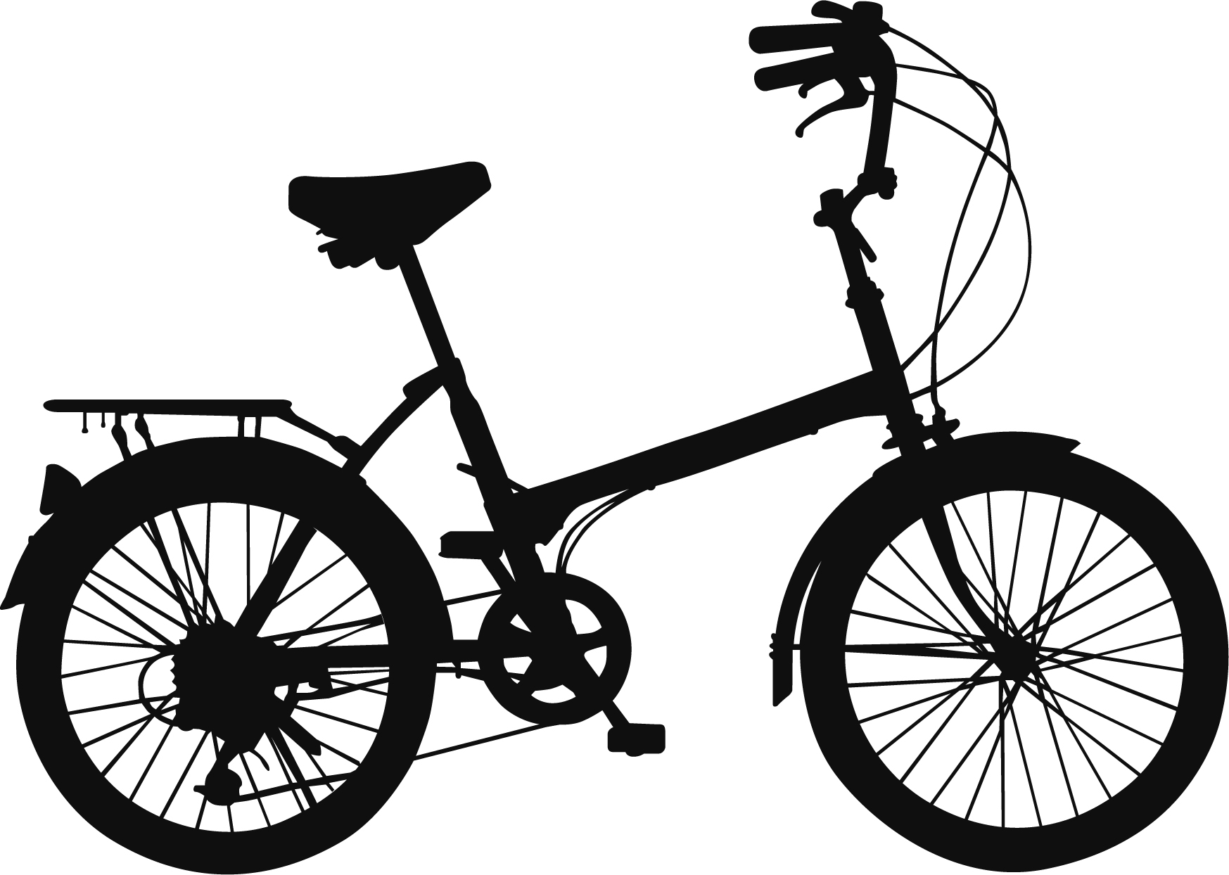
Bike

Slide 25

Activity:
Similar to your last activity, have a go at sketching the chair as a silhouette.
How is it different to the negative shape sketch?

Slide 26
Final Piece

Slide 27
LO: To independently create a final piece using techniques.
Must: Remember techniques they have learnt.
Should: Combine a variety of techniques.
Could: Justify choices of techniques used.

Slide 28
Activity:
Using our skills we have learnt today, we need to put them all together and create our final Easter Art.

