Slide 1

Dragon’s Den
An Introduction

Slide 2

LO: To brainstorm ideas for my invention.
I can think of solutions to common problems
I can draw a basic design for my inventions
I can start to conduct market research

Slide 3
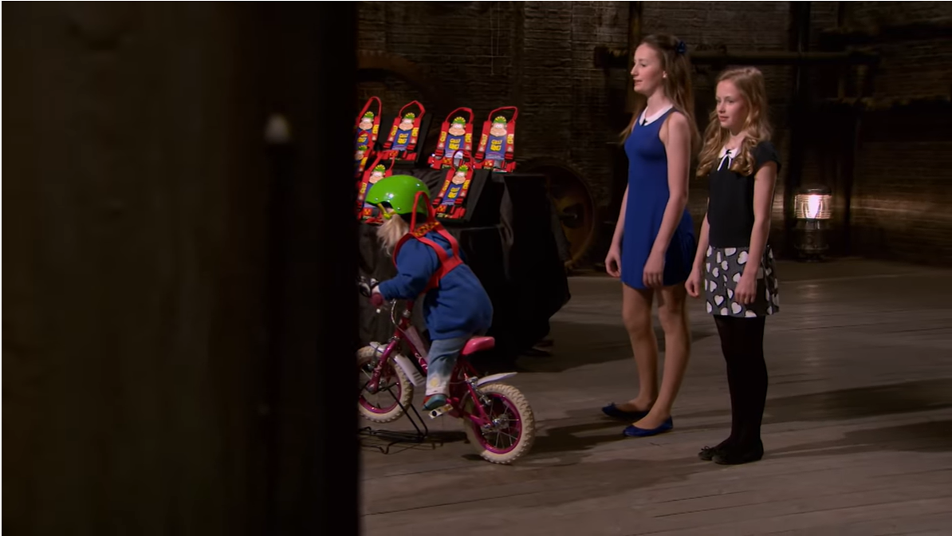
Dragon’s Den
The Future of Britain Is Bright With These Two Sisters | Dragon's Den - YouTube

Slide 4
“Necessity is the mother of invention” - Plato
To be able to invent something useful, you need to first think of a problem.
The invention should help to solve a problem or make it better.
Can you think of a problem that lots of people might have? Talk to a partner.

Slide 5
“Necessity is the mother of invention” - Plato
Can you think of some inventions which already exist that solve these problems?
Having two babies that you need to take out together
Using too many tissues when you wash your hands
Hot drinks going cold too quickly

Slide 6
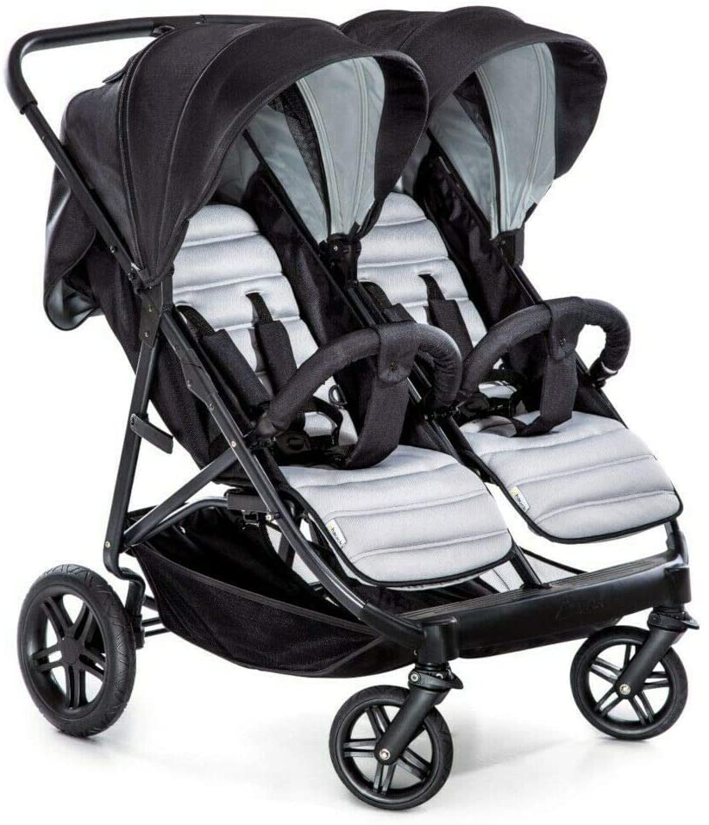


“Necessity is the mother of invention” - Plato
Can you think of some inventions which already exist that solve these problems?
Having two babies that you need to take out together
Using too many tissues when you wash your hands
Hot drinks going cold too quickly

Slide 7
“Necessity is the mother of invention” - Plato
Over the next few weeks, we are going to design an invention to present to our Dragon’s Den panel. You can work in groups to do this.
Next week we will be designing and carrying out our questionnaire. We call this market research because we are finding out more information about the people that we think will buy our product.
Some questions may include age, gender, where you live, how many times a week you do a certain task and how much would people be willing to pay for your product.
These are all things to consider in your planning.

Slide 8
Market Research
Before you can design a robot, you need to find out some information.
Does your idea already exist?
Do other people share your problem?
Do other people need this product?
How much would people be willing to pay for your product?
In order to find this out, you need to conduct market research.

Slide 9
Market Research
One of the ways that we can start to conduct market research is online. If you think you have a good idea, you can google to see if anything already exists in the market.
Your task for today is to brainstorm ideas for your invention. Think about what problem you are going to solve and if it is a problem that lots of people have. I want you to think of at least 5 ideas for inventions.
Include information about who you think would use it and how much roughly you think they would pay for it. Then, one person from your group can lead your research to see if the product already exists.

