Slide 1
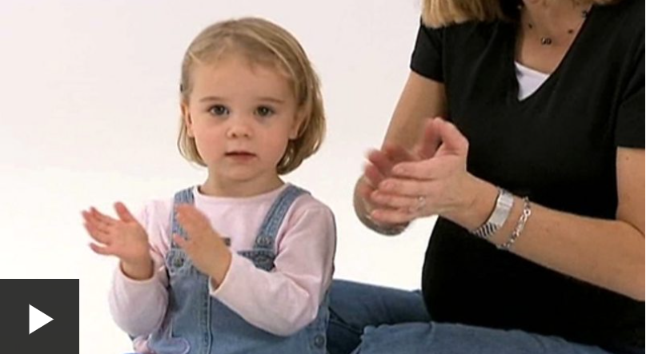
Growth and change (clip compilation) - KS1 Science - BBC Bitesize
Notes:
Video has no narration. Tell chn we are going to conduct an investigation -ask chn to think about what our lesson could be about.

Slide 2
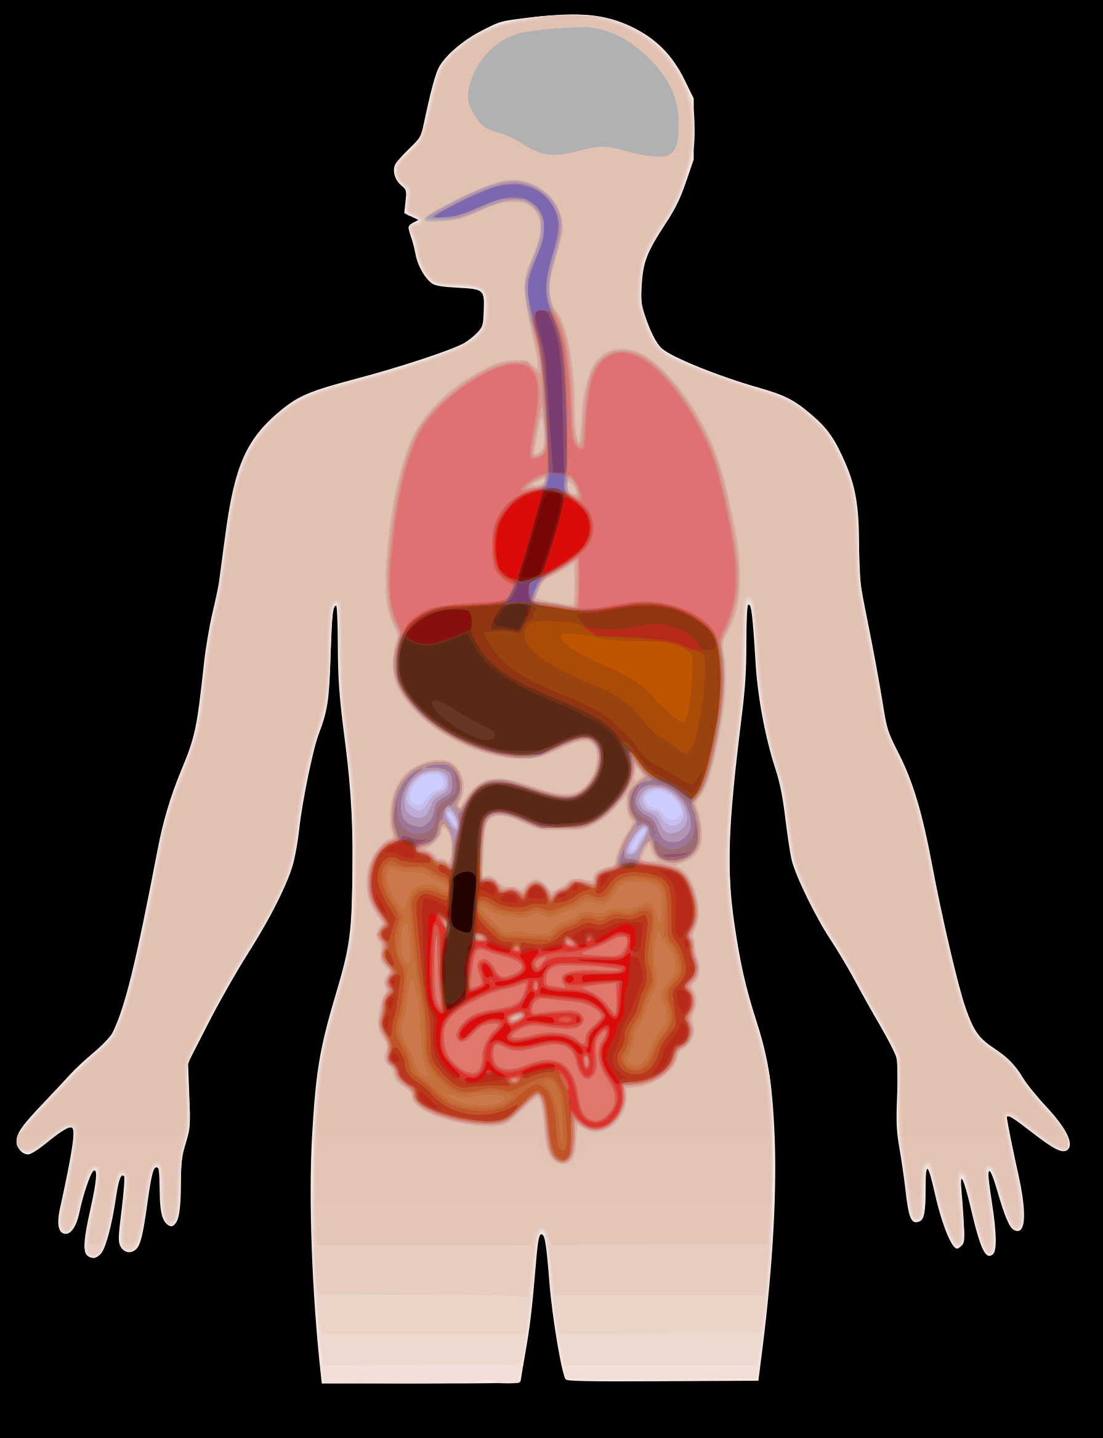
Do our body parts grow?
British Science Week 2022
Notes:
Pg 19 Primary Pack

Slide 3
Do all body parts grow as we get older?
Are there any body parts you think stay the same size?
What body parts would it be easy for you to measure to find out?
Notes:
Ask chn to talk in partners about these two questions. Brainstorm ideas on IWB. We are going to use our hands and our feet. Link to measuring lessons.

Slide 4
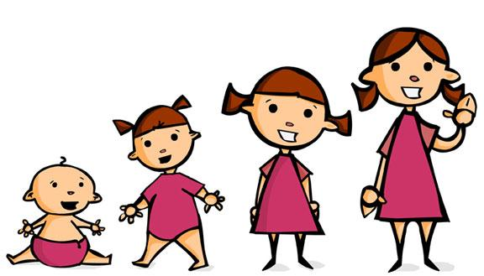
Our investigation
We want to find out if your body parts gets bigger as we get older.
We are going to test this using our shoe size and our hand length.
What enquiry questions could we ask for our investigation?
Notes:
Chn should hopefully suggest good enquiry questions but if not, use “do our hands and feet get bigger as we get older?”
An enquiry is something you want to find out or investigation

Slide 5
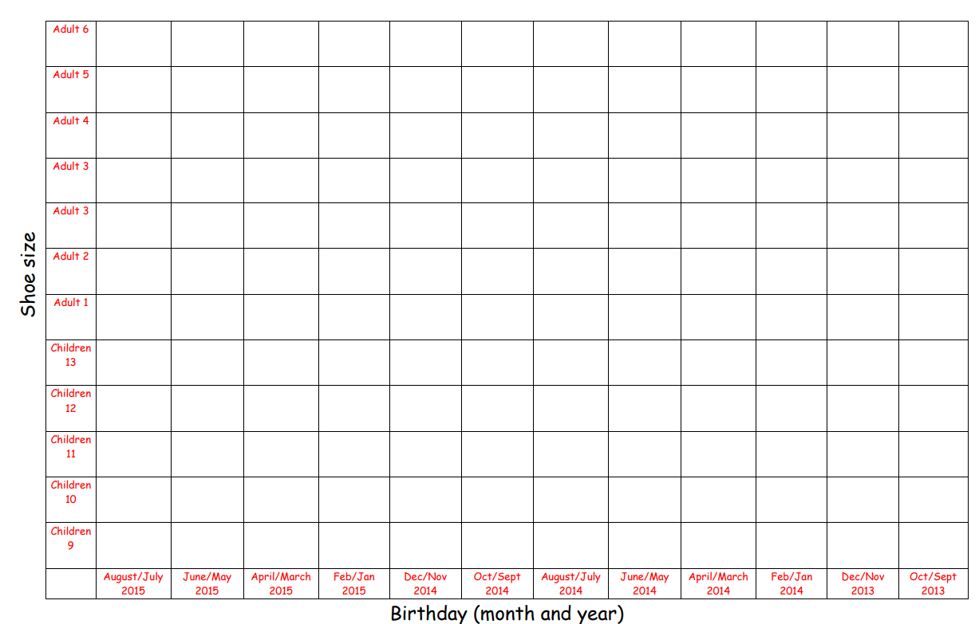
Collecting data:
As a whole class, we are going to plot our data on a scatter graph using stickers.
All we need to know is when we were born and our shoe size.
Then, you are going to place a sticker in the correct box.
Notes:
We are looking to see if our data is linked. What do you think we would see if your shoe size and age are linked?

Slide 6
What patterns did we see? What does this tell us?

Slide 7
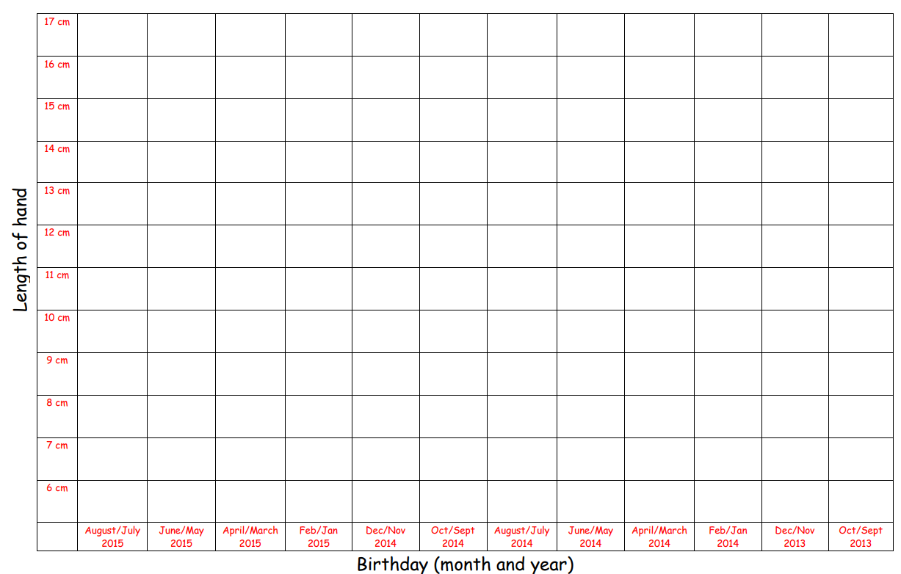
Collecting data:
As a whole class, we are going to plot our data on a scatter graph using stickers.
We need to measure the length of one of our hands in cm. Measure to the nearest cm.
Then, you are going to place a sticker in the correct box.
Notes:
Remind chn to measure from the base of their hand to the top of their middle finger. Reminders about using a ruler, starting on 0 etc.

Slide 8
What patterns did we see? What does this tell us?

Slide 9
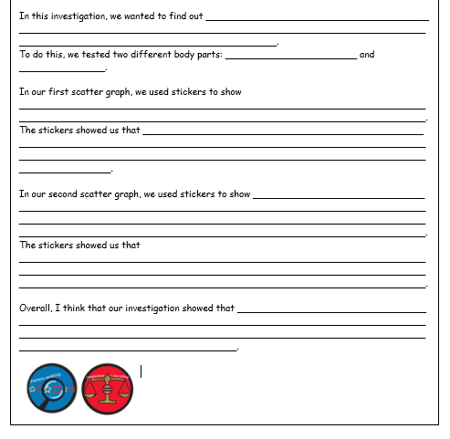
Our evaluation
Using the evaluation sheet, you are going to explain what we found out from this investigation.
Let’s go over the sheet together.
Word bank:
body shoe size hands cm feet born hands ruler older long

Slide 10
If you were to do this investigation again, what other enquiry question could you have?
Notes:
E.g. do boys hands grow bigger than girls. Are your body parts linked to height?

