Slide 1
Design Technology
LO: To design a desk tidy for Ms Smith

Slide 2
Design Brief
Ms Smith needs a desk tidy!
At the moment, the pencil pot on my desk does not meet my needs. I regularly end up with pens and stationery all over my desk because I don’t have anything useful to put them in; the highlighters fall below the rim, making them difficult to retrieve, and it’s very overcrowded.
I need somewhere to store my marking pens, highlighters, pencils, paperclips, BluTack and drawing pins.
It should be sturdy and look attractive.
Think about colours, designs and styles that I might like.

Slide 3
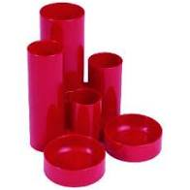
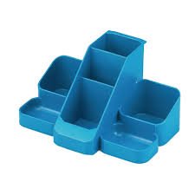
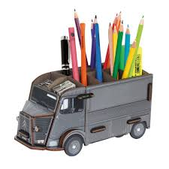
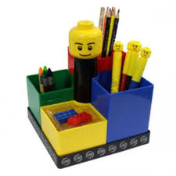
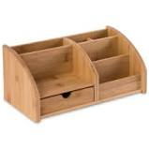
Research
What do you think about existing designs of desk tidies?
Which elements do you like? Or dislike?
What do you think you could improve upon?
What do you think would suit Ms Smith best?

Slide 4
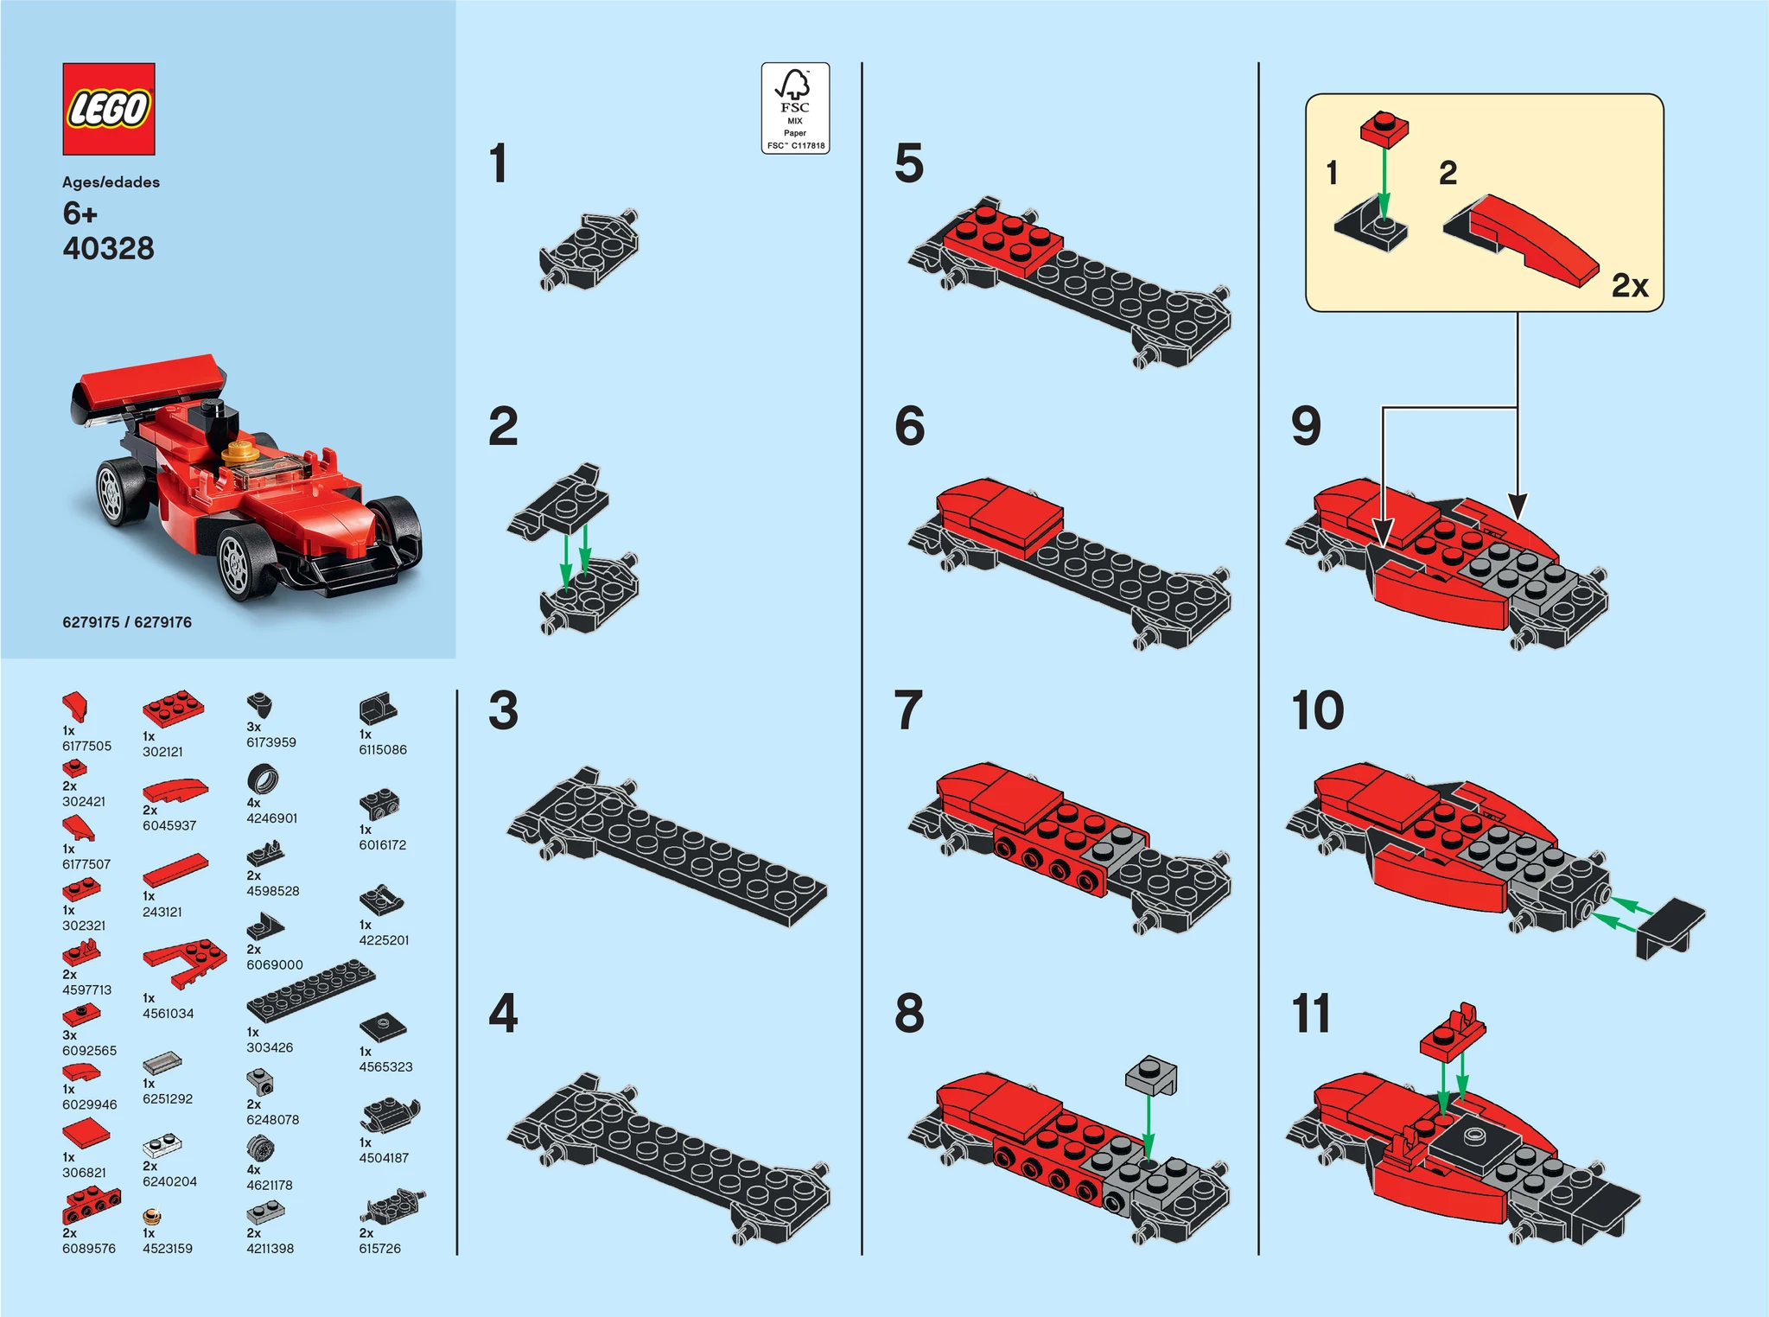
Design
What materials do you have available to make it with? You could use card, other recyclable materials (think about kitchen packaging) or even Lego!
Think about the how you will organise the different pens etc. Think about the sizes they are.
Don’t forget to annotate your design to show this information.
Include exploded diagrams to show additional details or joining methods.
Year 5 and 6 – ensure you include a step by step plan for construction (think Lego instructions).

Slide 5
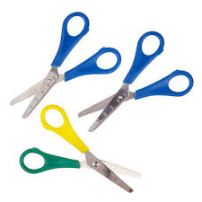
Make!
Follow your plan to construct your desk tidy.
If you are using glue or tape, think carefully about the quantity you are using and how it will look.
Don’t forget to send me a photo!

Slide 6
Evaluate – year four
What went well? What didn’t?
What do you like most about your product? Why?
How does your product compare to your design? Did you have to make any changes to your design? Why?
Does your product meet the criteria set out in the design brief?
If you were to make it again, what changes would you make? What would you do differently? Why?

Slide 7
Evaluate – year five
Explain how your final product would appeal to Ms Smith.
Evaluate your product’s appearance and function against the design brief.
How was it to build? What went well? What didn’t? Why?
How effective are the materials that you’ve used for construction?
What could be improved about your desk tidy? How?

Slide 8
Evaluate – year six
Evaluate your product against the design brief.
Explain how you have met the design brief and the steps you have taken to ensure it appeals to your audience (Ms Smith!).
Did you encounter any problems? How did you overcome them?
How effective was your design/plan in supporting you in the construction of the desk tidy?
What is your favourite feature of your product? Why?

