Slide 1
Creating tones

Slide 2
LO: To experiment creating tones with primary colours.
Must: identify what a tone is.
Should: Use correct colours to create different tones.
Could: Evaluate my tones created.

Slide 3
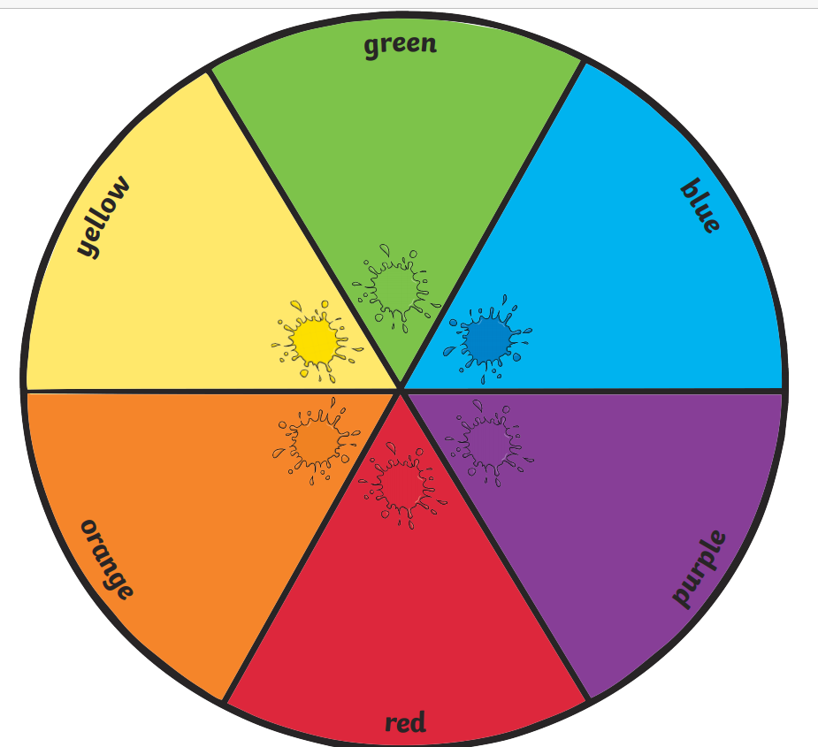
Today we need to use the primary colours.
Who can tell me the primary colours?

Slide 4
We are experimenting with creating tones today.
With your partner, can you discuss what you think a tone is?

Slide 5

When there are different versions of the same colour, they are called tones.
Is there just one type of the colour brown?

Slide 6
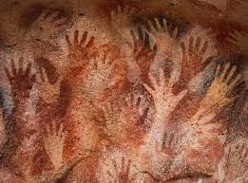
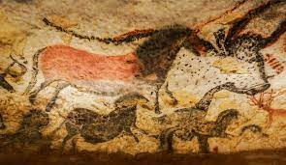
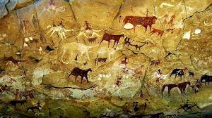
What colours can you identify in these cave paintings?
Are they all the same tone?
In todays lesson we are going to experiment making the different tones we can see in these cave paintings.

Slide 7

As a challenge we can only use primary colours and white. We cannot use black to darken our tones.
We need to experiment how to make the tones we want using only these colours.

Slide 8
Task:
In your sketch book you are going to experiment making different tones.
Make swatches in your book and write a comment whether it is the colour you wanted, and if it isn’t, what do you need to do to fix it? What do you need to add now to create a different tone?
Notes:
Model on piece of paper.
Explain to chd that your going to create different tones of red first, chd should know that adding white will lighten.
Add a bit of blue to the next swatch and then model to the Y2 that I would write next to swatch red + tiny bit of blue
Y3 would write- I didn’t add enough blue to my swatch, next I will add more blue etc
Chd to show different tones of colour in books.

