Slide 1
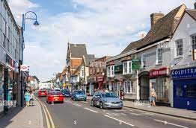
L.O: To compare from my locality to a nearby town. 18.11.21
P | Success Criteria | T
 | I can use street view to virtually visit a town.
 | I can present my data in a bar chart.
 | I can draw conclusions from the data.
 | I can evaluate our data collection methods.

Slide 2
Task 1: Use a streetview tool to take a virtual tour of a local town.
Your task is to use streetview to remotely view the businesses in St. Neots. Compare the businesses you can see here with the list you made during our Kimbolton field day.
What differences did you notice?
What do you think the reason for this is?
google.com/maps/@52.2276954,-0.271277,3a,75y,275.35h,87.03t/data=!3m6!1e1!3m4!1sZ3d-ErKlpQ3BfZlJpVSfAA!2e0!7i13312!8i6656
Partner Task- What kind of business do you think would do well in Kimbolton or St Neots? What are your reasons?

Slide 3
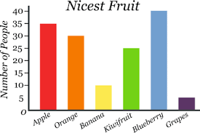
Task 2: To use your data from Kimbolton and St Neots to make a bar graph.
What are the key features of a bar graph?

Slide 4
Bar Charts
Data that is counted and has no in-between value is called discrete data. Discrete data is usually collected in a frequency table and then presented as a bar chart.
Pet | Number of Children
Cat | 12
Dog | 14
Fish | 7
Rabbit | 5
Other | 8
A bar chart has a horizontal axis and a vertical axis.
A bar chart must always have a title explaining what it shows.
Bars must be carefully drawn to show the data.
There must be a gap between each bar.
Each bar must be the same width.
A number line is marked on the vertical axis. The scale of this number line is chosen based on the data range.
The data categories are organised on the horizontal axis.
Each axis must have a label explaining what it shows.

Slide 5


Bar Charts
Discrete data in each category can also be represented in subcategories:
We can draw a grouped bar chart to show this data. In this bar chart, each category has more than one bar. A key is used to identify the subcategories of the data.
Pet | Number of Boys | Number of Girls
Cat | 7 | 5
Dog | 6 | 8
Fish | 3 | 4
Rabbit | 1 | 4
Other | 2 | 6

Slide 6
Once you have finished your graphs, Explain what you have noticed about your data.
What do you think the reasons for this might be?
Evaluation time- How could we improve the quality of our data?
How can we make sure this is a fairer test?

