Slide 2
Aim
I can explain what bullying is and explore the impact of kind words and actions.
Success Criteria
I can recognise different types of bullying.
I can discuss how bullying can affect people.
I can talk about the impact of kindness on our own and others’ emotional wellbeing.
I can suggest ways we can show kindness to ourselves and to others.

Slide 3
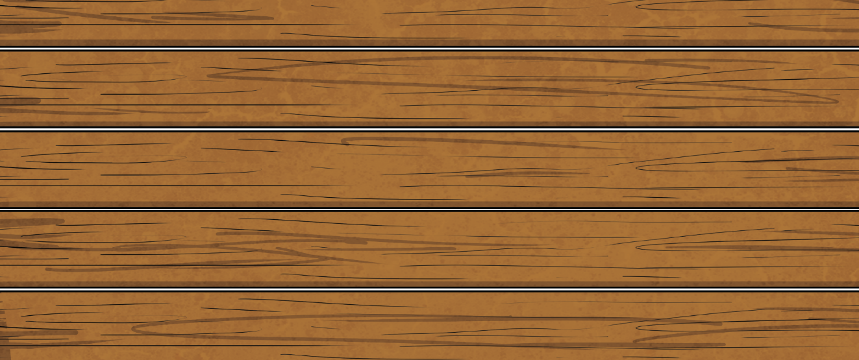

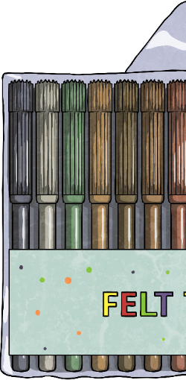
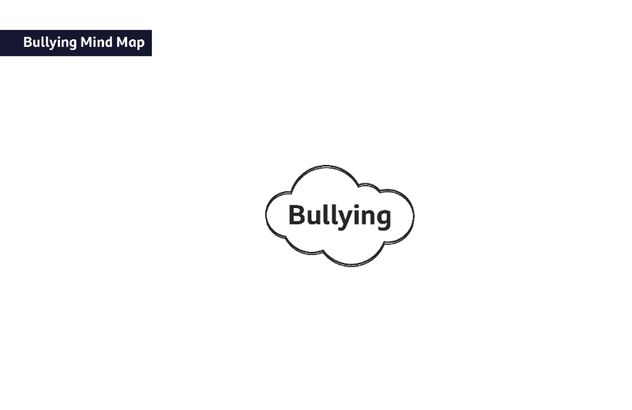

What Is Bullying?
Did You Know…?
Can you complete this sentence?
Bullying is….
Write down everything you know about bullying on your Bullying Mind Map.
One in three children report having been bullied at some point in their lives.
We’ll be adding to this sheet throughout the lesson as we share our thoughts and learn more information.

Slide 4
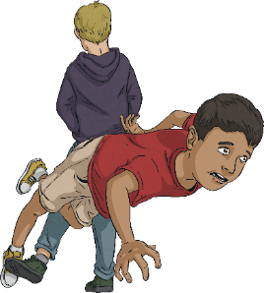
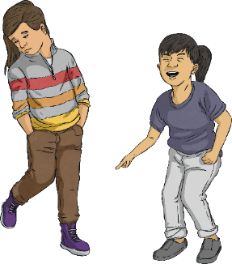
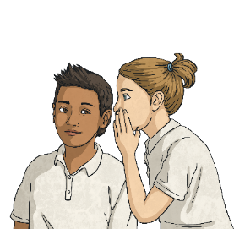
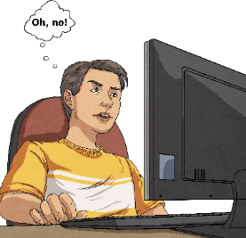
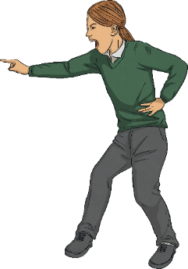
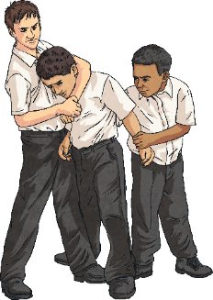
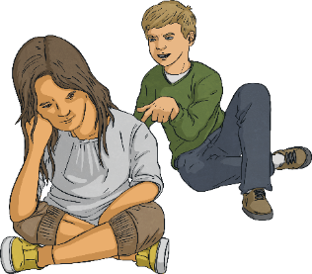
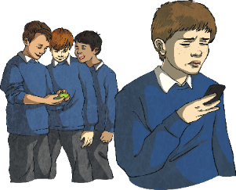
What Is Bullying?
In your groups, share your ideas about what bullying can be.
You might find these pictures useful to prompt some ideas.

Slide 5
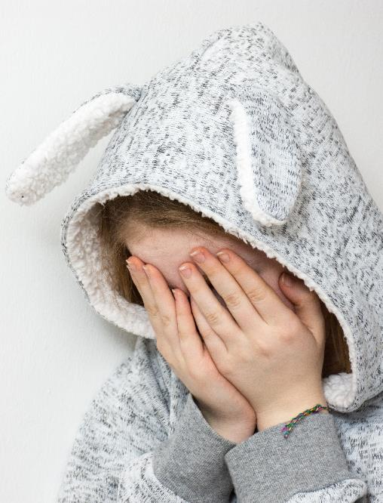
What Is Bullying?
Bullying can happen in lots of different ways. It can happen to anyone and often involves someone thinking they are more powerful than someone else. Bullying:
is when someone intentionally hurts someone else with their actions or their words;
can hurt people’s feelings, body or mind;
can happen in a group or individually;
involves someone feeling they are more important than someone else;
can be in person or online;
often happens repeatedly but may happen just once;
is not OK!

Slide 6
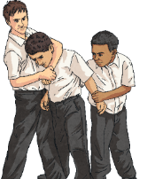
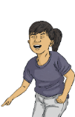


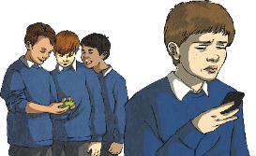
What Is Bullying?
Let’s look at some different forms of bullying.
Physical bullying is when someone uses their body to hurt someone else. This may include hitting, kicking, punching, pushing and damaging property.
Verbal bullying is when someone uses their words to hurt someone else. This may include name-calling and teasing.
Social bullying is when someone tries to make others think badly of someone on purpose. This may include excluding them, spreading rumours or telling lies about someone.
Cyberbullying is when someone is bullied using technology such as a computer, laptop, tablet or mobile phone. This may include sending hurtful images, texts, social media posts or emails.

Slide 7
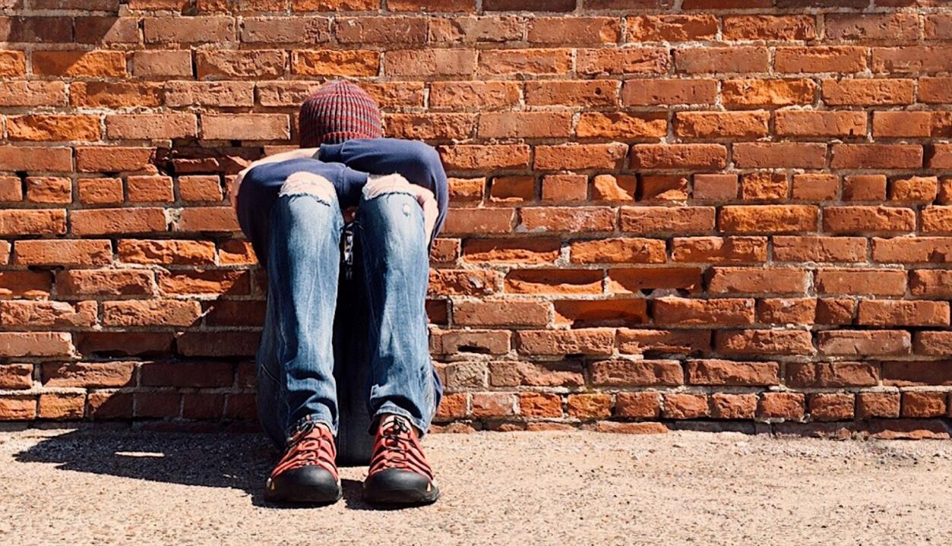
What Is Bullying?
Chronic bullying means bullying behaviour that has lasted for a long period of time, such as six months or more.
What sort of bullying is more likely to go on for long periods of time and go unnoticed?
Why might some bullying behaviour go on for so long?

Slide 8
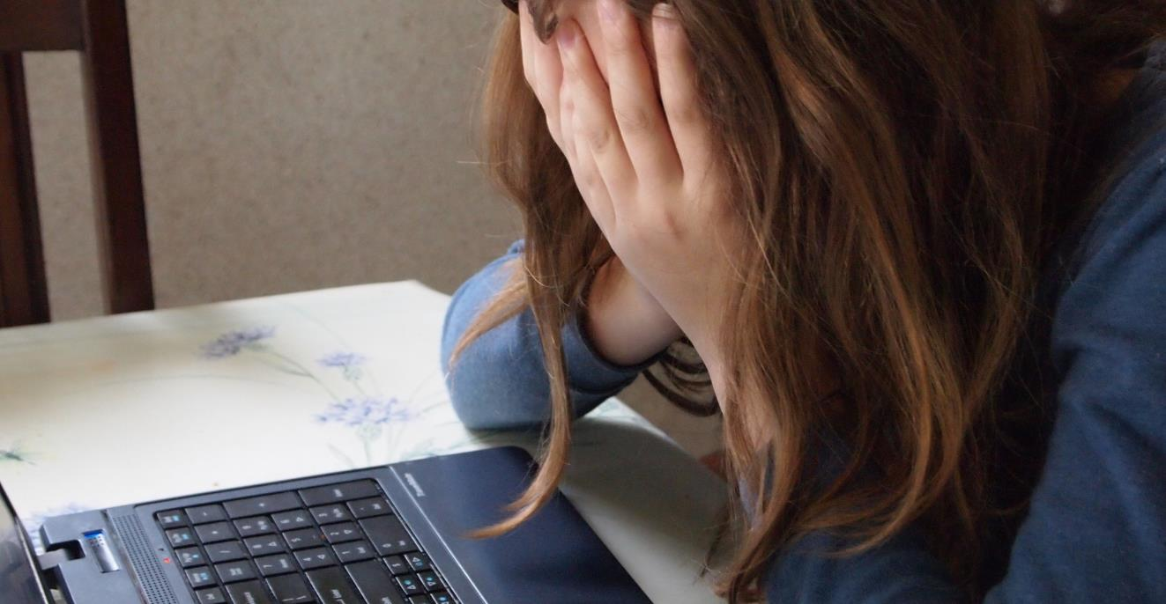
The Impact of Bullying
Bullying can happen in lots of different ways. It can happen to anyone and often involves someone thinking they are more powerful than someone else.
Harmful effects include:
making someone feel worthless;
causing someone to feel frightened or lonely;
affecting a person’s ability to concentrate on learning;
making someone feel angry or upset;
making a person withdraw from people they are close to;
causing someone to avoid coming to school;
affecting a person’s overall confidence;
negatively impacting a person’s mental and physical health.

Slide 9
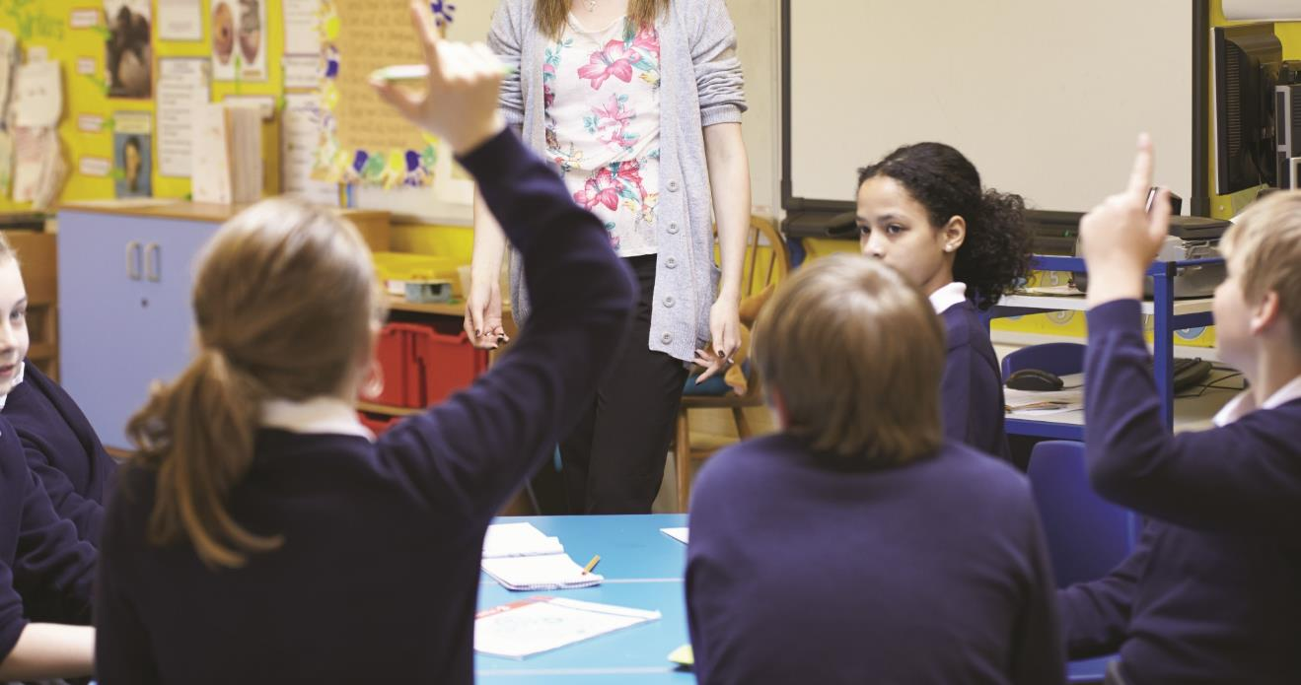
The Impact of Bullying
To truly understand the impact bullying can have on a person, we need to use empathy.
In the following activity, we will be putting ourselves in someone else’s shoes and considering their emotions and thoughts.
This activity is called hot seating.
We’ll read through some scenarios and you will need to imagine you are the person in the scenario.
If you’re chosen to be in the ‘hot seat’, we’ll ask you how your character is feeling and what they're thinking.

Slide 10
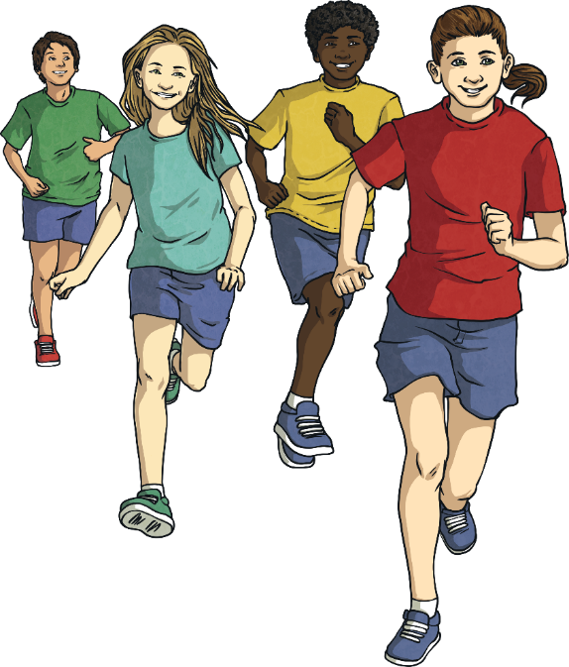
The Impact of Bullying
Torin and Felicity have played together since they were in nursery. They enjoy playing at each other’s houses and meeting up in the park. Recently, Felicity has started playing with a new group of friends. Torin has asked if he can join in but the others make an excuse and run away, giggling.
We’ll read through some scenarios and you will need to imagine you are the person in the scenario.
Imagine you are Torin.
What sorts of emotions are you experiencing?
What might you say or do?

Slide 11
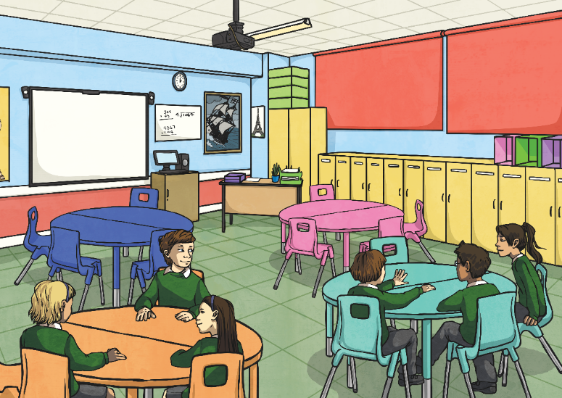
The Impact of Bullying
Yin sits next to Martha in class. Recently, Martha has started to poke Yin hard in the leg with a pencil. Yin has asked her to stop but Martha tells Yin to stop moaning.
We’ll read through some scenarios and you will need to imagine you are the person in the scenario.
If you’re chosen to be in the ‘hot seat’, we’ll ask you how you’re feeling and what you’re thinking.
Imagine you are Yin.
How do you feel towards Martha?
What impact might the incidents have on your classwork?

Slide 12
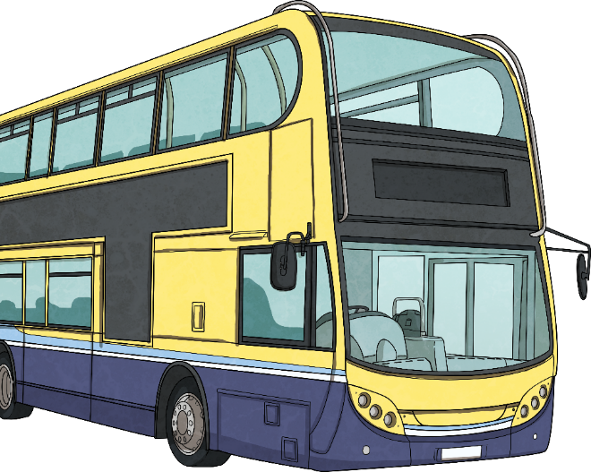
The Impact of Bullying
There was recently a class trip to a museum. The children went on a coach and Mario fell asleep. When he logged on to his social media account, he saw a photo of himself asleep with lots of unkind comments.
We’ll read through some scenarios and you will need to imagine you are the person in the scenario.
If you’re chosen to be in the ‘hot seat’, we’ll ask you how you’re feeling and what you’re thinking.
Imagine you are Mario.
How does this make you feel?
How might you react around your friends?

Slide 13
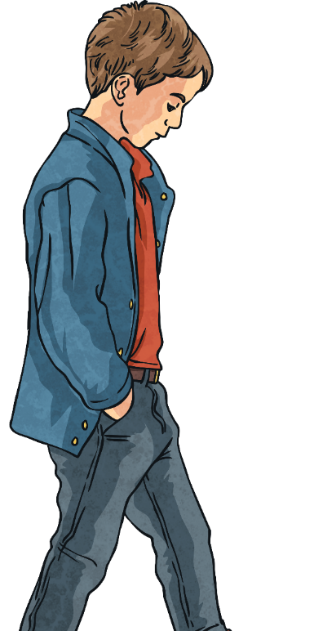
The Impact of Bullying
Zain walks to school the same way each day. Every day, they walk past the same group of children in the year above at school. They call out to Zain, using mean names and laugh at the way they walk.
We’ll read through some scenarios and you will need to imagine you are the person in the scenario.
If you’re chosen to be in the ‘hot seat’, we’ll ask you how you’re feeling and what you’re thinking.
Imagine you are Zain.
How are you feeling?
What do you think you might do?

Slide 14
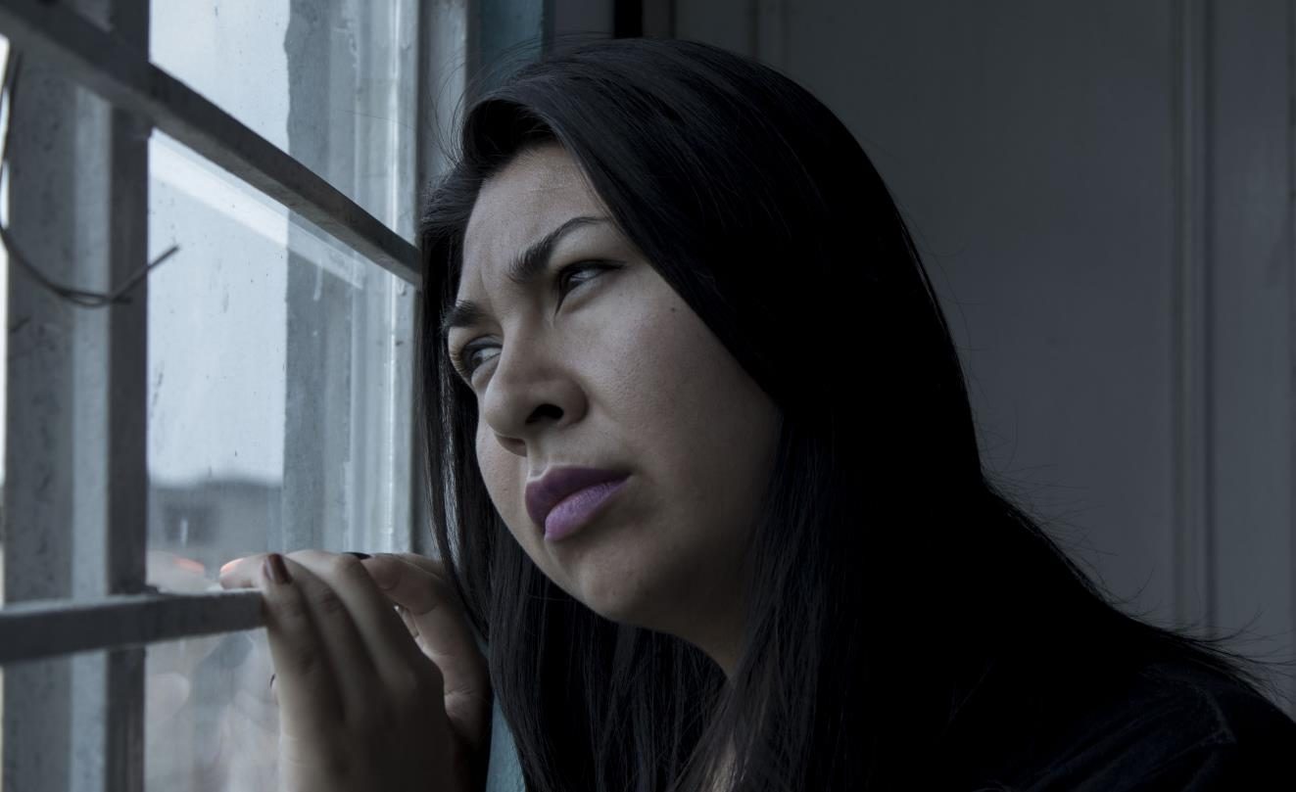
The Impact of Bullying
This why getting help as soon as bullying behaviour starts is so important.
Bullying can also have long-term effects, such as depression and anxiety.
Research shows that the effects of bullying can continue into adulthood and greatly impact our mental health.
Experiences of being bullied may well influence a person’s future mindset, including how they view themselves and others.

Slide 15
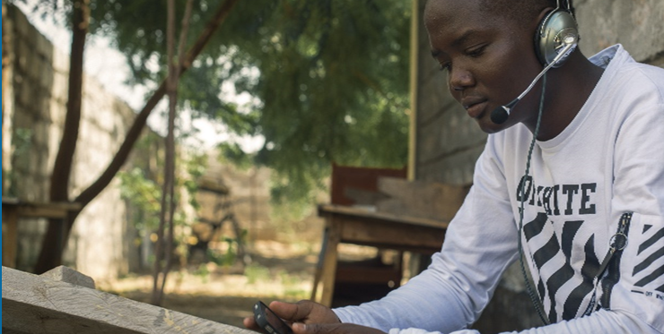
How Should We Respond?
Bullying can happen in lots of different ways. It can happen to anyone and often involves someone thinking they are more powerful than someone else.
How Should We Respond?
report concerns to a trusted adult at home or at school;
say no to unkind behaviour if others try to involve you;
capture evidence of bullying, for example, unkind or threatening messages sent online to show when reporting it;
remember that if we are bullied, it is not our fault.

Slide 16
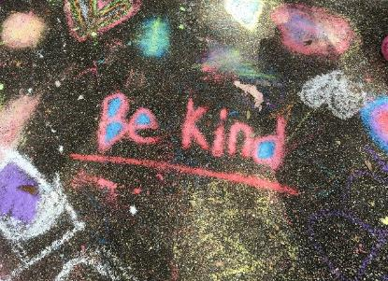
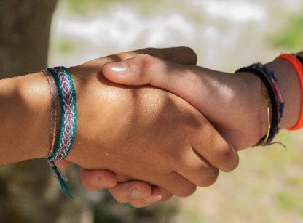
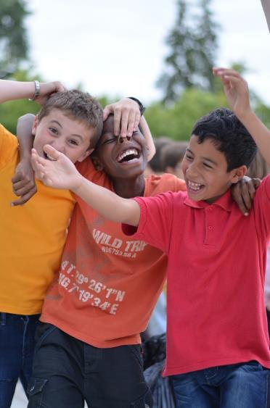
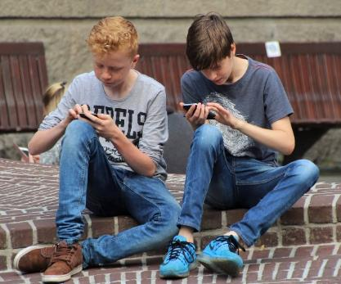
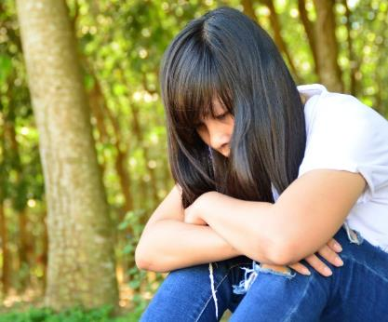
Creating a Kinder World
Bullying is unacceptable behaviour. Nobody should have to live with bullying and there are things we can all do to help prevent it.
Use kind words and actions to everyone around us;
Think before we speak or before we post comments online;
Include everyone in games and conversations;
Kindness
Inclusivity
Remember, we are all equally important - nobody is more important than anyone else;
Empathise with others and consider how they feel.
Inclusivity
Equality
Empathy

Slide 17
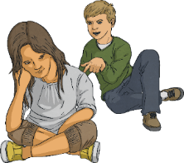
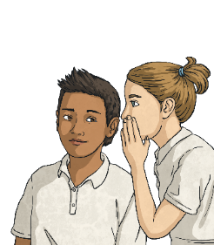
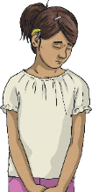
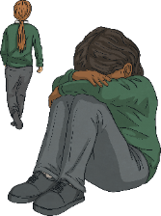
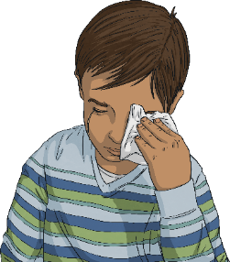
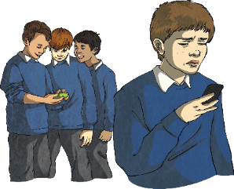
Creating a Kinder World
Using kind words and actions can have an impact on the emotional wellbeing of people around us as well as on ourselves. If someone is upset or worried, showing kindness and respect can help make it clear that there are people to talk to who can support their emotional wellbeing. Supporting others can also support our own emotional wellbeing.
As the following pictures appear, talk to your partner about kind words or actions that you could use to help in each situation.

Slide 18
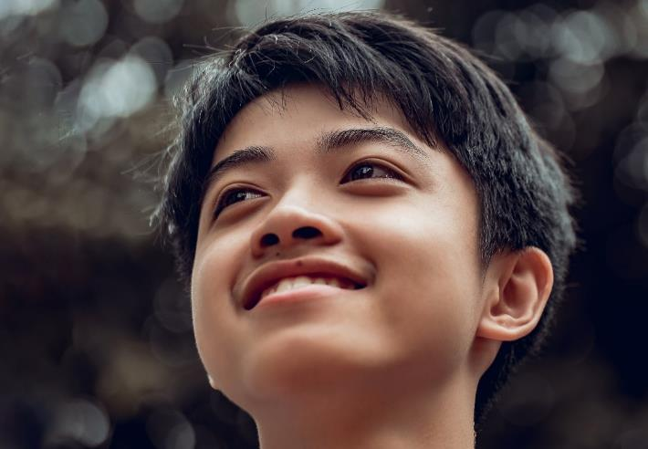
Showing Kindness and Respect
Using kind words and actions can:
encourage others to show kindness too;
support people who are feeling upset or worried;
help our own emotional wellbeing;
show respect for others’ feelings.

Slide 19
Showing Kindness and Respect
Showing kindness and respect to ourselves and others is very important.
Take a read of these quotes and discuss how they apply to what we have been learning about today.
‘No act of kindness, no matter how small, is ever wasted.’ Aesop
‘How do we change the world? One random act of kindness at a time.’ Morgan Freeman
‘A single act of kindness throws out roots in all directions, and the roots spring up and make new trees.’
Amelia Earhart
‘Sometimes it takes only one act of kindness and caring to change a person’s life.’
Jackie Chan

Slide 20
Showing Kindness and Respect
Now, let’s all make a difference with one kind word. Remember, one kind word leads to another. We’re going to create a chain of kindness.
We’ll need to decide who will start us off and which route our chain of kindness will follow so it includes everyone in the room.
Using one kind word from this word bank, say something respectful, caring or supportive to the next person in the chain.
care
support
fair
friend
listen
share
thoughtful
play
understand
respect
learn
appreciate
love
kind
share
positive
funny
lovely
helpful
loyal
welcome
honest

Slide 21
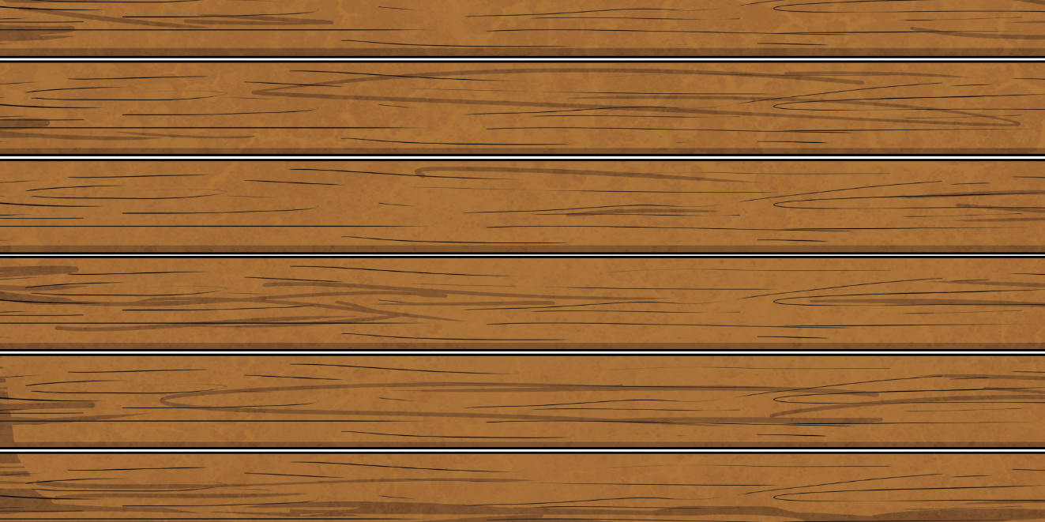
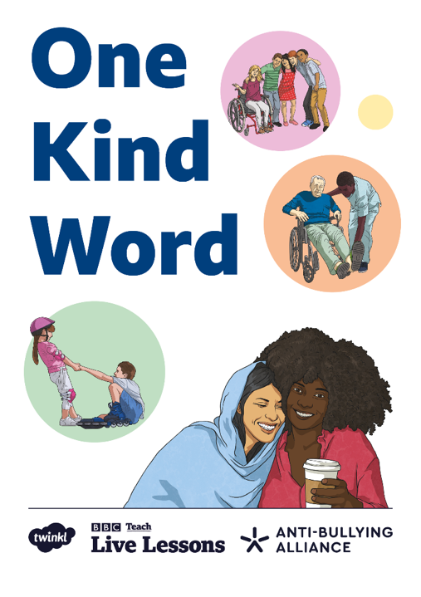
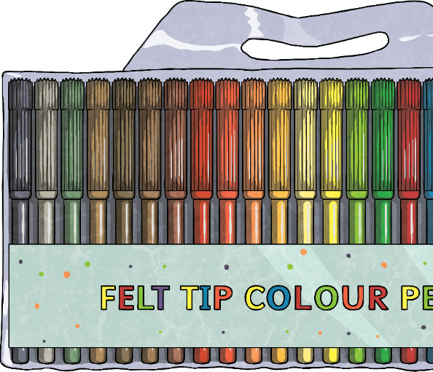

One Kind Word
Every year, Anti-Bullying Week, set up by the Anti-Bullying Alliance, focuses on a particular theme.
This year’s theme is ‘One Kind Word’.
Using everything we have discussed and learnt today, create a leaflet telling others about the power of kindness and how it can be used to tackle the issue of bullying.
If you are worried about anything at all or have any questions, talk to an adult you trust and ask for help.

Slide 22
Aim
I can explain what bullying is and explore the impact of kind words and actions.
Success Criteria
I can recognise different types of bullying.
I can discuss how bullying can affect people.
I can talk about the impact of kindness on our own and others’ emotional wellbeing.
I can suggest ways we can show kindness to ourselves and to others.

Slide 23


BBC Own It is there to help you be the boss of your online life. There’s help and advice for any problems you might face online and tips and inspiration to make the most of your digital world.
The website is full of videos, articles and quizzes, covering everything from your relationships online, to
self-esteem, to all the things you’re passionate about like vlogging and gaming. Meanwhile, the Own It keyboard and app is on hand with advice whenever you type, and allows you to track your feelings and find help whenever you need it most.
Natterhub is an interactive online safety platform for primary schools.
With over 300 interactive lessons, quizzes, activities, all aligned to the curriculum, assessed and tracked for teachers, it’s a one stop online safety hub! There’s even a safe space to practise online safety skills so Natterhub can prepare children to be safe and savvy internet users.
Think of Natterhub as your whole school online safeguarding, media literacy and digital wellbeing solution.

