Slide 1
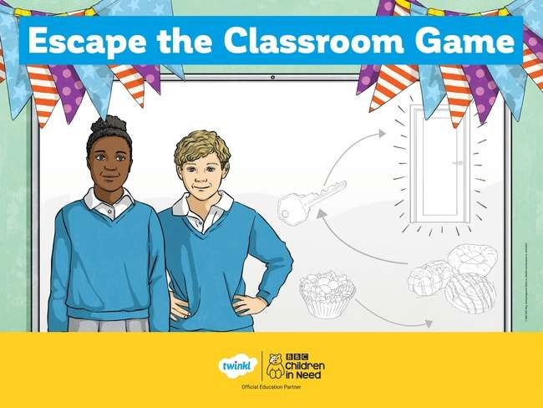

Slide 2
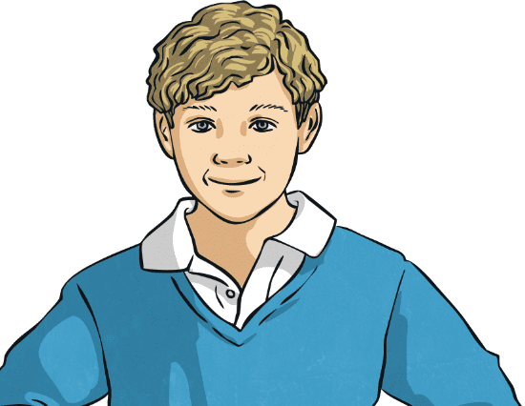
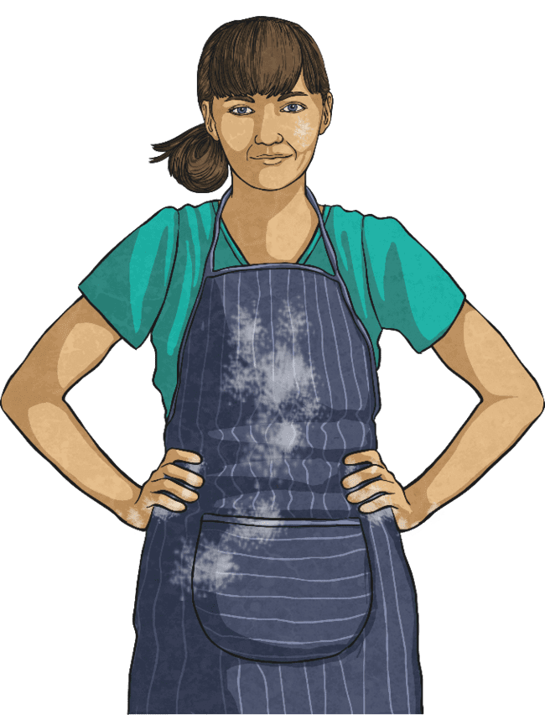
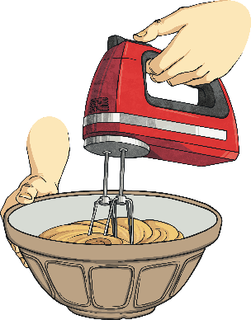

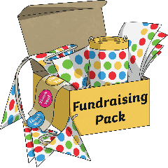
Escape the Classroom
It’s the day before the BBC Children in Need bake sale. Your class have been eagerly anticipating this day and you know that you’re going to spend it baking like you’ve never baked before.
Next
Next

Slide 3
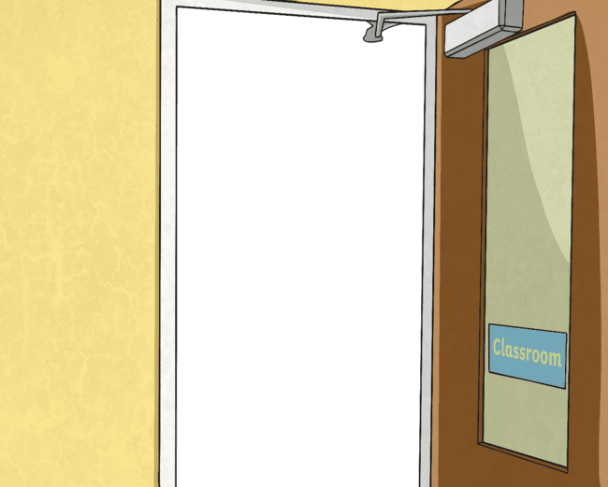

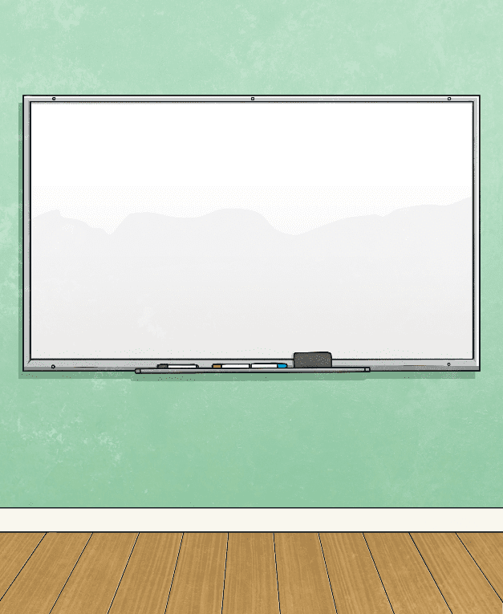
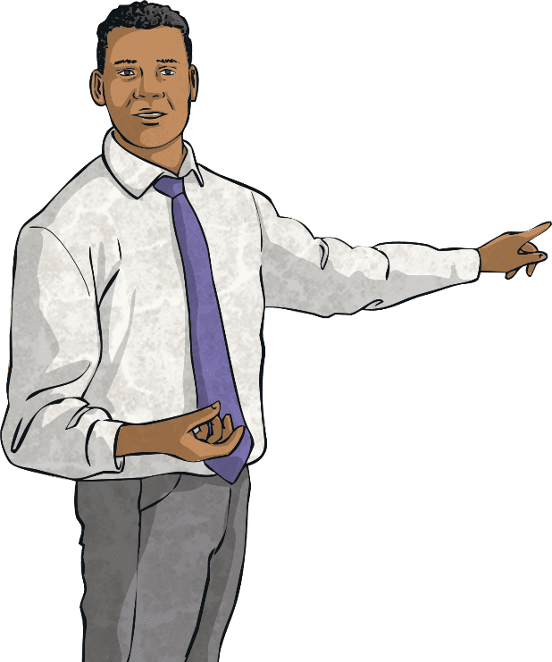
Escape the Classroom
As you’re weighing out the ingredients needed for some delicious Pudsey-themed cupcakes, you notice that you’ve run out of flour. When you tell your teacher, they send you to the year 2 classroom as they have a spare bag.
Next
Next

Slide 4
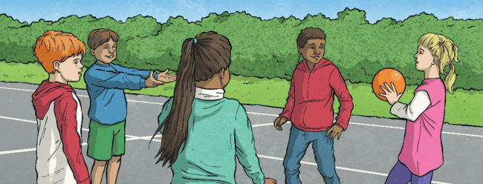

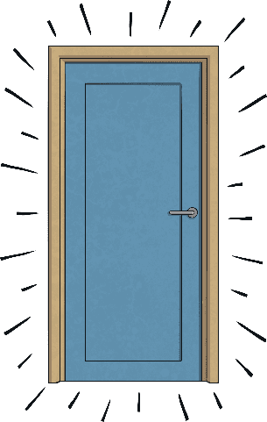


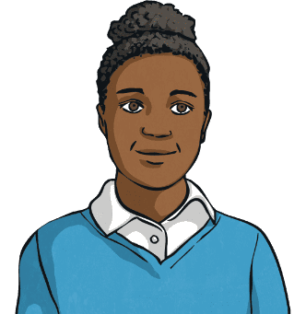
Escape the Classroom
When you arrive, year 2 are outside and the classroom is empty.
You tiptoe inside hoping that someone has left the flour on the side when… click! The door has locked behind you!
?
Next
Next

Slide 5
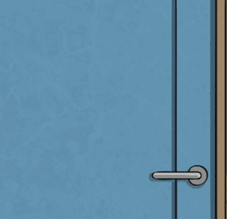


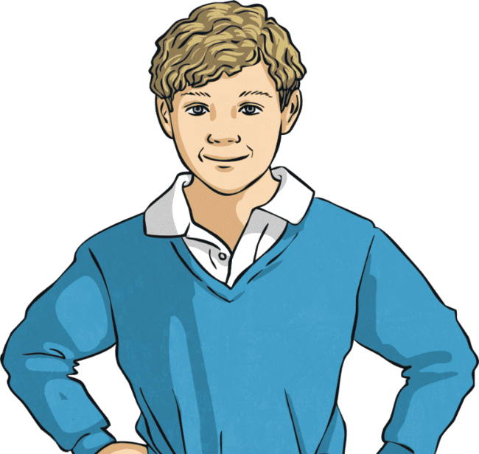
Escape the Classroom
Solve the clues and puzzles hidden around the room and reveal the keypad code needed to open the door. The clues could be anywhere so you need to keep your eyes peeled and your mind sharp!
Good luck!
Next
Next

Slide 6

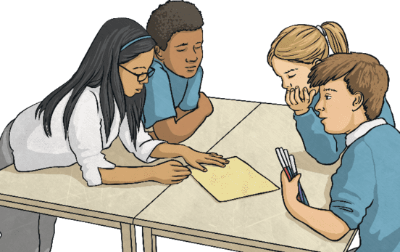
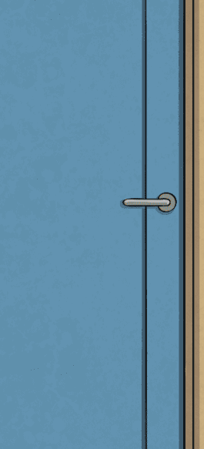


The Rules
You can work in small groups.
When you find a clue that has been hidden, work together to find the answer and reveal one of the digits to the keypad code.
Record your answer on the answer sheet.
Once you have discovered the
ten-digit code for the keypad, check it with your teacher and find out if you can escape the classroom.
Next

Slide 7

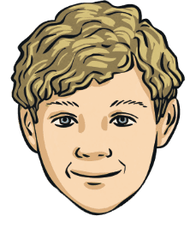
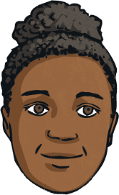
Reveal the Answers
1
?
?
5
9
4
3
7
?
2
3
7
3
?
?
?
?
?
?
?
Click on a rectangle to uncover the clue!
Escape

Slide 8

Clue for Digit 1
How many of the words below are prepositions?
your
on
around
between
under
in
mix
batter
their
behind
beside
cake
serve
bake
coat
Seven of these words are prepositions.
Can you spot any other word classes?
Answer
Next
?
Next

Slide 9

Clue for Digit 2
Read the sentences below. How many of them are missing inverted commas? Correct any errors you find.
“Those cakes look fantastic!” said Claudia before taking a big bite. “Yum! They taste fantastic too!”
Our teacher told us that if we didn’t want to spend our playtime cleaning the floor, we had to sieve the flour really carefully.
Those cakes look fantastic! said Claudia before taking a big bite. Yum! They taste fantastic too!
Are you sure you’ve washed your hands? asked Mr Cook, suspiciously.
“Welcome to the BBC Children in Need appeal show,” announced the presenter.
“Are you sure you’ve washed your hands?” asked Mr Cook, suspiciously.
Welcome to the BBC Children in Need appeal show, announced the presenter.
I’m so excited for the bake sale that I
can barely sleep!
When asked how loud they could cheer, class 4 erupted with yells and whoops.
Three of these sentences are missing inverted commas.
Did you manage to correct them all?
Answer
Next
?
Next

Slide 10
Clue for Digit 3
How many of these words can have the prefix anti– added to
them to form a real word?
venom
pizza
motorway
septic
freeze
ear
walk
social
cakes
clockwise
name
cake
Five of these words make real words when the prefix anti– is added to them. How does the prefix anti– change the meaning of the words?
Answer
Next
?
Next

Slide 11
Clue for Digit 4
Add the correct subordinating conjunctions into the sentences
below. The letters in each yellow box can be rearranged to spell a number.
going to bed, it is important that you brush your teeth.
B
e
f
o
r
e
You’ll be allowed to use the oven unattended
you’re older.
w
h
e
n
The children waited with eager anticipation the day of the BBC Children in Need bake sale finally arrived!
u
n
t
i
l
you carry on eating all of the hundreds and thousands, there’ll be none left over for the cupcakes!
I
f
The answers are before, when, until and if. The letters in the yellow boxes spell the number nine when rearranged.
Answer
Next
?
Next

Slide 12
Clue for Digit 5
Read the sentences below. How many of them are missing a
comma after a fronted adverbial? Correct any you find.
Before taking the class to the lion and tiger petting zoo the teacher filled out a risk assessment.
Before taking the class to the lion and tiger petting zoo, the teacher filled out a risk assessment.
Our class was so excited to begin baking some tasty cakes as part of our fundraising challenge.
On Wednesday, David chose to put on a pair of blue socks labelled ‘Tuesday’.
On Wednesday David chose to put on a pair of blue socks labelled ‘Tuesday’.
In 2018, BBC Children in Need raised an incredible £58m!
In 2018 BBC Children in Need raised an incredible £58m!
I can’t wait to see everyone dressed up to raise money for BBC Children in Need!
As quick as a flash Gertrude the guinea pig leapt over the side of the enclosure and towards the juicy carrot.
As quick as a flash, Gertrude the guinea pig leapt over the side of the enclosure and towards the juicy carrot.
Four of these sentences are missing a comma after a fronted adverbial. Did you manage to correct them all?
Answer
Next
?
Next

Slide 13
Clue for Digit 6
Rewrite the words below in their contracted form using
apostrophes for contraction. How many times does the letter o
appear in the contracted forms?
can’t
cannot
could’ve
could have
he’d
he would
you’ve
you have
wouldn’t
would not
The contracted forms are can’t, could’ve, he’d, you’ve
and wouldn’t. The letter o appears three times.
Answer
Next
?
Next

Slide 14
Clue for Digit 7
How many of the words below belong to the ‘write’ word family?
underwrite
pencil
rewrite
right
handwriting
pen
written
letter
writer
writes
writing
wrist
Seven of the words belong to the ‘write’ word family. They all mean something to do with writing.
Answer
Next
?
Next

Slide 15
Clue for Digit 8
How many of these plurals are spelt correctly?
Correct any errors you find.
When I howled at the wolves, they looked at me for a moment and then howled back.
When I howled at the wolfs, they looked at me for a moment and then howled back.
There are eight planets which orbit the Sun in our Solar System.
There are eight planets which orbit the Sun in our Solar System.
After surviving several falls from the roof, I have concluded that our cat must have nine lives.
After surviving several falls from the roof, I have concluded that our cat must have nine lifes.
Even the babies at our local nursery are dressing up for BBC Children in Need.
Even the babys at our local nursery are dressing up for BBC Children in Need.
During their break, the children imagined they were spies sent to gather information about an alien invasion.
During their break, the children imagined they were spys sent to gather information about an alien invasion.
Using grey icing and some carefully positioned ears can make your cupcakes look like hundreds of tiny mice.
Using grey icing and some carefully positioned ears can make your cupcakes look like hundreds of tiny mouses.
Only one of these sentences has used a correctly spelt plural. Were you able to correct the others?
Answer
Next
?
Next

Slide 16
Clue for Digit 9
A piece of punctuation is missing from each of these sentences.
Add in the correct punctuation. How many were missing a question mark?
“Which class will raise the most amount of money for BBC Children in Need” asked our headteacher.
“Which class will raise the most amount of money for BBC Children in Need?” asked our headteacher.
What an incredible cake you’ve made
What an incredible cake you’ve made!
Tomorrow, I’ll be taking part in a wheelbarrow race with my best friend
Tomorrow, I’ll be taking part in a wheelbarrow race with my best friend.
Did you notice the big mess the rabbits have left on the school field
Did you notice the big mess the rabbits have left on the school field?
As much as a try to enjoy them, I still strongly dislike peas
As much as a try to enjoy them, I still strongly dislike peas.
When the visitors entered the hall, they were amazed at the artwork on display and asked if we had made it all ourselves
When the visitors entered the hall, they were amazed at the artwork on display and asked if we had made it all ourselves.
Two of these sentences were missing a question mark. The others were missing full stops and exclamation marks.
Answer
Next
?
Next

Slide 17
Clue for Digit 10
Add a letter to each box to complete the word.
How many times have you had to use the letter h?
Apples, pears and peaches are all types of .
Apples, pears and peaches are all types of .
f
f
r
u
i
t
Use a metre ruler to measure the of your table.
Use a metre ruler to measure the of your table.
l
l
e
n
g
t
h
    is the third planet from the Sun.
    is the third planet from the Sun.
e
E
a
r
t
h
It is my birthday today; I am years old.
It is my birthday today; I am years old.
e
e
i
g
h
t
The letter h is used three times in these words.
What other letter appears three times?
Answer
Next
?
Next

Slide 18


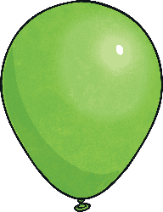

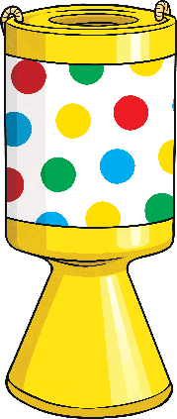
You Escaped from the Classroom!
Finish

Slide 19
