Slide 1
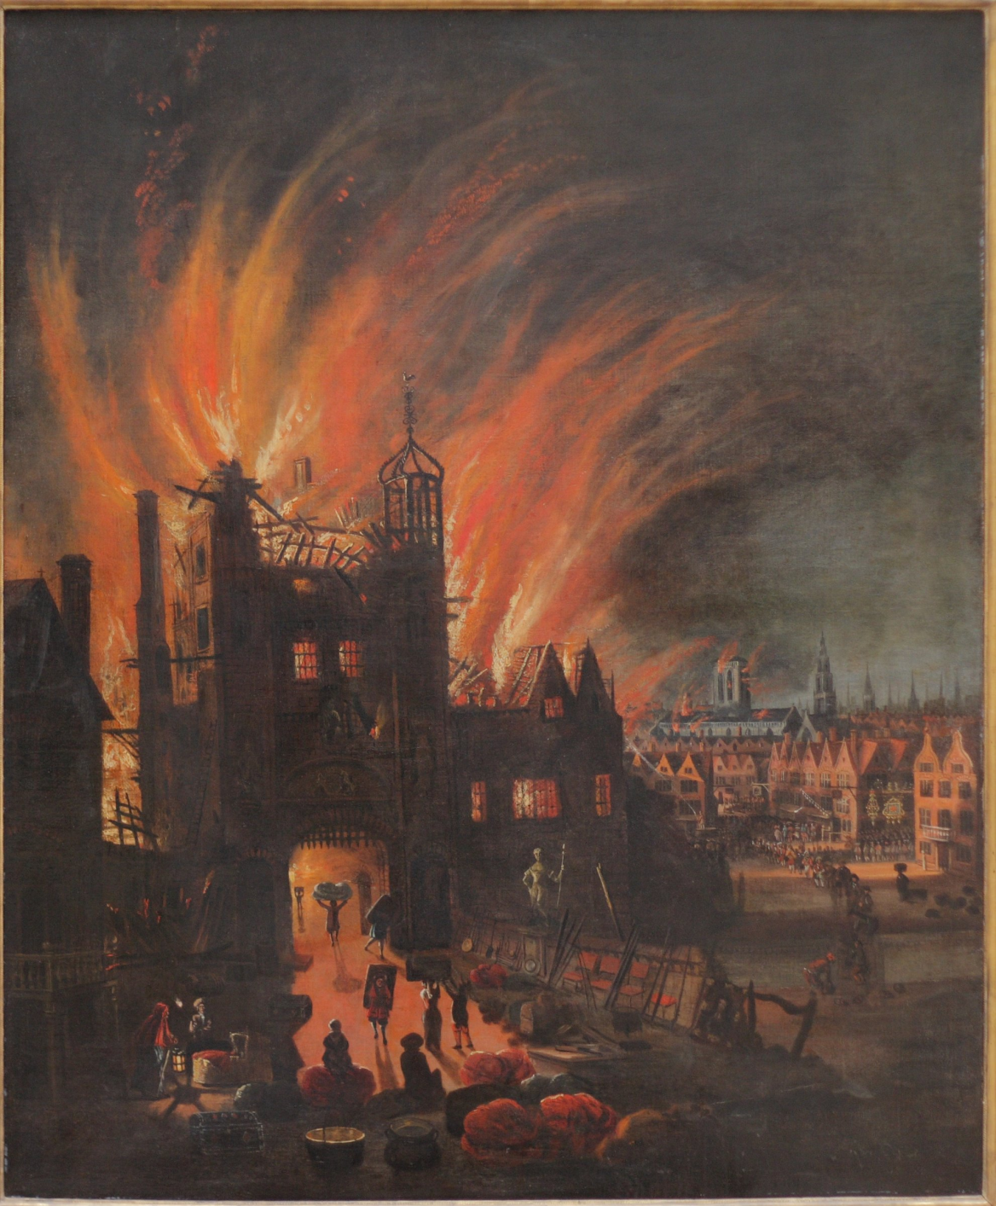
How do we know about the Great Fire of London?

Slide 2
LO: to understand how we can find out about the past.
People who were there wrote about the fire in diaries.
People wrote about the fire in newspapers.
Did they have computers? Cameras? Telephones?
How else could people find out what the fire was like?

Slide 3
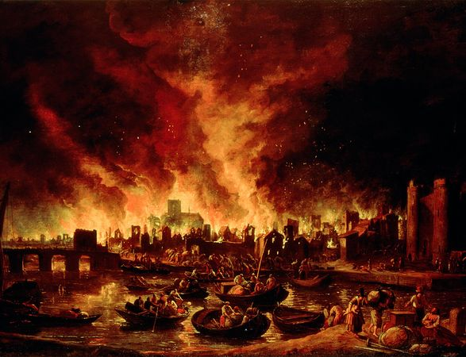
People painted pictures of the fire. Why didn’t they take photographs?

Slide 4
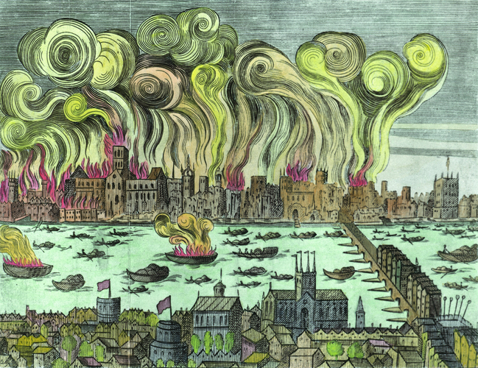
Do you think these pictures show exactly what the fire was like?

Slide 5
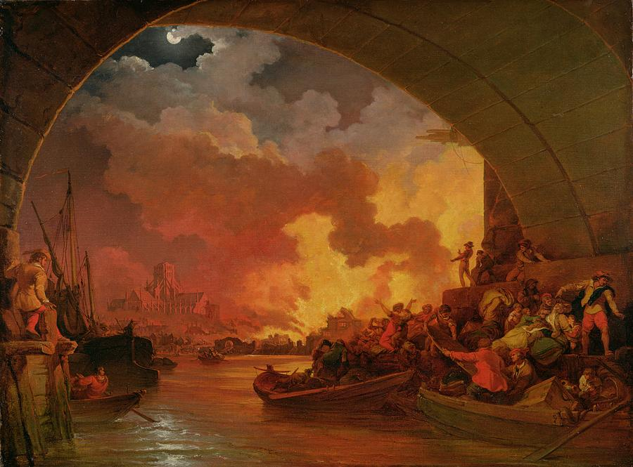

Slide 6
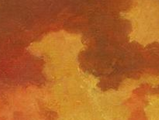
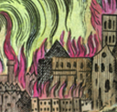
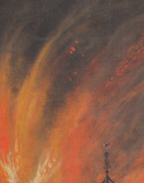

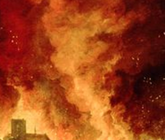
Think about the colours and textures used in the paintings that we have looked at so far. What effect do they have? Why did the artist choose to use them?

