Slide 1
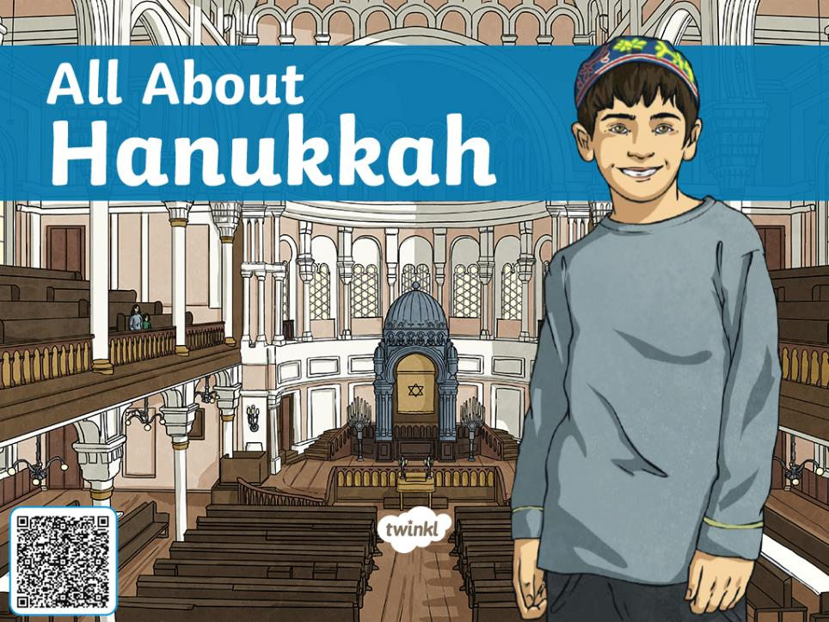

Slide 2
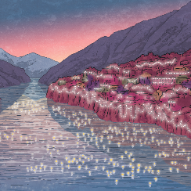
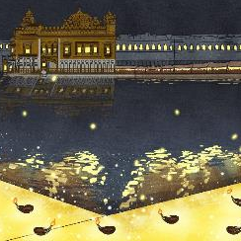
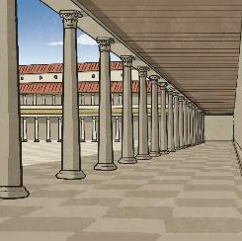



The Festival of Lights
Many religions have a festival of light.
The Hindu and Sikh festival of lights is called Diwali.
The Buddhist festival of lights is called the Tazaungdaing festival.
Today, we are going to learn about the Jewish festival of Hanukkah.

Slide 3
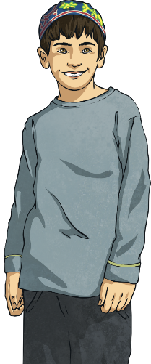
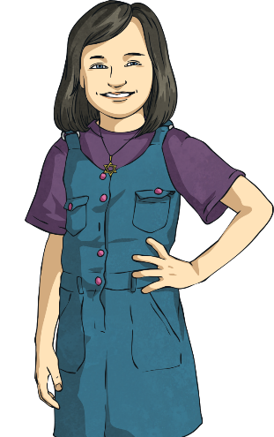
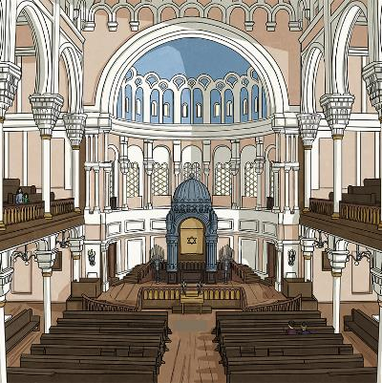
What is a Miracle?
What do you think a miracle is?
Tell your partner.
A miracle is when something special
happens that can’t be explained.
Lots of people believe that miracles
come from God.
Hanukkah celebrates a miracle that
happened for the Jewish people a very long
time ago.

Slide 4
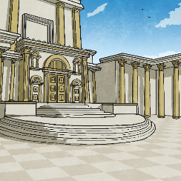
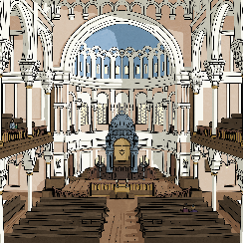
What is Hanukkah
The word Hanukkah means ‘re-dedication’.
To dedicate means to commit something (like a place) or yourself to something
(such as a god, religion or cause).
Talk About It!
Use your knowledge of prefixes to work out what re-dedication
means.

Slide 5
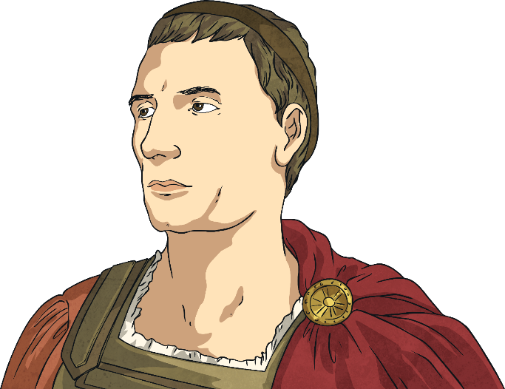
The Story of Hanukkah
Over two thousand years ago, the Jewish people
were under the rule of the Syrian-Greek
Empire.
Antiochus, King of Syria, wished to impose
his beliefs and religious practices on all the
people he ruled over. He issued a decree
that Jewish people had to abandon their
faith and start to worship Greek gods
and goddesses.

Slide 6
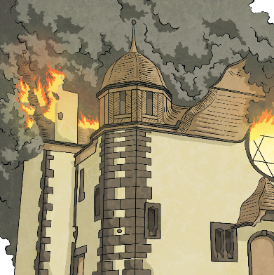
The Story of Hanukkah
All across the land, Jewish temples were destroyed. Jewish customs such as resting on the Sabbath
(the Jewish Holy day) were banned. Soldiers
tried to force the Jews to eat pork, which
was strictly against their faith.
Many Jewish people refused to follow
these orders. They were treated badly and
some were even killed.
Talk About It!
What things are important to you? What would you do if someone asked you to give them up?

Slide 7
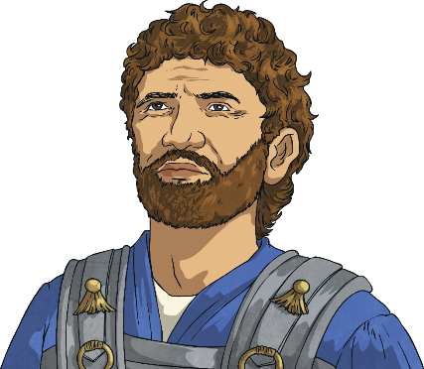
The Story of Hanukkah
Among those who stood up to Antiochus was a group of Jews called the Maccabees. Their leader was a brave man named Judah the Strong, or Judah Maccabee.
The Maccabees decided to defend their faith
even if it meant death. For over three years,
they fought. They defeated two of Antiochus’
legions. Finally, Antiochus sent an army of
40,000 to defeat the small band of Jewish fighters. Amazingly, the Maccabees were victorious.

Slide 8
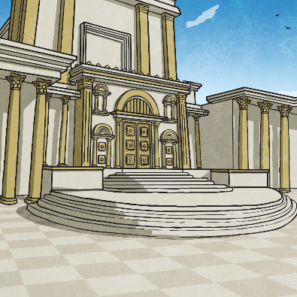
The Story of Hanukkah
The Maccabees travelled in triumph to the Temple in Jerusalem. Much of the Temple had been destroyed. Other parts of it had been turned
into a place to worship Greek gods and
goddesses.
The Maccabees rebuilt the ruined areas,
cleared the Temple of all the Greek
statues and rededicated it to their God.

Slide 9
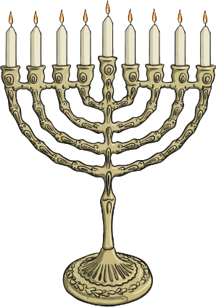
The Story of Hanukkah
As part of the rededication, the Maccabees lit the Menorah, a special Jewish candelabra used
in acts of worship, which they believe
symbolises God’s presence.
It was discovered that there was only enough
oil to keep the Menorah alight for one day. However, the Menorah remained lit for eight
days, until more oil could be obtained. The people believed this was a miracle from God.

Slide 10
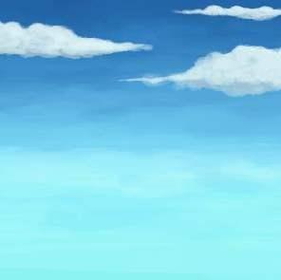
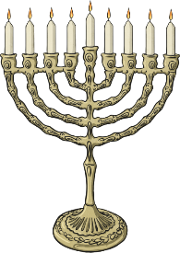
How is Hanukkah Celebrated?
Hanukkah happens each year on the 25th of the Jewish month of Kislev, which falls in November or December.
It lasts for eight days to remember the miracle of the
Menorah. Jewish people have candelabras called
Hanukiah in their houses, and light a candle each
of the eight nights.
The Hanukiah is left near a window so anyone
passing by the house will remember the miracle
of Hanukkah.
Did You Know?
It might look as if a Hanukiah has nine candles. However, the one in the middle is the shamash, or servant candle, which is used to light the others.

Slide 11
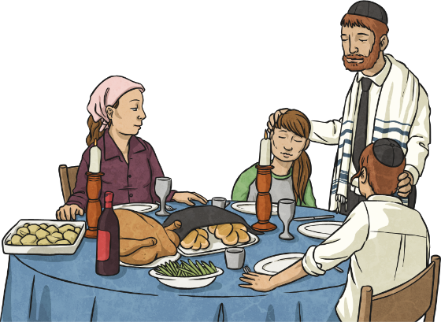
How is Hanukkah Celebrated?
Family and friends will gather for special meals. Some of the dishes will be deep fried to remember the miracle of the Menorah oil. Popular dishes include potato latkes, which is a kind of potato pancake and sufganiyot (doughnuts).
Each evening, people give each other small gifts or money.
Talk About It!
What food do you like to eat on special occasions?

Slide 12
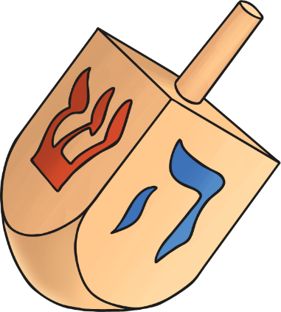
The Dreidel
At Hanukkah, Jewish children are often given a toy
called a dreidel. The dreidel is a four-sided
spinning top. On each side is a Hebrew letter.
The letters are the first letter of each word
in the phrase ‘Nes gadol haya sham’ which
means ‘a great miracle happened there’.

Slide 13
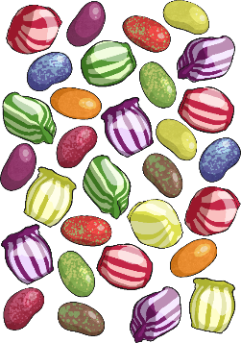
How to Play
Any number of people can play.
Each player has an equal number of sweets or chocolate coins.
At the start of each round, each player puts on item in a pot.
Each player then spins the dreidel. If it lands on ‘nun’, they do nothing. If the dreidel lands on ‘gimel’, they get everything in the pot. If it lands on ‘hey’, they get half of what is in the pot. If the dreidel lands on ‘shin’, they add an item to the pot.
Each round is over when someone has won all the items.
Talk About It!
Play the dreidel with this Hanukkah Dreidel NetPlay the dreidel with this Hanukkah Dreidel Net and Hanukkah Dreidel Game Instructions

