Slide 1
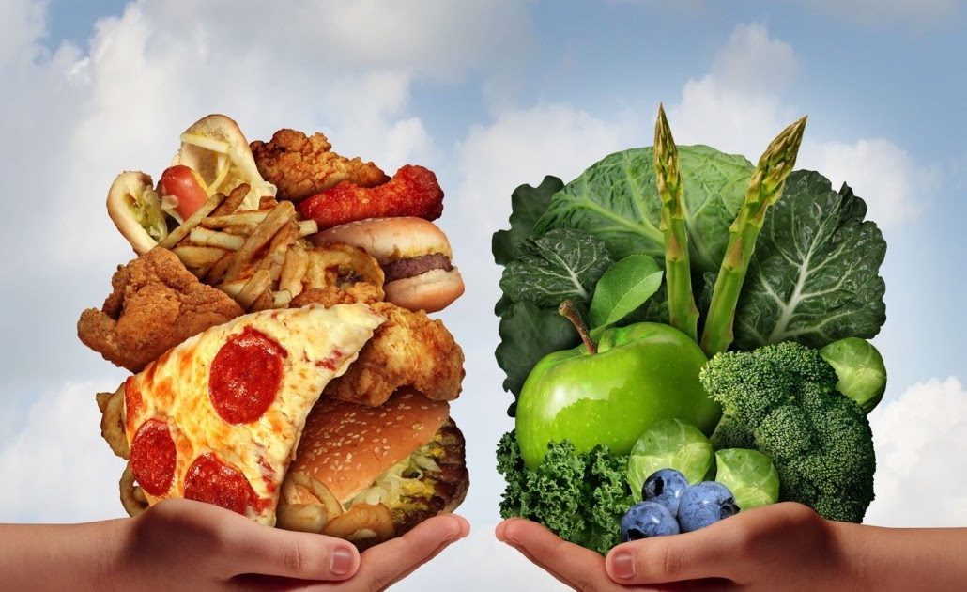
A balanced healthy lifestyle
LO: To be aware of the factors which influence our food choices.
I can know what might influence what we choose to eat.
I can know what might influence adults when they are shopping for food.
I can know how food companies might try to persuade us to buy their food.

Slide 2
Starter:
Lets have a look at Jayden’s Food Diary.
Can we see what choices he has made in his day?
Are they healthy choices or unhealthy choices?
Why do you think he may have made these choices?

Slide 3
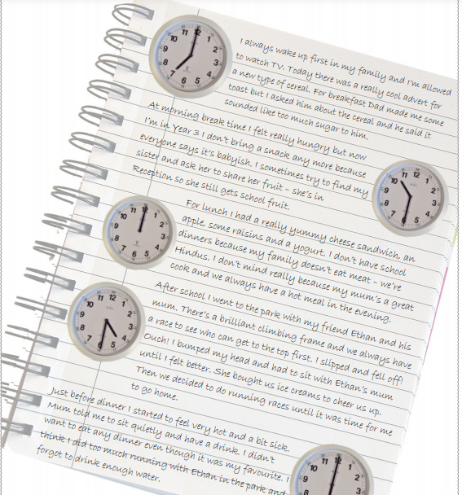

Slide 4
Supermarket Shopper
Think about the adult who does the food shopping for your house.
What might make them choose certain foods? For example, they are healthy, they are cheap, someone in your family likes them.
Looking at the food choices sheet, can you list them in order of importance for your adult when shopping.
Lets discuss our ratings, and consider why they may change sometimes.
Notes:
Lets discuss our ratings, and consider why they may change sometimes e.g. When we are on holiday we don’t always choose healthy food but we choose something new to try; When it is Christmas we sometimes choose special food which might not be very cheap.

Slide 5
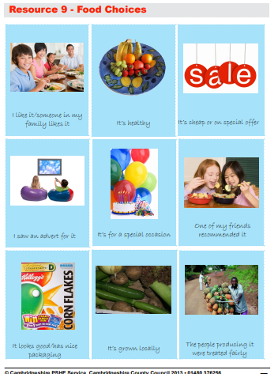

Slide 6
Task:
We are going to watch three adverts for food.
Using the sheet, we are going to say whether we think the advert is persuasive, and give reasons why.
Lets discuss our thoughts and reactions to the adverts.
Can you think of any television or magazine food adverts which they like.
What makes the advert effective?
Notes:
– e.g. saying a food is healthy; showing happy children; using fun music; including animals or cartoons.

Slide 7
