Slide 1
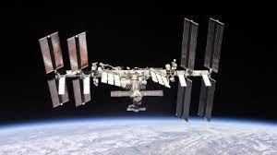
LO: To choose a research question for the International Space Station.
I can consider what life is like on the ISS.
I understand the ISS allows scientists to research in space.
I can create an action plan to answer a question
What is this structure? What do you know about it already?

Slide 2
The International Space Station is an orbiting laboratory on which hundreds of experiments have been conducted. Astronauts (or Cosmonauts if trained by the Russian Space Agency) live on board the ISS and conduct the experiments. The experiments help us learn more about living and working in space but also help us with things back on Earth.
During Tim Peake's mission, the Royal Horticultural Society sent rocket seeds to space for schools to investigate if the effects of being in space would affect how rocket seeds germinated and grew back on earth.
The ISS is constantly orbiting the Earth and does a full orbit every 90 minutes! How many times is that in our school day?
https://www.esa.int/kids/en/Multimedia/Videos/Paxi_on_the_ISS/Fun_facts_about_the_ISS
https://www.nasa.gov/audience/forstudents/5-8/features/nasa-knows/what-is-the-iss-58.html

Slide 3
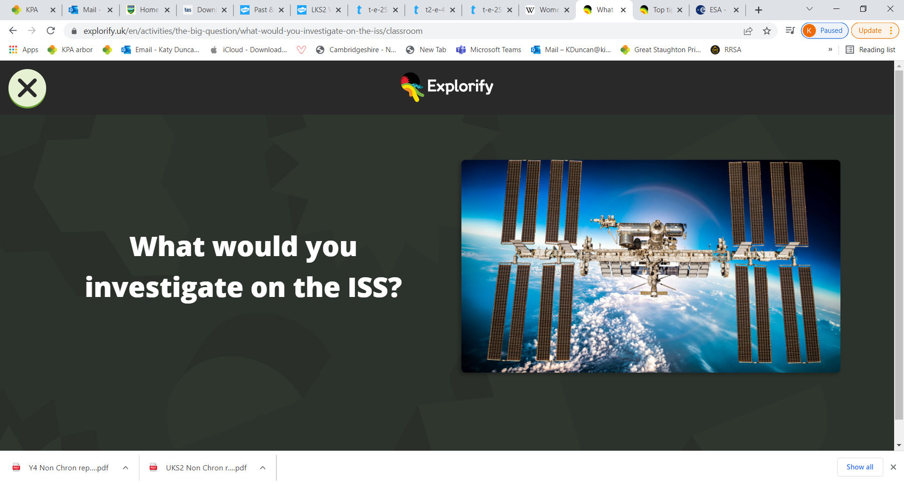
Your task is to work in small groups to come up with a research question that you would like to answer- that could only be answered through research on the ISS.
Example- What effect would microgravity have on how seeds germinate?
You should then work as a team to come up with an enquiry to answer your question.

Slide 4
Choosing a research question.
Try to select a question that might provide a useful benefit for people living on earth, or be useful for astronauts in the future.
Try to make sure your research question is specific, not vague. How will you measure your answer?
e.g. How well does electricity work in space? (Too vague, what do you mean by well?)
What effect does microgravity have on battery life? (a question we can measure the answer to).

Slide 5
Thinking of an action plan.
What method of enquiry will you select?
Observation over time
Pattern seeking
Identifying, classifying and grouping
Comparative and fair testing
Research using secondary sources
How will the environment of the ISS help you research this question?
How will it create difficulties?
What equipment will you need?
How will you measure and record results?

Slide 6
At the end of the lesson, your group will present their research question in addition to an action plan to answer it.
The audience should listen carefully and decide: will their enquiry find out the information needed to answer the question?

