Slide 1
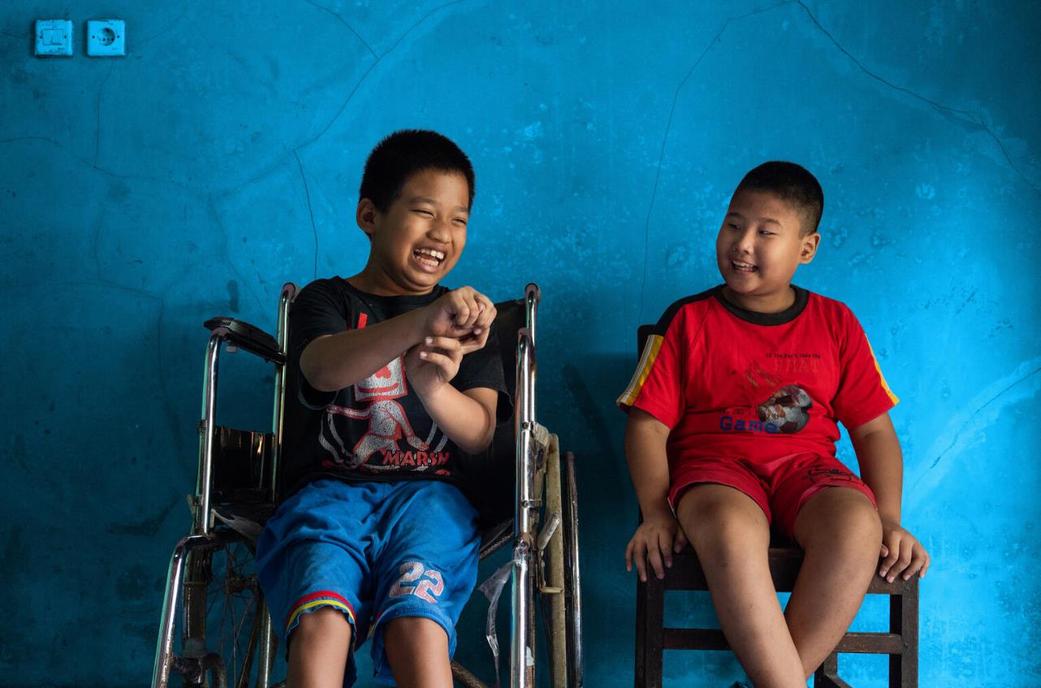
Unicef.com/ _UNI358857

Slide 2
Slide 3 – Introducing International Day of People with Disabilities
Slide 4 – Introducing the articles
Slide 5 – Exploring International Day of People with Disabilities question
Slide 6 – Exploring International Day of People with Disabilities answers
Slides 7&8 – Primary Activities
Reflection

Slide 3
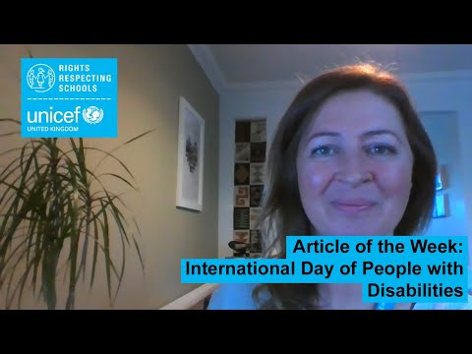

INTRODUCING INT. DAY OF PEOPLE WITH DISABILITIES
International Day of People with Disabilities
On 3 December we’re celebrating International Day of People with Disabilities. It is a global event which promotes equality for people with disability and celebrates their achievements. It has been celebrated every year since 1981.
It is also a day to promote awareness of the challenges faced by over 1 billion people living with disabilities, and the role communities and societies play in breaking down barriers to inclusion.
This year’s theme is ‘not all disabilities are visible’.
For more information visit https://idpwd.org/
Jenny Price, Professional Adviser at UNICEF UK, introduces International Day of People with Disabilities
Click here to watch on YouTube

Slide 4


LINKED UNCRC ARTICLES
There are two articles that provide a particularly strong link this week:
Article 2 – No discrimination
The Convention applies to every child without discrimination, whatever their ethnicity, gender, religion, language, abilities or any other status, whatever they think or say, whatever their family background.
Article 23 – Children with disabilities
A child with a disability has the right to live a full and decent life with dignity and, as far as possible, independence and play an active part in the community. Governments must do all they can to support disabled children and their families.

Slide 5
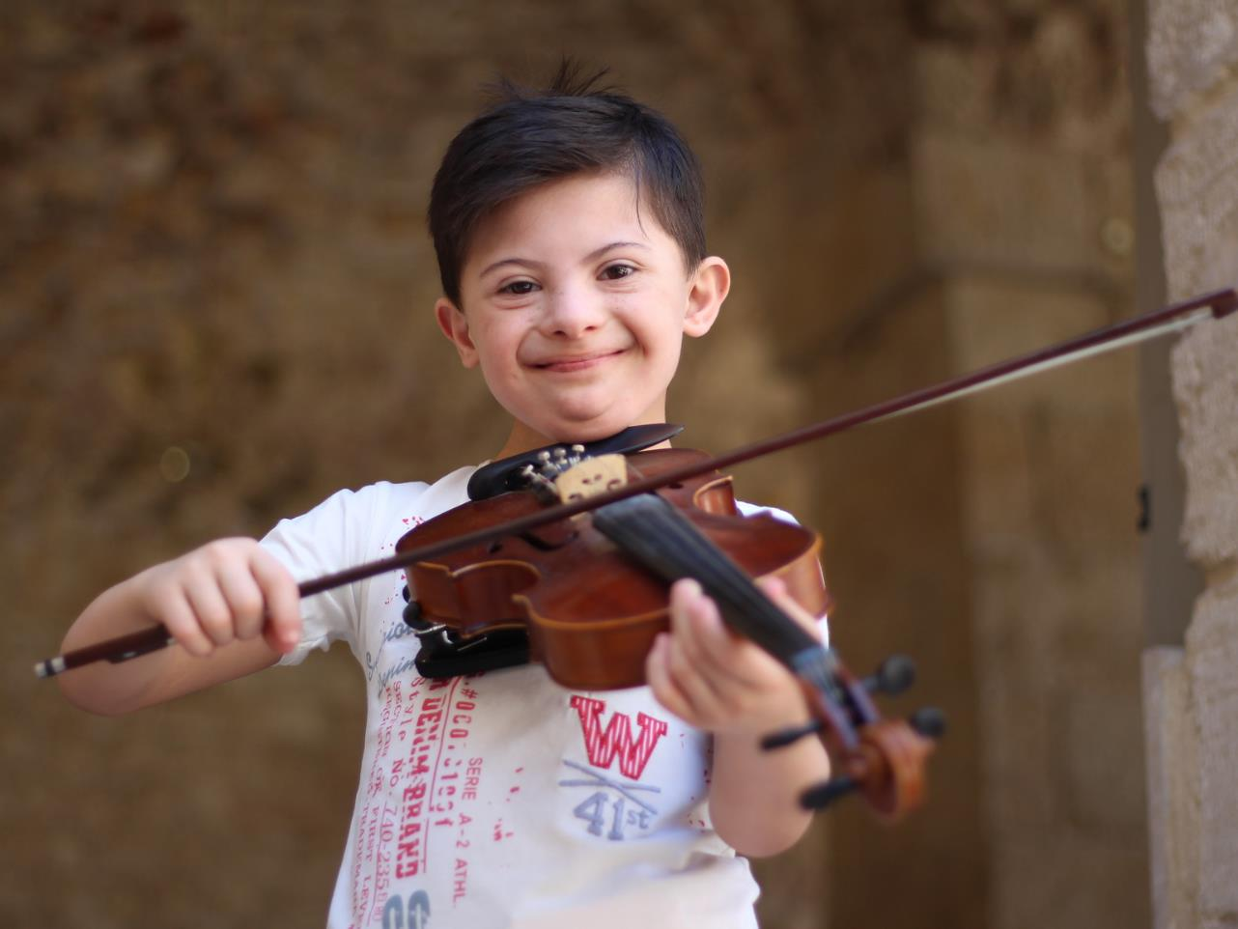
EXPLORING INT. DAY OF PEOPLE WITH DISABILITIES
2021 theme: Not all disabilities are visible
The theme for this year’s International Day of Persons with Disabilities is to increase awareness of invisible disabilities such as mental health disorders, chronic pain and fatigue.
What can schools do to support children with disabilities? Make sure you think about some invisible disabilities too.
Unicef.com/ UN073783

Slide 6
How many of these did you get?
Make sure the building is physically accessible (ramps and lifts for example).
Work with specialist services to meet the needs of the child such as accessible buildings, specialist equipment or audio descriptions.
Make lessons and activities accessible for all (easy read, sign language, Braille).
Have quiet, calm and relaxing spaces such as a nurture room.
Teach everyone about different types of disability.
Use special equipment such as a microphone or hearing loop.
Listen to the child and help them to be included – every child is unique.
Work together and create a plan – making sure the child is heard.
Have toilets that are accessible.
Make sure all children can enjoy the playground.
Did you list anything else?

Slide 7

Have you read any stories about people with disabilities? Download My Brother is an Astronaut from the website of the charity SCOPE. Read it as a class and discuss what life is like for Jake and his family. If you have time, look at some of the other stories.
Use dolls, toys and/or images to open up a discussion with children about disability. Design a poster or welcome banner for your class to promote inclusion and diversity.
Article 23 says that children with a disability have the right to live a “full and decent life with dignity”. Do you know what dignity is? Work in a group to look up and understand the word. Which rights from the CRC relate to dignity?
Write a poem or prepare a short presentation to help others to understand dignity.
Sign language is a way of communicating using your hands, mostly used by people with loss of hearing. Have a look at this website and see if you can learn some sign language. Teach what you learn to a friend. How does sign language help other types of disability?

Slide 8


Watch this short highlights film from the 2020 Paralympics. What sporting opportunities are available in your community for children with disabilities? Is there something you could do to increase access to sports for children with disabilities so they can enjoy their rights to the fullest?
Investigate different types of ‘invisible’ or ‘hidden’ disabilities. Discuss in class why it is important to understand such disabilities. Use your creativity, through art, drama or music to help other people in your school to learn a little more about hidden disabilities – don’t forget to mention rights.
Does your school library have any of the books mentioned here about children with autism? If so, choose one to read and discuss some of the barriers they face and which of their rights may be impacted or write a book review, making reference to rights. If not, talk to you teacher about broadening the range of books available.
This is the logo for the International Day of Persons with Disabilities. Work with a partner and try to use words to describe what you think it represents.
Feedback your ideas to the class.

Slide 9
REFLECTION
Mine
I have a dream; please don't influence it,
It belongs to me.
I have a delicate heart; please don't break it,
It belongs to me.
I have peace of mind; please don't disturb it,
It belongs to me.
I have to follow a path; please don't obstruct it,
It belongs to me.
I have an amazing life; please let me live it,
It belongs to me.
I have a choice; please don't choose for me,
It belongs to me.
I have freedom; please don't capture me,
It belongs to me.
I have incredible feelings; please don't hurt me,
They belong to me.
I have a lot of love; please don't hate me,
Love is mine to share.
I'm on my material journey; don't follow me
It won't be fair.
So... I have a dream; it's my dream to be free.
Give yourself some quiet time….some space… some peace….
Read the poem by Kuli Kohli on the left-hand side.
What does it say to you about people… about life.. about (dis)ability?
Read more about Kulis’ story here: bbc.co.uk/news/stories-53749629

Slide 10

MORE INFO…
RRSA WEBSITE
For more information or to download previous Article of the Week packs please visit the RRSA website by clicking the link below
CLICK HERE

Slide 11
Thank you
UNICEF UK/Dawe
Notes:
UNICEF UK/Dawe

