Slide 1
UNICEF/Dejongh
Notes:
UNICEF/Dejongh
A mother cuddling her baby, in the region of Soubré, in the South West of Côte d’Ivoire.

Slide 2
Slide 3 – Introducing Black History Month
Slide 4 – Introducing the articles
Slide 5 – Exploring Black History Month
- Question
Slide 6 – Exploring Black History Month
- Answers
Slides 7&8 – Primary Activities
Slide 9 – Reflection

Slide 3
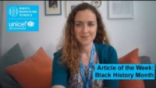
INTRODUCING BLACK HISTORY MONTH
Black History Month is celebrated in October every year and is a celebration of key figures and events in Black history.
In 2021 the theme is ‘Proud to Be’, which aims to recognise the achievements and contributions that Black people make to the UK every day, from working on the Covid-19 frontline in hospitals, care homes, schools and supermarkets to the children and young people leading the fight for equality in the classroom.
Helen introduces Black History Month
Click here to watch on YouTube

Slide 4




LINKED UNCRC ARTICLES
Article 2 (non-discrimination)
The Convention applies to every child without
discrimination, whatever their ethnicity, gender, religion,
language, abilities or any other status, whatever they
think or say, whatever their family background.
Article 12 (respect for the views of the child)
Every child has the right to express their views, feelings
and wishes in all matters affecting them, and to have their
views considered and taken seriously.
Article 29 (goals of education)
Education must develop every child’s personality, talents and
abilities to the full.
Article 30 (children from minority or indigenous groups)
Every child has the right to learn and use the language, customs
and religion of their family, whether or not these are shared by the majority of the people in the country where they live.

Slide 5
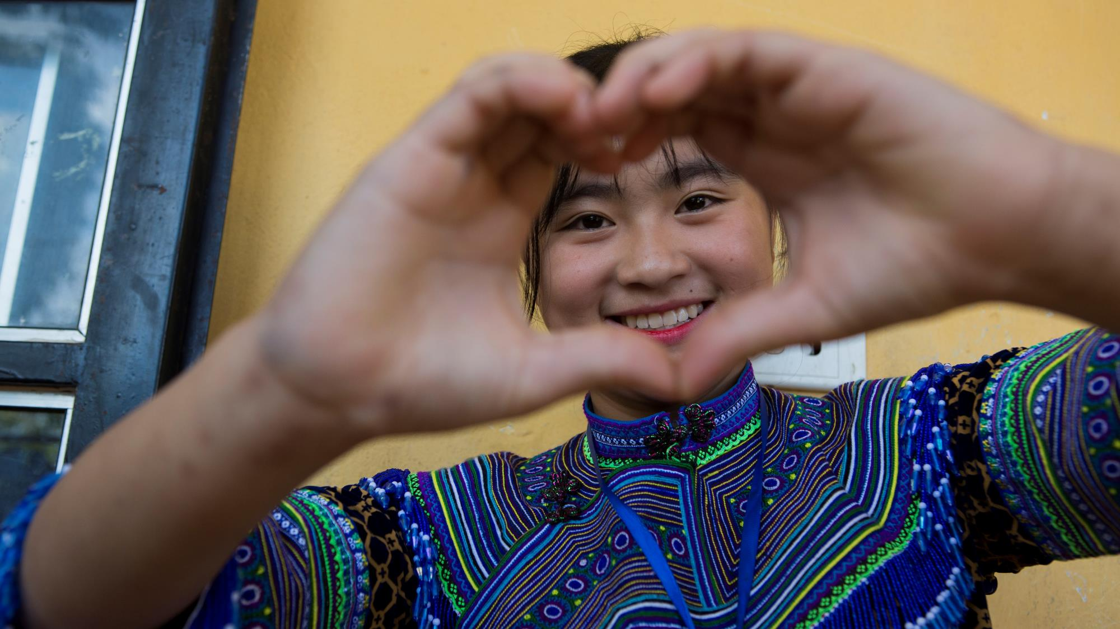
EXPLORING BLACK HISTORY MONTH
Why do you think
Black History Month
is important?
UNICEF/Pouget
Notes:
UNICEF/Pouget
Healthcare professionals on vaccination day at a health centre in Mauritania.

Slide 6
How many of these did you get?
To recognise the contribution and achievements of those with African and Caribbean heritage throughout history.
To ensure that we hear from a diverse range of stories when considering the past.
To celebrate people’s heritage and cultures.
To learn how to challenge negative stereotypes.
Because no one should be treated differently because of who they are.
Because all schools should encourage respect for everyone and celebrate diversity and inclusion.
To think about how we can make the world a more equal place where everyone’s rights are respected.
To learn about racism and its effects.
To ensure that there is time and space for people to discuss more recent events and issues such as Black Lives Matter, the treatment of the Windrush generation and the death of George Floyd.
To support young people to recognise and challenge discrimination.
What else did you think of?

Slide 7
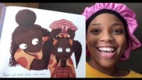
Everyone is special and important!
The theme for Black History Month this year is ‘Proud to Be’.
What is the best thing about being you?
Create a classroom display that reflects what you are ‘Proud to Be’… (don’t forget to link this to relevant articles from the CRC).
Enjoy story time by choosing some books to share by some new Black British authors such as My Hair by Hannah Lee which was nominated for the 2020 Book Trust Storytime Prize.
Watch these children talking about Black History with their parents.
Who could you have a conversation with about Black History?
What could you tell them about what Black History Month is and why it is important?
Watch this Horrible Histories video of five important black people from history.
Discuss their achievements and how these link to rights in the CRC.
You could then choose someone who inspires you and write a short fact sheet about them.

Slide 8
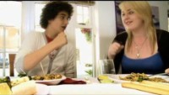
Watch this BBC video and discuss as a class what Black History Month is and why it matters.
Write a short paragraph explaining why you think Black History Month is important and how this links to your work as a Rights Respecting school.
Take a look at the books in your school library to check how diverse they are.
Does it have books by a range of authors?
Are there books with a wide range of characters?
How could you work together as a school community to make sure that everyone is represented by the books in the library?
Read the poem The British by Benjamin Zephaniah or watch it performed.
As a class write your own poem about all the different people and values that make up your school community.
Or you can choose another poem to do your own version of from here.
Watch this video of children talking about their experience of racism in UK.*
How did this make you feel?
Take some time as a class to reflect on this and discuss the issues the children raise.
Make a pledge to stand up against racism.
Notes:
*Note for teachers – please be aware that some of your students may have lived experiences of these issues and the video could possible be triggering and they may also not be comfortable speaking about it in a group setting.

Slide 9
Take a little time to think…
find somewhere quiet and give yourself some space….
Spend some time thinking again about what makes you proud to be you. How can you regularly remind yourself of these things?
What can you say to others to help them feel proud of themselves and who they are?
Think about what you could do if you ever hear or see racism at school or in your community.
How can you challenge this and be an ally to others?
REFLECTION
UNICEF/Dejongh
Notes:
UNICEF/Dejongh
Children attending class in Mbandaka, the Equatorial Provence of the Democratic Republic of Congo. A 68 years old teacher, who has been teaching for 48 years, says: “As long I can I will continue teaching children. Education can’t stop. It’s my passion and the children future.” For every child, education.

Slide 10
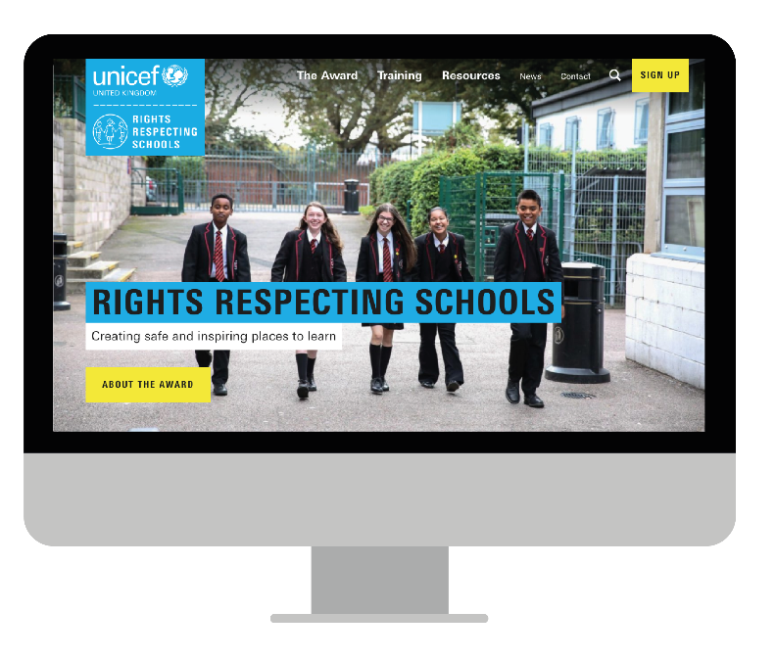
MORE INFO…
RRSA WEBSITE
For more information or to download previous Article of the Week packs please visit the RRSA website by clicking the link below
CLICK HERE

