Slide 1
Times tables
13.01.22

Slide 2
Y2 LO: To recap my knowledge of my two-, five- and ten-times tables.
Y3 LO: To be able to multiply by three.
I can recall multiplication facts for the two-, five- and ten-times tables.
I can show my multiplication sentences pictorially.
I can answer multiplication questions using my knowledge.
I can recall multiplication facts for the three times table.
I can show my multiplication sentences pictorially.
I can answer multiplication questions using my knowledge.

Slide 3

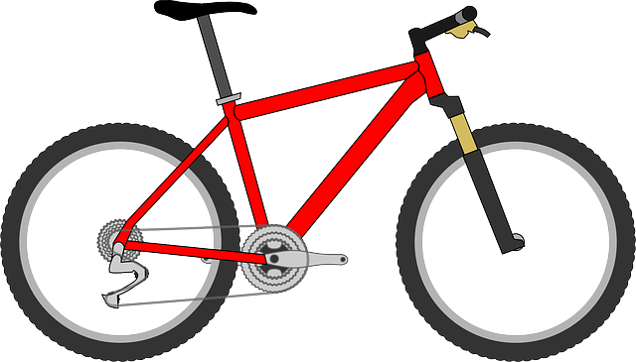
Fluency
How many wheels altogether?
6
There are ________ wheels in total.
3
2
________ x ________

Slide 4
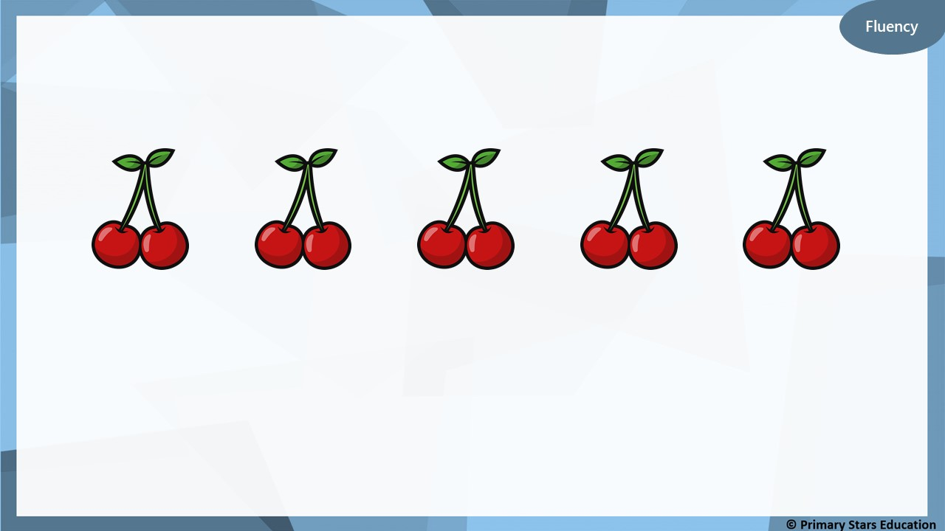
How many cherries altogether?
10
There are ________ cherries in total.
5
2
________ x ________

Slide 5
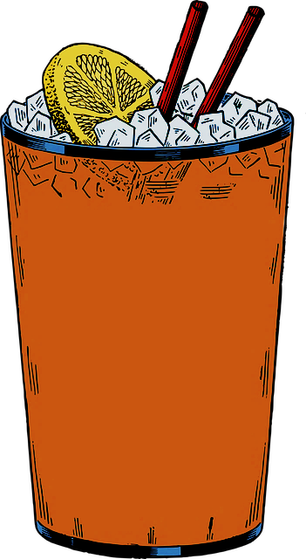
Fluency
How many straws altogether?
14
There are ________ straws in total.
7
2
________ x ________

Slide 6
Fluency
Complete the number tracks.
2 |  | 6 |  | 10
4
8
12
 |  | 12 | 14 |  | 18
8
10
16
14 | 16 |  |  | 22
18
20
24
10 |  |  |  |  | 20
12
14
16
18

Slide 7
Fluency
Match the number sentences to the correct answer.
8 x 2 =
12
5 x 2 =
20
6 x 2 =
14
10 x 2 =
16
7 x 2 =
10

Slide 8

10 x 2 = 22
No
Is Rob correct? ________
Explain how you know.
10 x 2 = 20 (not 22).

Slide 9


Fluency
How many marbles altogether?
20
There are ________ marbles in total.
4
5
________ x ________

Slide 10

How many fingers altogether?
25
There are ________ fingers in total.
5
5
________ x ________

Slide 11
Fluency
Match the number sentences to the correct answer.
8 x 5 =
45
10 x 5 =
50
9 x 5 =
40
2 x 5 =
25
5 x 5 =
10

Slide 12
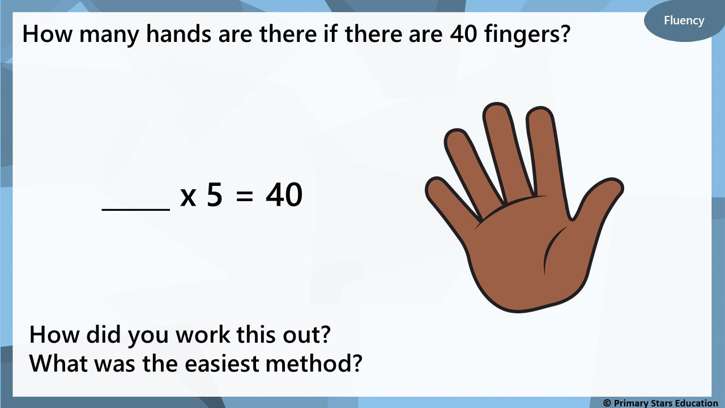
8

Slide 13

Fluency
There are 45 Christmas lights.
How sets of lights are there?
9
_____ x 5 = 45
How did you work this out?
What was the easiest method?

Slide 14
Fluency
Compare the multiplications using <, > or =.
>
3 x 5
5 x 2
=
10 x 5
5 x 10
<
4 x 5
11 x 2

Slide 15

Reasoning
Kat says,
The bar model shows 5 lots of 6.
30
5 | 5 | 5 | 5 | 5 | 5
No
Is Kat correct? ________
Explain how you know.
The bar model shows 6 lots of 5 (6 x 5).

Slide 16

Problem solving
Cookies come in packs of 5.
Mo has 18 cookies.
How many full packs can be made and how many left over?
Mo can make 3 full packs of 5 cookies with 3 left over.

Slide 17


Fluency
How many apples altogether?
30
There are ________ apples in total.
3
10
________ x ________

Slide 18
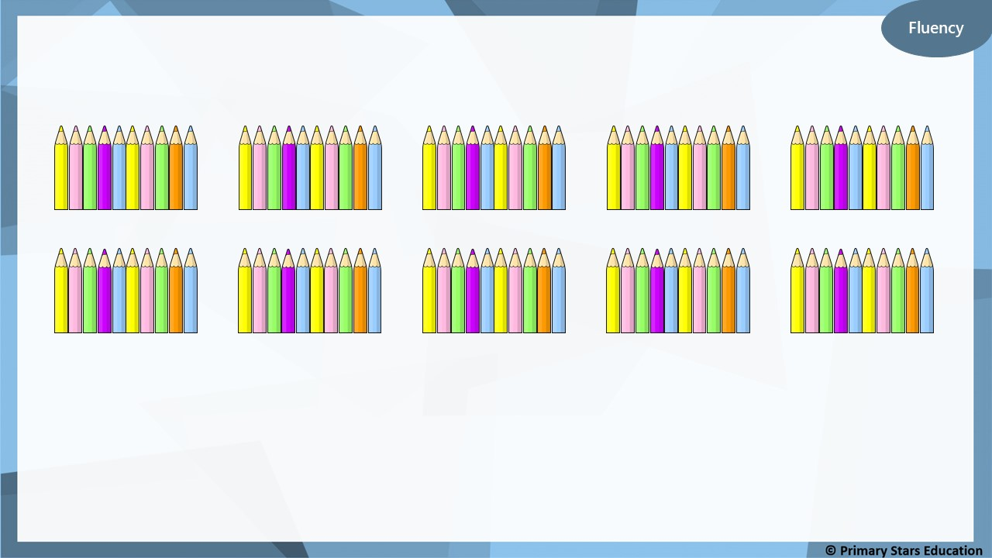
How many pencils altogether?
100
There are ________ pencils in total.
10
10
________ x ________

Slide 19


Fluency
How many cakes altogether?
50
There are ________ cakes in total.
5
10
________ x ________

Slide 20


Fluency
There are 80 fish.
How many tanks are there?
8
______ x 10 = 80
How did you work this out?
What was the easiest method?

Slide 21
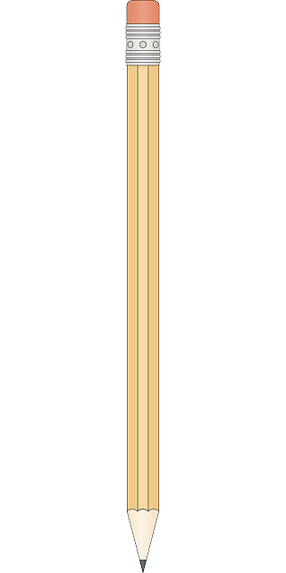

Fluency
How many pencil pots are there if there are 70 pencils?
7
______ x 10 = 70
How did you work this out?
What was the easiest method?

Slide 22
Fluency
There are 120 cupcakes.
How plates are there?
12
______ x 10 = 120
How did you work this out?
What was the easiest method?

Slide 23
Fluency
Write a number sentence to make the ordered number sentences true.
2 x 10
5 x 10
3 x 10 or 4 x 10
smallest
greatest

Slide 24
Fluency
Write a number sentence to make the ordered number sentences true.
4 x 10
5 x 10, 6 x 10
or 7 x 10
8 x 10
smallest
greatest

Slide 25
Reasoning
Che creates a number track counting up in 10s from 50.
50 | 60 | 70 | 80 | 90 | 110 | 120
What mistake has Che made?
Che has missed the number 100 from the number track. The number track goes up in 10s.

Slide 26

Help Asha complete the following problem:
Can you help me find a multiplication fact for this problem?
2 x 10
3 x 10, 5 x 5, 6 x 5 or 7 x 5
8 x 5
smallest
greatest

Slide 27
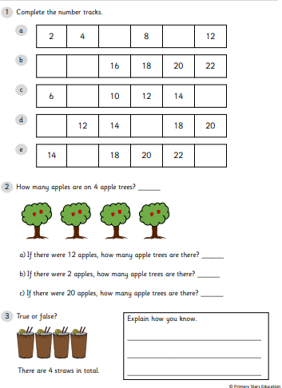
Y2 Activity:
Complete the worksheets.

Slide 28
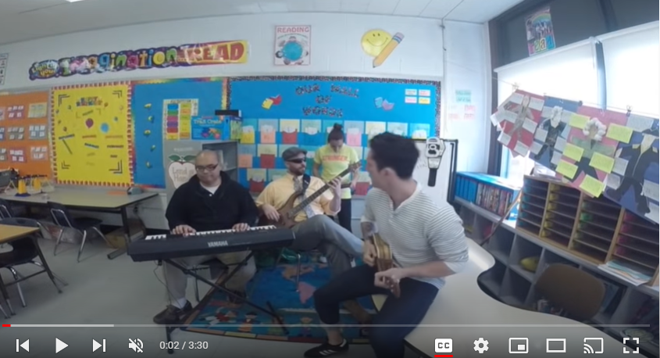
Three Times Table Song (Cover of Uptown Funk by Mark Ronson and Bruno Mars) - YouTube

Slide 29

3
6
9
12
15
18
21
24
27
30
33
36

Slide 30








How many groups of 3 teddies?
4
$$×$$
3
$$=$$
12
or
3
$$×$$
4
$$=$$
12
8
$$×$$
3
$$=$$
24
or
3
$$×$$
8
$$=$$
24

Slide 31







Have a think
6
$$×$$
3
$$=$$
18
3
$$×$$
6
$$=$$
18
18
$$÷$$
3
$$=$$
6
18
$$÷$$
6
$$=$$
3

Slide 32






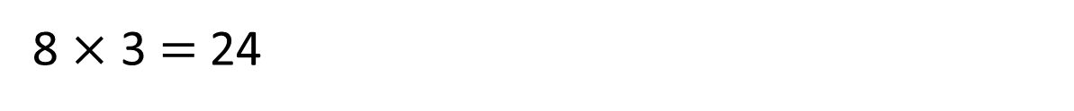
What number did Eva roll?
Eva rolled 11
12 | 3 | 18 | 24 | 15
24 | 30 | 21 | 18 | 9
15 | 24 | 6 | 30 | 36
9 | 33 | 12 | 21 | 6
$×$ 3 $=$ 33
11
8 $×$ 3 $=$ 24
Have a think

Slide 33






What do you see?
3
3
There are ____ equal groups of ____
$+ + =$
3
3
3
9
$× =$
3
3
9

Slide 34



What do you see?
5
3
There are ____ equal groups of ____
3
3
15
$+ + + + =$
3
3
3
$× =$
5
3
15
$× =$
3
5
15

Slide 35
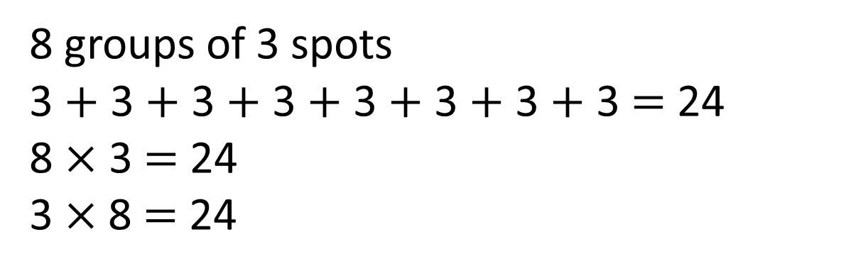
What do you see?
Have a think
8 groups of 3 spots
3 $+$ 3 $+$ 3 $+$ 3 $+$ 3 $+$ 3 $+$ 3 $+$ 3 $=$ 24
8 $×$ 3 $=$ 24
3 $×$8 $=$ 24

Slide 36
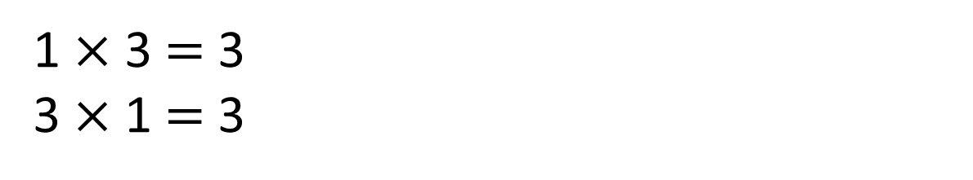
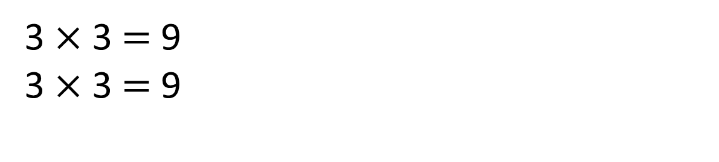
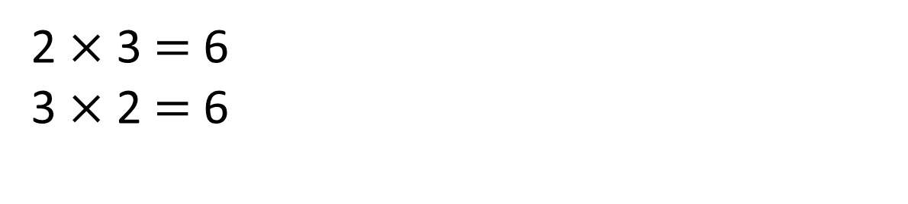
3
1 $×$ 3 $=$ 3
3 $×$ 1 $=$ 3
Have a think
0
3
3
3
2 $×$ 3 $=$ 6
3 $×$ 2 $=$ 6
0
3
6
3
3
3
3 $×$ 3 $=$ 9
3 $×$ 3 $=$ 9
0
3
6
9

Slide 37


Introduction
Match the questions to the correct answer.
15
4 x 3 =
12
12 ÷ 3 =
5
5 x 3 =
4
15 ÷ 3 =
3
© Classroom Secrets Limited 2018

Slide 38
Introduction
Match the questions to the correct answer.
15
4 x 3 =
12
12 ÷ 3 =
5
5 x 3 =
4
15 ÷ 3 =
3
© Classroom Secrets Limited 2018

Slide 39
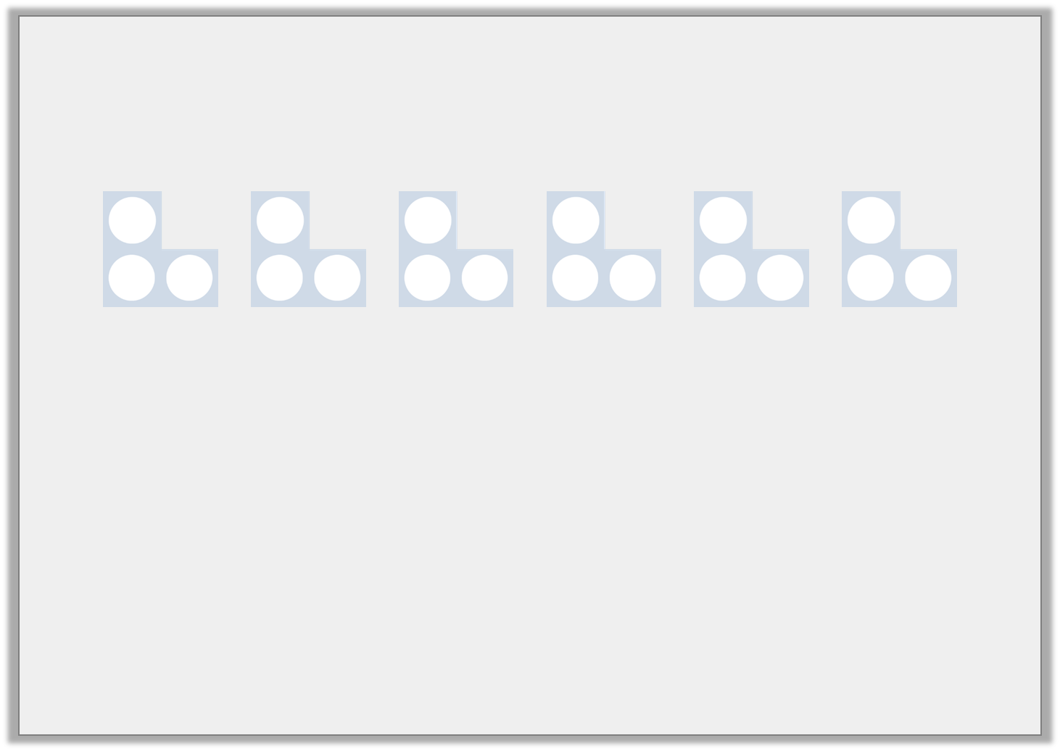
Varied Fluency 1
Complete the number sentences.
 | x | 3 | =
 | = |  | ÷ | 3
© Classroom Secrets Limited 2018

Slide 40
Varied Fluency 1
Complete the number sentences.
6 | x | 3 | = | 18
6 | = | 18 | ÷ | 3
© Classroom Secrets Limited 2018

Slide 41
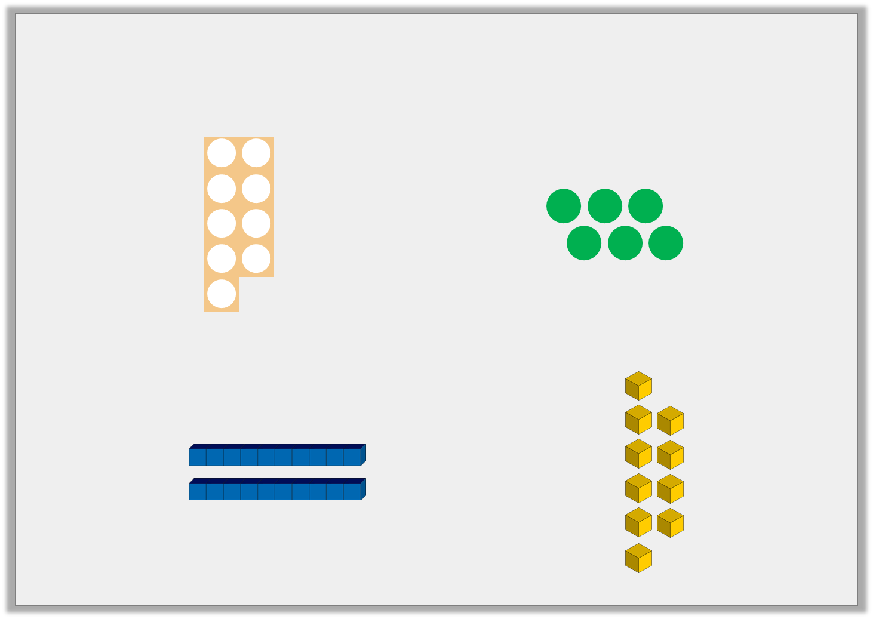
Varied Fluency 2
Circle the numbers and images that are in the 3 times table.
6
36
17
15
31
© Classroom Secrets Limited 2018

Slide 42
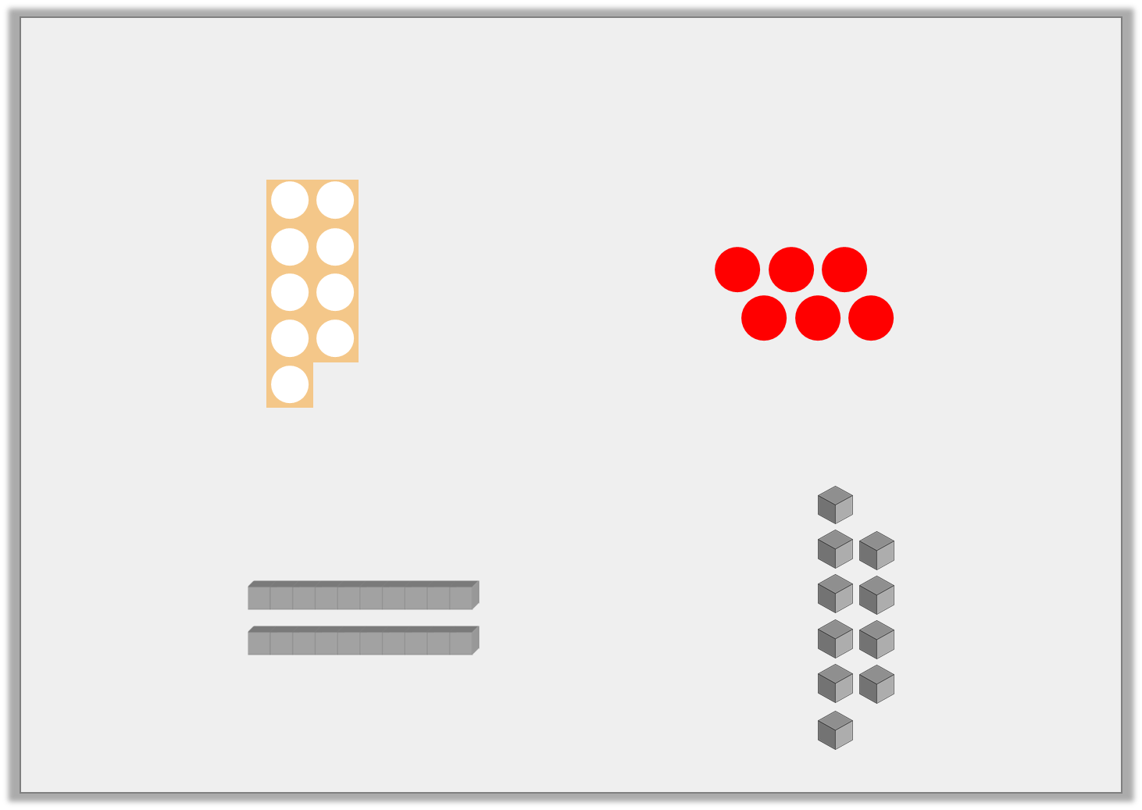
Varied Fluency 2
Circle the numbers and images that are in the 3 times table.
6
36
17
15
31
© Classroom Secrets Limited 2018

Slide 43
Varied Fluency 3
Use the array to write 4 number sentences.
 | x |  | =
 | x |  | =
 | ÷ |  | =
 | ÷ |  | =
© Classroom Secrets Limited 2018

Slide 44
Varied Fluency 3
Use the array to write 4 number sentences.
9 | x | 3 | = | 27
3 | x | 9 | = | 27
27 | ÷ | 3 | = | 9
27 | ÷ | 9 | = | 3
© Classroom Secrets Limited 2018

Slide 45
Varied Fluency 4
Complete these number sentences.
12 | ÷ |  | = | 4
8 | x | 3 | =
 | ÷ | 3 | = | 1
 | = | 3 | x | 5
© Classroom Secrets Limited 2018

Slide 46
Varied Fluency 4
Complete these number sentences.
12 | ÷ | 3 | = | 4
8 | x | 3 | = | 24
3 | ÷ | 3 | = | 1
15 | = | 3 | x | 5
© Classroom Secrets Limited 2018

Slide 47
Problem Solving 1
Use the clues to work out the number.
My number can be divided by 3.
It is more than 15 and less than 25.
The sum of its digits is 3.
© Classroom Secrets Limited 2018

Slide 48
Problem Solving 1
Use the clues to work out the number.
My number can be divided by 3.
It is more than 15 and less than 25.
The sum of its digits is 3.
21
© Classroom Secrets Limited 2018

Slide 49

Reasoning 1
Suzie has drawn a pattern.
Is she correct?
Explain your answer.
The 18th shape in my pattern will be a circle.
© Classroom Secrets Limited 2018

Slide 50
Reasoning 1
Suzie has drawn a pattern.
Is she correct?
Explain your answer.
No because…
The 18th shape in my pattern will be a circle.
© Classroom Secrets Limited 2018

Slide 51
Reasoning 1
Suzie has drawn a pattern.
Is she correct?
Explain your answer.
No because every multiple of 3 is a star and every other number is a circle. 3 x 6 = 18 so the 18th shape will be a star.
The 18th shape in my pattern will be a circle.
© Classroom Secrets Limited 2018

Slide 52
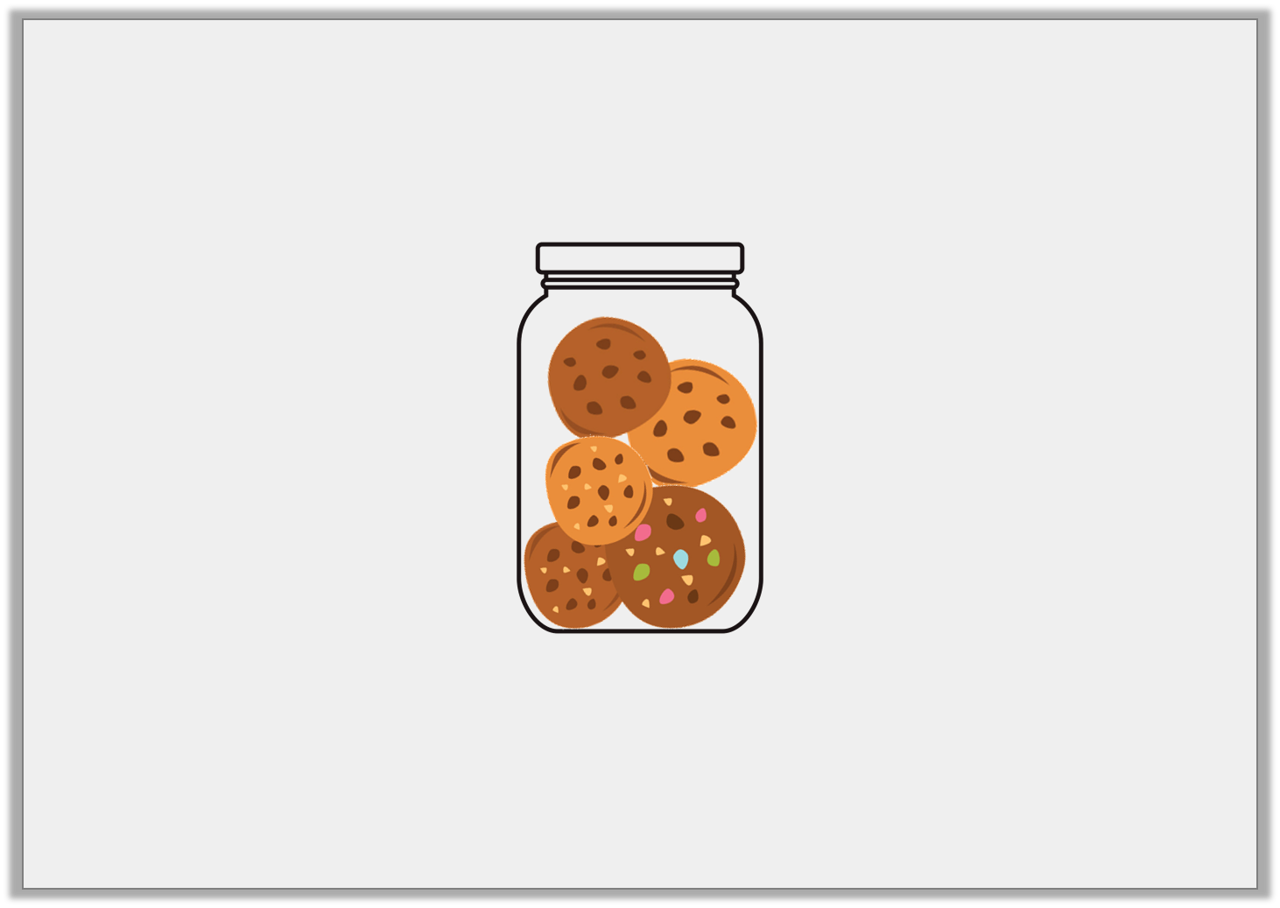
Problem Solving 2
There are 5 cookies in a jar.
How many cookies would there be in 3 jars?
Write the number sentence to show how you worked this out.
© Classroom Secrets Limited 2018

Slide 53
Problem Solving 2
There are 5 cookies in a jar.
How many cookies would there be in 3 jars?
Write the number sentence to show how you worked this out.
There would be 15 cookies in 3 jars because 5 x 3 = 15.
© Classroom Secrets Limited 2018

Slide 54
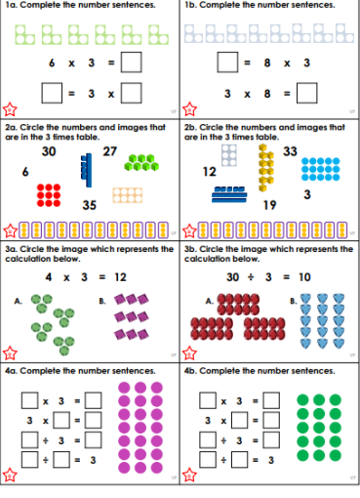
Y3 Activity:
Complete the worksheets.

