Slide 1
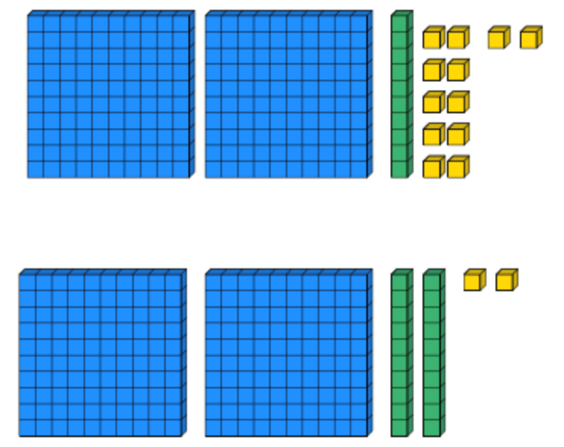
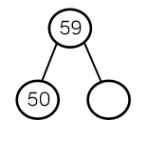
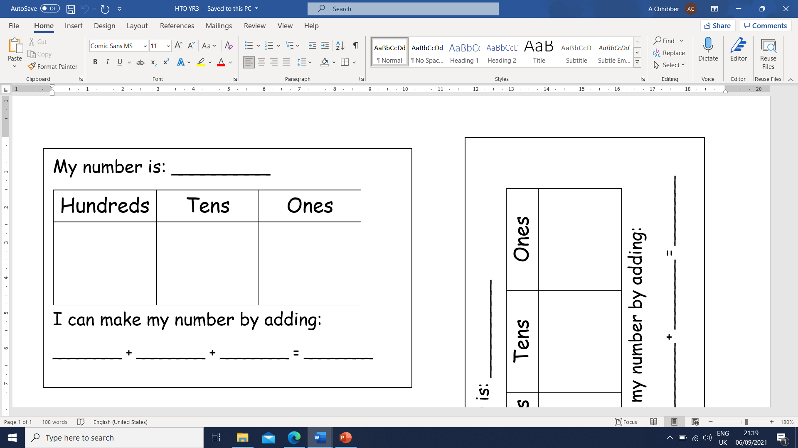
Place Value
Lesson 5

Slide 2
LO: To compare numbers using >, < and =.
I know which symbol to use for more than, less than and equals.
I can partition numbers accurately.
I know which digit I need to compare in two numbers.
I can compare digits in two and three digit numbers using more than, less than or equals.

Slide 3
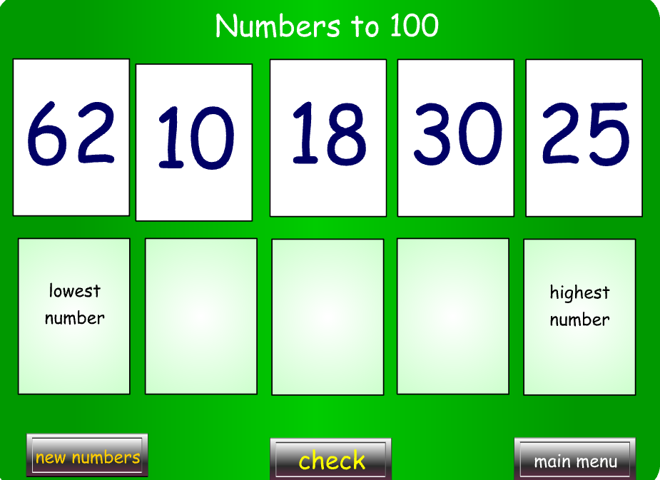
Starter
Notes:
Higher and Lower - 3-11 year olds - Topmarks

Slide 5
Recap
>
<
=
This sign means more than or greater than.
This sign means less than or smaller than.
This sign means equals or the same as.

Slide 6
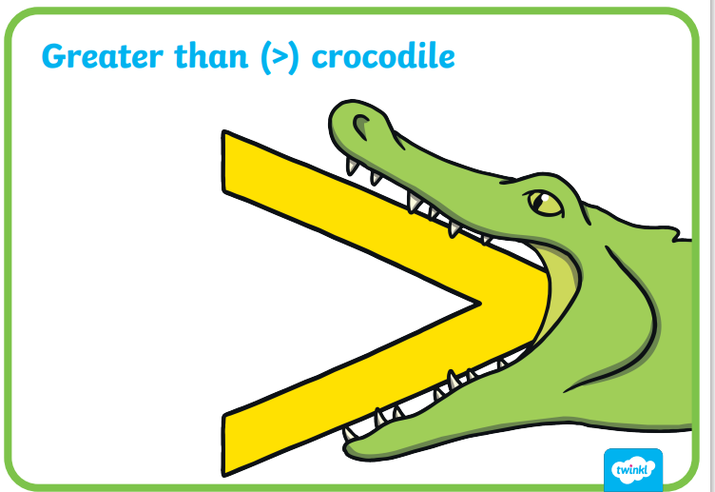
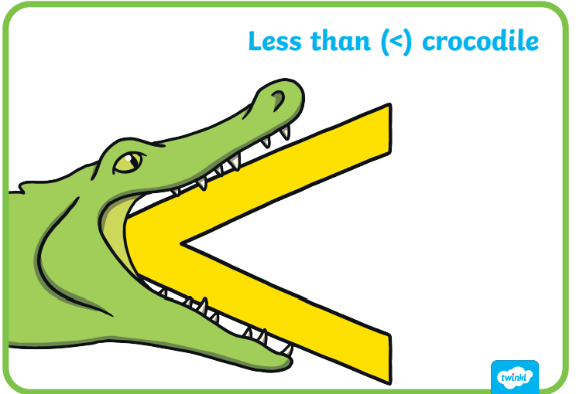
How do we remember them?
Crocodiles are really hungry animals. They always open their mouth towards the biggest amount.

Slide 7
How do we know if a number is bigger or smaller?
If we don’t know which number is bigger, we can look at it’s place value.
For example, if I count 21 cars and 83 cars, I know that 83 is bigger because it has more tens.
If I count 21 cars and 27 cars, I can see that both numbers have 2 tens, so I need to look at the ones. 7 is bigger than 1 so I know that 27 is the bigger number.

Slide 8
Which symbol would we need? How do we know?
38 72
<
<
3
8
7
2
7 tens is bigger than 3 tens so 38 is smaller than 72.

Slide 9
Which symbol would we need? How do we know?
29 23
>
>
2
9
2
3
Both numbers have 2 tens so we need to look at the ones. 9 ones is more than 3 ones so 29 is the bigger number.

Slide 10
Which symbol would we need? How do we know?
>
29 + 12 32
>
4
1
3
2
Sometimes we might need to add two numbers before we can compare. Put the bigger number in your head and count on.
Notes:
29 add 10 is 39. Then add 2.

Slide 11
Which symbol would we need? How do we know?
129 923
<
<
1
2
9
9
2
3
9 hundreds is bigger than 1 hundred so 923 is the biggest number. Remember to work from left to right.

Slide 12
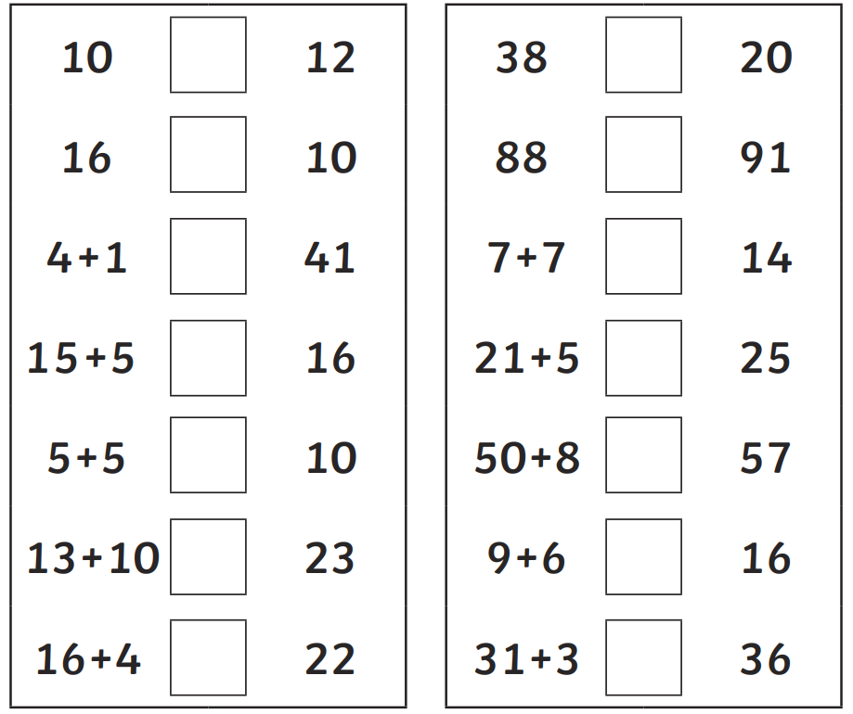
Year 2 task:
Choose the right symbol to compare the numbers. You may have to add numbers together before you compare them.
HA – Number the questions 1 to 14. On the page in your book next to where the sheet is glued, write a sentence to explain how you know the answer.
E.g.
Q1. Both of the numbers have 1 ten but 12 has more 1’s so it is bigger.

Slide 13
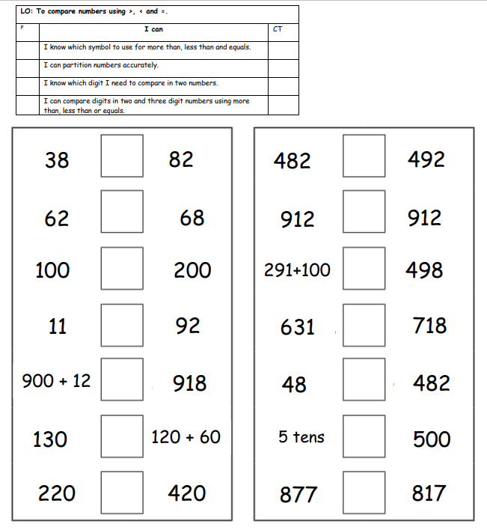
Year 3 task:
Choose the right symbol to compare the numbers. You may have to add numbers together before you compare them.
HA – Number the questions 1 to 14. On the page in your book next to where the sheet is glued, write a sentence to explain how you know the answer.
E.g.
Q1. Both of the numbers have 1 ten but 12 has more 1’s so it is bigger.

Slide 14
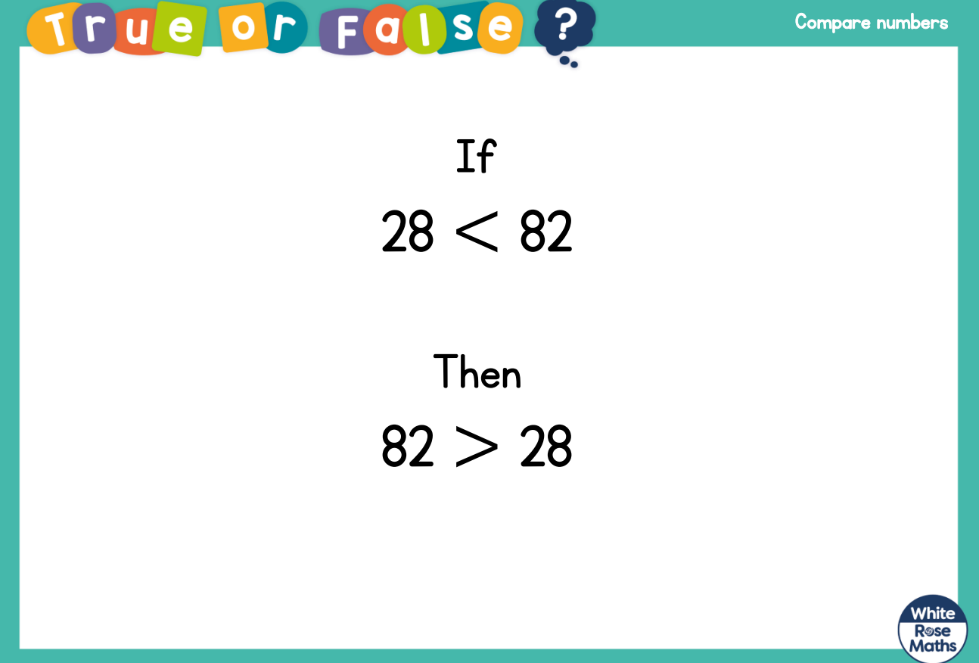
Plenary

Slide 15
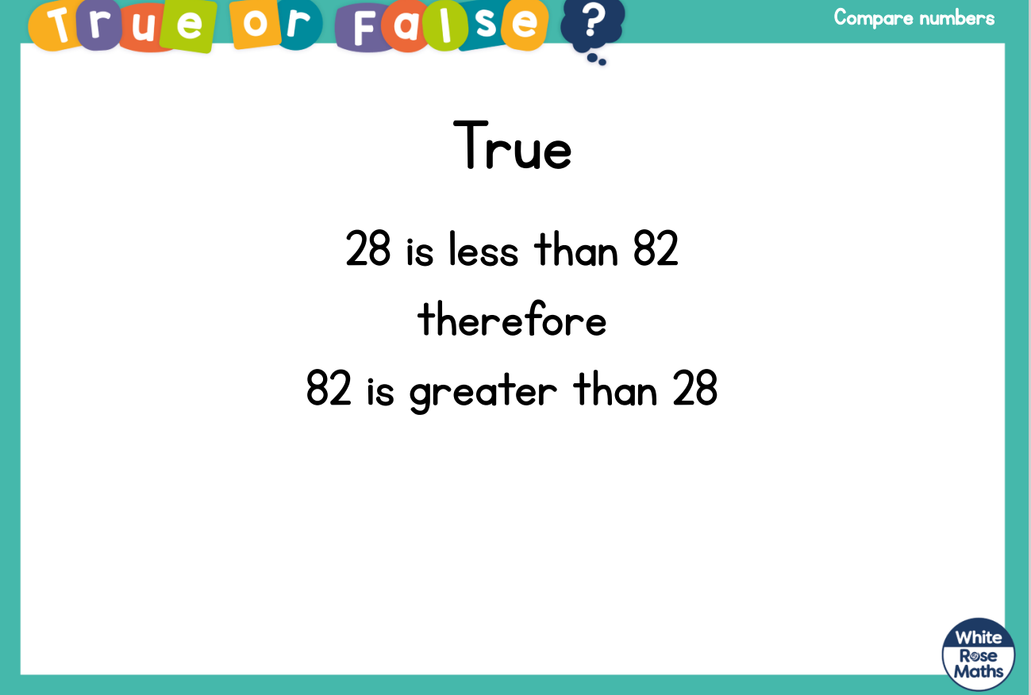
Plenary

