Slide 1
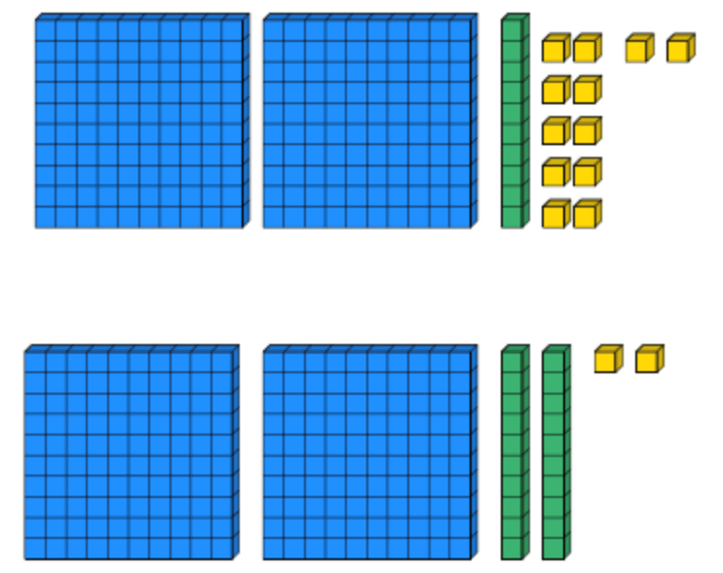
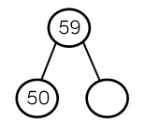
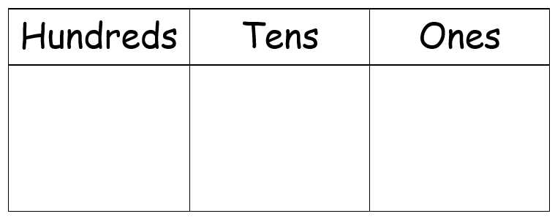
Place Value
Lesson 5

Slide 2
LO: To compare objects using >, < and =.
I can count objects accurately.
I know which symbol to use for more than, less than and equals.
I can compare objects using more than, less than and equals.

Slide 3
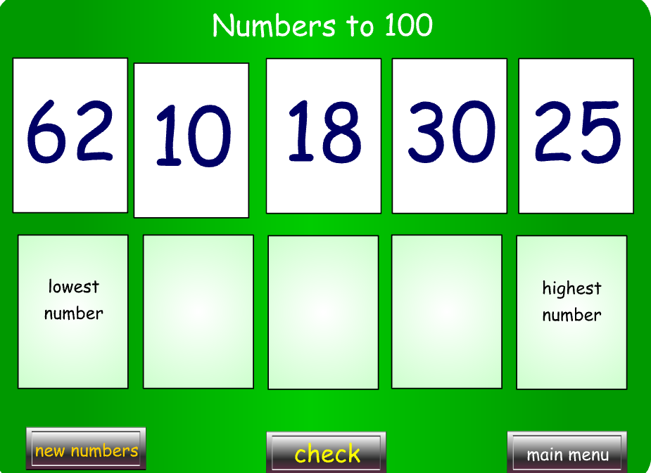
Starter
Notes:
Higher and Lower - 3-11 year olds - Topmarks

Slide 5
Do we recognize what these signs mean?
>
<
=
This sign means more than or greater than.
This sign means less than or smaller than.
This sign means equals or the same as.

Slide 6
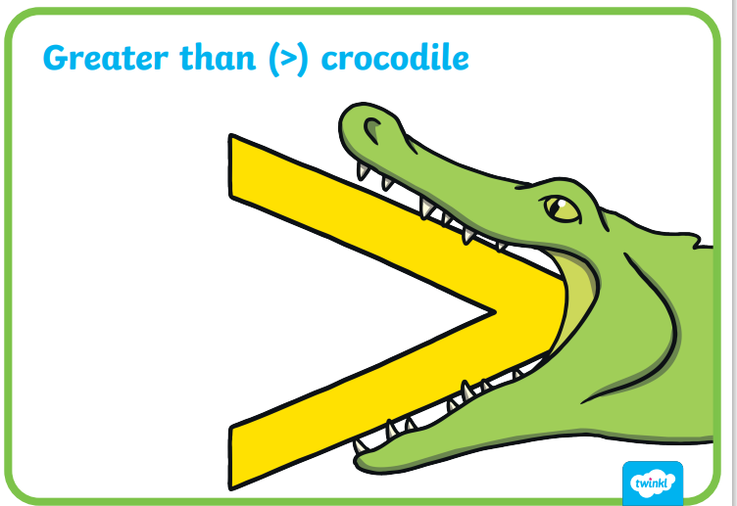
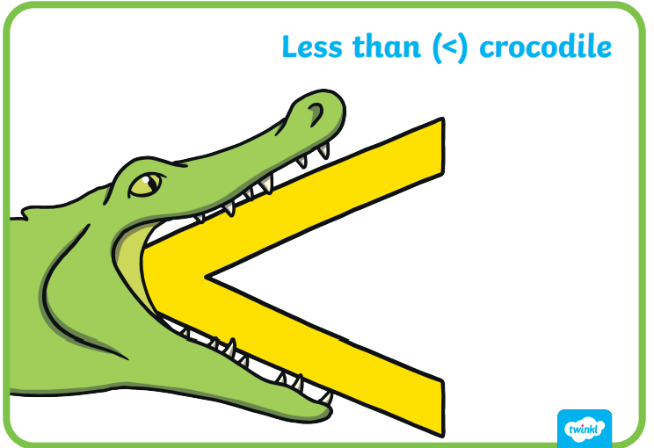
How do we remember them?
Crocodiles are really hungry animals. They always open their mouth towards the biggest amount.

Slide 7
How do we know if a number is bigger or smaller?
If we don’t know which number is bigger, we can look at it’s place value.
For example, if I count 21 cars and 83 cars, I know that 83 is bigger because it has more tens.
If I count 21 cars and 27 cars, I can see that both numbers have 2 tens, so I need to look at the ones. 7 is bigger than 1 so I know that 27 is the bigger number.

Slide 8
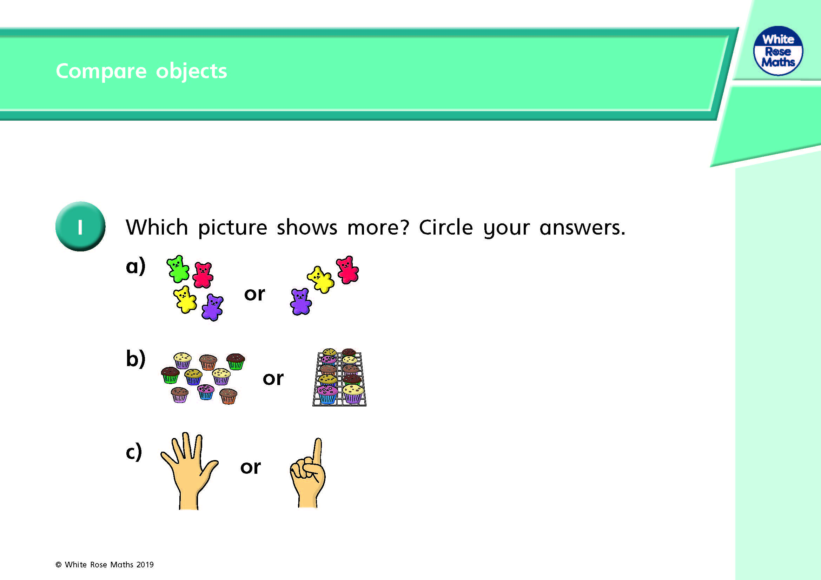
Which symbol would we need here?

Slide 9
Which symbol would we need here?

Slide 10
Which symbol would we need here?

Slide 11

Which symbol would we need here?

Slide 12
Which symbol would we need here?

Slide 13
Draw pictures to represent the sentences
19 is bigger than 8

Slide 14
Draw pictures to represent the sentences
28 is less than 51

Slide 15
Draw pictures to represent the sentences
61 is less than 8 tens and 9 ones

Slide 16
Your task
Year 2: Complete either the 1 or 2 star comparing objects to 100 sheets that match your understanding. If you find comparing objects tricky, complete the WhiteRose comparing objects sheet first.
Year 3: Complete the WhiteRose comparing objects sheet. Once you have completed that, choose the extension sheet that matches your understanding of comparing objects.

Slide 17
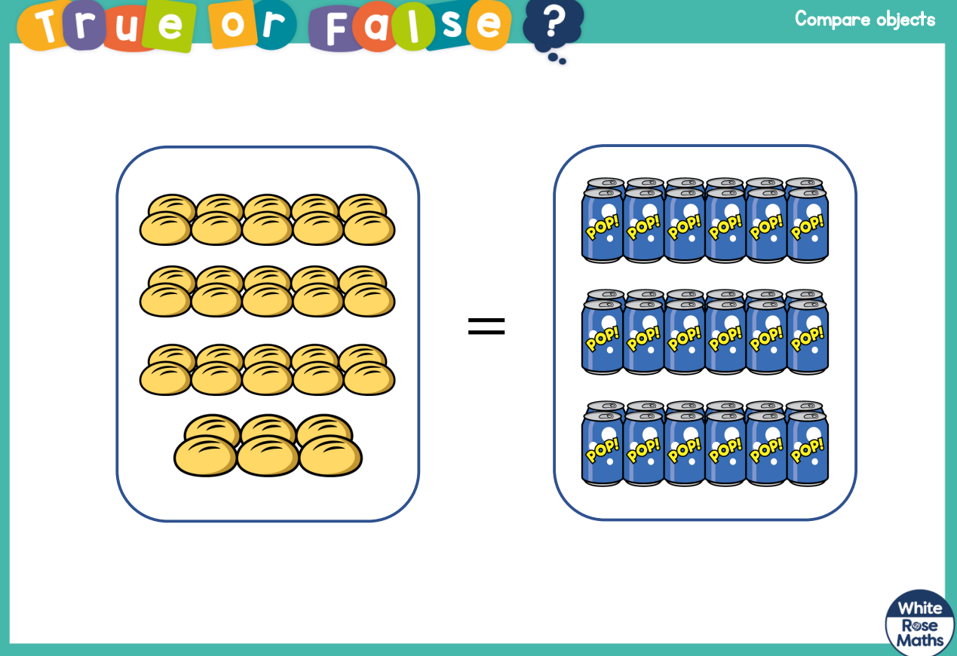
Plenary – True or False

Slide 18
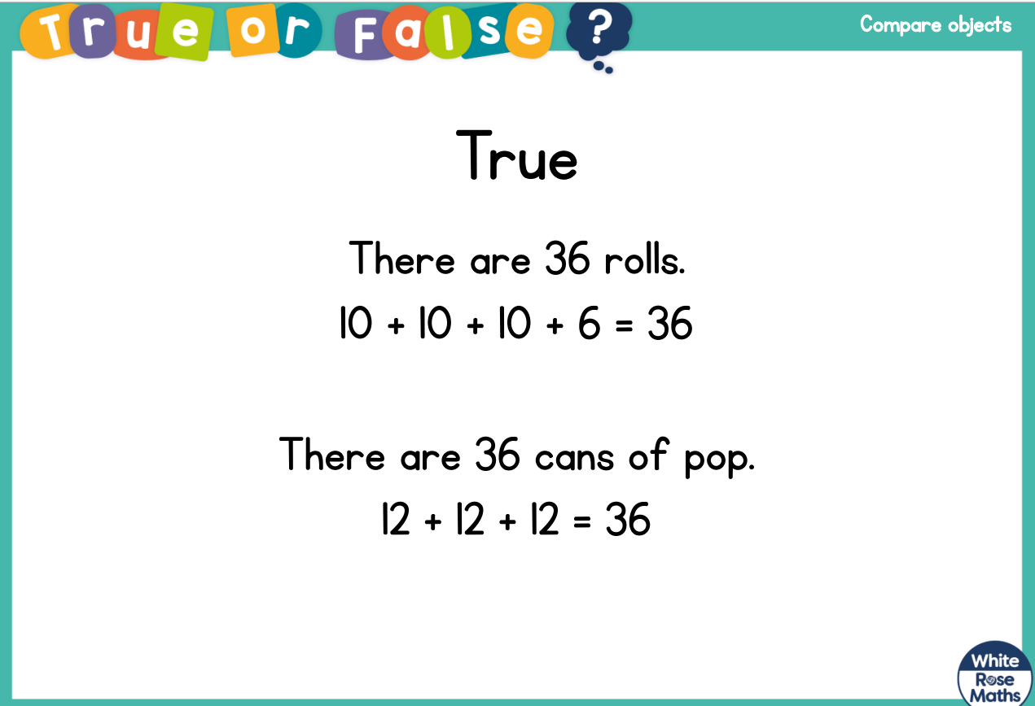
Plenary – True or False

