Slide 1
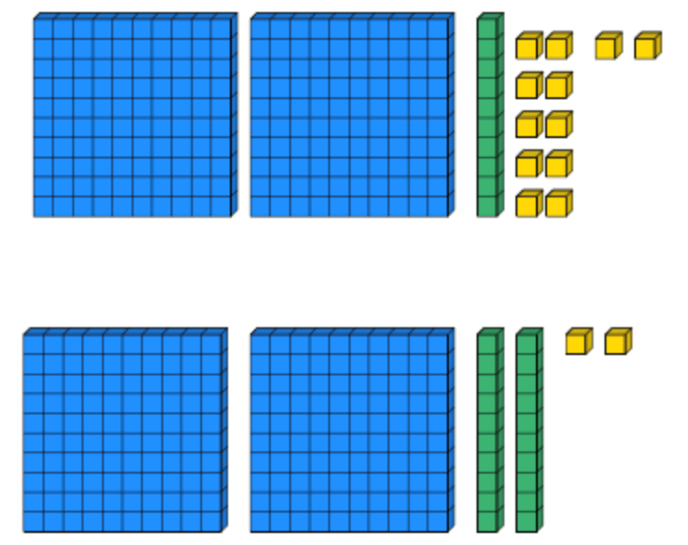
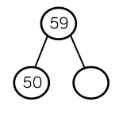
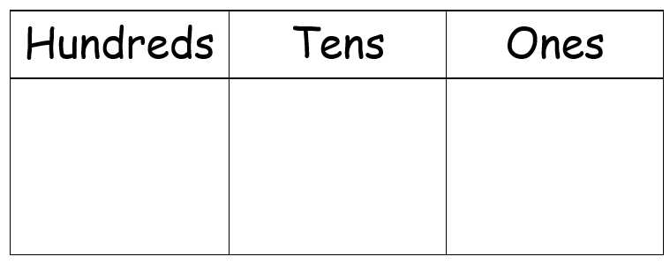
Place Value
Lesson 4

Slide 2
YR2 LO: To consolidate my understanding of place value.
I can read and write numbers up to 100.
I can recognize and represent the value of each digit in a two-digit number.
I can use place value and number facts to solve problems.

Slide 3
YR3 LO: To consolidate my understanding of place value.
I can read and write numbers up to 1000.
I can recognize and represent the value of each digit in a three-digit number.
I can use place value and number facts to solve problems.

Slide 4
Starter
On your whiteboards, write these numbers in words.
E.g. 5 would be five.
27 84 153 639

Slide 6
Dienes/Base 10
Big squares = 100
Long sticks = 10
Small cubes = 1

Slide 7

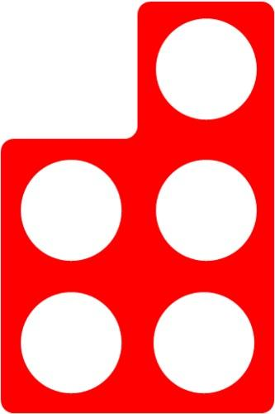
Numicon
The circles in the numicon help us to figure out the number. If two pieces of numicon have the same number of circles, we can just add the number again.
For example, two 5 pieces of numicon is the same as 5 + 5

Slide 8
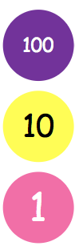
Place value counters
Place value counters are easy because the number on the counter tells us its’ value! They might be different colours but the number will always be correct.

Slide 9
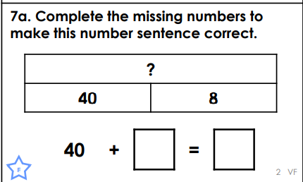
Bar charts
Bar charts are the same as part-whole models, they just look a little bit different. The biggest bar is always the whole number.

Slide 10
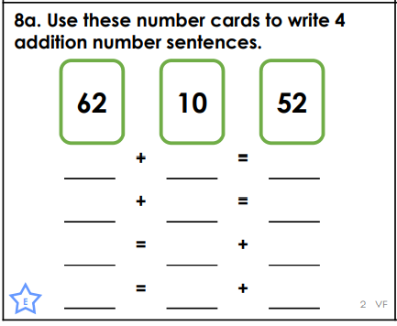
Number sentences
In this case, number sentences add two numbers together and give a total answer.
41
51
Notes:
Remind (or teach) chn that the total number will come after the equals sign if it follows A + B = C or at the start if it follows C = A + B.

Slide 11
Your task
Choose and complete the ‘Varied Fluency’ and ‘Reasoning and Problem Solving’ worksheet that matches your understanding of place value. If you want to complete the greater depth sheets, start with the expected sheets first.
EXT - Read and solve the discussion problems. Make sure to explain your reasoning.

Slide 12
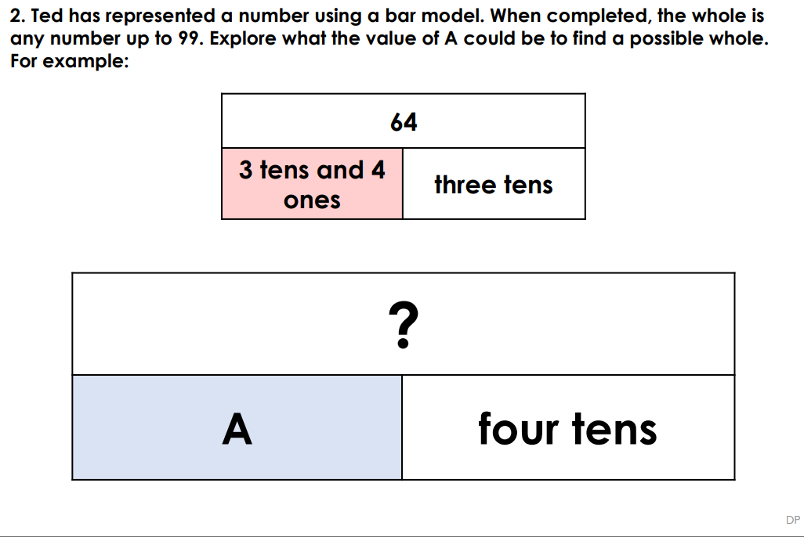
Plenary
Notes:
Demonstrate that it will have different answers, not just one.

