Slide 1
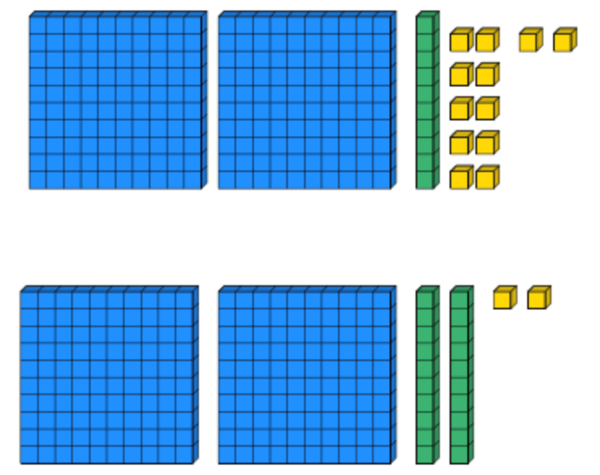
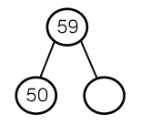
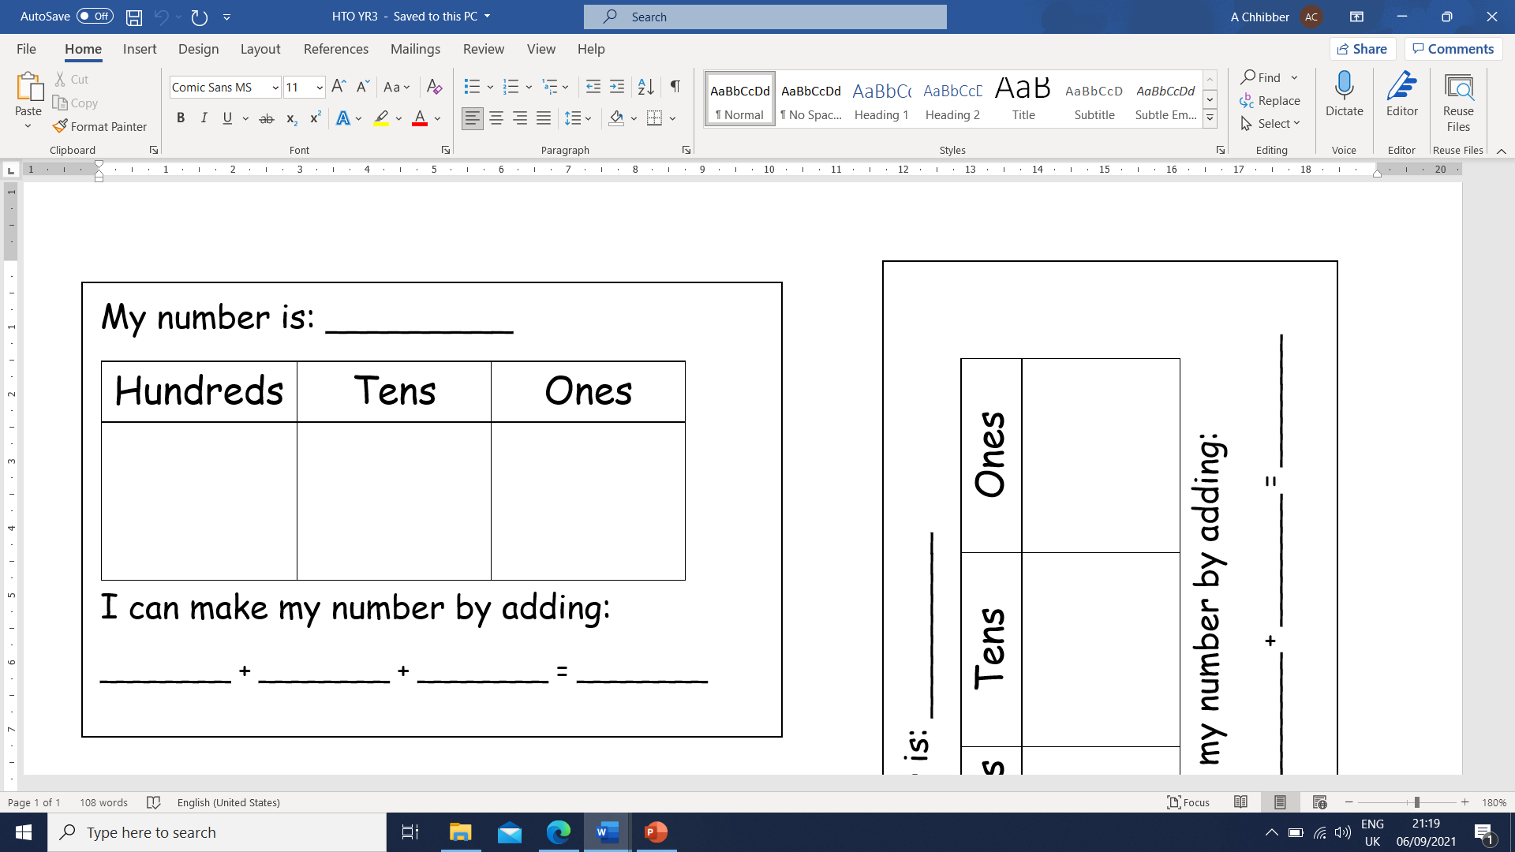
Place Value
Lesson 3

Slide 2
LO: To identify and represent numbers using different representations.
I can read and write numbers up to 100/1000.
I can use dienes and PPW model to identify a number.
I can use dienes and PPW model to represent a number.
I can partition a number in more than one way.

Slide 3
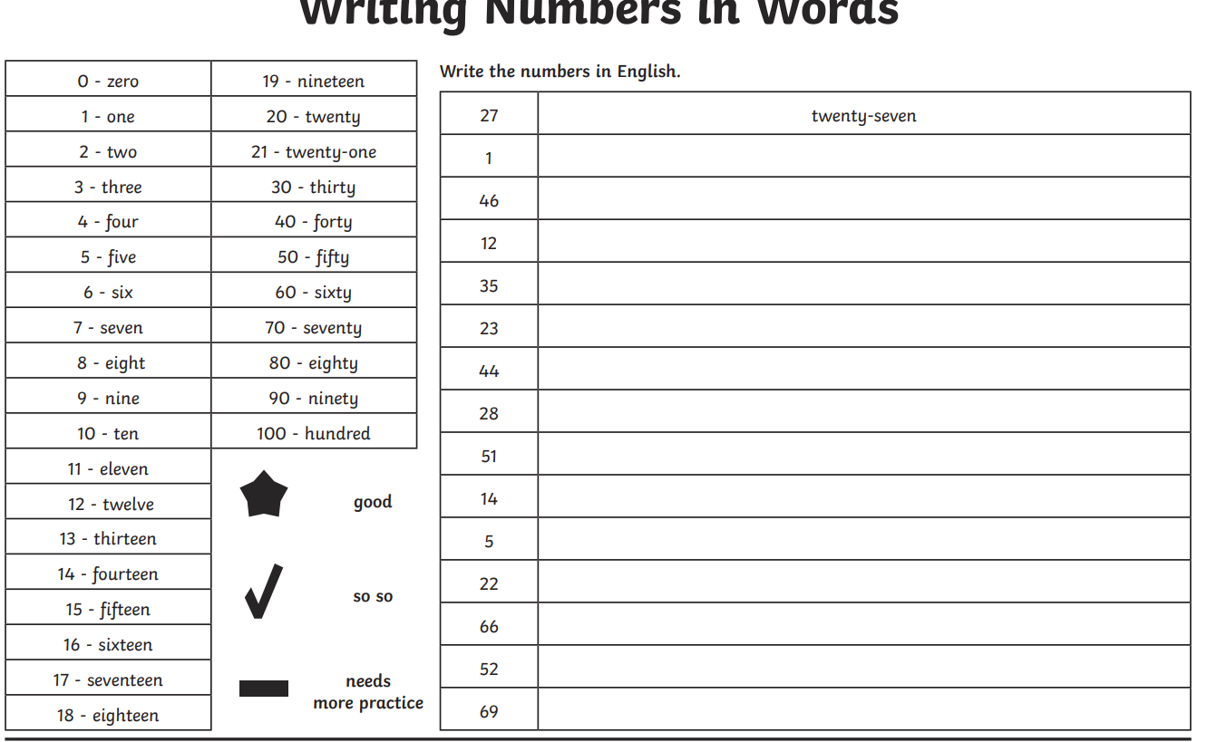
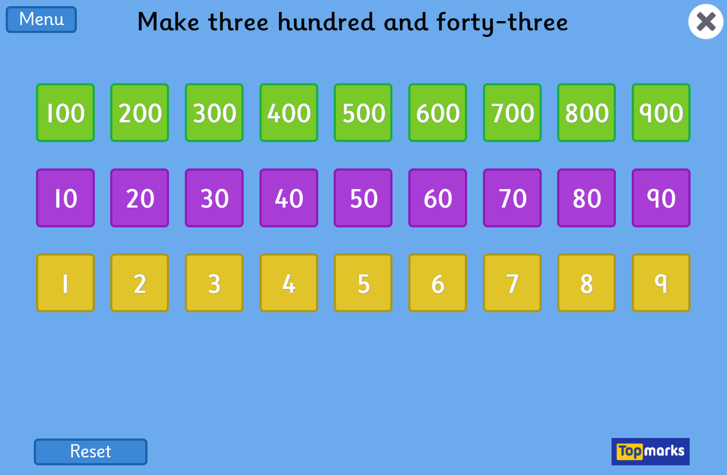
Starter
Notes:
Place Value Charts - Topmarks

Slide 4
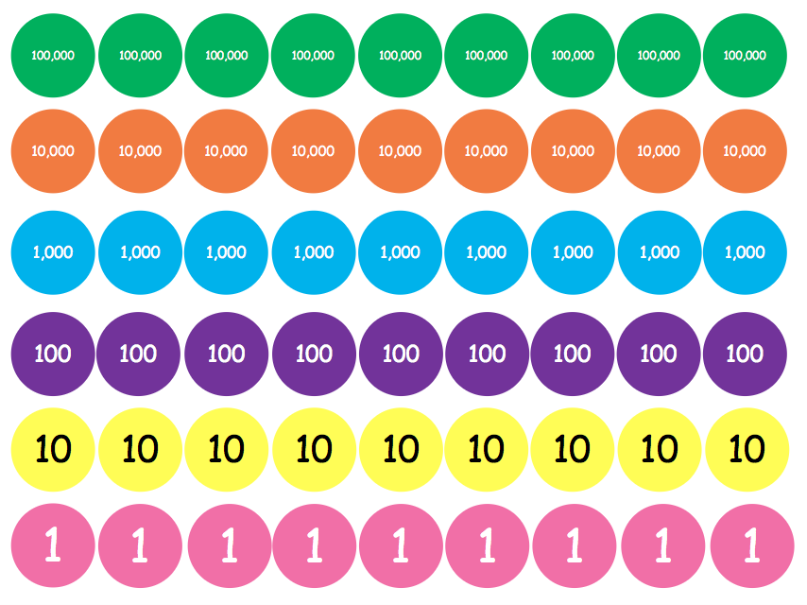


How many different ways might we see numbers?
Dienes (base 10)
Part Part Whole
Numicon
Place Value Counters

Slide 5
What number have I made? Can you show it on a place value chart?
3
5
4
Three hundred and fifty four

Slide 6
What number have I made? Can you show it on a place value chart?
4
5
Fourty five
Notes:
Remind chn we know these are 10 so we can count in 10s

Slide 7
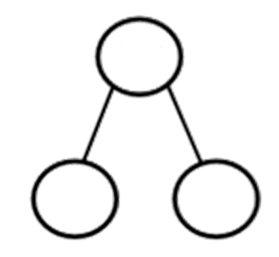
What number have I made? Can you show it on a place value chart?
7
8
Seventy eight
70
8
Notes:
Remind chn we know these are 10 so we can count in 10s

Slide 9
Part Whole Model
When we look at a Part Whole model, the number that is in a circle by itself is the whole number.
The other circles show the numbers that add together to make the whole number. These are the parts.

Slide 10
Part Whole Model
Sometimes we are given the whole number and must work out which two numbers add together to create it.
Sometimes we are given one of the parts and must work out the missing number.

Slide 11
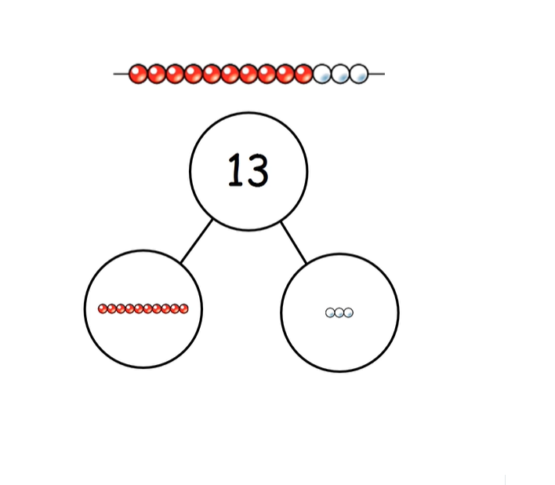
Aut2.2.5 - Tens and ones using part whole model on Vimeo

Slide 12
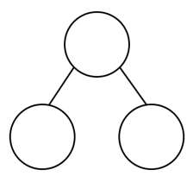
Practice questions:
62
62
12
Notes:
Demonstrate partitioning first q’s using 10s and 1. For second question you could demonstrate using resources or drawing dienes on a WB to figure out answer.

Slide 13
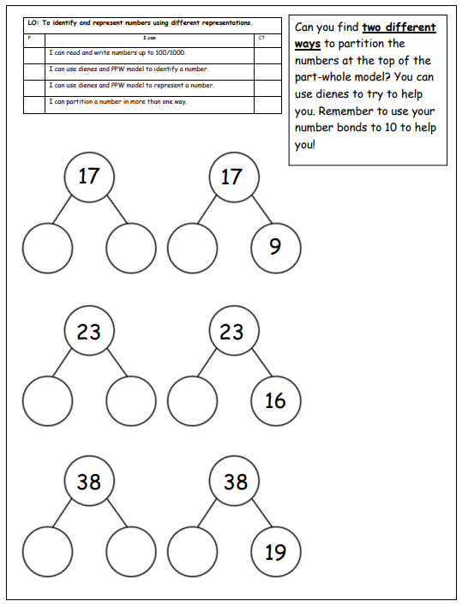
Your task: Year 2
Work through question sheet given to you to partition the number. Your first partition should always be tens and ones.
Use the clues given to find out the missing number. Remember to use resources to help if you are unsure of adding and taking away.

Slide 14
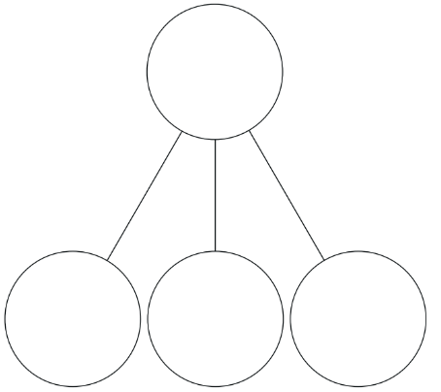
Practice questions:
135
135
35
Notes:
Demonstrate partitioning first q’s using 100s, 10s and 1. For second question you could demonstrate using resources or drawing dienes on a WB to figure out answer.

Slide 15
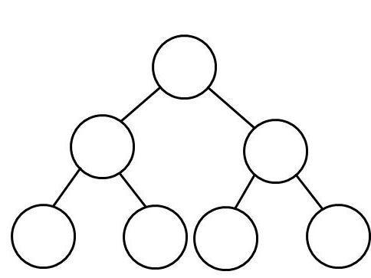
Practice questions:
35
5
20
Notes:
Demonstrate partitioning using the given numbers. Numbers should be 30 split into 20 and 10 and 5 split into any two numbers that equal 5.

Slide 16
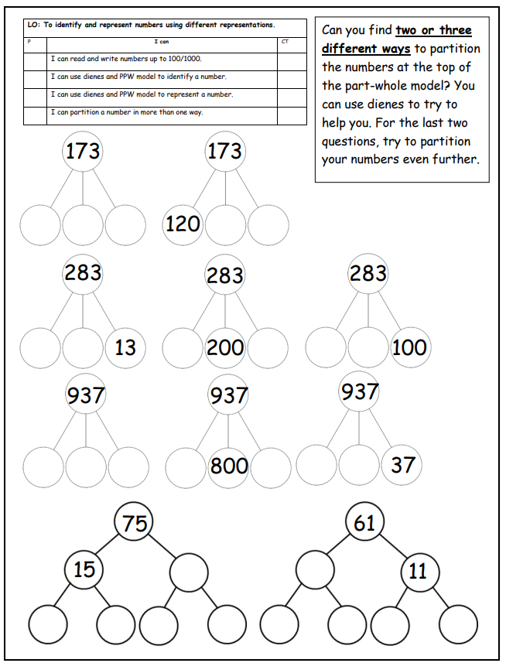
Your task: Year 3
Work through question sheet given to you to partition the number. Your first partition should always be hundreds, tens and ones.
Use the clues given to find out the missing number. Remember to use resources to help if you are unsure of adding and taking away.
When you get to the questions at the bottom of the sheet, you need to partition your numbers further.

Slide 17
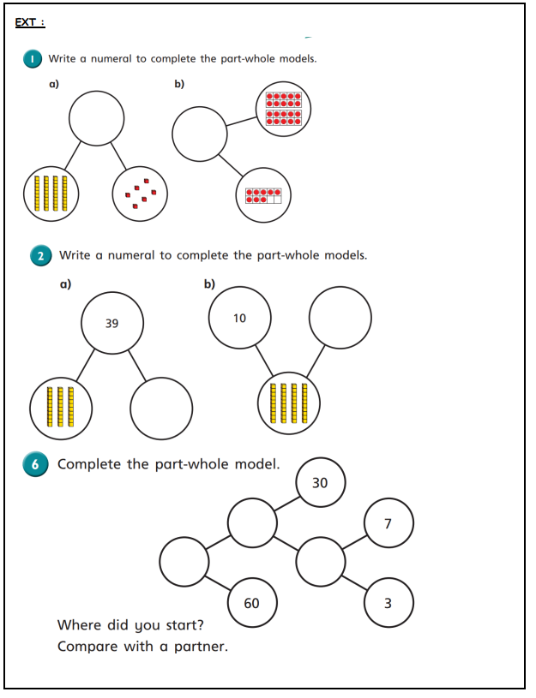
Ext for all
Complete White Rose ext sheet.

