Slide 1
Multiplication using the ‘x’ symbol.
12.01.22

Slide 2
Y2 LO: To use my knowledge of repeated addition to create multiplication sentences.
YR3 LO: To recap my knowledge of using repeated addition to create multiplication sentences.
I can understand what the multiplication symbol means.
I can link this to repeated addition.
I can write my own multiplication sentences using the correct symbol.
I can understand what the multiplication symbol means.
I can link this to repeated addition.
I can write my own multiplication sentences using the correct symbol.

Slide 3
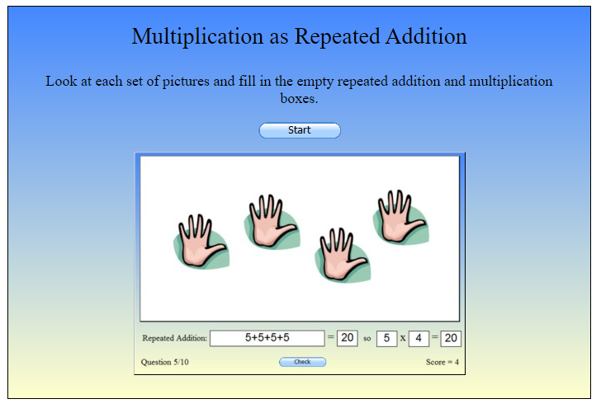
Division by Sharing Bingo (snappymaths.com)

Slide 4
3 x 6 =
What does the 3 represent?
What does the 6 represent?
3 lots of 6 =
What does lots of mean?
Does 18 = 3 ×6 mean the same?

Slide 5
How is 7 +7 +7 the same as 3 ×7?

Slide 6

Fluency
Complete the sentences to describe the equal groups.
3
3
______ + ______ = 6
2
3
______ x ______ = 6
2
3
There are ______ equal groups with ______ in each group.
3
There are two ______s.

Slide 7
Fluency
Complete the sentences to describe the equal groups.
3
3
3
______ + ______ + ______= 9
3
3
______ x ______ = 9
3
3
There are ______ equal groups with ______ in each group.
3
There are three ______s.

Slide 8
Fluency
Complete the sentences to describe the equal groups.
5
5
5
______ + ______ + ______= 15
3
5
______ x ______ = 15
3
5
There are ______ equal groups with ______ in each group.
5
There are three ______s.

Slide 9
Fluency
Complete:
Addition | Multiplication
2 + 2
 | 2 x 3
3 + 3 + 3
 | 3 x 4
5 + 5 + 5
2 x 2
3 + 3
3 x 3
4 + 4 + 4
3 x 5
Can you think of a story to go with each calculation?

Slide 10
Fluency
Use <, > or = to make the statements correct.
>
5 + 5 + 5
2 x 5
3 x 4
=
4 + 4 + 4
3 x 5
<
10 + 10

Slide 11
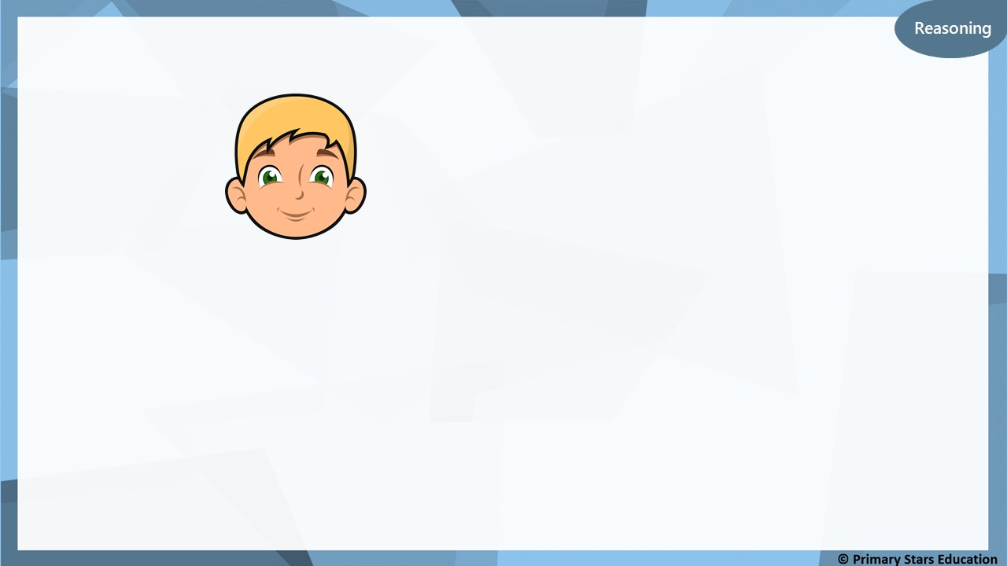
Ben says,
Reasoning
3 x 4 = 4 + 4 + 4
Is Ben correct?
Explain how you know.
Ben is correct as:
3 x 4 = 12
4 + 4 + 4 = 12

Slide 12
Problem solving
Complete the comparison to make it true.
5 + 5 + 5 > ______ x ______
Any answer that multiplies to an answer less than 15.
Example:
5 + 5 + 5 > 2 x 5

Slide 13
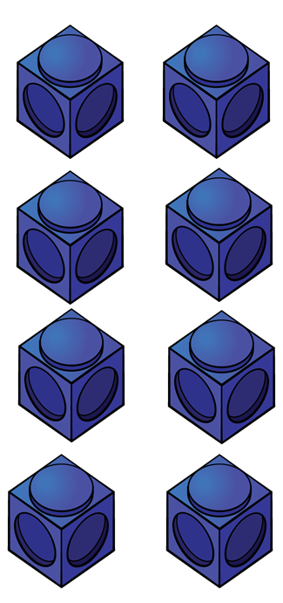



What do you see?
3
4
There are ____ equal groups of ____
$+ + =$
4
4
4
12
$× =$
3
4
12

Slide 14

What do you see?
2
6
There are ____ equal groups of ____
$+ =$
6
6
12
$× =$
2
6
12

Slide 15


I can write 4 different multiplications
I think there are 8

Slide 16
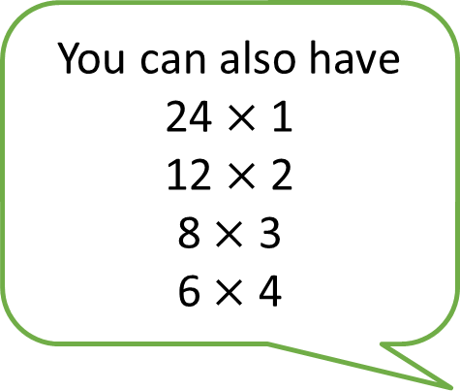
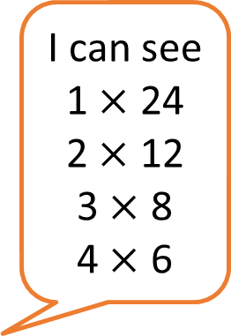
I can see
1 $×$ 24
2 $×$ 12
3 $×$ 8
4 $×$ 6
You can also have
24 $×$1
12 $×$ 2
8 $×$ 3
6 $×$ 4

Slide 17

Activity one:
Notes:
Model how to show this.
2+2+2+2 = 6 Then the array
4 x 2 = 6
Y2 chd need to write one or two for the 2 times tables, 5 times tables and 10 times table. Y2 HA to write one for the 3 times tables.
Y2 to do the same as Y2 including the 3 times tables. Y3 HA to write one for the 4 times table or 8 times table.

Slide 18
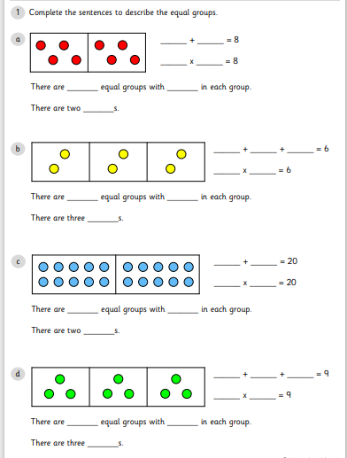
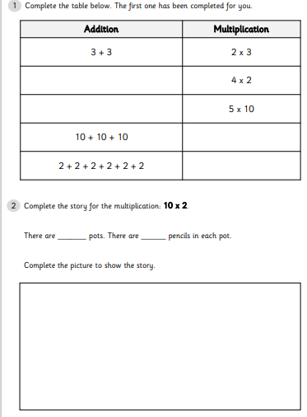
Y2 Activity:
Complete the worksheets.

Slide 19
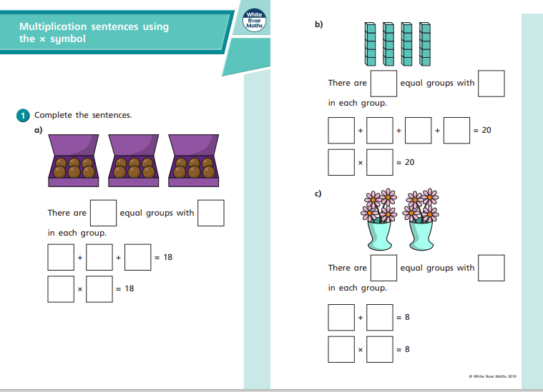
Y3 Activity:
Complete the worksheets.

