Slide 1
Money
Lesson 4
18.11.21

Slide 2
LO: To be able to find different combinations of coins that equal the same amount of money.
I can recognise the value of each coin.
I can think of different ways to calculate amounts.
I can use my knowledge to complete problem solving.

Slide 3
Starter:
How many different ways can you think of to make these totals?
65p
£3 and 78p

Slide 4
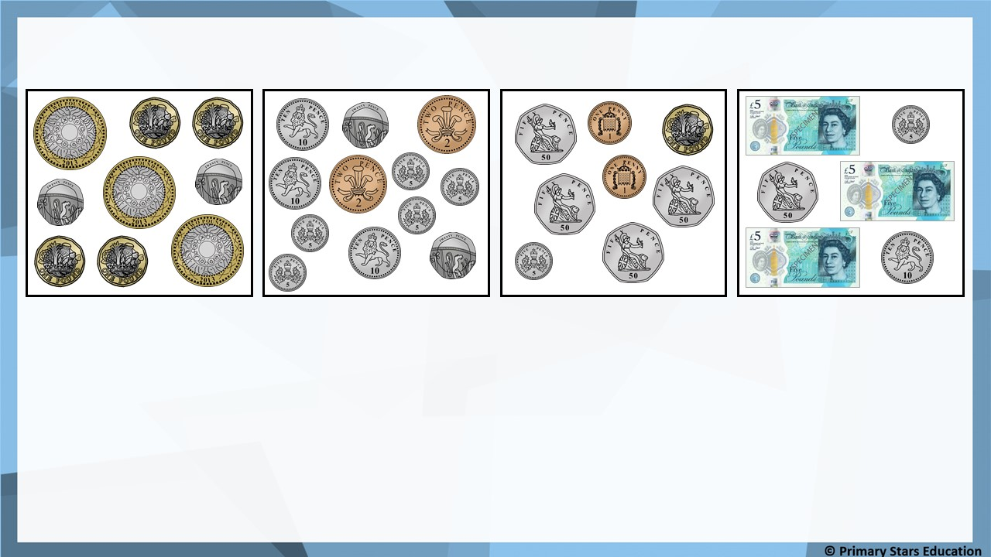
Fluency
Match the coins to the correct amount.
£3 and 7p
£10 and 40p
£15 and 65p
99p

Slide 5

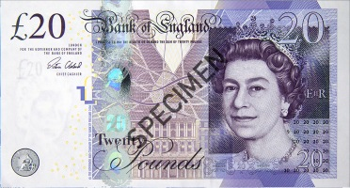
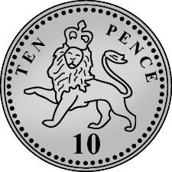
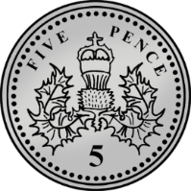
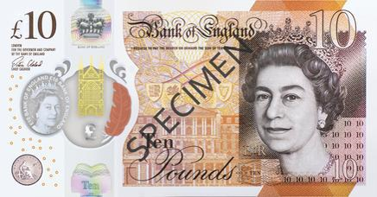
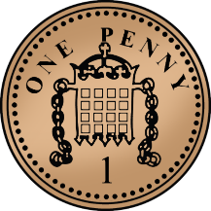
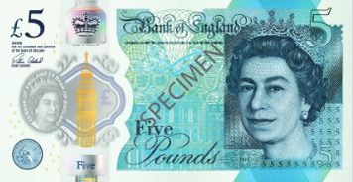
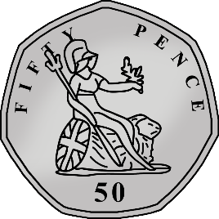
Fluency
Match the coins to the correct amount.
£50 and 50p
£20 and 77p
£45 and 8p
£30 and 35p

Slide 6
Fluency
Complete the part-whole models.
15p
£15
10p
5p
£5
£5
£5

Slide 7
Fluency
Complete the part-whole models.
40p
£40
20p
20p
£20
£10
£10

Slide 8
Fluency
Complete the part-whole models.
60p
£60
50p
10p
£20
£20
£20

Slide 9
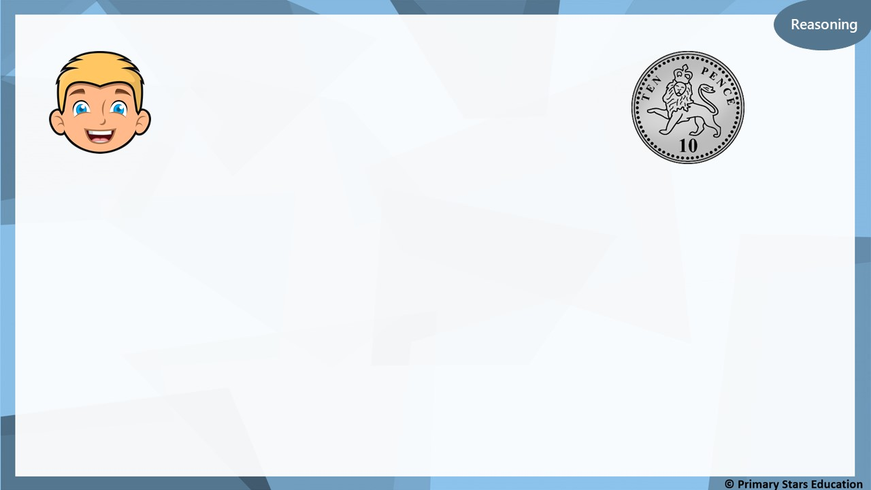
You can make 10p in at least 5 different ways using coins.
Yes
Do you agree? __________
Explain why.
2p, 2p, 2p, 2p, 2p
2p, 2p, 2p, 2p, 1p, 1p
2p, 2p, 2p, 1p, 1p, 1p, 1p
2p, 2p, 1p, 1p, 1p, 1p, 1p, 1p
2p, 1p, 1p, 1p, 1p, 1p, 1p, 1p, 1p
1p, 1p, 1p, 1p, 1p, 1p, 1p, 1p, 1p, 1p

Slide 10
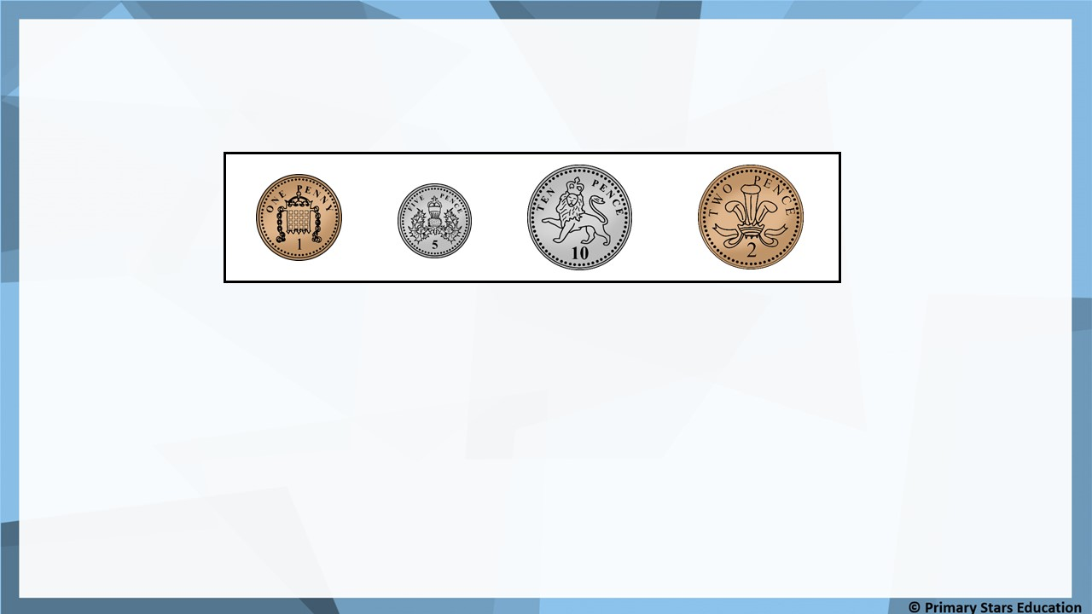
Problem solving
Make 30p three ways using the coins below.
You can each coin more than once.
Possible examples:
10p, 10p, 10p
10p, 10p, 5p, 5p
10p, 5p, 5p, 5p, 5p
5p, 5p, 5p, 5p, 5p, 5p 30 x 1p
15 x 2p

Slide 11
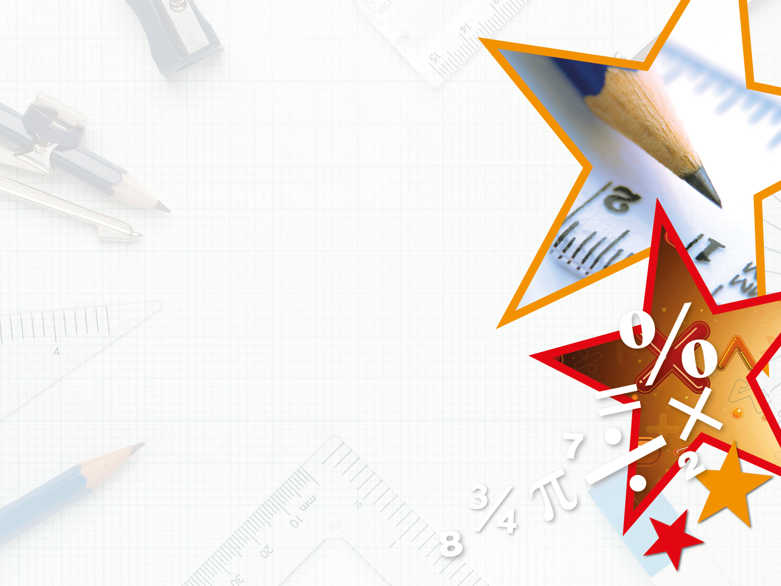
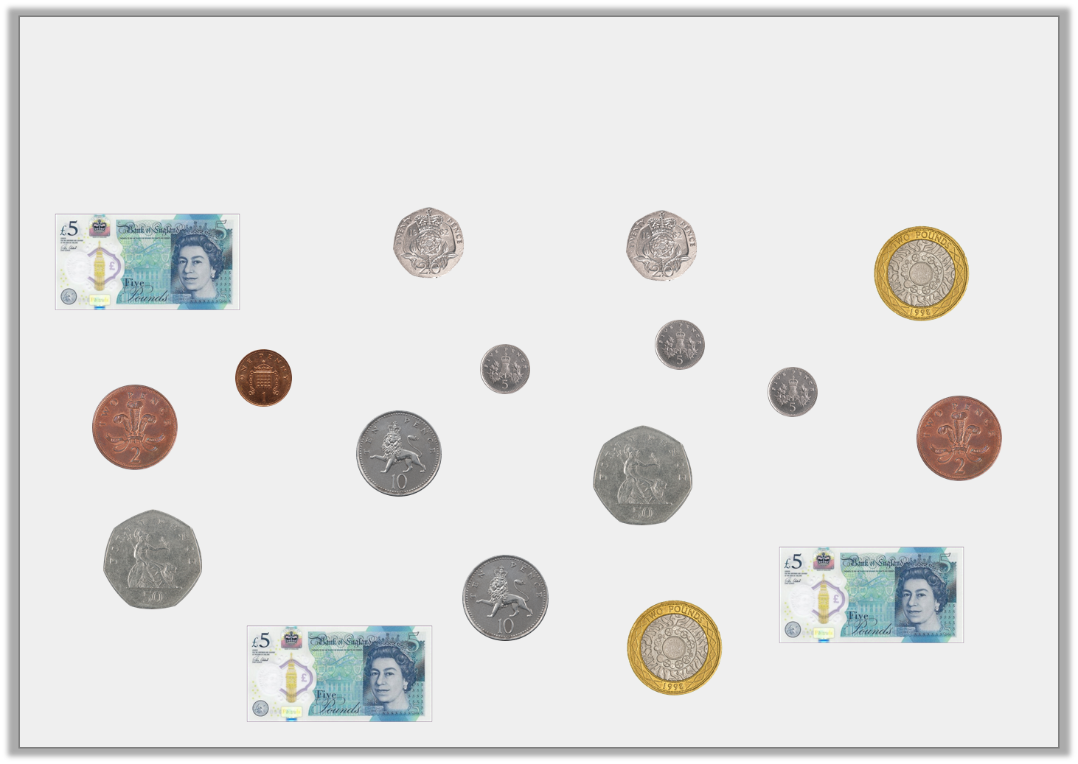

Varied Fluency 3
Matt is going to the shops to buy an item which costs £13 and 71p. Cross out the coins and notes which are not needed.
© Classroom Secrets Limited 2018

Slide 12
Varied Fluency 3
Matt is going to the shops to buy an item which costs £13 and 71p. Cross out the coins and notes which are not needed.
© Classroom Secrets Limited 2018

Slide 13
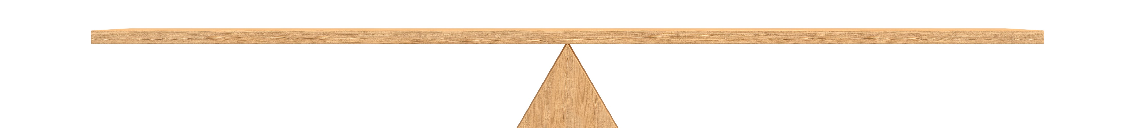
Varied Fluency 4
Balance the scales by drawing coins or notes to make the same amount.
?
£17 and 35p
© Classroom Secrets Limited 2018

Slide 14
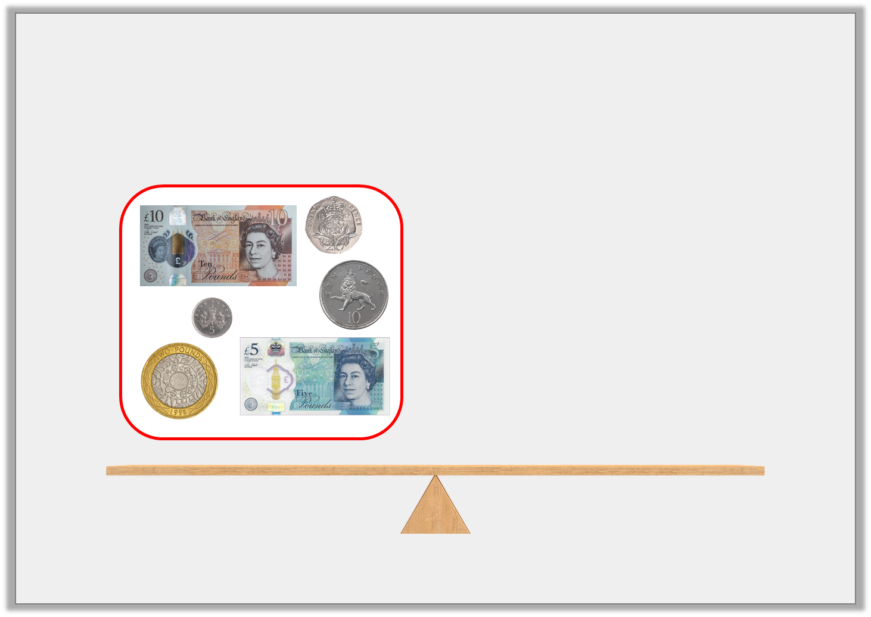
Varied Fluency 4
Balance the scales by drawing coins or notes to make the same amount.
£17 and 35p
© Classroom Secrets Limited 2018

Slide 15
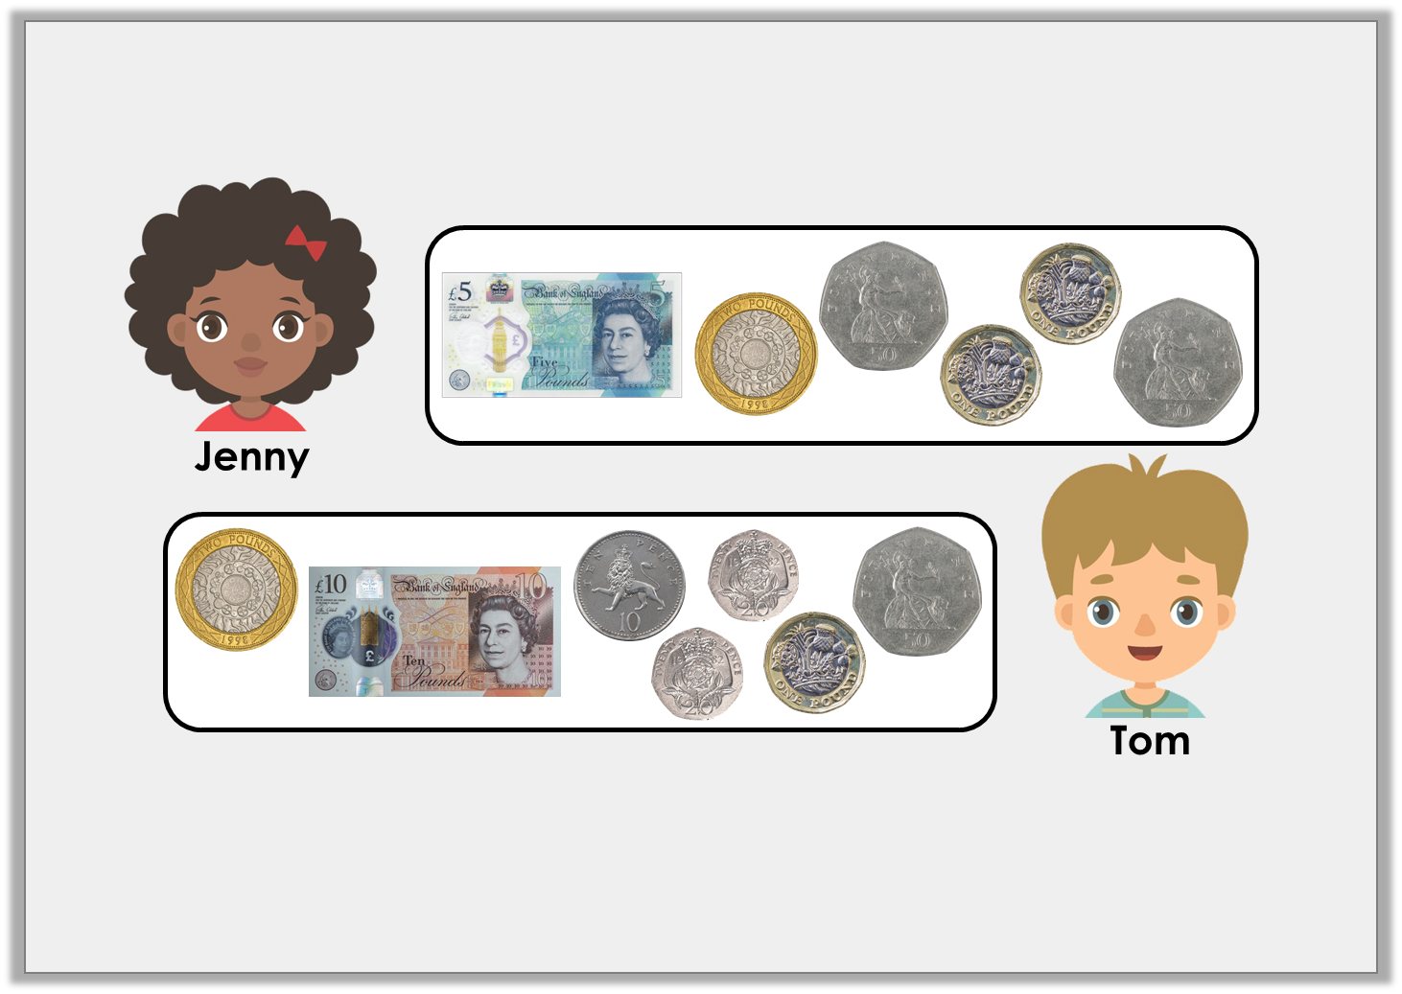
Reasoning 1
Jenny says she has the same amount of money as Tom.
Is she correct? Explain your answer.
© Classroom Secrets Limited 2018

Slide 16
Reasoning 1
Jenny says she has the same amount of money as Tom.
Is she correct? Explain your answer.
Jenny is incorrect because…
© Classroom Secrets Limited 2018

Slide 17
Reasoning 1
Jenny says she has the same amount of money as Tom.
Is she correct? Explain your answer.
Jenny is incorrect because she has £10 and Tom has £14.
© Classroom Secrets Limited 2018

Slide 18
Problem Solving 1
Solve the word problem.
Jonathan has two coins and a note.
Jane has four coins and two notes.
They each have £12 and 20p in total.
What combination of money could Jonathan and Jane have?
© Classroom Secrets Limited 2018

Slide 19
Problem Solving 1
Solve the word problem.
Jonathan has two coins and a note.
Jane has four coins and two notes.
They each have £12 and 20p in total.
What combination of money could Jonathan and Jane have?
Jonathan – £10, £2 and 20p
Jane – £5, £5, £1, £1, 10p and 10p (or £5, £5, £2, 10p, 5p and 5p/ £5, £5, £1, 50p, 50p and 20p)
© Classroom Secrets Limited 2018

Slide 20
Activity:
Complete the worksheet.
Once you have had this checked, move onto the extension.

