Slide 1
Money
W.B 6th December

Slide 2
Y2 LO: To be able to find the difference.
Y3 LO: To be able to subtract money accurately.
I can count on to find the difference.
I can count backwards to find the difference.
I can discuss and understand the most efficient method.
I can independently choose a method to complete subtraction questions.
I can use the inverse to check my answers.
I can complete problem solving questions using my learning.

Slide 3
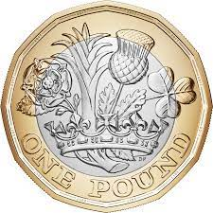
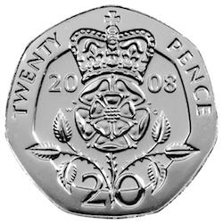
Starter:
Notes:
Show / draw two coins. Ask children to find the difference between the two coins. Find what method they used (count up / back? Y2- Promote discussion on what method they would use for greater amounts.)
Ask Y3 what methods could they use? Column/ number line forwards or backwards portioning etc.

Slide 4



Fluency
Calculate the difference.
10p
?
30p
20p
10p + ________ = 30p
Notes:
Make sure modelling all methods on whiteboards as we work through PP

Slide 5


Fluency
Calculate the difference.
35p
?
75p
40p
35p + ________ = 75p

Slide 6
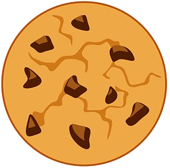

Fluency
Calculate the difference.
£1 and 25p
?
£1 and 50p
25p
£1 and 25p + ________ = £1 and 50p

Slide 7
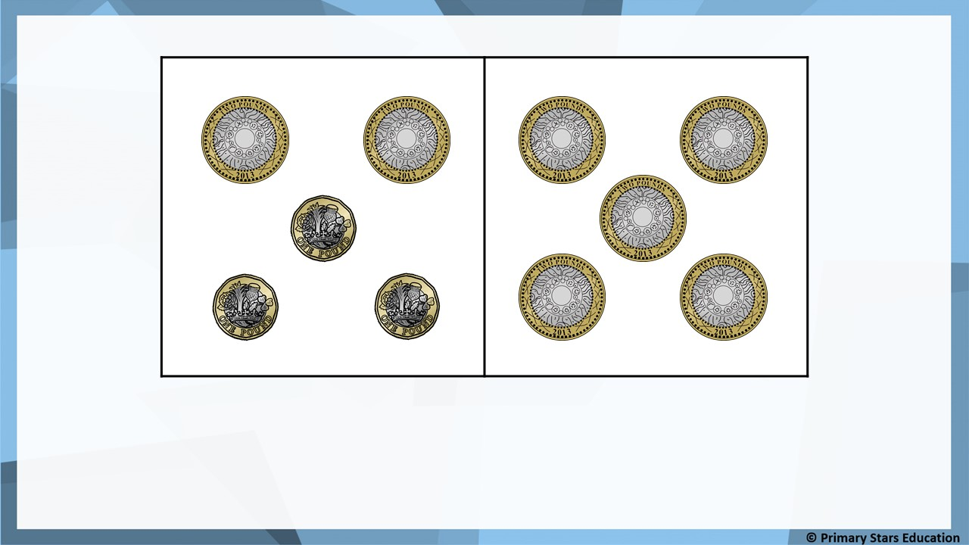
Fluency
Ben
Tam
£3
How many pounds less does Ben have? ______.

Slide 8
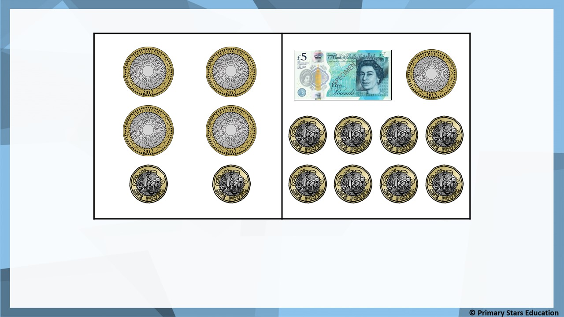
Fluency
Jack
Beth
£5
How many pounds more does Beth have? ______.

Slide 9
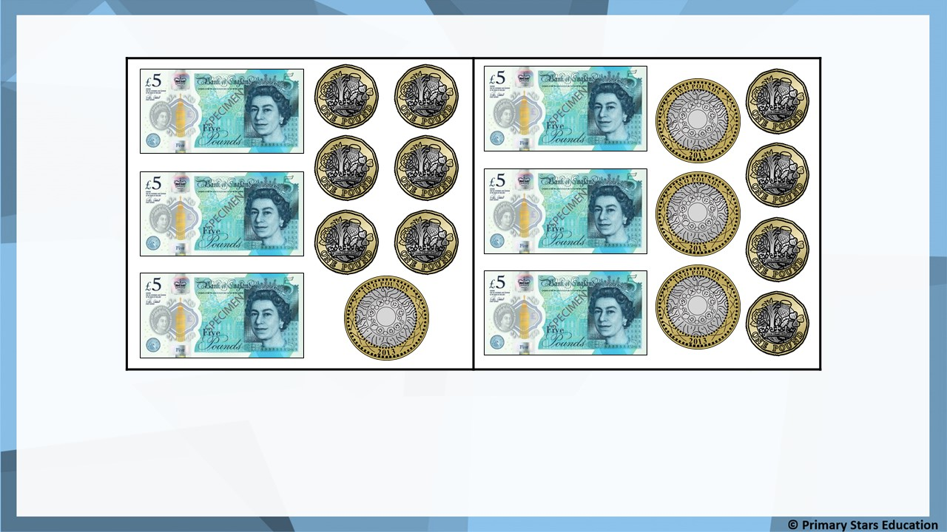
Fluency
Jack
Sue
£2
How many pounds less does Jack have? ______.

Slide 10
Fluency
a) Mo has £1 and 50p.
Asha has £1 and 65p.
How much more money does Asha have than Mo?
Asha has 15p more than Mo.
b) Rob has £1 and 75p.
Gina has £2 and 25p.
How much more money does Gina have than Rob?
Gina has 50p more than Rob.

Slide 11

I have £1 and 40p.
I have £1 and 20p.
Tam
Dom
Tam says she has 30p more than Dom.
Is Tam correct? How do you know?
No. Tam has 20p more than Dom.
£1 and 40p - £1 and 20p = 20p.

Slide 12
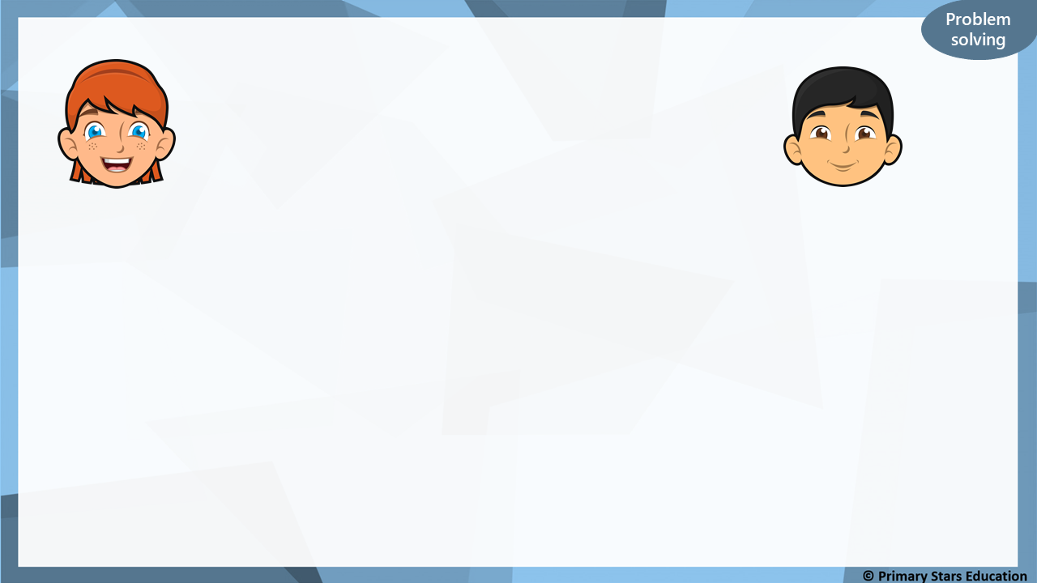
I have 10p.
I have 30p.
Sue
Che
Both children have a 10p coin. Che only has silver coins.
What other silver coins could Che have?
Any combination of silver coins to make 20p, for example:
4 x 5p 2 x 5p and 1 x 10p 2 x 10p 1 x 20p

Slide 13


Varied Fluency 1
Complete the missing numbers on the number line.
_____p
£ _____
_____p
75p
£1
£____
£6 and
70p
© Classroom Secrets Limited 2019

Slide 14
Varied Fluency 1
Complete the missing numbers on the number line.
25p
£5
70p
75p
£1
£6
£6 and
70p
© Classroom Secrets Limited 2019

Slide 15
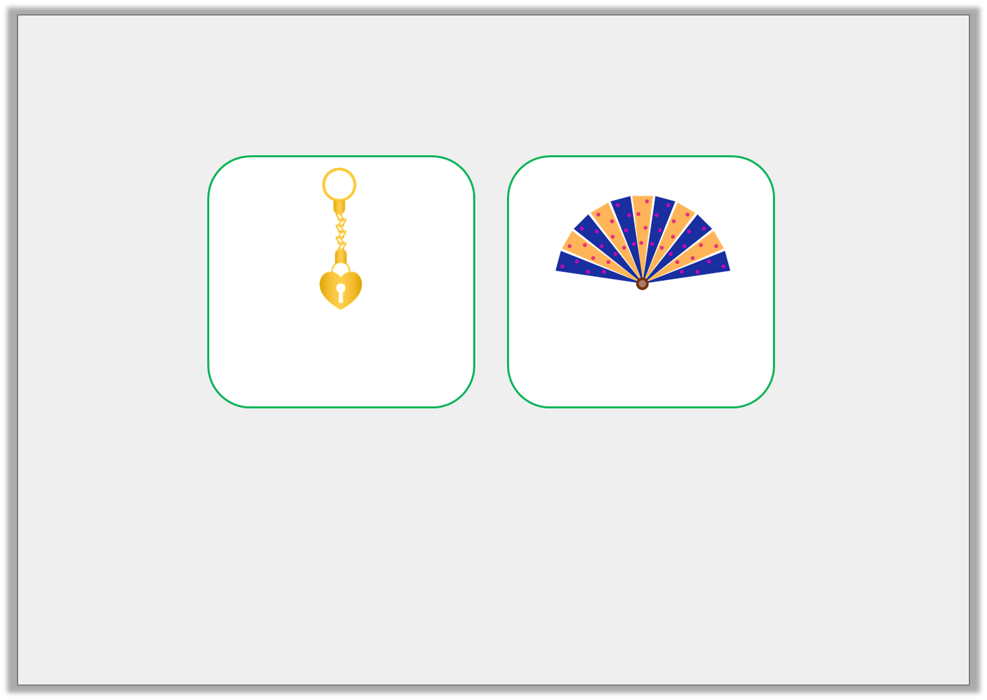
Varied Fluency 2
Shirelle likes two items in the museum’s gift shop.
How much less does the gold keyring cost?
£_____ and ______p
£3 and 60p
£7 and 45p
© Classroom Secrets Limited 2019

Slide 16
Varied Fluency 2
Shirelle likes two items in the museum’s gift shop.
How much less does the gold keyring cost?
£3 and 85p
£3 and 60p
£7 and 45p
© Classroom Secrets Limited 2019

Slide 17
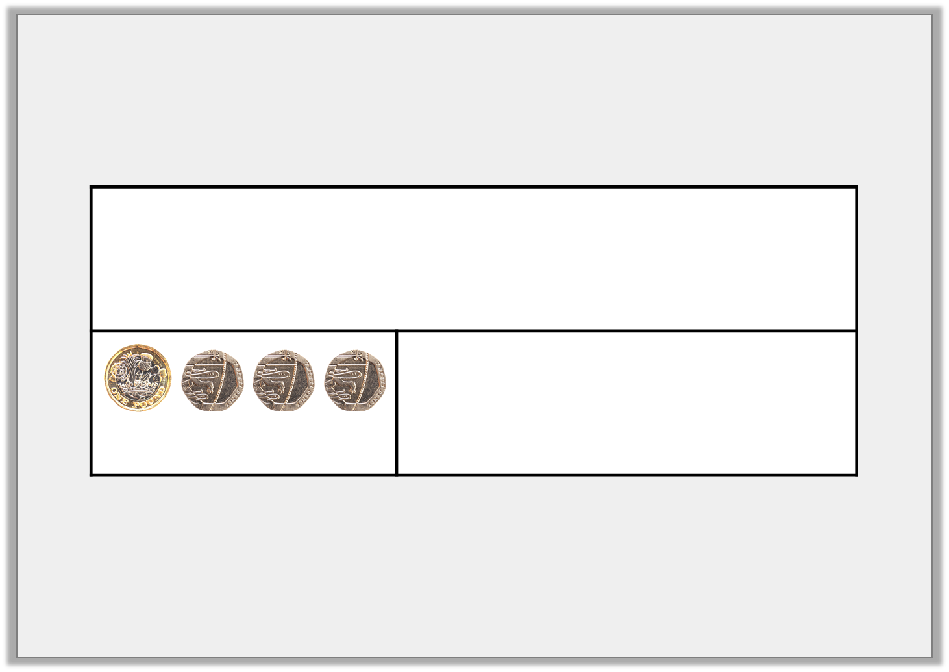
Varied Fluency 3
Saoirse had £7 and 85p in her piggy bank. She spent £1 and 60p. Complete the bar model to show how much she has left.
= £1 and 60p
© Classroom Secrets Limited 2019

Slide 18
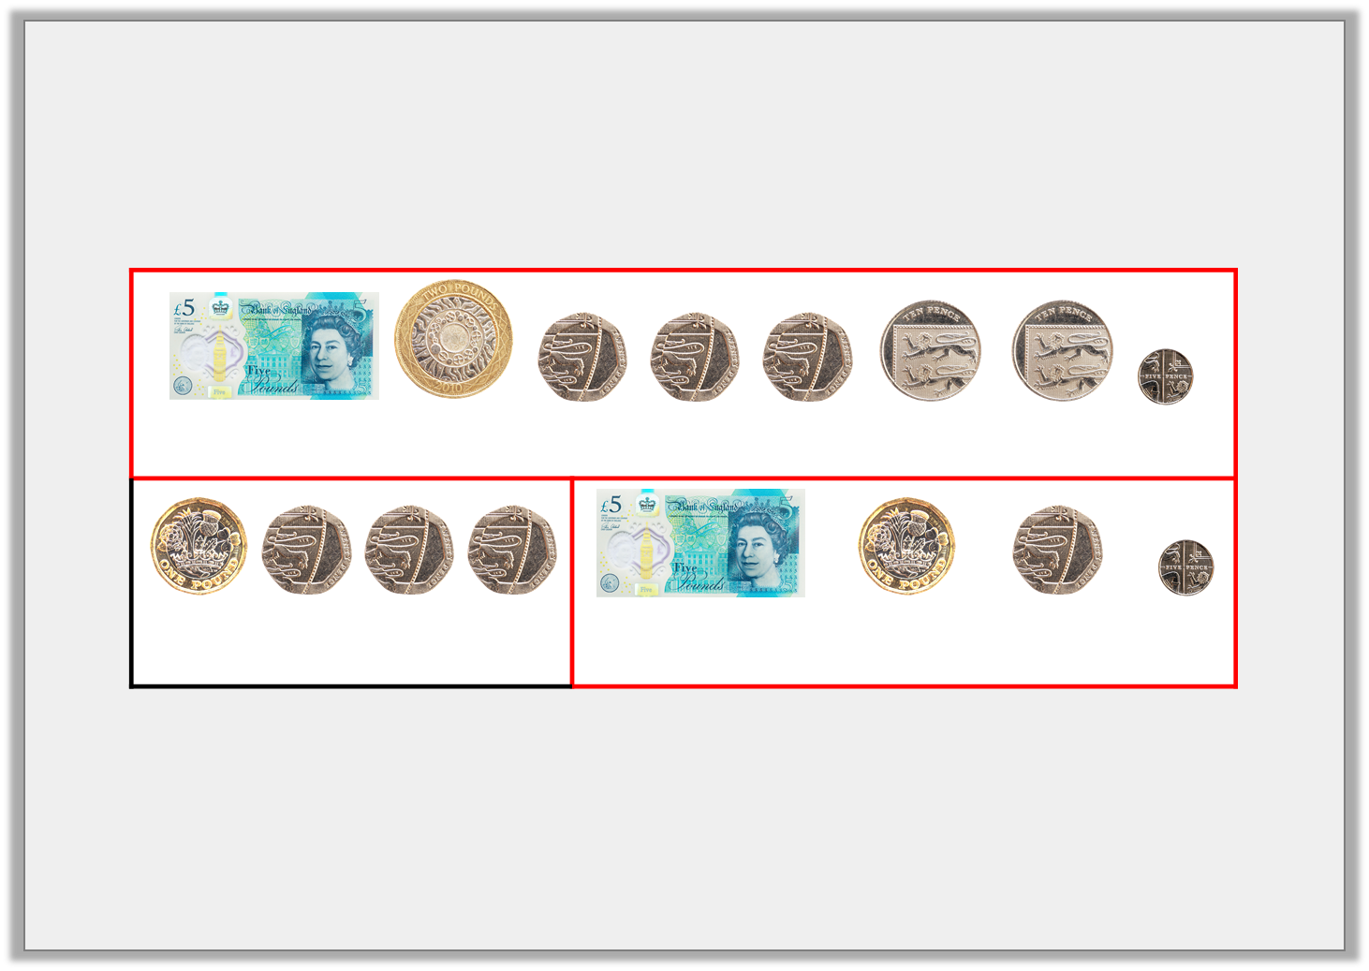
Varied Fluency 3
Saoirse had £7 and 85p in her piggy bank. She spent £1 and 60p. Complete the bar model to show how much she has left.
Saoirse has £6 and 25p left.
= £7 and 85p
= £1 and 60p
= £6 and 25p
© Classroom Secrets Limited 2019

Slide 19
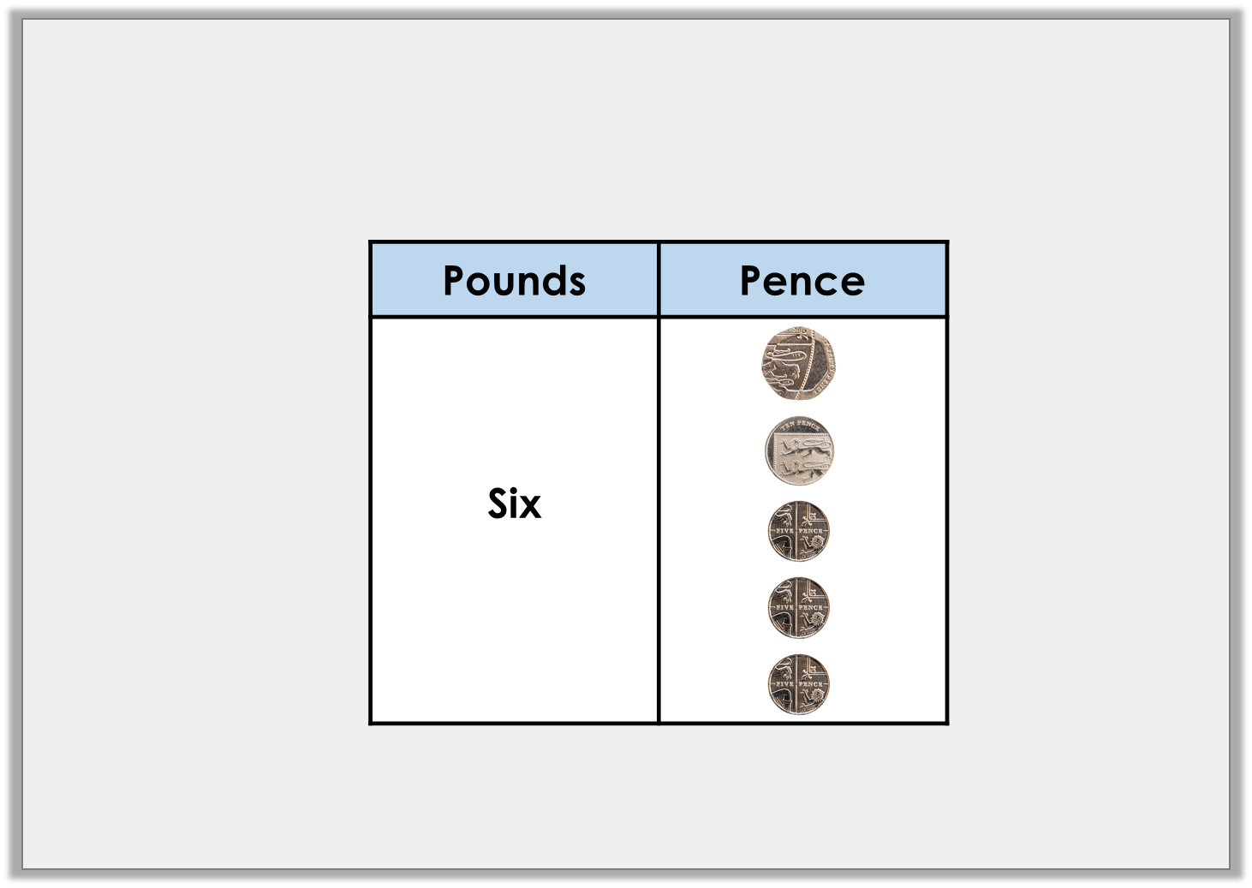
Varied Fluency 4
Take away £2 and 65p from the amount shown below.
How much is left?
© Classroom Secrets Limited 2019

Slide 20
Varied Fluency 4
Take away £2 and 65p from the amount shown below.
How much is left?
£6 and 45p – £2 and 65p = £3 and 80p
© Classroom Secrets Limited 2019

Slide 21

Reasoning 1
Luke and Viola have saved some money.
How much more money does Viola have than Luke?
Explain how you know.
I have £4 and 30p.
Luke
I have £8 and 85p.
Viola
© Classroom Secrets Limited 2019

Slide 22
Reasoning 1
Luke and Viola have saved some money.
How much more money does Viola have than Luke?
Explain how you know.
Viola has £4 and 55p more than Luke because…
I have £4 and 30p.
Luke
I have £8 and 85p.
Viola
© Classroom Secrets Limited 2019

Slide 23
Reasoning 1
Luke and Viola have saved some money.
How much more money does Viola have than Luke?
Explain how you know.
Viola has £4 and 55p more than Luke because £8 and 85p – £4 and 30p = £4 and 55p.
I have £4 and 30p.
Luke
I have £8 and 85p.
Viola
© Classroom Secrets Limited 2019

Slide 24

Reasoning 2
Errol says,
Explain the mistake that Errol has made.
I have £7 and 25p and I spend £3 and 60p on some popcorn. This means I will have
£3 and 60p left.
40p
£3
25p
£3 and
60p
£4
£7
£7 and
25p
© Classroom Secrets Limited 2019

Slide 25
Reasoning 2
Errol says,
Explain the mistake that Errol has made.
Errol has subtracted £3 and 65p…
I have £7 and 25p and I spend £3 and 60p on some popcorn. This means I will have
£3 and 60p left.
40p
£3
25p
£3 and
60p
£4
£7
£7 and
25p
© Classroom Secrets Limited 2019

Slide 26
Reasoning 2
Errol says,
Explain the mistake that Errol has made.
Errol has subtracted £3 and 65p in total, rather than £3 and 60p. The correct subtraction is: £7 and 25p – £3 and 60p = £3 and 65p.
I have £7 and 25p and I spend £3 and 60p on some popcorn. This means I will have
£3 and 60p left.
40p
£3
25p
£3 and
60p
£4
£7
£7 and
25p
© Classroom Secrets Limited 2019

Slide 27

Problem Solving 1
Find possible values of the hidden digits. Complete the subtraction using 4 of the cards below.
Find two possible solutions.
5
7
6
£ |  | and |  | 5p | – | £ |  | and |  | 0p | = | £4 | and | 35p
£ |  | and |  | 5p | – | £ |  | and |  | 0p | = | £4 | and | 35p
© Classroom Secrets Limited 2019

Slide 28
Problem Solving 1
Find possible values of the hidden digits. Complete the subtraction using 4 of the cards below.
Find two possible solutions.
Two different solutions are shown above.
5
7
6
£ | 7 | and | 5 | 5p | – | £ | 3 | and | 2 | 0p | = | £4 | and | 35p
£ | 5 | and | 6 | 5p | – | £ | 1 | and | 3 | 0p | = | £4 | and | 35p
© Classroom Secrets Limited 2019

Slide 29
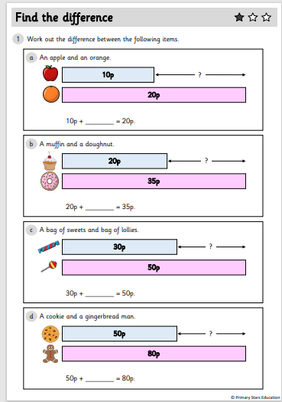
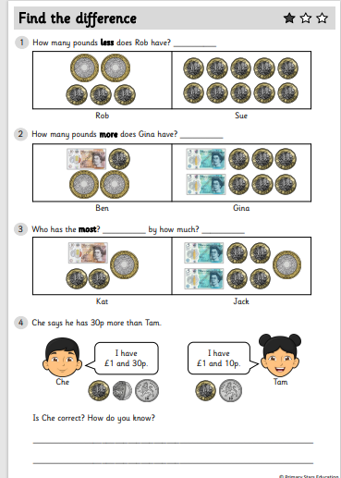
Y2 Activity :
Complete the worksheet, you have two sheets to complete. The first sheet is finding the difference.
The second sheet is looking at problem solving questions.

Slide 30
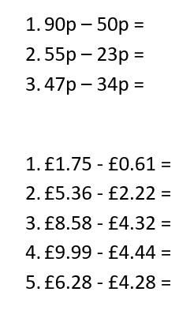
Y3 Activity:
Complete the worksheet. Choose the level you are most comfortable with.
You need to show your method in your book.
Notes:
Model on next slide how to layout work

Slide 31


