Slide 1
Money
W.B 6th December

Slide 2
Y2 LO: To be able to find a total.
Y3 LO: To be able to add money accurately.
I can recognise the value of coins notes.
I can discuss different ways to find totals.
I can practice using different methods to find a total.
I can recognise the value of coins and notes.
I can remember to convert pence to pounds.
I can practice using different methods to add money accurately.

Slide 3
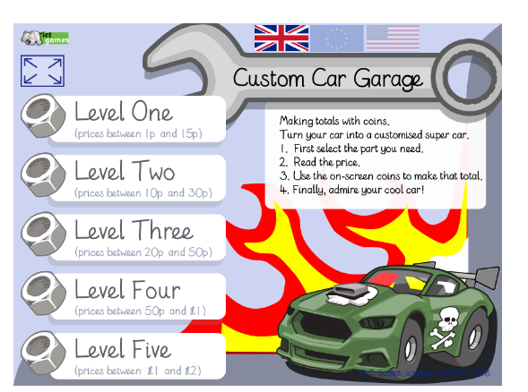
Starter:
Notes:
Select coins to pay for a given amount. Have children to write the addition sum on their whiteboards.
http://www.ictgames.com/payForIt/index.html

Slide 4

Fluency
Complete the table.
Pounds | Pence | Total
£1 | 10p | £________ and ________p
£2 | 35p | £________ and ________p
£________ | 75p | £2 and ________p
£________ | 50p | £3 and ________p
£4 | ________p | £________ and 5p
£5 | ________p | £________ and 60p
1
10
2
35
2
75
3
50
5
4
60
5

Slide 5


Fluency
Mo buys an apple and a banana.
30p
45p
0
75
How much does he spend? £________ and ________p
Notes:
Model different methods on whiteboards and ask chd to show you

Slide 6



Fluency
Sue buys an doughnut, slice of cake and a cookie.
50p
80p
30p
1
60
How much does she spend? £________ and ________p

Slide 7



Fluency
Kat buys a shoes, a t-shirt and a jumper.
£10
£7
£5 and 75p
22
75
How much does she spend? £________ and ________p

Slide 8
Fluency
Complete the bar models.
10p | 5p | 5p
20p
£1 | £1 | 10p
£2 and 10p

Slide 9
Fluency
Complete the bar models.
£17
£2
£5
£10
£45
£15
£15
£15

Slide 10



Reasoning
What is the total of:
£1 and 50p
£1 and 25p
£2
a) Hat and the socks? £________ and ________p.
3
50
b) Gloves and the socks? £_______ and _______p.
2
75
c) The total of all the items is £5 and 75p. True or false?
False, the total of all the items is £4 and 75p.

Slide 11
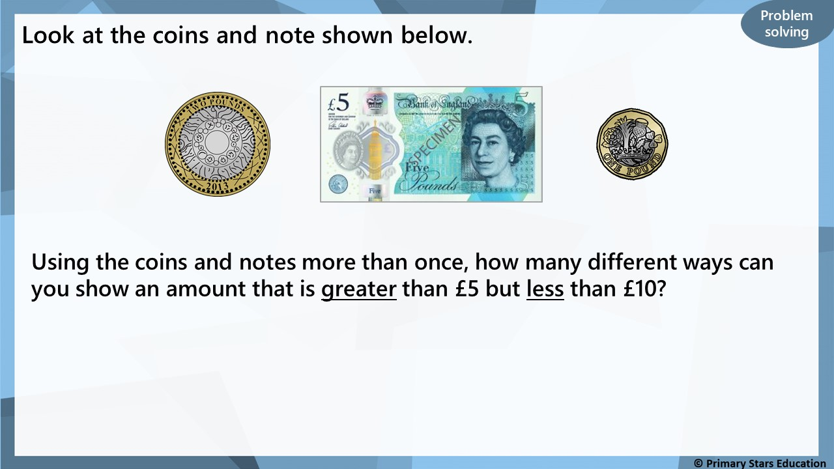
Any combinations of the above coins and note that amount to more than £5 but less than £10, for example:
£5, £2 = £7 OR £2, £2, £2 = £6 OR £1, £1, £1, £5 = £8

Slide 12


Varied Fluency 1
Complete the addition represented on this number line.
£5 and 35p | + |  | =
65p
£2 and 85p
£5 and 35p
© Classroom Secrets Limited 2019

Slide 13
Varied Fluency 1
Complete the addition represented on this number line.
£5 and 35p | + | £3 and 50p | = | £8 and 85p
65p
£2 and 85p
£5 and 35p
£6
£8 and 85p
© Classroom Secrets Limited 2019

Slide 14
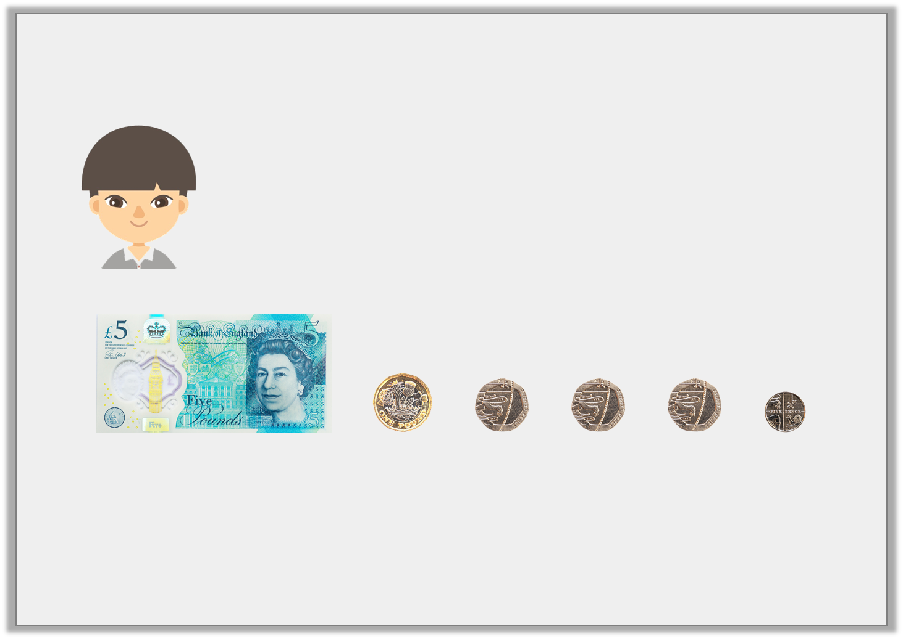
Varied Fluency 2
Jilani says,
His friend gives him £1 and 90p more.
How much does he have altogether?
This is how much money I have in my pocket.
© Classroom Secrets Limited 2019

Slide 15
Varied Fluency 2
Jilani says,
His friend gives him £1 and 90p more.
How much does he have altogether?
£6 and 65p + £1 and 90p = £8 and 55p
This is how much money I have in my pocket.
© Classroom Secrets Limited 2019

Slide 16
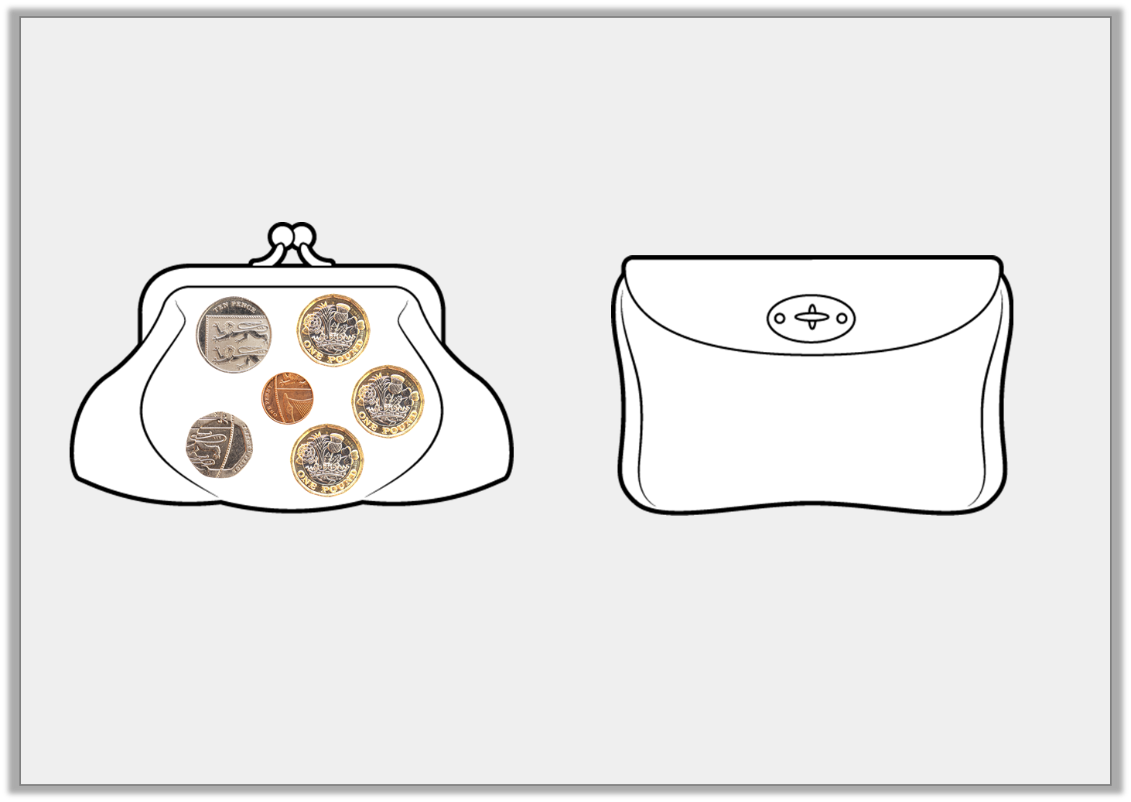
Varied Fluency 3
Find the total amount of money in these two purses.
Show your calculation.
Purse 1:
Purse 2:
+
£5 and 99p
© Classroom Secrets Limited 2019

Slide 17
Varied Fluency 3
Find the total amount of money in these two purses.
Show your calculation.
£3 and 31p + £5 and 99p = £9 and 30p
Purse 1:
Purse 2:
+
£5 and 99p
£3 and 31p | + | £5 and 99p
© Classroom Secrets Limited 2019

Slide 18
Varied Fluency 4
Complete these additions.
A. £2 and 85p | + | £4 and 35p | =
B. £5 and 22p | + | £3 and 34p | =
© Classroom Secrets Limited 2019

Slide 19
Varied Fluency 4
Complete these additions.
A. £2 and 85p | + | £4 and 35p | = | £7 and 20p
B. £5 and 22p | + | £3 and 34p | = | £8 and 56p
© Classroom Secrets Limited 2019

Slide 20
Problem Solving 1
Add any two amounts shown below, together to make a total more than £9.
Find three possibilities.
£7 and 15p
£1 and 70p
£2 and 20p
£4 and 60p
£3 and 65p
£1 and 30p
© Classroom Secrets Limited 2019

Slide 21
Problem Solving 1
Add any two amounts shown below, together to make a total more than £9.
Find three possibilities.
Various answers, for example:
£7 and 15p + £2 and 20p = £9 and 35p,
£7 and 15p + 365p = £10 and 80p
£4 and 60p + £7 and 15p = £11 and 75p.
£7 and 15p
£1 and 70p
£2 and 20p
£4 and 60p
£3 and 65p
£1 and 30p
© Classroom Secrets Limited 2019

Slide 22

Problem Solving 2
Geraint has made £8 and 60p below by adding two amounts of money together.
Help Geraint find two other ways of making £8 and 60p by adding two amounts together, using 1 note and 6 coins in total.
£5 and 35p + £3 and 25p = £8 and 60p
I used 1 note and 12 coins in total.
© Classroom Secrets Limited 2019

Slide 23
Problem Solving 2
Geraint has made £8 and 60p below by adding two amounts of money together.
Help Geraint find two other ways of making £8 and 60p by adding two amounts together, using 1 note and 6 coins in total.
Various answers, for example:
£6 and 55p (made up of: one £5 note + three 50p coins + one 5p coin) + £2 and 5p (made up of: one £2 coin + one 5p coin) = £8 and 60p
£6 and 10p (made up of: one £5 note + one £1 coin + one 10p coin) + £2 and 50p (made up of: one £2 coin + two 20p coins + one 10p coin) = £8 and 60p.
£5 and 35p + £3 and 25p = £8 and 60p
I used 1 note and 12 coins in total.
© Classroom Secrets Limited 2019

Slide 24
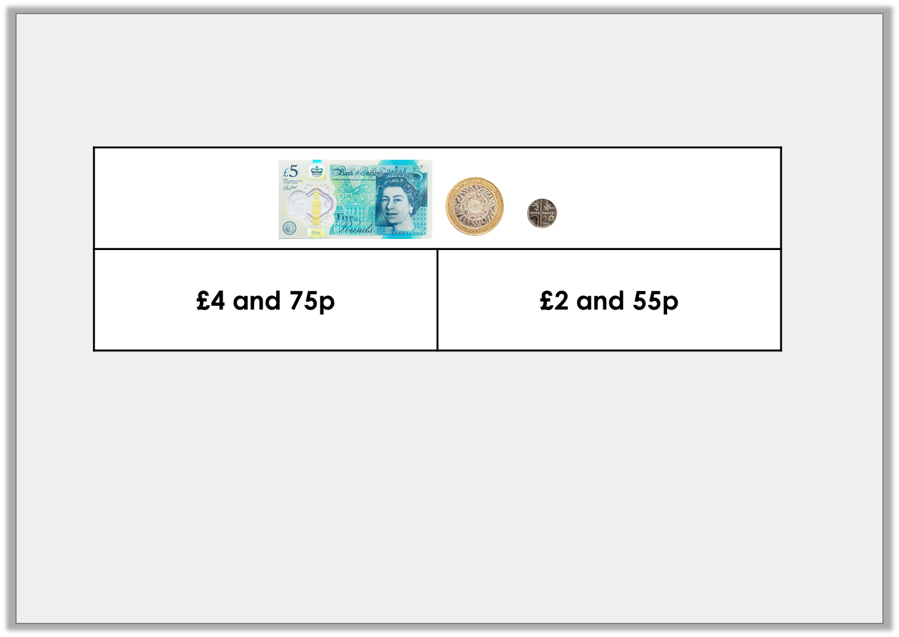
Reasoning 1
Sanjay has used this bar model to represent an addition.
He thinks he has lost two different silver coins.
Do you agree? Explain your reasoning.
© Classroom Secrets Limited 2019

Slide 25
Reasoning 1
Sanjay has used this bar model to represent an addition.
He thinks he has lost two different silver coins.
Do you agree? Explain your reasoning.
Yes, this is possible because…
© Classroom Secrets Limited 2019

Slide 26
Reasoning 1
Sanjay has used this bar model to represent an addition.
He thinks he has lost two different silver coins.
Do you agree? Explain your reasoning.
Yes, this is possible because the difference is 25p which can be made with two different silver coins (20p and 5p).
© Classroom Secrets Limited 2019

Slide 27
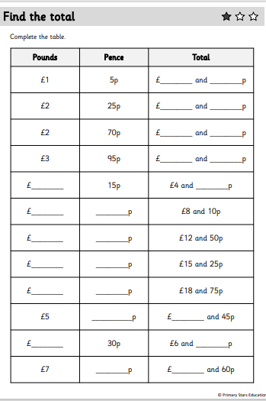
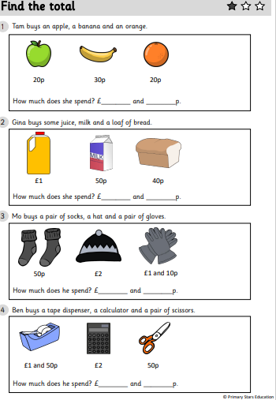
Y2 Activity :
Complete the worksheet, you have two sheets to complete. The first sheet is adding totals.
The second sheet is looking at problem solving questions.

Slide 28
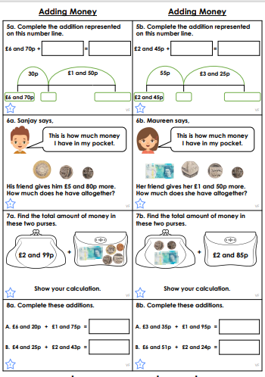
Y3 Activity:
Complete the worksheet. Choose the level you are most comfortable with.

