Slide 1
Money
W.B 6th December

Slide 2
Y2 LO: To be able to compare amounts with a focus on money.
Y3 LO: To be able to convert pounds and pence.
I can find the total.
I can use ‘>, < and =’ to compare.
I can discuss why an amount has the greatest value.
I know how many pence is in a pound.
I can convert pennies into pounds.
I can complete problem solving questions using my learning.

Slide 3
Starter:
£1.84
Notes:
Ask chd on whiteboards to make this amount in a range of different ways.

Slide 4
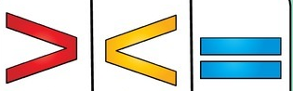
Notes:
Ask chd to use correct vocab to explain the symbols

Slide 5
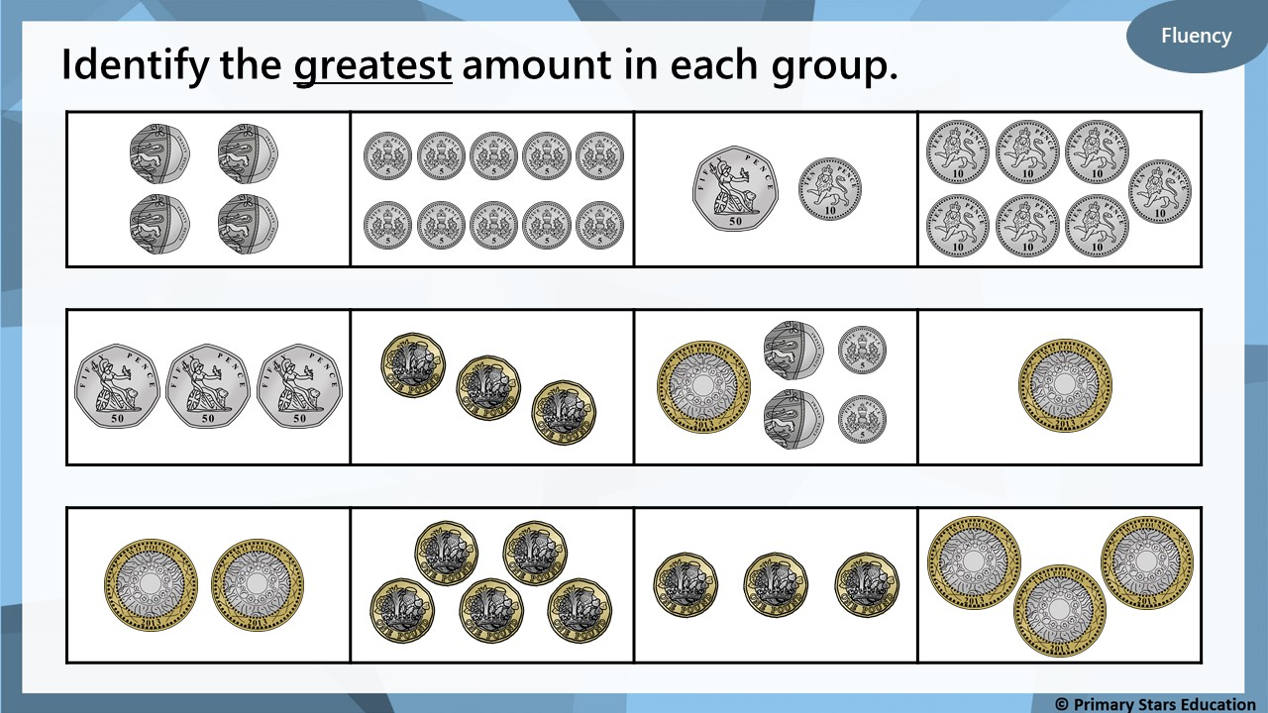

Slide 6
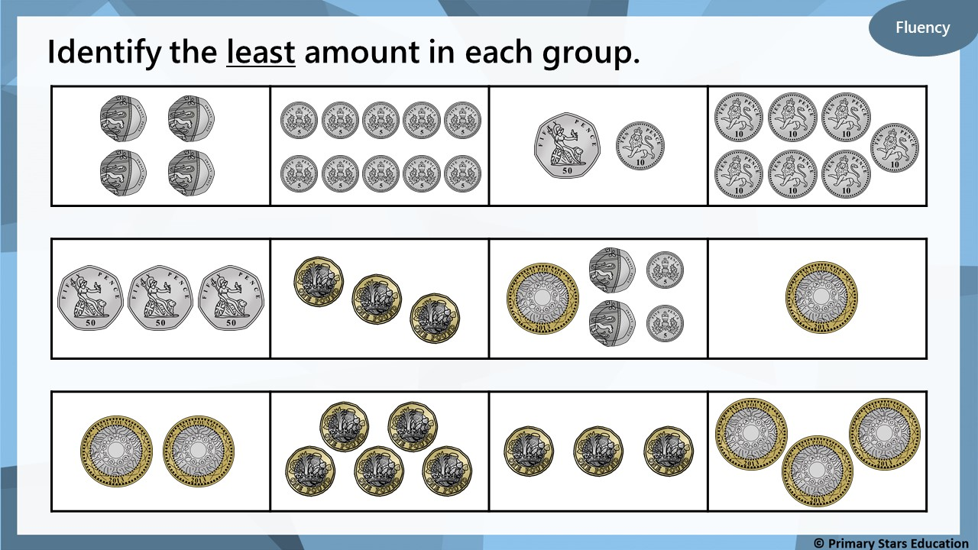

Slide 7
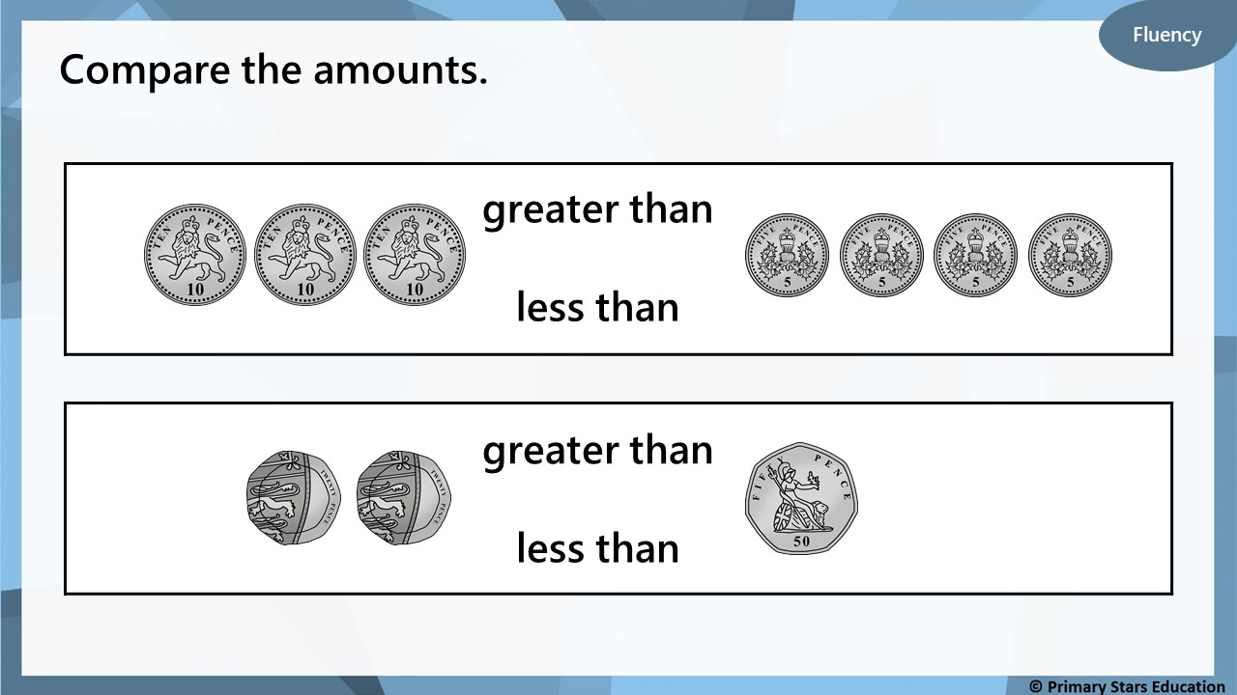

Slide 8
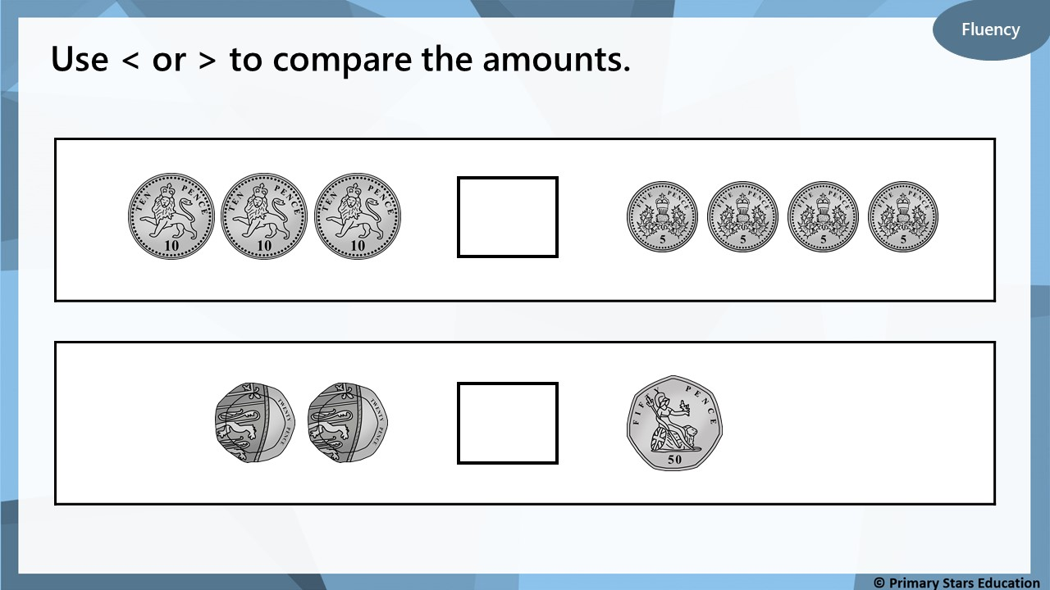
>
<

Slide 9

Reasoning
Who has the most and who has the least?
I have £10.
I have 10p.
Beth
Gina
How do you know?
Beth has the most and Gina has the least.
Beth’s amount is in pounds whereas Gina’s is in pence.
£10 is more than 10p.

Slide 10

Problem solving
Put coins in the boxes to show…
3 copper coins > 1 silver coin
>
How many different ways are there?

Slide 11


Varied Fluency 1
Complete the amounts to make them equal.
A. | 418p | = | ________ and ________
B. | __________ p | = | £5 and 92p
C. | £7 and 26p | = | __________ p
© Classroom Secrets Limited 2019

Slide 12
Varied Fluency 1
Complete the amounts to make them equal.
A. | 418p | = | £4 and 18p
B. | 592p | = | £5 and 92p
C. | £7 and 26p | = | 726p
© Classroom Secrets Limited 2019

Slide 13
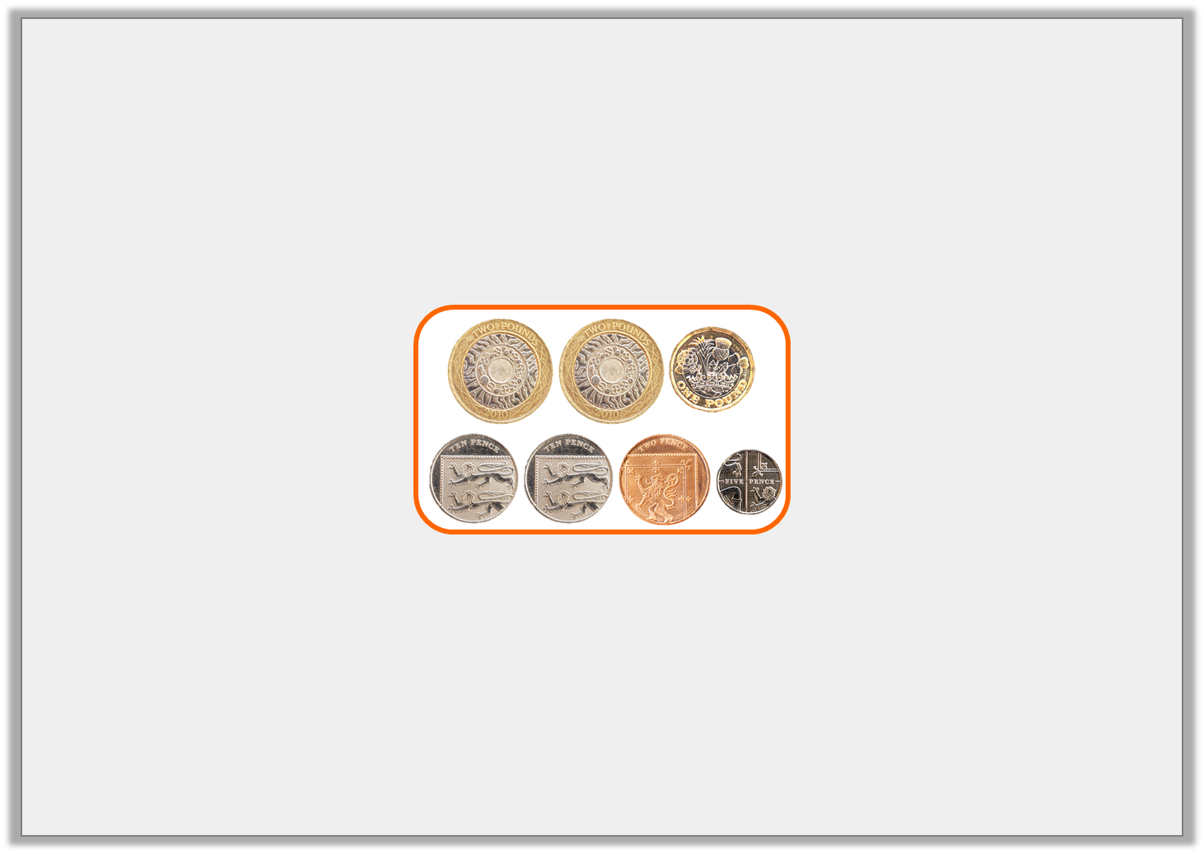
Varied Fluency 2
Circle the amount that will complete the statement.
823p
£7 and 9p
£7 and 81p | <
© Classroom Secrets Limited 2019

Slide 14

Varied Fluency 2
Circle the amount that will complete the statement.
823p
£7 and 9p
£7 and 81p | < | 823p
© Classroom Secrets Limited 2019

Slide 15
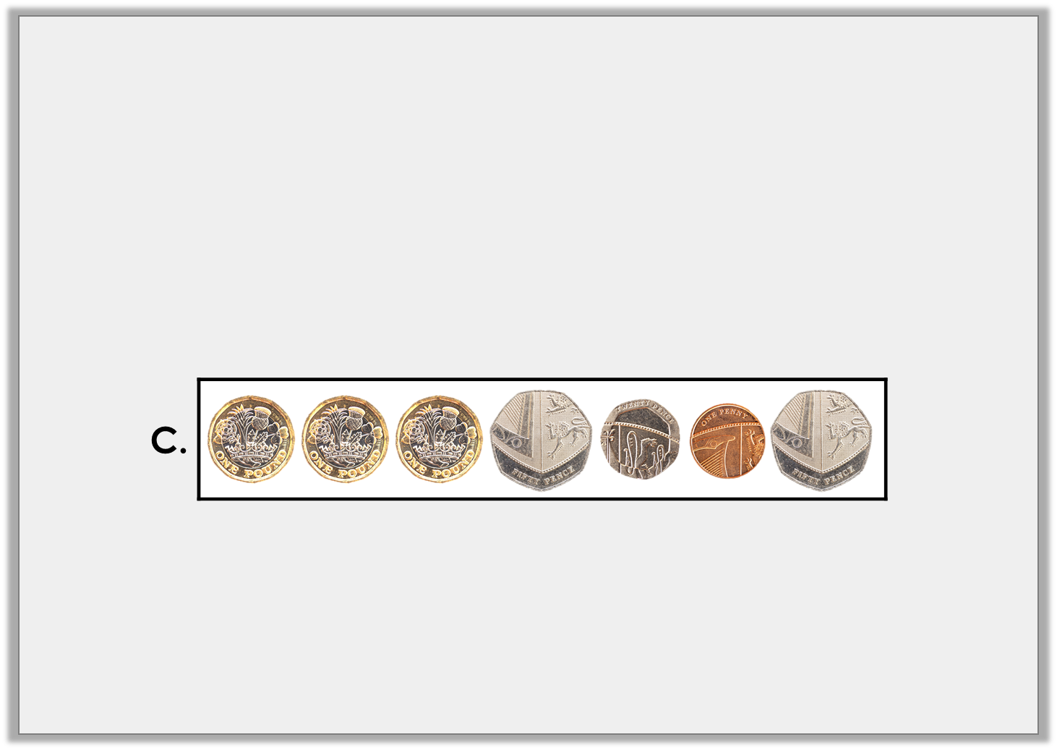
Varied Fluency 3
Put these amounts in order from the smallest to the largest.
A. | £4 and 46p
B. | 391p
© Classroom Secrets Limited 2019

Slide 16
Varied Fluency 3
Put these amounts in order from the smallest to the largest.
B, C, A
A. | £4 and 46p
B. | 391p
© Classroom Secrets Limited 2019

Slide 17
Varied Fluency 4
Complete the conversion table.
Pounds and Pence | Pence
£2 and 56p | _______ p
________ and ________ | 763p
£5 and 10p | _______ p
________ and ________ | 484p
© Classroom Secrets Limited 2019

Slide 18
Varied Fluency 4
Complete the conversion table.
Pounds and Pence | Pence
£2 and 56p | 256p
£7 and 63p | 763p
£5 and 10p | 510p
£4 and 84p | 484p
© Classroom Secrets Limited 2019

Slide 19
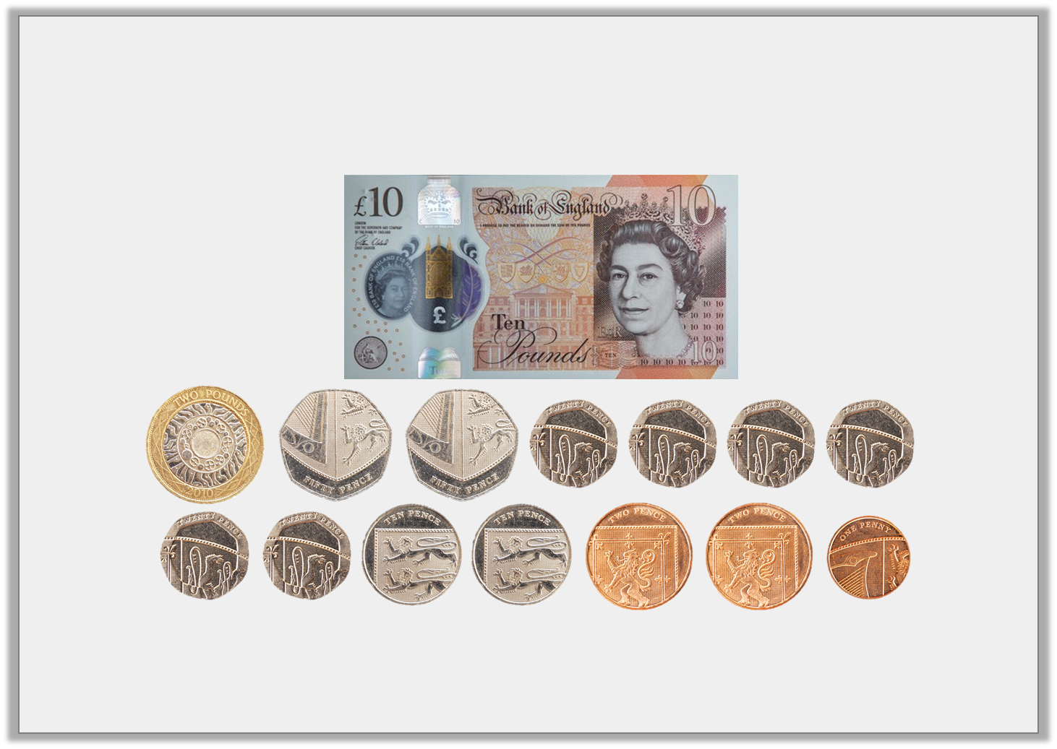
Reasoning 1
Fay has these coins in her pocket. Does she have enough money to buy a watch that costs £14 and 63p? Convince me.
© Classroom Secrets Limited 2019

Slide 20
Reasoning 1
Fay has these coins in her pocket. Does she have enough money to buy a watch that costs £14 and 63p? Convince me.
Fay has £10 and 445p…
© Classroom Secrets Limited 2019

Slide 21
Reasoning 1
Fay has these coins in her pocket. Does she have enough money to buy a watch that costs £14 and 63p? Convince me.
Fay has £10 and 445p = £14 and 45p. £14 and 45p is less than £14 and 63p so she doesn’t have enough money.
© Classroom Secrets Limited 2019

Slide 22

Reasoning 2
Theresa and Hardin are converting 407p into pounds and pence.
They say,
Who is correct? Explain why.
I think 407p =
£40 and 7p.
Theresa
I think 407p =
£4 and 7p.
Hardin
© Classroom Secrets Limited 2019

Slide 23
Reasoning 2
Theresa and Hardin are converting 407p into pounds and pence.
They say,
Who is correct? Explain why.
Hardin is correct because…
I think 407p =
£40 and 7p.
Theresa
I think 407p =
£4 and 7p.
Hardin
© Classroom Secrets Limited 2019

Slide 24
Reasoning 2
Theresa and Hardin are converting 407p into pounds and pence.
They say,
Who is correct? Explain why.
Hardin is correct because he has recognised that 400p = £4 so 407p = £4 and 7p.
I think 407p =
£40 and 7p.
Theresa
I think 407p =
£4 and 7p.
Hardin
© Classroom Secrets Limited 2019

Slide 25
Problem Solving 1
Azra has 4 different coins in her purse; a £1 coin, a 50p and 2 other coins.
How much money could be in the purse? Write 3 possible answers.
Written in pounds and pence | Written in pence
© Classroom Secrets Limited 2019

Slide 26
Problem Solving 1
Azra has 4 different coins in her purse; a £1 coin, a 50p and 2 other coins.
How much money could be in the purse? Write 3 possible answers.
Various answers, for example: See table.
Written in pounds and pence | Written in pence
£3 and 51p | 351p
£1 and 72p | 172p
£1 and 65p | 165p
© Classroom Secrets Limited 2019

Slide 27
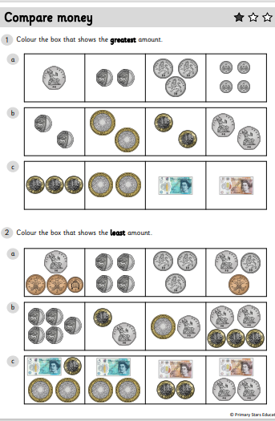
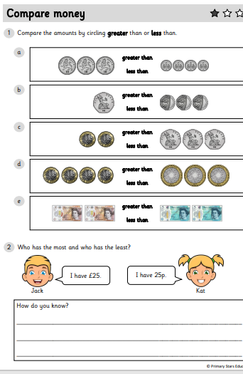
Y2 Activity :
Complete the worksheet, you have two sheets to complete. The first sheet is comparing amounts.
The second sheet is looking at problem solving questions.

Slide 28
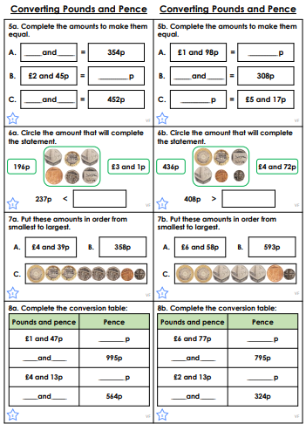
Y3 Activity:
Complete the worksheet. Choose the level you are most comfortable with.
Once it has been marked, complete the problem solving sheet.

