Slide 1
Y3 LO: To be able to multiply 2 digits by 1 digit with exchange.
Y2 LO: To consolidate what we have learnt so far.
I can use my knowledge of the times tables I know to complete double digit multiplication.
I can complete multiplication using the column method.
I can use my knowledge of exchanging to complete calculations.

Slide 2
Year 2:
In pairs, you are going to try and complete the investigations. You are using what you have learnt so far this term.
What have we learnt so far?

Slide 3
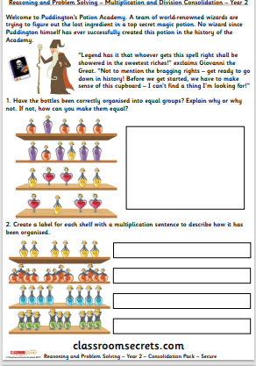

Slide 4
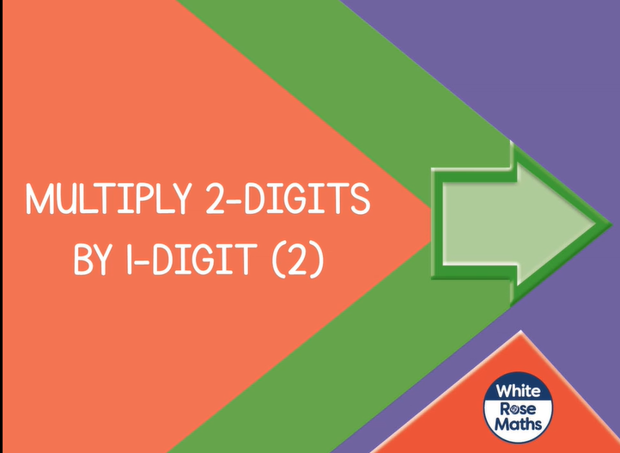
Year 3:
Spr3.2.2 - Multiply 2-digits by 1-digit (2) on Vimeo

Slide 5




Introduction
Match the calculation to the correct answer.
+
93
+
+
82
+
+
+
28
+
+
+
88
+
© Classroom Secrets Limited 2019

Slide 6
Introduction
Match the calculation to the correct answer.
+
93
+
+
82
+
+
+
28
+
+
+
88
+
© Classroom Secrets Limited 2019

Slide 7


Varied Fluency 1
There are 24 pencils in a packet. Mr Lund buys 8 packets.
How many pencils does Mr Lund have?
 | + |  | + |  | + |  | + |  | + |  | + |  | + |  | =
 |  | 2 | 4
x |  |  | 8
© Classroom Secrets Limited 2019

Slide 8
Varied Fluency 1
There are 24 pencils in a packet. Mr Lund buys 8 packets.
How many pencils does Mr Lund have?
24 x 8 = 192
24 | + | 24 | + | 24 | + | 24 | + | 24 | + | 24 | + | 24 | + | 24 | = | 192
 |  | 2 | 4
x |  |  | 8
 | 1 | 9 | 2
© Classroom Secrets Limited 2019

Slide 9
Varied Fluency 2
Complete the calculation and draw
the missing place value counters.
x |  |  | 3
Hundreds | Tens | Ones
10
10
10
10
10
1
1
© Classroom Secrets Limited 2019

Slide 10
Varied Fluency 2
Complete the calculation and draw
the missing place value counters.
 |  | 5 | 2
x |  |  | 3
 | 1 | 5 | 6
Hundreds | Tens | Ones
10
10
10
10
10
1
1
10
10
10
10
10
1
1
10
10
10
10
10
1
1
10
10
10
10
10
1
1
1
1
10
10
10
10
10
100
1
1
10
10
10
10
10
© Classroom Secrets Limited 2019

Slide 11
Varied Fluency 3
Use the Base 10 to complete the calculation.
x |  |  | 4
Tens | Ones
© Classroom Secrets Limited 2019

Slide 12
Varied Fluency 3
Use the Base 10 to complete the calculation.
 |  | 1 | 7
x |  |  | 4
 |  | 6 | 8
 |  | ²
Tens | Ones
© Classroom Secrets Limited 2019

Slide 13
Problem Solving 1
Chloe multiplies a 2-digit number by a 1-digit number.
Which numbers did she use?
x
 | 1 | 3 | 6
26
41
4
34
3
© Classroom Secrets Limited 2019

Slide 14
Problem Solving 1
Chloe multiplies a 2-digit number by a 1-digit number.
Which numbers did she use?
 |  | 3 | 4
x |  |  | 4
 | 1 | 3 | 6
26
41
4
34
3
© Classroom Secrets Limited 2019

Slide 15


Problem Solving 2
Yan and Sasha are trying to get an answer near to the target number. Arrange their three digits to make a multiplication calculation with the nearest answer.
110
Yan
Sasha
5
4
2
3
3
8
© Classroom Secrets Limited 2019

Slide 16
Problem Solving 2
Yan and Sasha are trying to get an answer near to the target number. Arrange their three digits to make a multiplication calculation with the nearest answer.
Yan can make 54 x 2 = 108; Sasha can make 38 x 3 = 114.
Yan can get the nearest.
110
Yan
Sasha
5
4
2
3
3
8
© Classroom Secrets Limited 2019

Slide 17
Reasoning 1
Alex’s teacher asks him to find, explain and correct his mistake.
 |  | 2 | 8
x |  |  | 4
 | 8 | 3 | 2
 |  | ³
© Classroom Secrets Limited 2019

Slide 18
Reasoning 1
Alex’s teacher asks him to find, explain and correct his mistake.
 |  | 2 | 8
x |  |  | 4
 | 8 | 3 | 2
 |  | ³
© Classroom Secrets Limited 2019

Slide 19
Reasoning 1
Alex’s teacher asks him to find, explain and correct his mistake.
Alex has not added the tens he exchanged from the ones column.
The correct answer is 112.
 |  | 2 | 8
x |  |  | 4
 | 1 | 1 | 2
 |  | ³
© Classroom Secrets Limited 2019

Slide 20
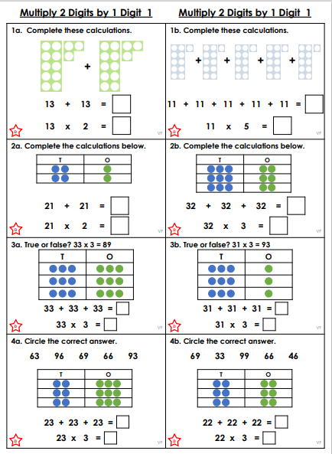
Y3 Activity one:
Complete the worksheet.

