Slide 1
Y2 LO: To identify odd and even numbers.
Y3 LO: To be able to multiply 2 digits by 1 digit.
I can recognise what makes a number even or odd.
I can sort numbers in to odd and even groups.
I can use my knowledge to answer problem solving questions.
I can use my knowledge of repeated addition to support my learning.
I can use my knowledge of the times tables I know to complete double digit multiplication.

Slide 2
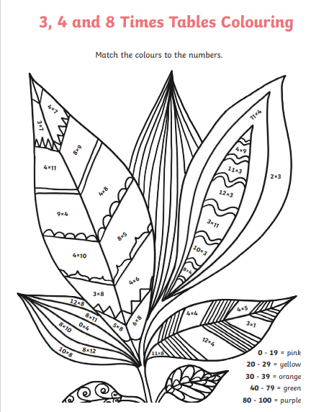
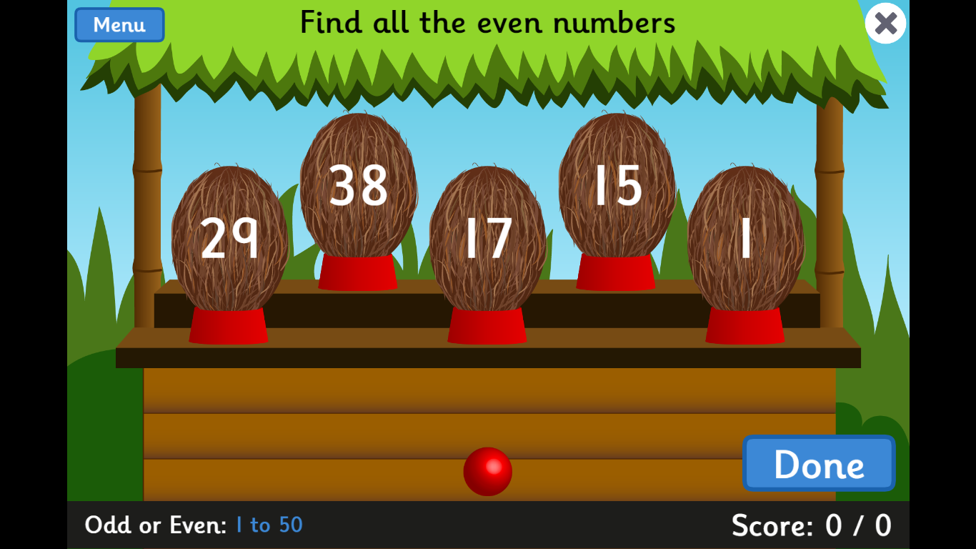
Y2 Starter:
Y3 Starter:
Notes:
https://www.topmarks.co.uk/learning-to-count/coconut-odd-or-even

Slide 3

Fluency
Put the numbers under the correct heading.
Odd | Even
1
11
6
14
3
15
8
16
9
17
12
20
3
17
20
6
14
11
16
8
15
9
12
1
Notes:
How do you find out if X is an odd or even number?
How do we know if a number is odd or even? What shows us?

Slide 4

Fluency
Which numbers are even?
15 1 60 19 22
40 29 50 9 5
58 25 3 10 7
30 87 12 11

Slide 5
Fluency
23? _______________
39? _______________
42? _______________
14? _______________
27? _______________
54? _______________
11? _______________
28? _______________
13? _______________
36? _______________
Are these numbers odd or even?
odd
even
odd
odd
even
even
even
odd
odd
even

Slide 6
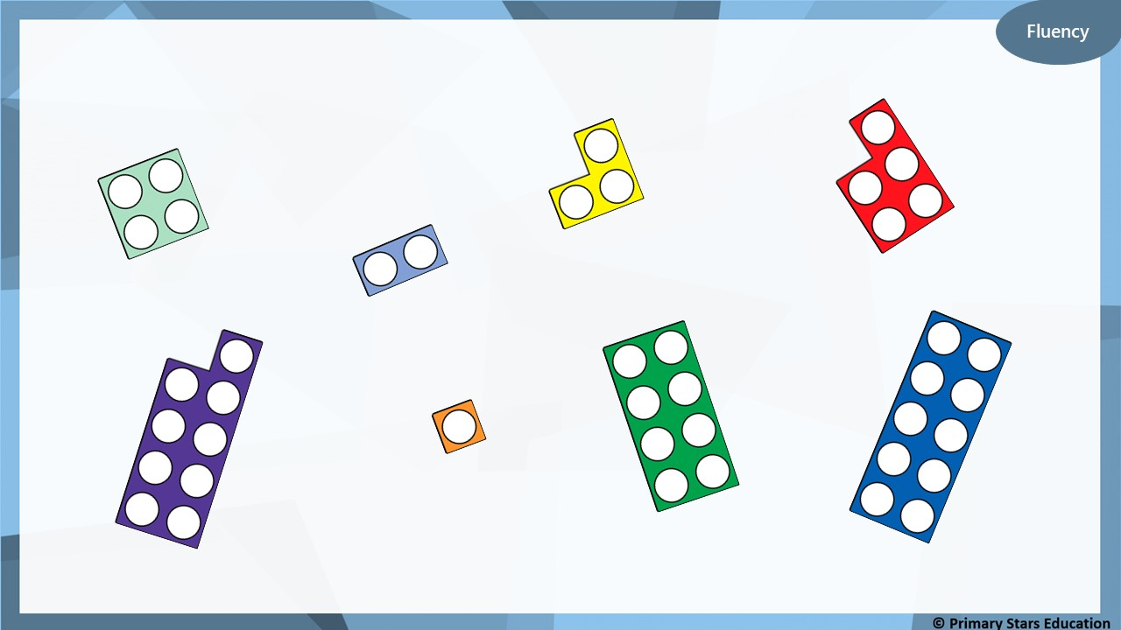
Which number frames are odd?

Slide 7
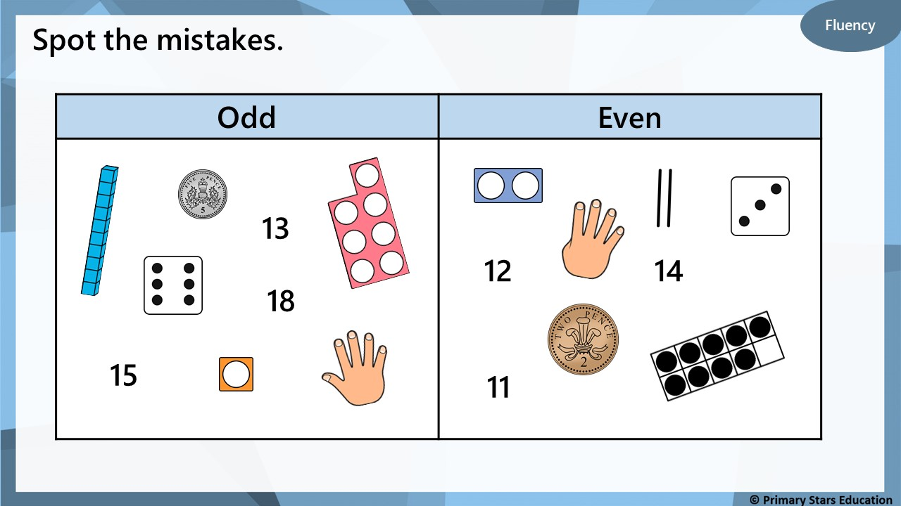

Slide 8
Reasoning
Jack has coloured 3 odd numbers yellow and 3 even
numbers red. What mistake has Jack made?
36 | 28 | 17 | 11 | 3 | 44
10 | 26 | 5 | 8 | 13 | 29
15 | 9 | 48 | 39 | 37 | 50
Jack has coloured 44 yellow.
It should not be yellow as it not an odd number.
44 is an even number.

Slide 9

Kat says,
I am thinking of an odd number between
16 and 28.
What could Kat’s numbers be?
17, 19, 21, 23, 25, 27

Slide 10
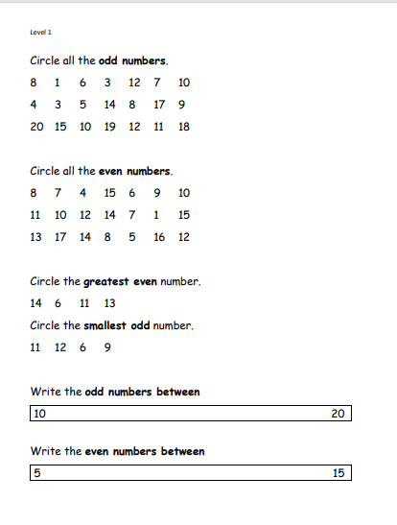
Y2 Activity one:
Complete the worksheet.

Slide 11

Can we recall our 3 times tables?
Now our 4 times tables?
Now our 8 times tables?

Slide 12


Introduction
Match the multiplication to the repeated addition.
10 + 10 + 10
12 x 3
9 + 9 + 9 + 9 + 9
10 x 3
12 + 12 + 12
2 x 4
2 + 2 + 2 + 2
5 x 9
© Classroom Secrets Limited 2018

Slide 13
Introduction
Match the multiplication to the repeated addition.
10 + 10 + 10
12 x 3
9 + 9 + 9 + 9 + 9
10 x 3
12 + 12 + 12
2 x 4
2 + 2 + 2 + 2
5 x 9
© Classroom Secrets Limited 2018

Slide 14
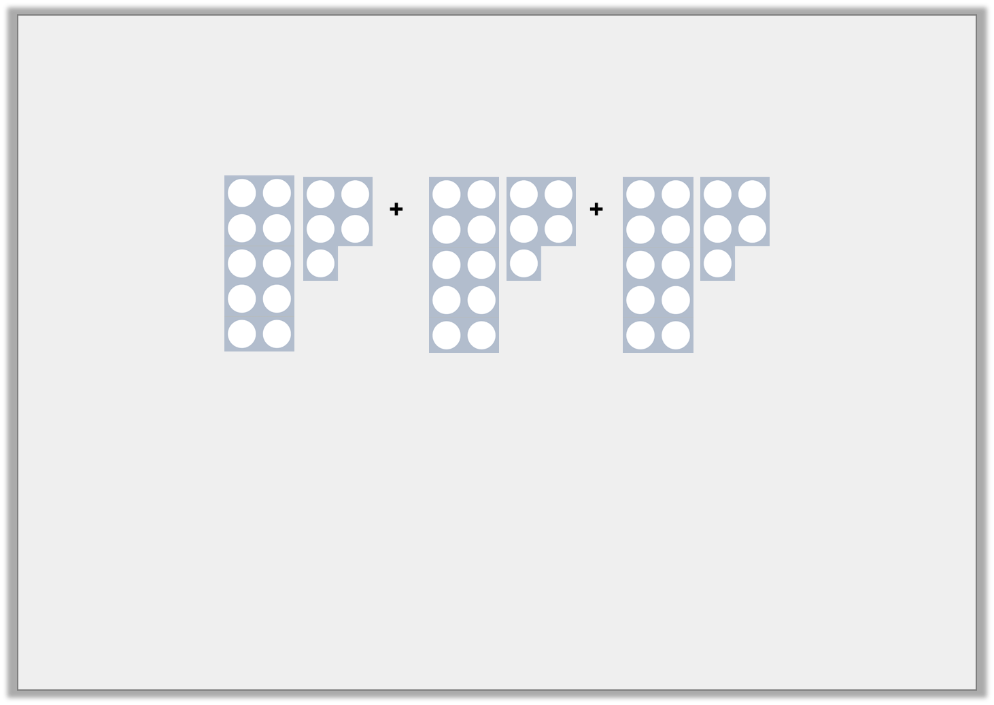
Varied Fluency 1
Complete these calculations.
 | + |  | + |  | =
 | x |  | =
© Classroom Secrets Limited 2018

Slide 15
Varied Fluency 1
Complete these calculations.
15 | + | 15 | + | 15 | = | 45
15 | x | 3 | = | 45
© Classroom Secrets Limited 2018

Slide 16
Varied Fluency 2
Complete the calculation.
T | O
 | x | 4 | =
© Classroom Secrets Limited 2018

Slide 17
Varied Fluency 2
Complete the calculation.
T | O
21 | x | 4 | = | 84
© Classroom Secrets Limited 2018

Slide 18
Varied Fluency 3
True or false? 24 x 2 = 48
48
 | T | O
 | 2 | 4
x |  | 2
1
1
10
1
10
1
1
1
10
1
10
1
© Classroom Secrets Limited 2018

Slide 19
Varied Fluency 3
True or false? 24 x 2 = 48
True
48
 | T | O
 | 2 | 4
x |  | 2
 | 4 | 8
1
1
10
1
10
1
1
1
10
1
10
1
© Classroom Secrets Limited 2018

Slide 20
Varied Fluency 4
Using the numbers below complete the calculation.
32 | 99 | 42 | 69 | 96
 | x | 3 | =
T | O
© Classroom Secrets Limited 2018

Slide 21
Varied Fluency 4
Using the numbers below complete the calculation.
32 | 99 | 42 | 69 | 96
32 | x | 3 | = | 96
T | O
© Classroom Secrets Limited 2018

Slide 22
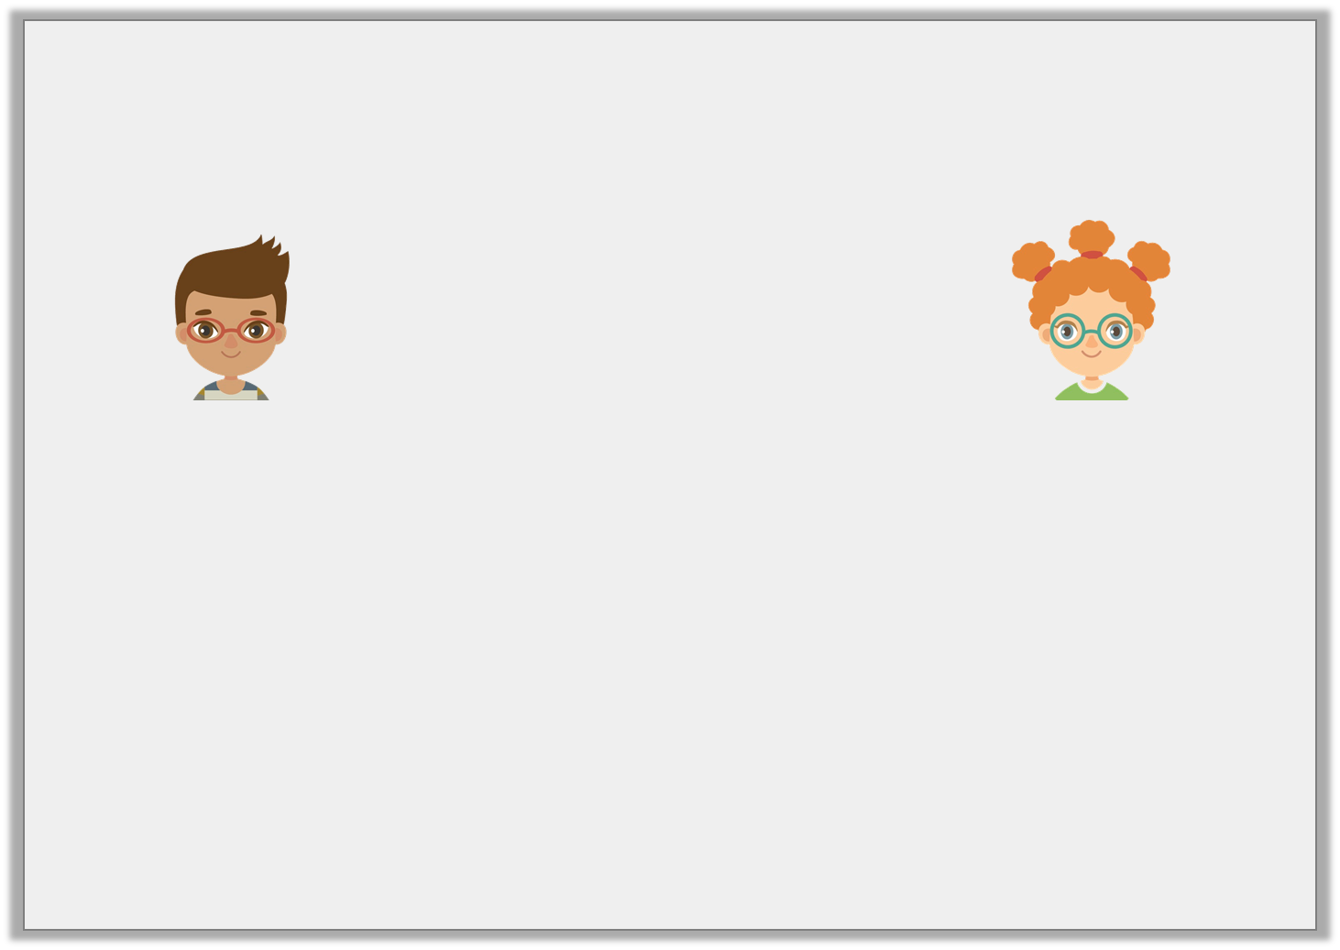
Reasoning 1
Blake and Brooke have solved the following multiplications.
Are they correct?
Explain how you know, using a place value grid to show your working.
 | T | O
 | 3 | 0
x |  | 3
 | 9 | 0
 | T | O
 | 3 | 1
x |  | 2
 | 5 | 3
Blake
Brooke
© Classroom Secrets Limited 2018

Slide 23
Reasoning 1
Blake and Brooke have solved the following multiplications.
Are they correct?
Explain how you know, using a place value grid to show your working.
 | T | O
 | 3 | 0
x |  | 3
 | 9 | 0
 | T | O
 | 3 | 1
x |  | 2
 | 5 | 3
Blake
Brooke
Blake is correct. Brooke is incorrect because…
© Classroom Secrets Limited 2018

Slide 24
Reasoning 1
Blake and Brooke have solved the following multiplications.
Are they correct?
Explain how you know, using a place value grid to show your working.
 | T | O
 | 3 | 0
x |  | 3
 | 9 | 0
 | T | O
 | 3 | 1
x |  | 2
 | 5 | 3
Blake
Brooke
Blake is correct. Brooke is incorrect because she has added the numbers together instead of multiplying them. 31 x 2 = 62.
© Classroom Secrets Limited 2018

Slide 25

Reasoning 2
Rehan is thinking of a number.
What is Rehan’s number?
Explain how you know.
I multiplied a number by 3. The answer was 36.
© Classroom Secrets Limited 2018

Slide 26
Reasoning 2
Rehan is thinking of a number.
What is Rehan’s number?
Explain how you know.
I multiplied a number by 3. The answer was 36.
Rehan’s number is 12 because…
© Classroom Secrets Limited 2018

Slide 27
Reasoning 2
Rehan is thinking of a number.
What is Rehan’s number?
Explain how you know.
I multiplied a number by 3. The answer was 36.
Rehan’s number is 12 because 3 x 12 = 36.
© Classroom Secrets Limited 2018

Slide 28
Problem Solving 1
Create and solve a calculation using the digit cards below.
 | T | O
 |  | 3
x
 | 3
9
1
3
© Classroom Secrets Limited 2018

Slide 29
Problem Solving 1
Create and solve a calculation using the digit cards below.
 | T | O
 |  | 3
x
 | 3
1
3
9
9
1
3
© Classroom Secrets Limited 2018

Slide 30
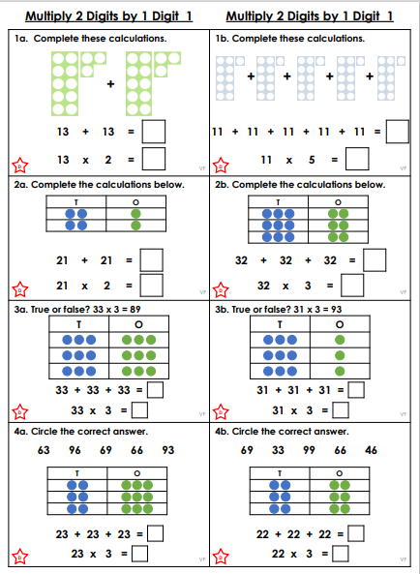
Y3 Activity one:
Complete the worksheet.

