Slide 1
Y3 LO: To be able to divide by three.
Y2 LO: To be able to make equal groups and share. (practical)
I can represent equal groups practically.
I can understand that division is a whole split into equal groups.
I can represent division as equal sharing.
I can recall and use multiplication facts for the three times tables.
I can discuss different methods to complete division.
I can choose the most suitable method to complete my calculations.

Slide 2
Starter:
With the cubes on your table, can you share them into 2 equal groups.
How many are in each group?
How did you do this?
What was the easiest method?
Is there another way?
How can you check you are correct?

Slide 3
What is division?
Dividing is sharing into equal groups. You might see it written differently in questions e.g.
divided by
share equally
equal groups of
divided into
share

Slide 4

Fluency
Share 4 counters between 2 equal groups.
4
There are _____ altogether.
There are _____ groups in total.
There are _____ in each group.
2
2

Slide 5
Fluency
Share 10 counters between 2 equal groups.
10
There are _____ altogether.
There are _____ groups in total.
There are _____ in each group.
2
5

Slide 6
Fluency
Share 9 counters between 3 equal groups.
9
There are _____ altogether.
There are _____ groups in total.
There are _____ in each group.
3
3

Slide 7
Fluency
Share 15 counters between 3 equal groups.
15
There are _____ altogether.
There are _____ groups in total.
There are _____ in each group.
3
5

Slide 8
Fluency
Share 8 counters between 4 equal groups.
8
There are _____ altogether.
There are _____ groups in total.
There are _____ in each group.
4
2

Slide 9
Fluency
Share 12 counters between 4 equal groups.
12
There are _____ altogether.
There are _____ groups in total.
There are _____ in each group.
4
3

Slide 10
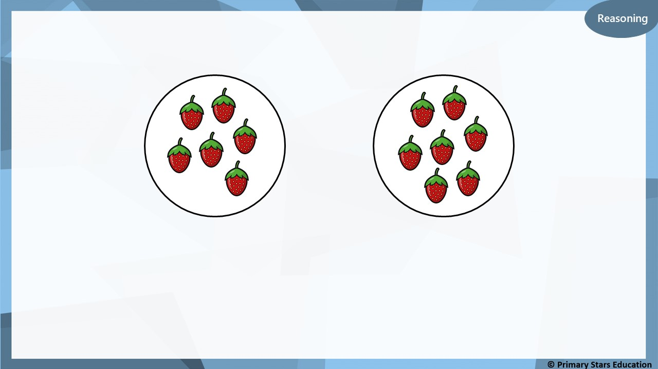
Kat is trying to share strawberries between 2 equal groups.
Group 1
Group 2
Has Kat shared them into equal groups?
Explain how you know.
No, Kat has not shared them correctly.
Group 1 shows 6. Group 2 shows 7, therefore they are not equal.

Slide 11
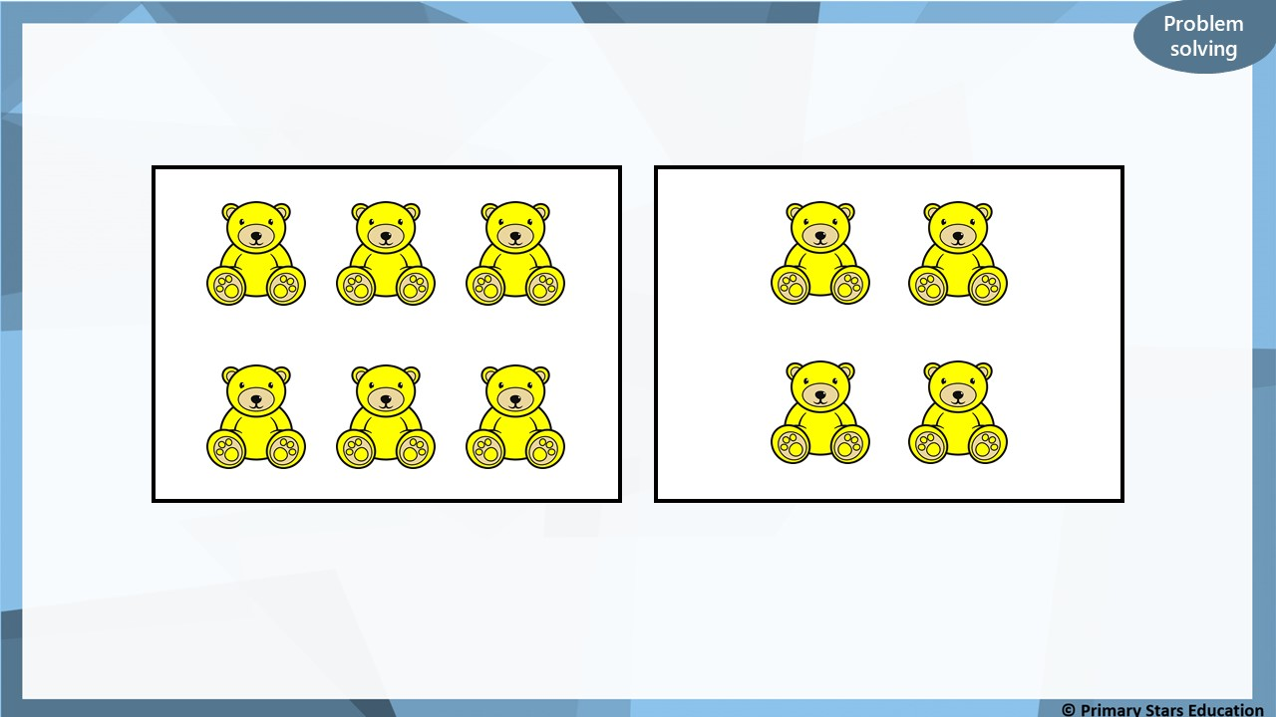
How could you make these equal groups?
Group 1
Group 2
One teddy bear could be moved from group 2 into group 1.
This will make two groups of 5.

Slide 12
Year 2 Activity:
Using counters or cubes, you need to share the objects into the equal groups.
Then complete the following sentences in your book.
There are ____ altogether.
There are ____ groups in total.
There are ____ in each group.
Level 1: share by making 2 equal groups.
Level 2: share by making 3 equal groups.
Level 3: share by making 4 equal groups.

Slide 13

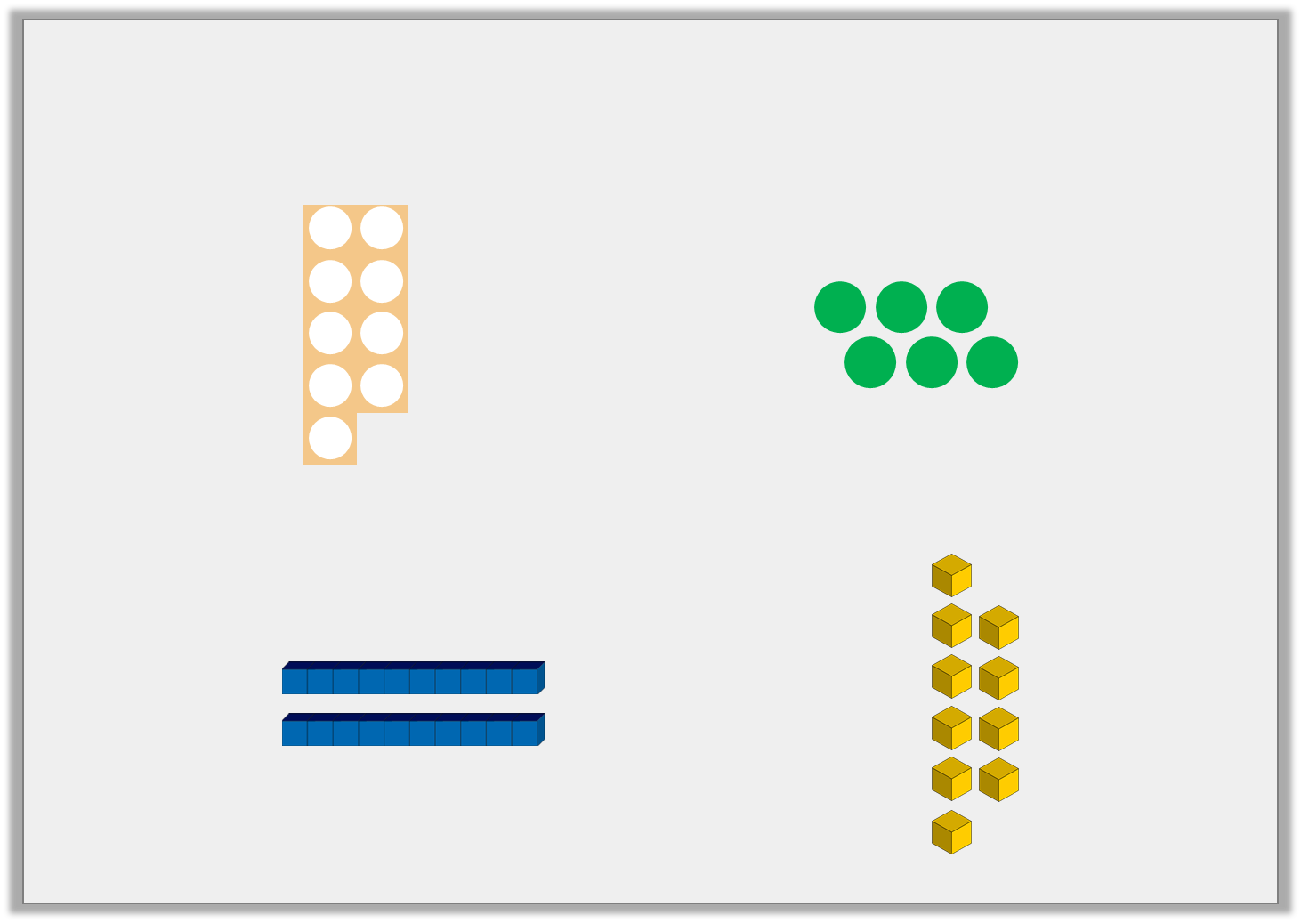

Varied Fluency 2
Circle the numbers and images that are in the 3 times table.
6
36
17
15
31
© Classroom Secrets Limited 2018

Slide 14
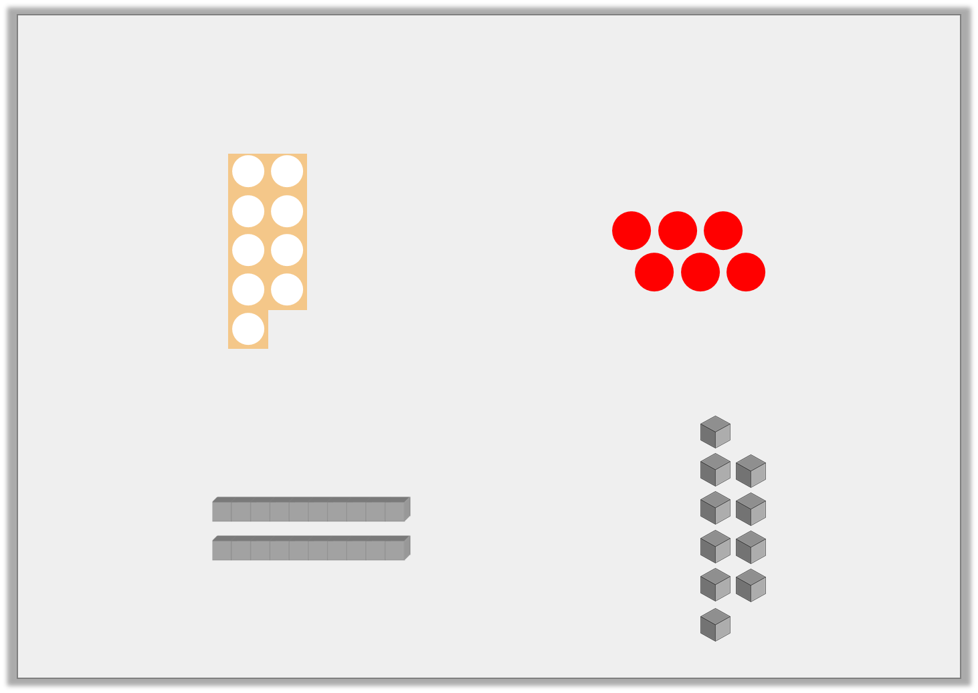
Varied Fluency 2
Circle the numbers and images that are in the 3 times table.
6
36
17
15
31
© Classroom Secrets Limited 2018

Slide 15
Different ways to divide:
Splitting into equal groups
Counting back
Groupings of a number until you reach the total number
Notes:
These are the methods we will be focusing on.

Slide 16
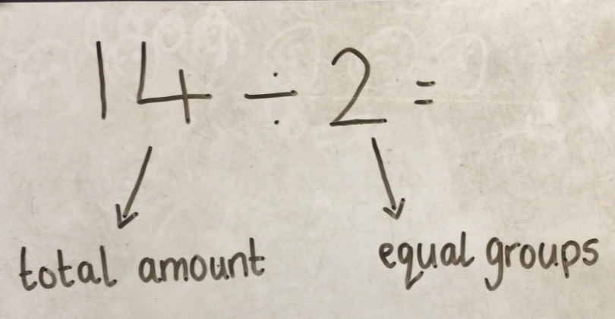
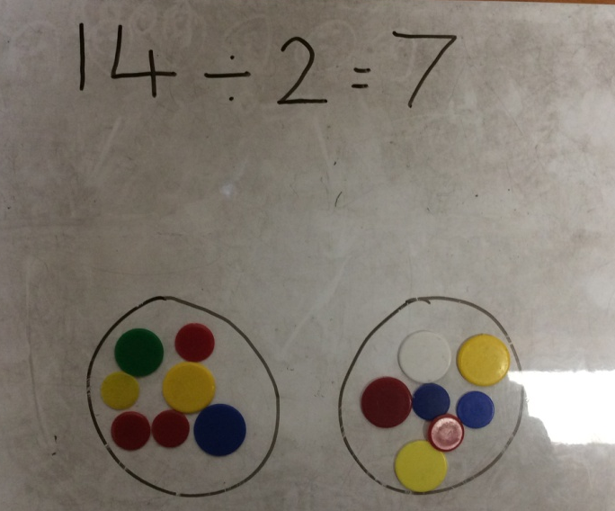
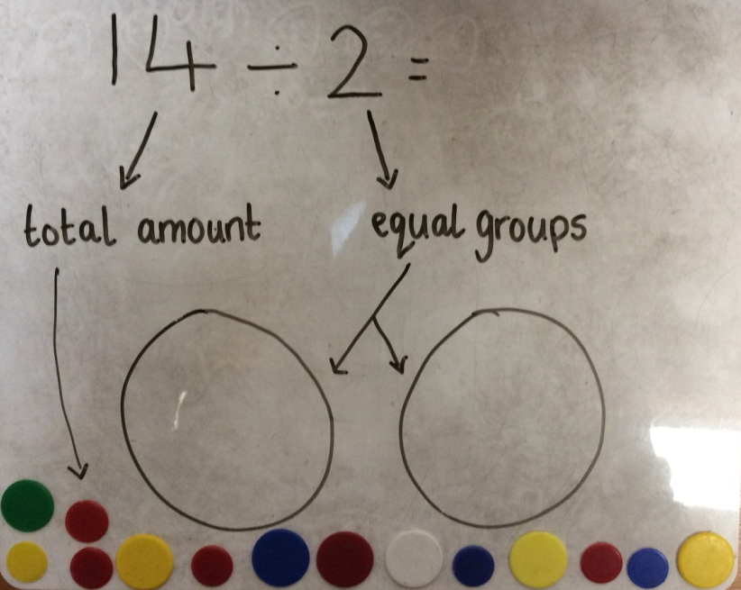
14 ÷ 2 = 7
Step 1
Step 3
Step 2
Notes:
Method one: splitting into equal groups.
show practically to chd. Remind chd that what we are dividing by is the number of groups and the first number Is the amount of cubes or counters we need.
Remind chd that commutative law does not work with division, we must follow the order of the question.
Have chd practically show it.

Slide 17
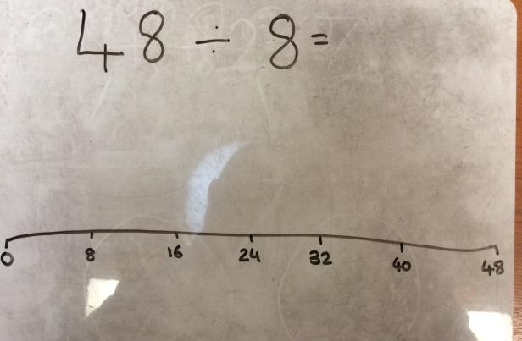
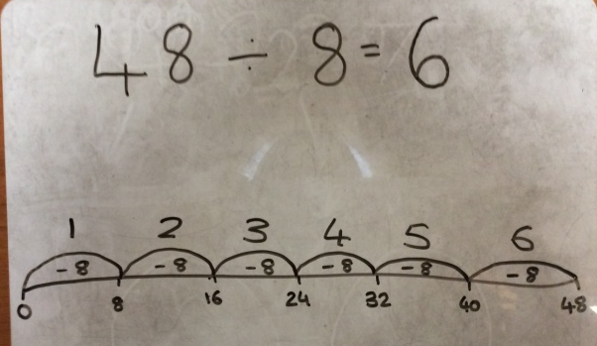
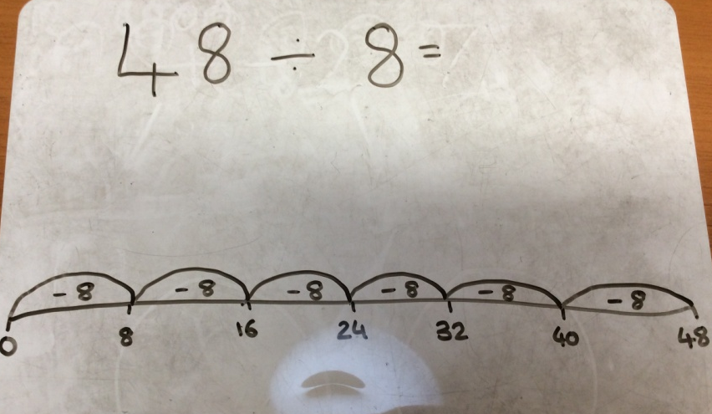
48 ÷ 8 = 6
Step 1
Step 3
Step 2
Notes:
Counting backwards method:
Draw no line with intervals of what we are dividing by to start with. Then counting back until we get to 0. We then count how many jumps which gives us our answer.
Have chd do this on a whiteboard at the same time.

Slide 18
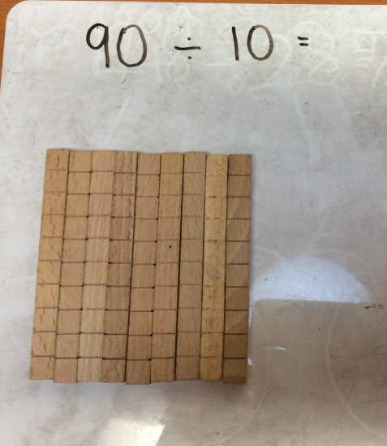
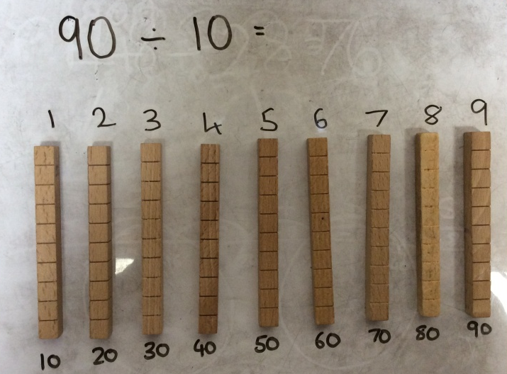
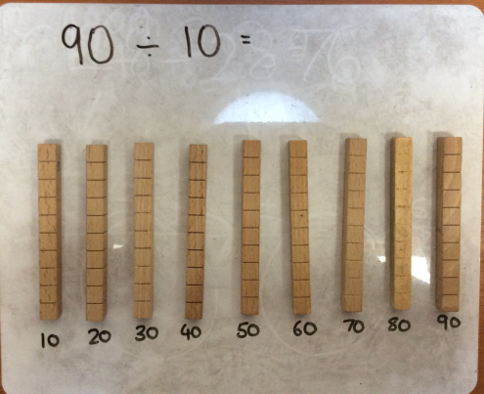
90 ÷ 10 = 9
Step 1
Step 3
Step 2
Notes:
Grouping method:
Start with cubes of the amount you are dividing- explain we have chosen 9 sticks of 10 instead of 90 ones due to it being more efficient,
Step 2 I need to make groups of 10, this is easier due to having sticks of ten.
Step 3 then I need to count how many groups of 10 I have.
Have chd complete alongside practically.

Slide 19
Year 3 Activity:
Choose your sheet of questions and complete in your book. Unless it tells you which method to use, you can choose a method we have looked at today to complete the question.
Don’t forget to use cubes or counters to help you as well.
Today we are focusing on the three times table.

Slide 20

Notes:
Model how to present in book.

Slide 21
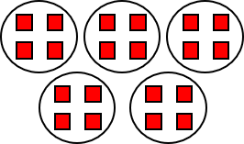
Plenary
Notes:
Ask children if they can come up with a division or multiplication sentence to describe the groups:
e.g., 20 ÷ 5 = 4 and 5 x 4 = 20.
Alternatively, children can describe the equal groups:
There are ____ altogether.
There are ____ groups in total.
There are ____ in each group.

