Slide 1
Y3 LO: To be able to multiply by eight.
Y2 LO: To recap my understanding of making doubles.
I can understand that doubling is two groups of the same number.
I can use pictorial representations to show doubling.
I can discuss doubling and how it links to repeated addition.
I can recall multiplication facts for the eight times table.
I can show my multiplication sentences pictorially.
I can answer multiplication questions using my knowledge.

Slide 2
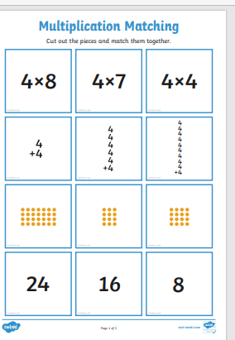
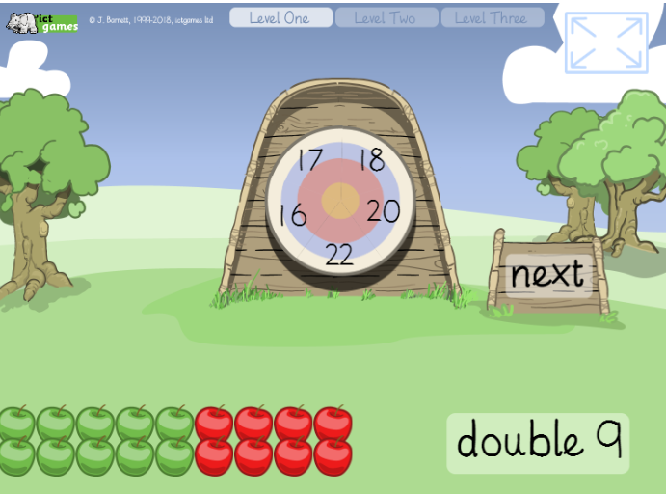
Y2 Starter:
Y3 Starter:

Slide 3


Fluency
Has this representation been doubled?
No
Notes:
They will understand that doubling is 2 groups of the same amount / number.

Slide 4
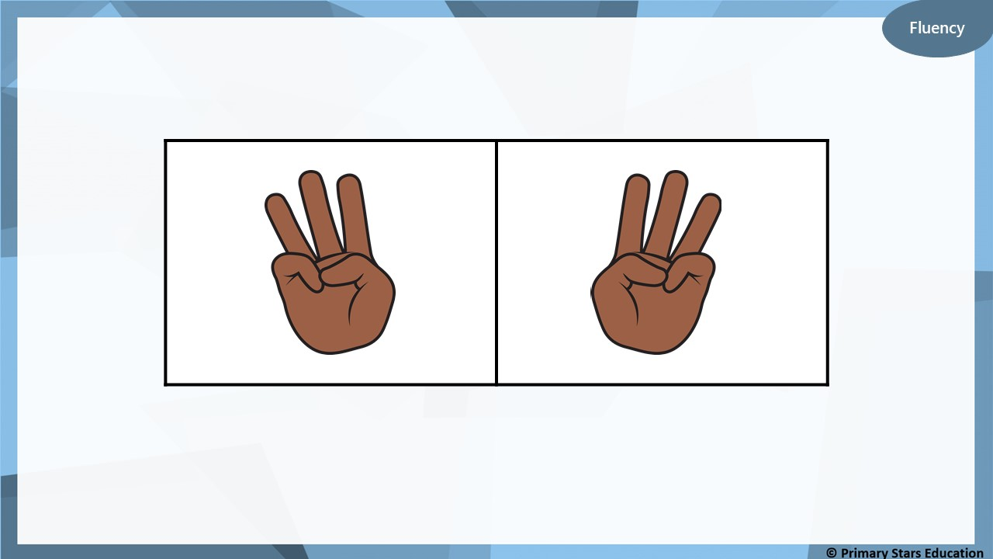
Has this representation been doubled?
Yes

Slide 5

2
Double 1 is _______

Slide 6
4
Double 2 is _______

Slide 7
7
14
Double _____ is _____

Slide 8
5
10
Double _____ is _____

Slide 9
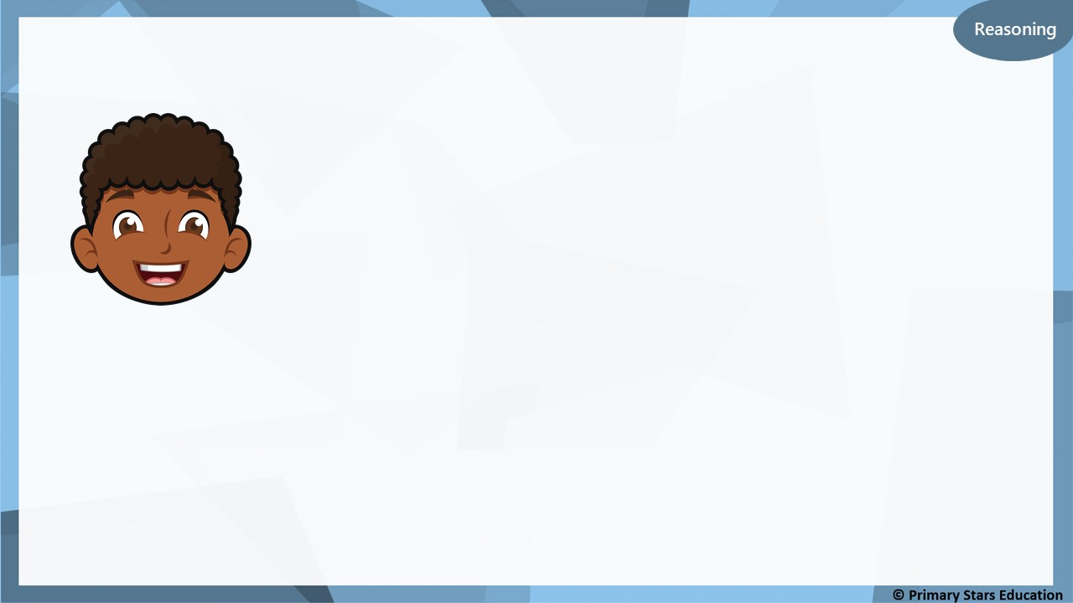
Dom says,
If I double 4, the answer will be equal to 12 – 6.
Do you agree with Dom?
No, double 4 is 8. 12 – 6 = 6.

Slide 10
8
Double is 16
?

Slide 11
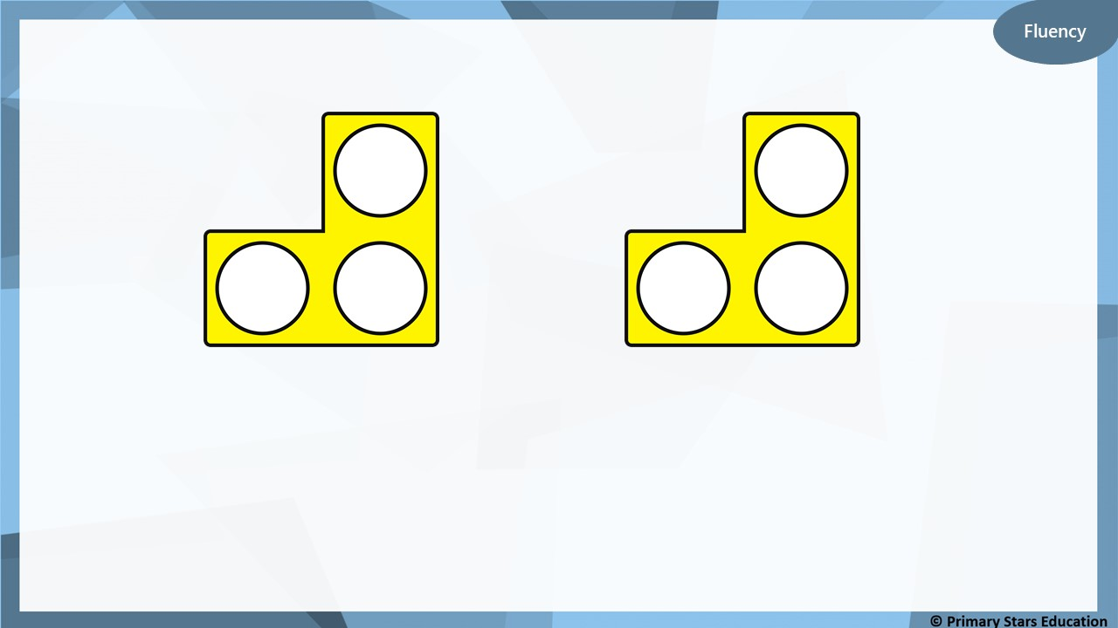
3
6
Double _____ is _____

Slide 12
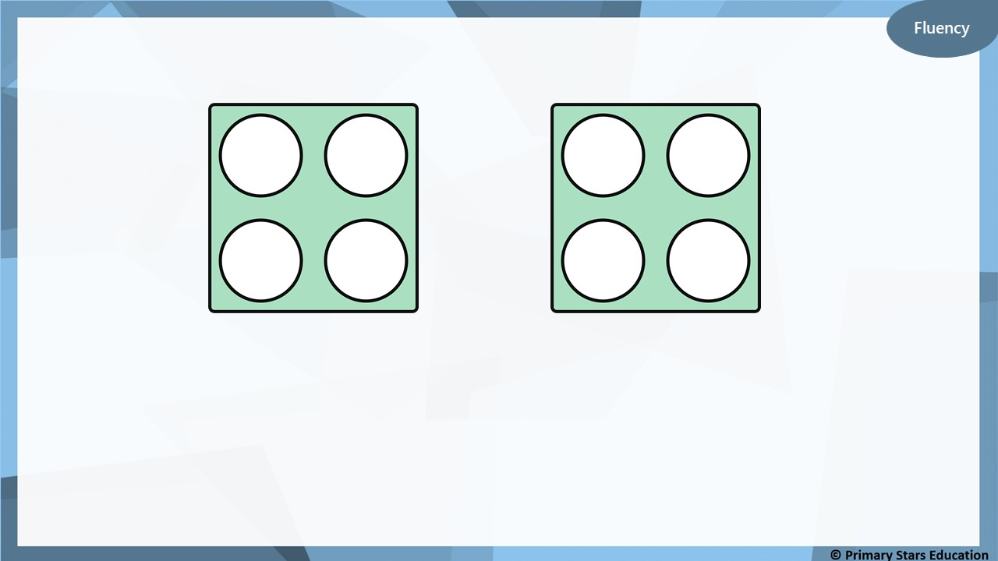
4
8
Double _____ is _____

Slide 13
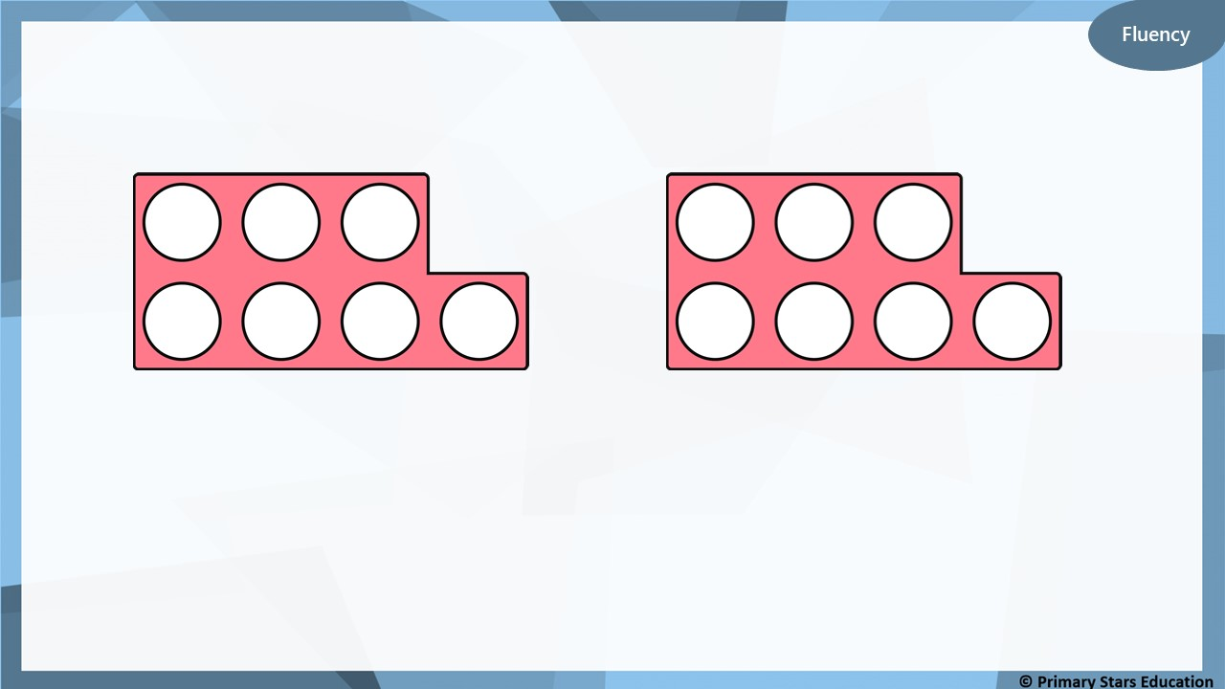
7
14
Double _____ is _____

Slide 14
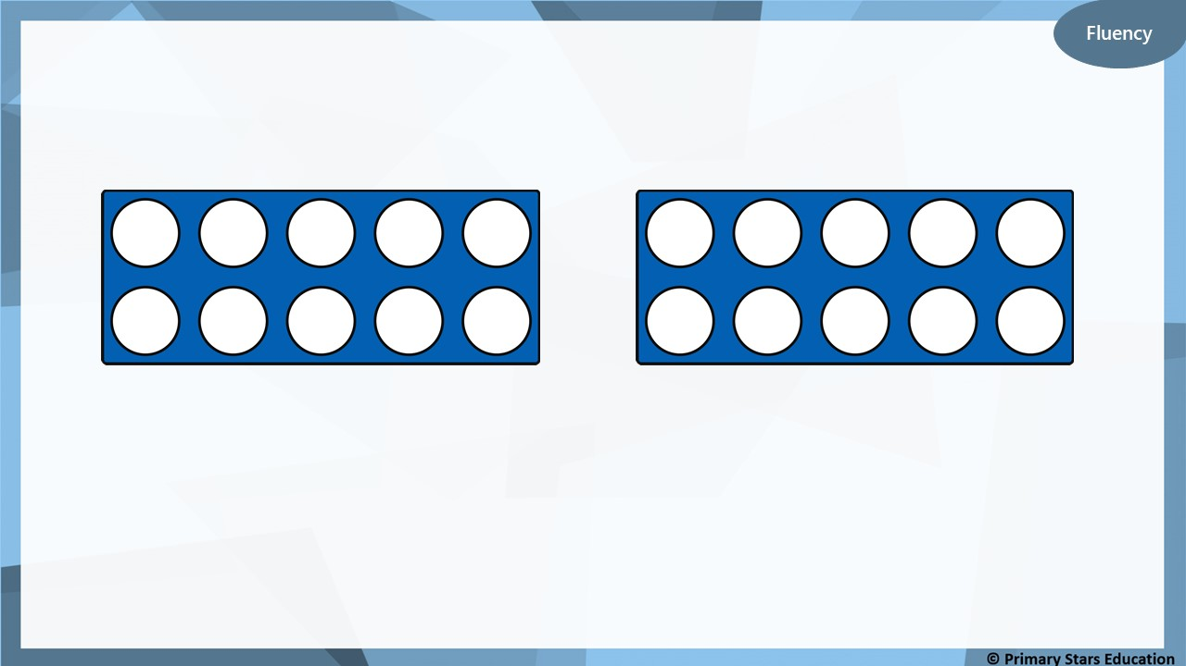
10
20
Double _____ is _____

Slide 15

Fluency
Complete the table.
Build | Represent | Add | Double
 |  |  | Double 1 = ______
 |  |  | Double 2 = ______
1 + 1 = 2
2
2 + 2 = 4
4

Slide 16
Fluency
Complete the table.
Build | Represent | Add | Double
 |  |  | Double 3 = ______
 |  |  | Double 4 = ______
3 + 3 = 6
6
4 + 4 = 8
8

Slide 17
Reasoning
Spot and explain the mistake.
Build | Represent | Add | Double
 |  |  | Double 5 = 10
5 + 5 = 10
There are 12 cubes in total (6 have been doubled). There should be 10 cubes in total (5 doubled).

Slide 18
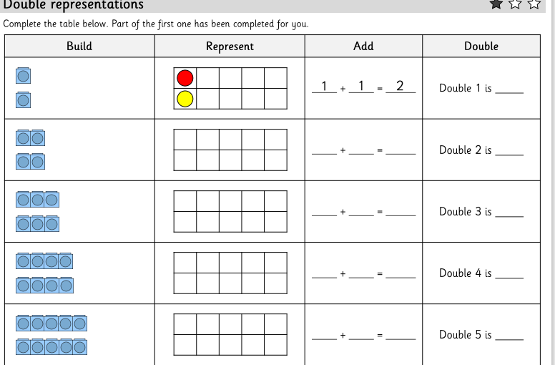
Y2 Activity one:
Complete the worksheet, you have two sheets to complete.

Slide 19
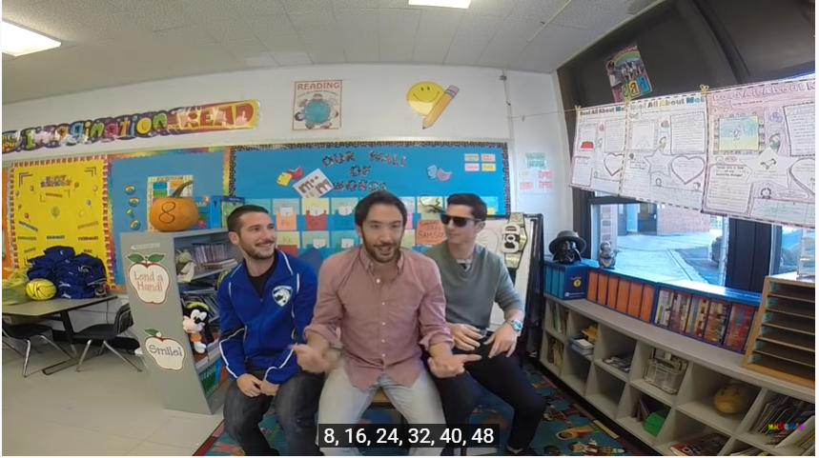
Eight Times Table Song (Cover of All About That Bass by Meghan Trainor) - YouTube
Notes:
Ask chd if they know their 8 times tables. Does anyone know any tips or tricks?
How could we link 8 times tables to multiplications we already know? Especially what we learnt yesterday.

Slide 20


Introduction
Place the numbers into the correct part of the Venn Diagram.
18
28
8
4
Multiple of 3
Multiple of 4
30
24
12
3
5
6
16
10
© Classroom Secrets Limited 2018

Slide 21
Introduction
Place the numbers into the correct part of the Venn Diagram.
Multiple of 3
Multiple of 4
3
6
18
30
4
8
16
28
12
24
5
10
© Classroom Secrets Limited 2018

Slide 22
Varied Fluency 1
Using the bar model, complete the calculation below.
?
8 | 8 | 8 | 8 | 8 | 8 | 8
 | x |  | =
© Classroom Secrets Limited 2018

Slide 23
Varied Fluency 1
Using the bar model, complete the calculation below.
56
8 | 8 | 8 | 8 | 8 | 8 | 8
7 | x | 8 | = | 56
© Classroom Secrets Limited 2018

Slide 24
Varied Fluency 2
Asha is using an array to multiply 8 x 11.
Circle the pair of multiplication facts that will help her find the answer?
A. | 9 x 8 |  | B. | 10 x 8 |  | C. | 5 x 8
 | 3 x 8 |  |  | 1 x 8 |  |  | 5 x 8
© Classroom Secrets Limited 2018

Slide 25
Varied Fluency 2
Asha is using an array to multiply 8 x 11.
Circle the pair of multiplication facts that will help her find the answer?
A. | 9 x 8 |  | B. | 10 x 8 |  | C. | 5 x 8
 | 3 x 8 |  |  | 1 x 8 |  |  | 5 x 8
© Classroom Secrets Limited 2018

Slide 26

Varied Fluency 3
Emily is counting the tentacles on 3 octopuses.
Complete the calculation below.
 | x |  | =
© Classroom Secrets Limited 2018

Slide 27
Varied Fluency 3
Emily is counting the tentacles on 3 octopuses.
Complete the calculation below.
3 | x | 8 | = | 24
© Classroom Secrets Limited 2018

Slide 28
Problem Solving 1
Colour in all the pairs of multiplications that can be used to solve 10 x 8.
2 x 8 5 x 8 | 7 x 8 3 x 8 | 1 x 8 8 x 8
6 x 8 3 x 8 | 9 x 8 2 x 8 | 4 x 8 6 x 8
3 x 8 7 x 8 | 5 x 8 5 x 8 | 2 x 8 7 x 8
© Classroom Secrets Limited 2018

Slide 29
Problem Solving 1
Colour in all the pairs of multiplications that can be used to solve 10 x 8.
2 x 8 5 x 8 | 7 x 8 3 x 8 | 1 x 8 8 x 8
6 x 8 3 x 8 | 9 x 8 2 x 8 | 4 x 8 6 x 8
3 x 8 7 x 8 | 5 x 8 5 x 8 | 2 x 8 7 x 8
© Classroom Secrets Limited 2018

Slide 30
Introduction
Double each of the numbers then double your answers.
Double 2 | is |  | and double again gives
Double 12 | is |  | and double again gives
Double 9 | is |  | and double again gives
Double 8 | is |  | and double again gives
© Classroom Secrets Limited 2018

Slide 31
Introduction
Double each of the numbers then double your answers.
Double 2 | is | 4 | and double again gives |  | 8
Double 12 | is | 24 | and double again gives |  | 48
Double 9 | is | 18 | and double again gives |  | 36
Double 8 | is | 16 | and double again gives |  | 32
© Classroom Secrets Limited 2018

Slide 32
Varied Fluency 1
Use the information given to answer the questions below.
4 | + | 4 | + | 4 | + | 4 | + | 4 | + | 4 | + | 4 | + | 4 | + | 4 | + | 4 | + | 4 | + | 4 | + | 4 | + | 4 | = | 56
8 | + | 8 | + | 8 | + | 8 | + | 8 | + | 8 | + | 8 | =
14 | x | 4 | = | 56
 | x | 8 | = | 56
© Classroom Secrets Limited 2018

Slide 33
Varied Fluency 1
Use the information given to answer the questions below.
4 | + | 4 | + | 4 | + | 4 | + | 4 | + | 4 | + | 4 | + | 4 | + | 4 | + | 4 | + | 4 | + | 4 | + | 4 | + | 4 | = | 56
8 | + | 8 | + | 8 | + | 8 | + | 8 | + | 8 | + | 8 | = | 56
14 | x | 4 | = | 56
7 | x | 8 | = | 56
© Classroom Secrets Limited 2018

Slide 34
Varied Fluency 2
Use the image below to solve the calculation.
8 | x | 9 | =
© Classroom Secrets Limited 2018

Slide 35
Varied Fluency 2
Use the image below to solve the calculation.
8 | x | 9 | = | 72
© Classroom Secrets Limited 2018

Slide 36

Reasoning 2
Which calculation is the odd one out?
Explain why.
A.
7 + 7 + 7 + 7 + 7 + 7 + 7 + 7 = 56
B.
C.
D.
8 x 6 = 48
© Classroom Secrets Limited 2018

Slide 37
Reasoning 2
Which calculation is the odd one out?
Explain why.
D is the odd one out because…
A.
7 + 7 + 7 + 7 + 7 + 7 + 7 + 7 = 56
B.
C.
D.
8 x 6 = 48
© Classroom Secrets Limited 2018

Slide 38
Reasoning 2
Which calculation is the odd one out?
Explain why.
D is the odd one out because A, C and B all represent 8 x 7 = 56 whereas D represents 8 x 6 = 48.
A.
7 + 7 + 7 + 7 + 7 + 7 + 7 + 7 = 56
B.
C.
D.
8 x 6 = 48
© Classroom Secrets Limited 2018

Slide 39
Problem Solving 1
Using the digit cards, complete the number sentences below.
8 | x |  | = | 24
2 | x | 3 | x |  | = | 24
2 | x | 2 | x |  | x | 3 | = | 24
4
3
2
© Classroom Secrets Limited 2018

Slide 40
Problem Solving 1
Using the digit cards, complete the number sentences below.
8 | x | 3 | = | 24
2 | x | 3 | x | 4 | = | 24
2 | x | 2 | x | 2 | x | 3 | = | 24
4
3
2
© Classroom Secrets Limited 2018

Slide 41
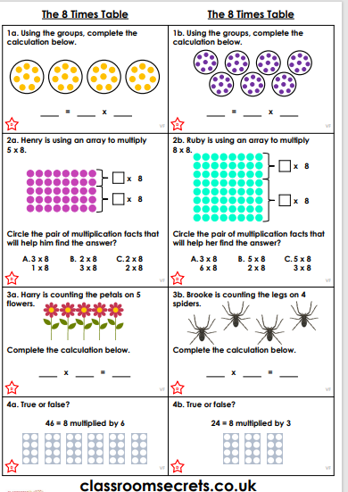
Y3 Activity one:
Complete the worksheet.

