Slide 1
Y3 LO: To be able to multiply by four.
Y2 LO: To complete multiplication sentences using pictures.
I can understand multiplication sentences pictorially.
I can recall multiplication facts for 2, 5 and 10.
I can discuss what the numbers represent in a multiplication sentence.
I can recall multiplication facts for the four times table.
I can show my multiplication sentences pictorially.
I can answer multiplication questions using my knowledge.

Slide 2
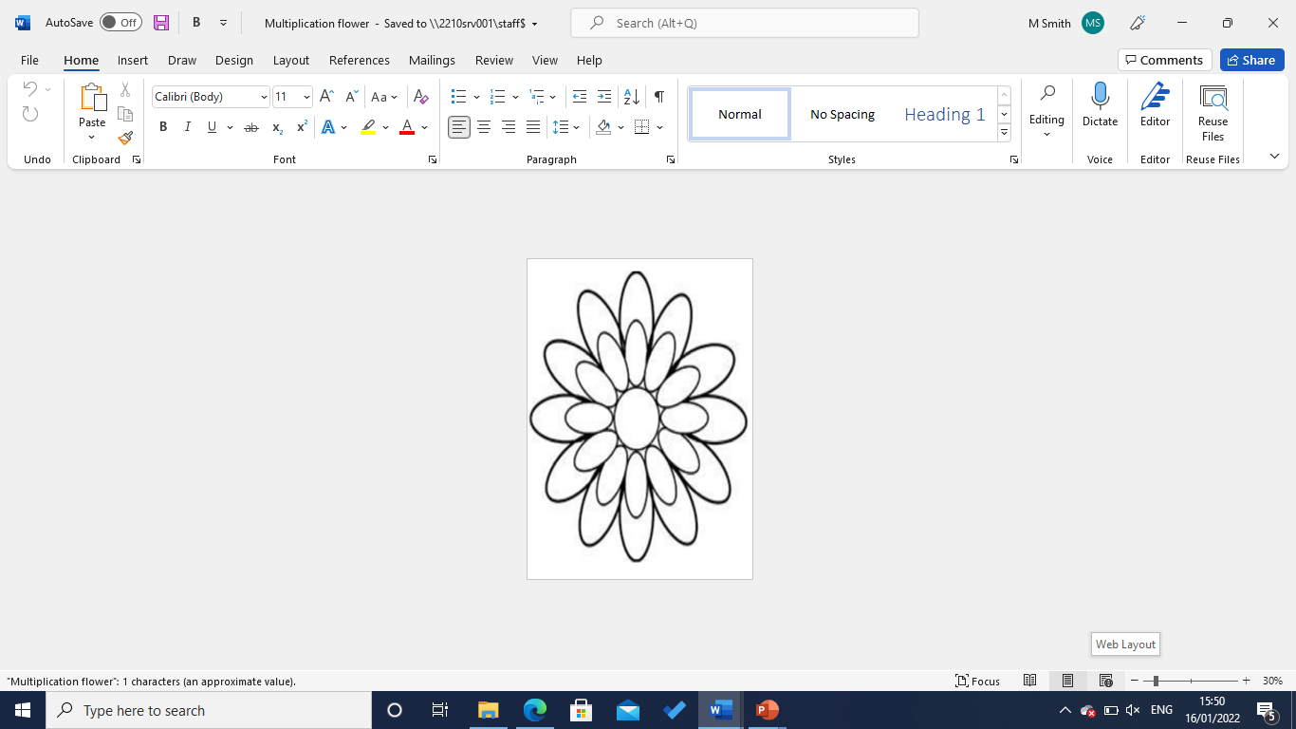
Starter:
Create your own multiplication flower, using a times table you find the trickiest.
Y2- 2s, 5s or 10s
Y3- 3s, 4s or 8s

Slide 3


Fluency
Complete:
______ x ______ = ______
3
3
9
______ lots of 3 = ______
3
9
______ multiplied by ______ = 9
3
3

Slide 4
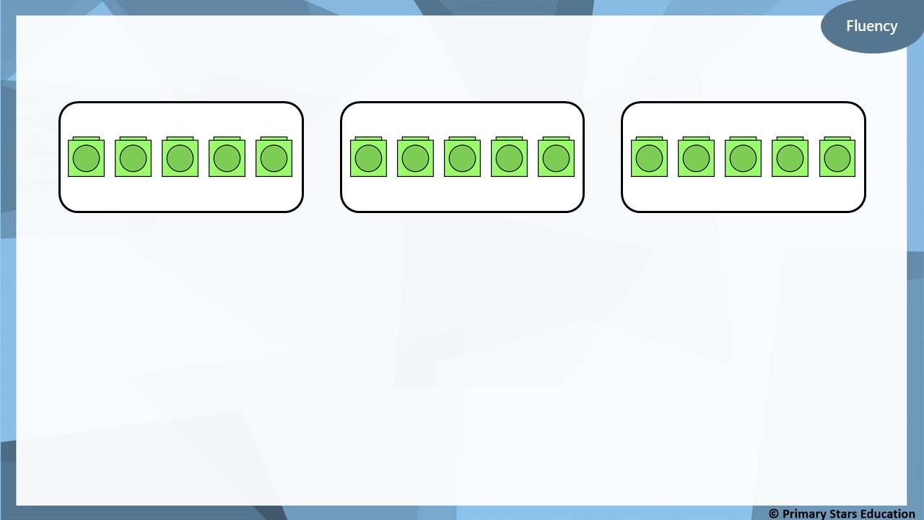
Complete:
______ x ______ = ______
3
5
15
______ lots of 5 = ______
3
15
3
5
_____ multiplied by ______ = 15
Notes:
What does the 3 represent?
What does the 5 represent?

Slide 5
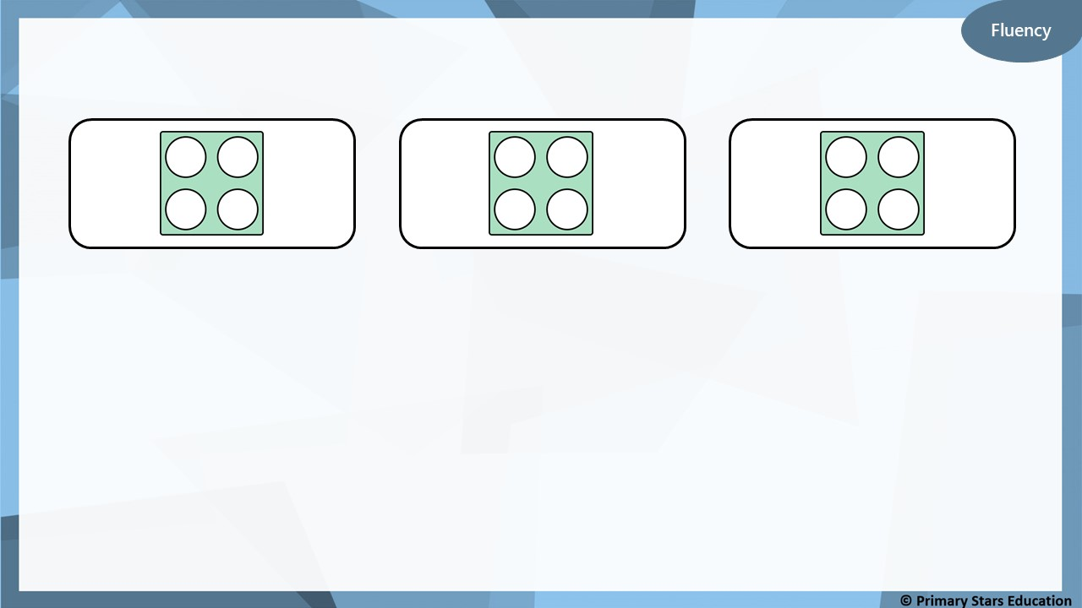
Complete:
______ x ______ = ______
3
4
12
______ lots of 4 = ______
3
12
______ multiplied by ______ = 12
3
4

Slide 6
Fluency
Complete:
______ x ______ = ______
3
6
18
______ lots of 6 = ______
3
18
______ multiplied by ______ = 18
3
6

Slide 7
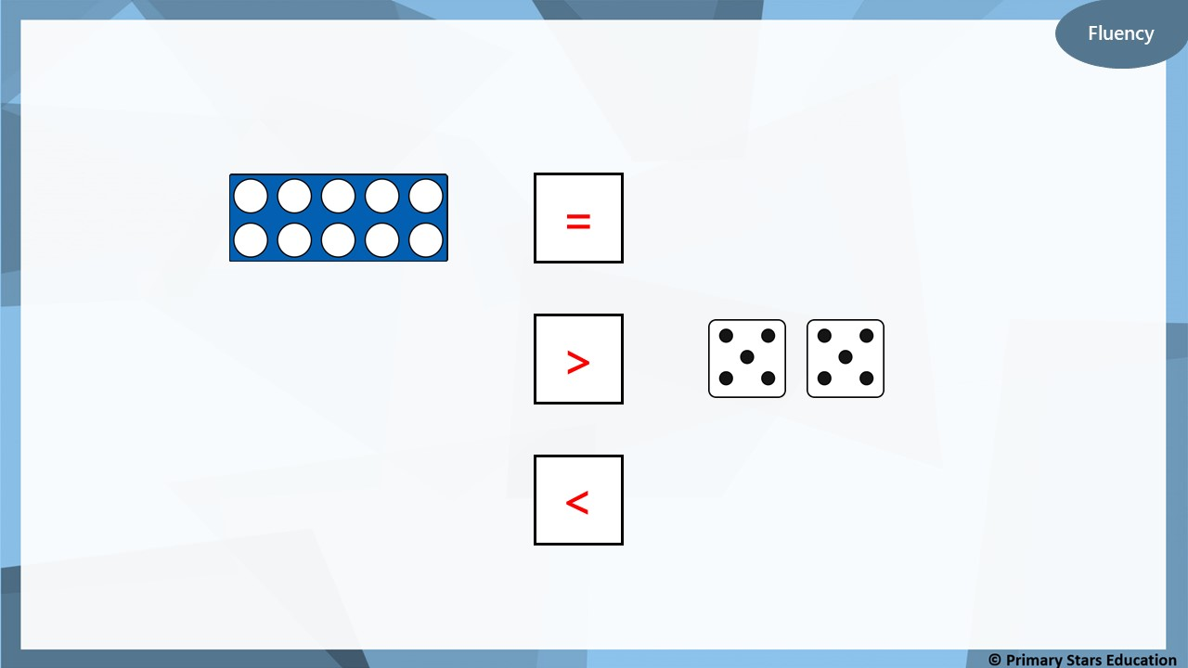
Complete using <, > or =.
=
2 x 5
3 lots of 4
>
<
3 multiplied by 3

Slide 8
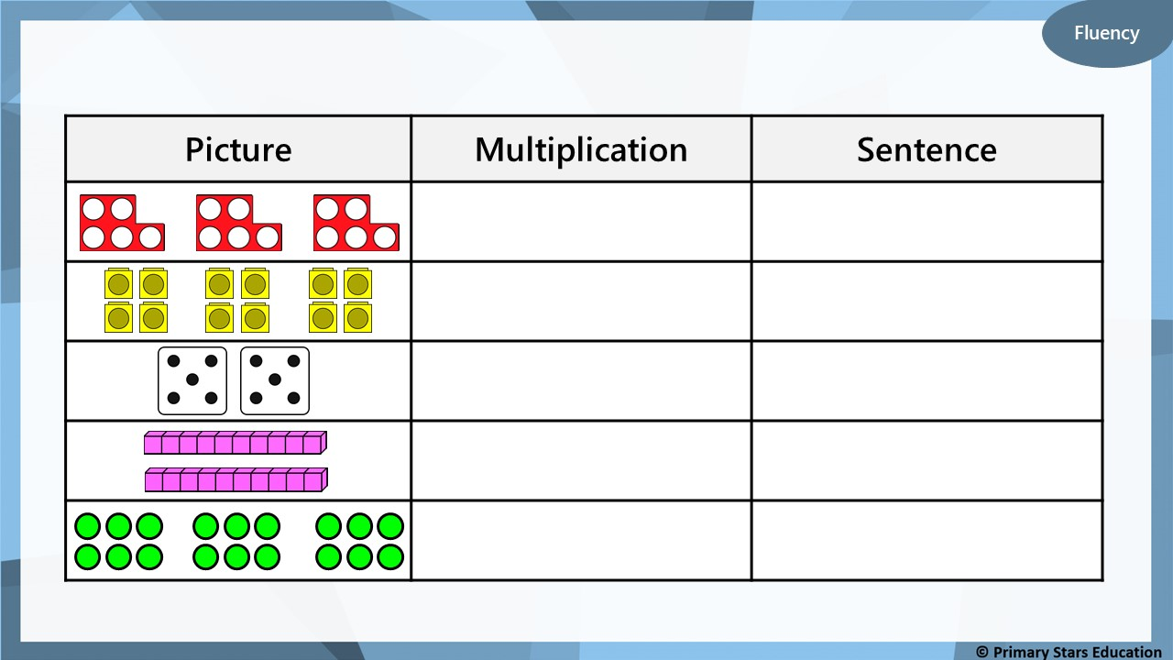
Complete the table.
3 x 5
3 lots of 5 is equal to 15
3 x 4
3 lots of 4 is equal to 12
2 x 5
2 lots of 5 is equal to 10
2 x 10
2 lots of 10 is equal to 20
3 x 6
3 lots of 6 is equal to 18
Notes:
Chd to complete on their whiteboards

Slide 9
Reasoning
True
False
Explain your answer.
5 x 3 is the same as 5 lots of 3.
✓
True. 5 x 3 is the same as 5 lots of 3 or three 5s.
5 x 3 = 15 and 5 lots of 3 = 15

Slide 10


Problem solving
Write a sensible story for the calculation 6 x 3 = 18.
Draw a picture to represent this.
Example story:
There are 6 plates. There are 3 bananas on each plate. There are 18 bananas altogether.

Slide 11
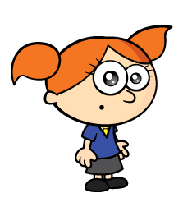

I think I can write 4 different multiplications
I think there are 8

Slide 12
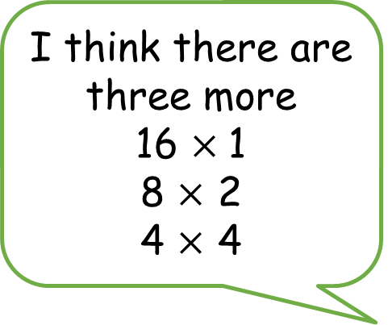
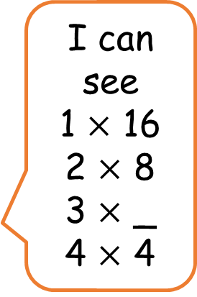
I think there are three more
16 $×$1
8 $×$ 2
4 $×$ 4
I can see
1 $×$ 16
2 $×$ 8
3 $×$ _
4 $×$ 4

Slide 13
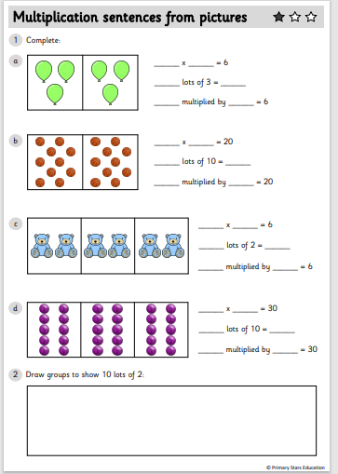
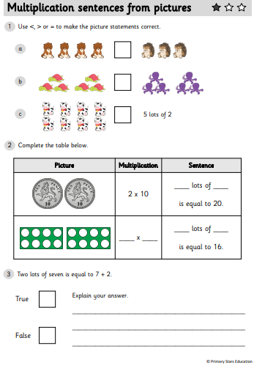
Y2 Activity one:
Complete the worksheet, you have two sheets to complete.

Slide 14
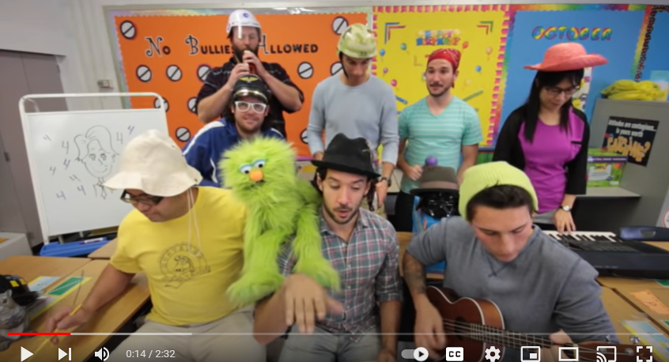
Four Times Table Song (Blurred Lines Cover) with Classroom Instruments - YouTube
Notes:
Ask chd if they know their 4 times tables. Does anyone know any tips or tricks?
How could we link 4 times tables to multiplications we already know?

Slide 15

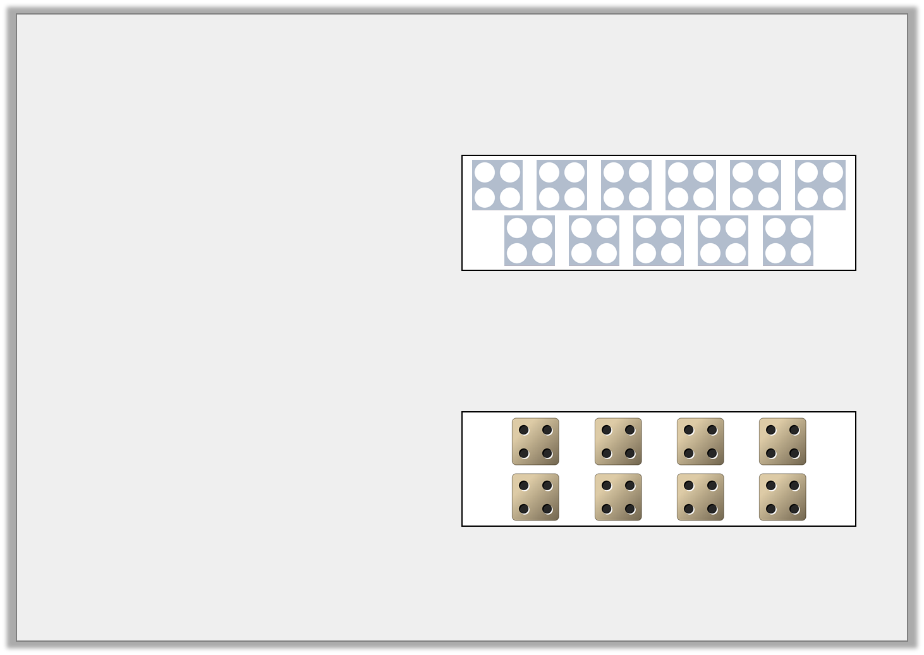

Varied Fluency 1
Match each calculation to the correct representation.
A. 7 x 4
4 | 4 | 4 | 4 | 4 | 4 | 4
B. 8 x 4
C. 11 x 4
© Classroom Secrets Limited 2018

Slide 16
Varied Fluency 1
Match each calculation to the correct representation.
A. 7 x 4
4 | 4 | 4 | 4 | 4 | 4 | 4
B. 8 x 4
C. 11 x 4
© Classroom Secrets Limited 2018

Slide 17

Varied Fluency 2
Which representation is the odd one out?
A.
7 x 4
C.
B.
4 x 6
D.
5 | 5 | 5 | 5
© Classroom Secrets Limited 2018

Slide 18
Varied Fluency 2
Which representation is the odd one out?
A.
7 x 4
C.
B.
4 x 6
D.
5 | 5 | 5 | 5
© Classroom Secrets Limited 2018

Slide 19
Varied Fluency 4
Complete the calculations using the bar models to help you.
12 | 12 | 12 | 12
?
4 | x |  | =
4 | 4 | 4 | 4
?
 | x | 4 | =
© Classroom Secrets Limited 2018

Slide 20
Varied Fluency 4
Complete the calculations using the bar models to help you.
12 | 12 | 12 | 12
48
4 | x | 12 | = | 48
4 | 4 | 4 | 4
16
4 | x | 4 | = | 16
© Classroom Secrets Limited 2018

Slide 21
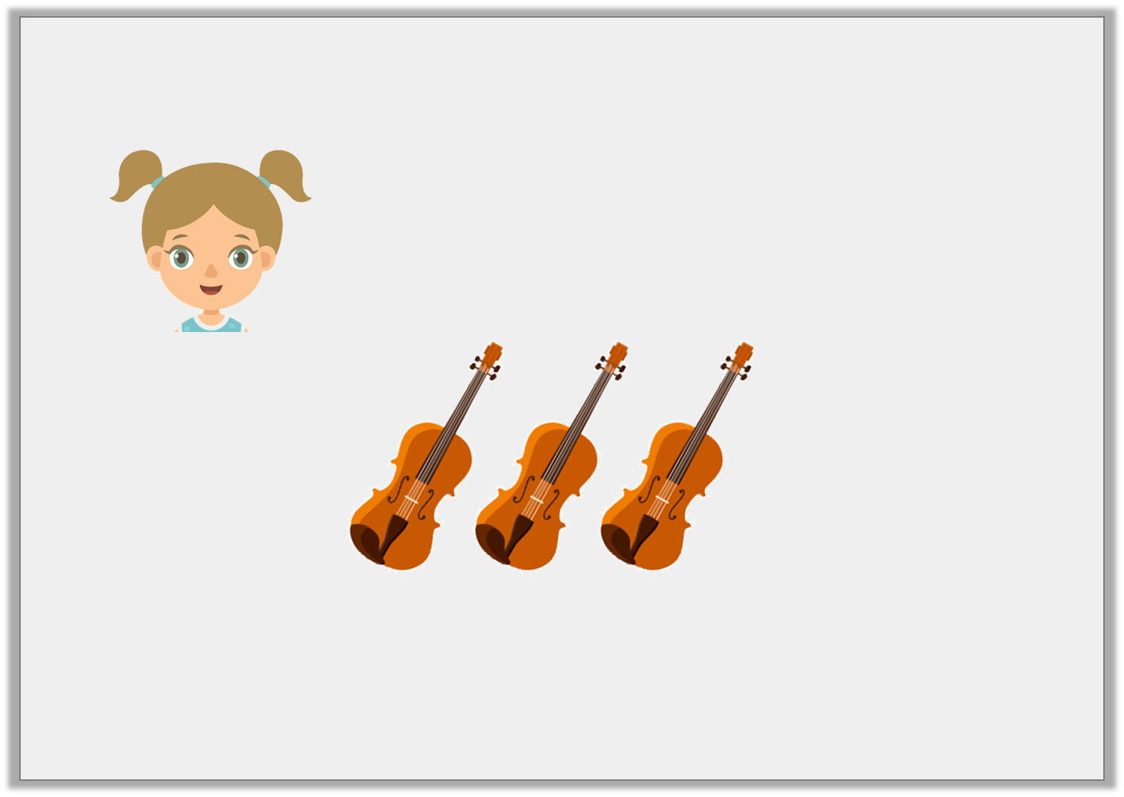
Reasoning 1
Rachel says,
Is Rachel correct?
If 3 violins have 12 strings, then 6 violins will have 20 strings.
Rachel
© Classroom Secrets Limited 2018

Slide 22
Reasoning 1
Rachel says,
Is Rachel correct?
Rachel is incorrect because…
If 3 violins have 12 strings, then 6 violins will have 20 strings.
Rachel
© Classroom Secrets Limited 2018

Slide 23
Reasoning 1
Rachel says,
Is Rachel correct?
Rachel is incorrect because 6 violins would have 24 strings, not 20, as 6 x 4 = 24.
If 3 violins have 12 strings, then 6 violins will have 20 strings.
Rachel
© Classroom Secrets Limited 2018

Slide 24

Problem Solving 1
John says,
What other facts might John know?
List three other facts.
I know 8 x 4 = 32 so I can tell you other related facts.
John
© Classroom Secrets Limited 2018

Slide 25
Problem Solving 1
John says,
What other facts might John know?
List three other facts.
4 x 8 = 32; 32 ÷ 8 = 4; 32 ÷ 4 = 8
I know 8 x 4 = 32 so I can tell you other related facts.
John
© Classroom Secrets Limited 2018

Slide 26
Introduction
Fill in the missing numbers on the number track.
48 | 44 |  |  | 32
24 |  | 16 |  | 8
© Classroom Secrets Limited 2018

Slide 27
Introduction
Fill in the missing numbers on the number track.
48 | 44 | 40 | 36 | 32 | 28
24 | 20 | 16 | 12 | 8 | 4
© Classroom Secrets Limited 2018

Slide 28
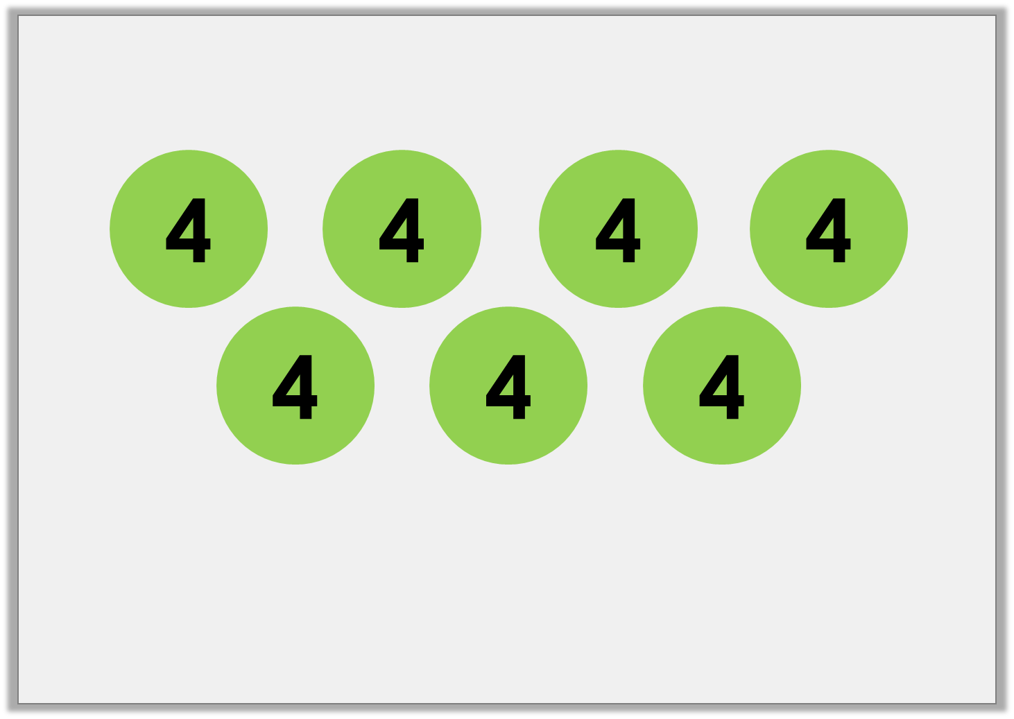
Varied Fluency 1
Complete the statements to match the image below.
 | + |  | + |  | + |  | + |  | + |  | + |  | =
 | x |  | =
© Classroom Secrets Limited 2018

Slide 29
Varied Fluency 1
Complete the statements to match the image below.
4 | + | 4 | + | 4 | + | 4 | + | 4 | + | 4 | + | 4 | = | 28
7 | x | 4 | = | 28
© Classroom Secrets Limited 2018

Slide 30
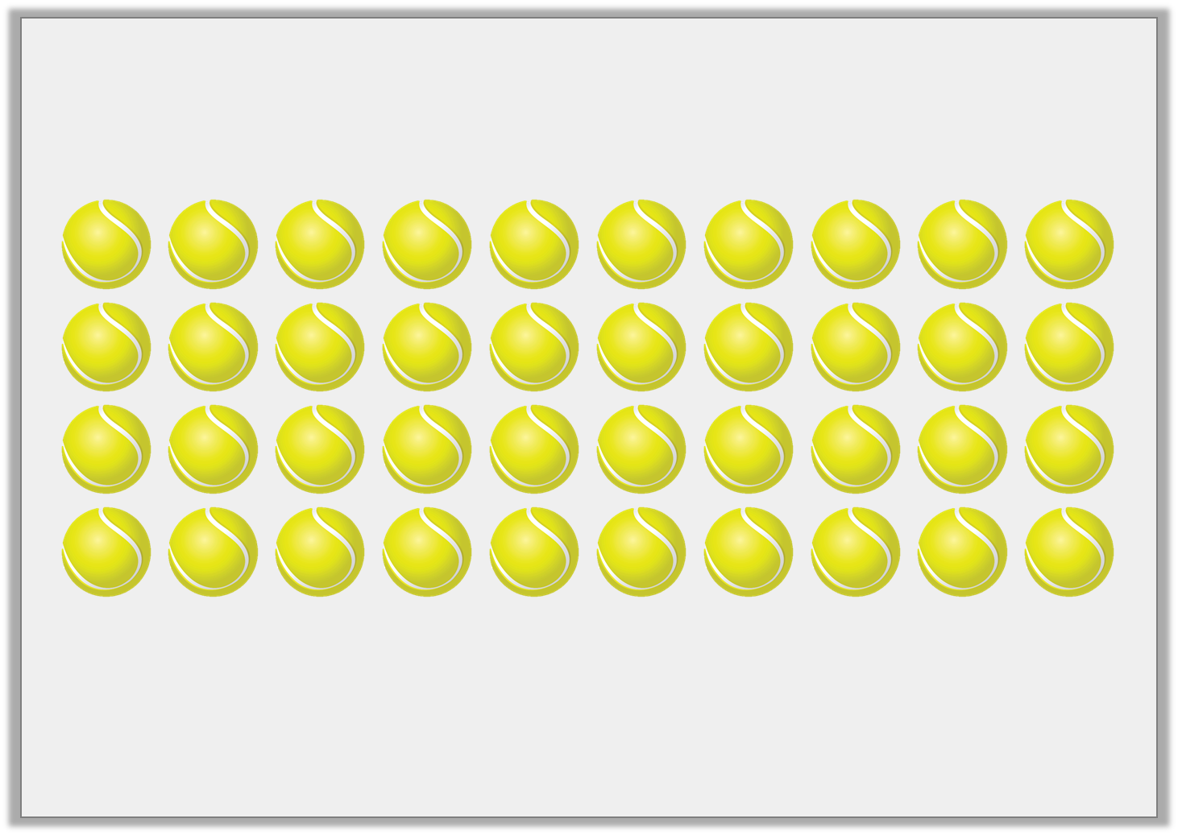
Varied Fluency 2
Sort the tennis balls into groups of 4 and complete the statement.
 | lots of |  | =
© Classroom Secrets Limited 2018

Slide 31
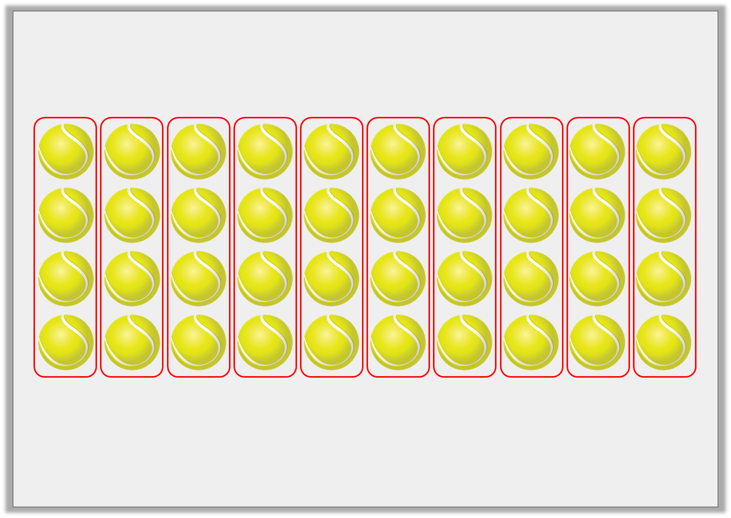
Varied Fluency 2
Sort the tennis balls into groups of 4 and complete the statement.
10 | lots of | 4 | = | 40
© Classroom Secrets Limited 2018

Slide 32

Reasoning 1
Morgan has four boxes of toys.
Each box contains four toys.
How many toys are there altogether?
Prove it.
© Classroom Secrets Limited 2018

Slide 33
Reasoning 1
Morgan has four boxes of toys.
Each box contains four toys.
How many toys are there altogether?
Prove it.
Morgan has … toys altogether because …
© Classroom Secrets Limited 2018

Slide 34
Reasoning 1
Morgan has four boxes of toys.
Each box contains four toys.
How many toys are there altogether?
Prove it.
Morgan has 16 toys altogether because 4 x 4 = 16.
© Classroom Secrets Limited 2018

Slide 35
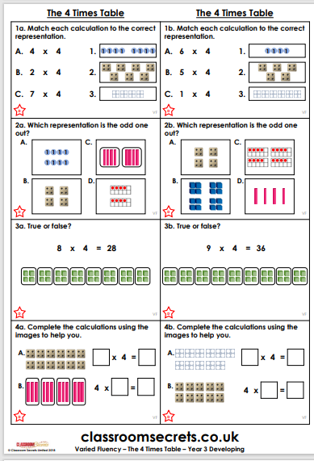
Y3 Activity one:
Complete the worksheet.

