Slide 1
Length – Lesson 3
03.03.22

Slide 2
YR2 LO: To order the length and height of objects.
Y3 LO: To use my knowledge of converting to work out equivalent lengths (mm and cm).
I can estimate which object is bigger without measuring using a ruler.
I can measure accurately to the nearest cm.
I can order objects by their length or height from shortest to longest/tallest.
I understand that 10mm = 1cm
I can convert measurements from mm to cm
I can convert measurements from cm to mm.

Slide 3
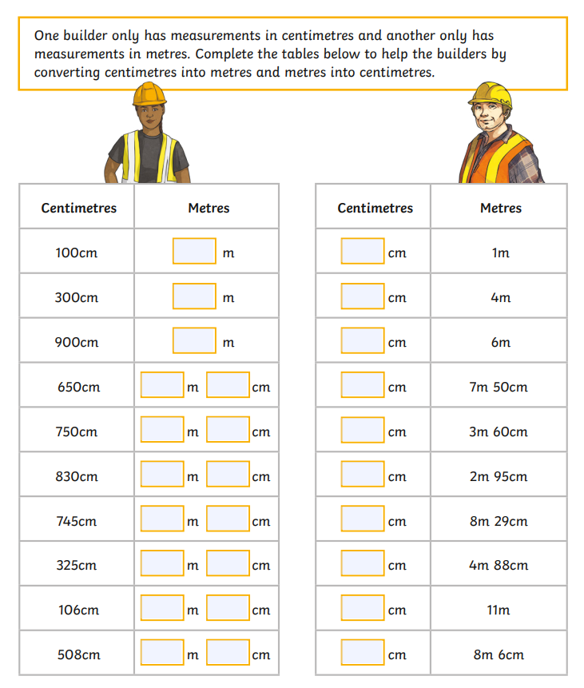
YR3 starter: Can you complete the sheet to convert the measurements between cm and m.

Slide 4
With a partner, can you collect 3 different sized colouring pencils and a ruler.
Can you estimate which pencil you think is longest and which is shortest and write your guess on your whiteboards.
Then, let’s measure them using a ruler. To keep our measurements fair, we need to makes sure we start on 0cm for all 3 pencils.
Were our guesses correct?
Main: YR2 teach – Chn to collect 3 different sized colouring pencils and a ruler in pairs. Ask chn to estimate which pencil they think is the longest and which is the shortest just by looking at them and write this on whiteboards. Remind chn how to measure accurately on a ruler – were they correct? Remind chn that to keep our measurements fair, we need to start at the same point of the object on 0cm and measure to the same end point. Show examples of task using PPT. Explain task.

Slide 5
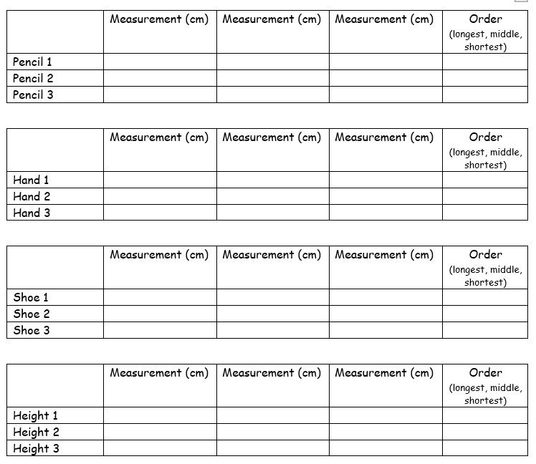
Year 2 task:
In groups of 3 or 4. You are going to measure different objects which will be different lengths e.g. their pencils, shoes, hand size etc. Have an estimate at the order you think they will go in without measuring them or placing them right next to each other.
Record the measurements on the table and order them from shortest to longest.

Slide 6

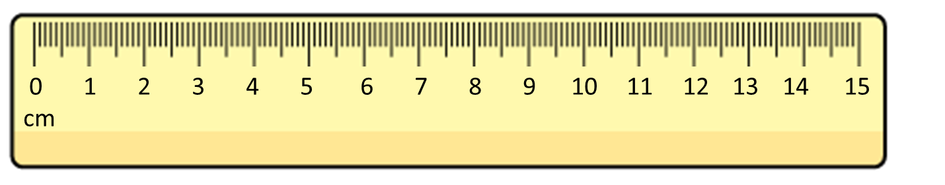

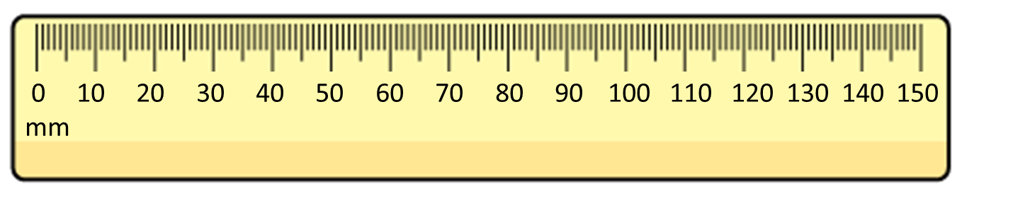
What is the length of the bar?
The bar is 8 cm long.
The bar is 80 mm long.
8 cm = 80 mm
Notes:
Explain that this is the same idea as last lesson except we are looking at mm and cm today. Does anyone know how many mm are in a cm? If not, tell chn it is 10mm in a cm.

Slide 7
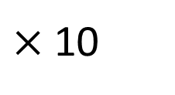
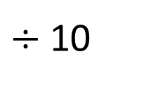
centimetres
0
1
2
3
4
5
6
7
8
9
10
0
10
20
30
40
50
60
70
80
90
100
millimetres
$×$10
$÷$10
1 cm = 10 mm
70
7 cm = mm
30 mm = cm
3

Slide 8
4 cm =
1 cm = 10 mm
40 mm
1 cm | 1 cm | 1 cm | 1 cm
1 cm
10 mm
10 mm
10 mm
10 mm
10 mm
20 mm =
2 cm
1 cm
1 cm
10 mm
10 mm

Slide 9
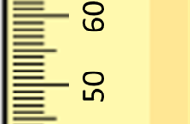
60
59
58
57
56
55
54
53
52
51
mm
50

Slide 10

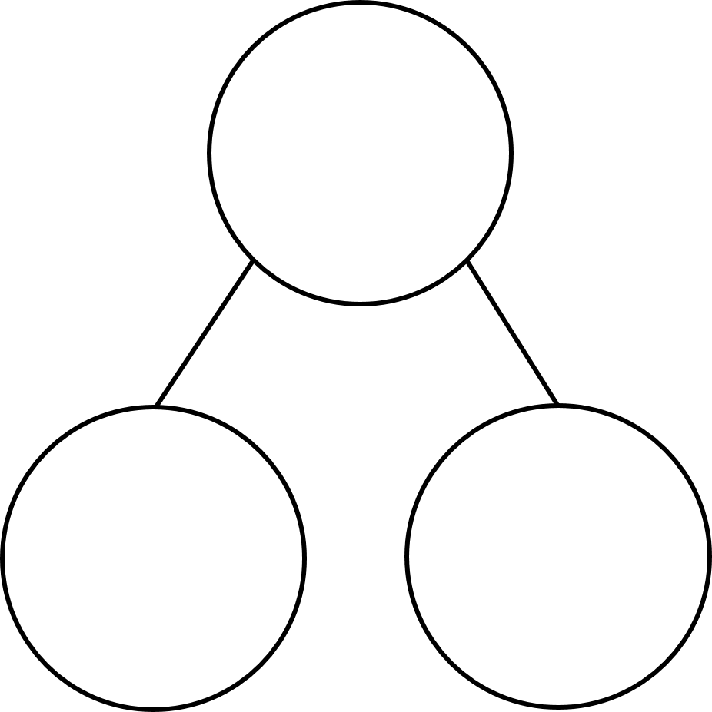
Have a think
60
6 cm
59
5 cm 9 mm
58
5 cm 8 mm
57
5 cm 7 mm
56
5 cm 6 mm
51 mm
5 cm 5 mm
52 mm
55
54
5 cm 4 mm
53
5 cm 3 mm
5 cm
1 mm
52
5 cm 2 mm
50 mm
2 mm
51
5 cm 1 mm
mm
50
5 cm
cm and mm

Slide 11
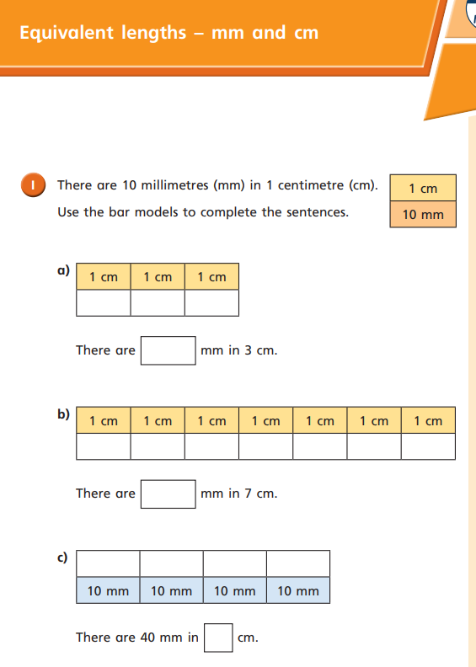
Year 3 task:
First, complete WhiteRose sheet. If you finish, you can move on to a task similar to the year 2 task, measuring objects in mm and converting to cm and vice versa.

