Slide 1
Length – Lesson 2
02.03.22

Slide 2
Y2 LO: To compare the length and height of objects.
Y3 LO: To use my knowledge of converting to work out equivalent lengths (m and cm).
I can use mathematical language to describe the length/height of an object.
I can recall and use the >,< and = symbols accurately.
I could apply this knowledge to reasoning and problem solving.
I understand that 1m = 100cm.
I can convert measurements from cm to m.
I can convert measurements from m to cm.

Slide 3
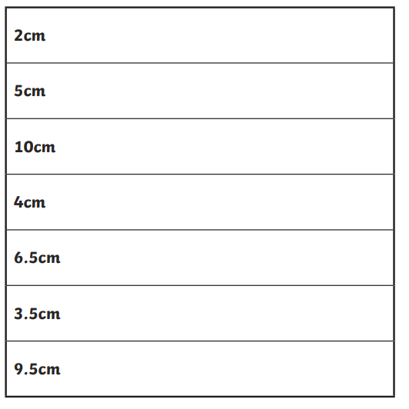
Year 2 starter:
Use a ruler to draw the lines to the right length.
Remember to start on 0cm.

Slide 4
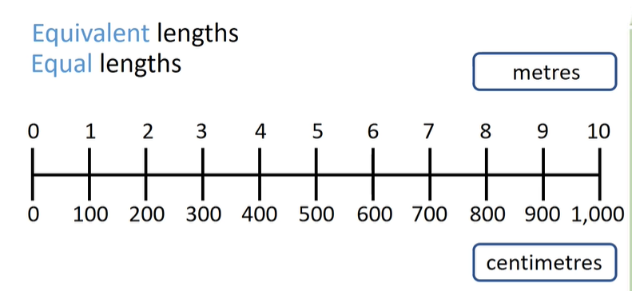
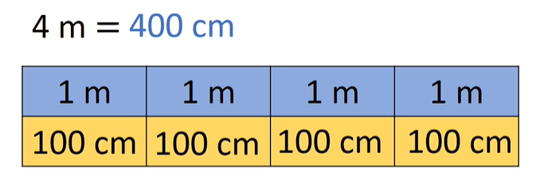
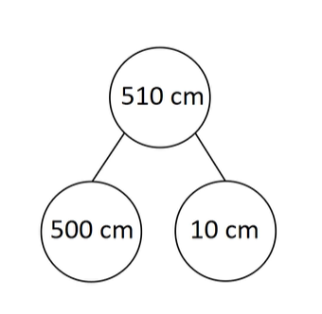
Today we are looking at equivalent length
Note: Equivalent means the same
Notes:
Does anyone know how many cm are in a m? If not, tell chn it is 100cm in a m. Use PowerPoint to work through examples, explaining that for every 100cm, there is 1m e.g. 840cm = 8m and 40cm. Show that we can explore this in different ways e.g. number line, part whole, bar model etc.

Slide 5
What would these measurements be?
2m =
300cm =
10m =
3.6m =
490cm =
Remember: 100cm = 1m

Slide 6
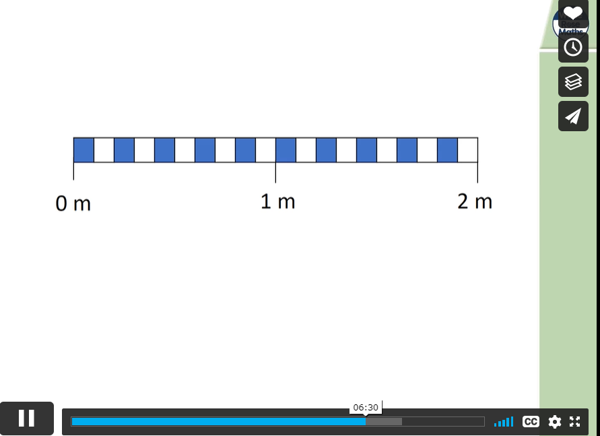
Watch from 6:25
Notes:
Spr3.7.3 - Equivalent lengths (m & cm) on Vimeo watch from 6:25 to end.

Slide 7
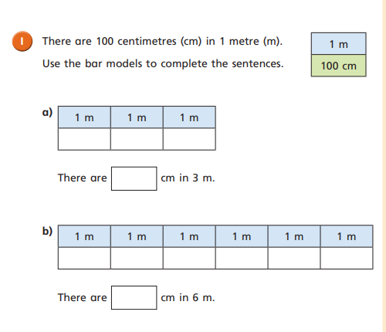
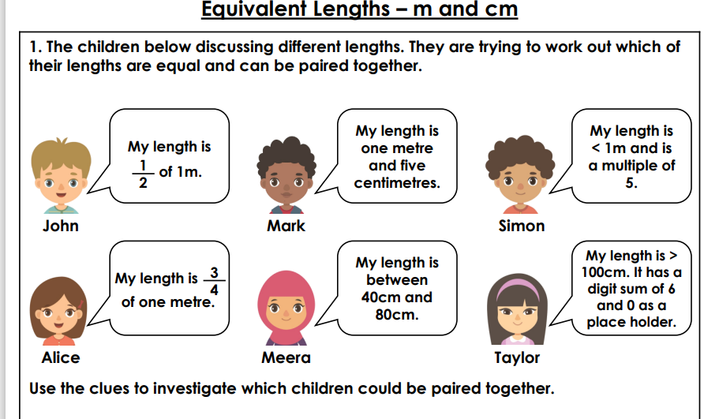
Year 3 task:
First, complete the WhiteRose sheet.
Then, see if you can answer the discussion problems with a partner.

Slide 8
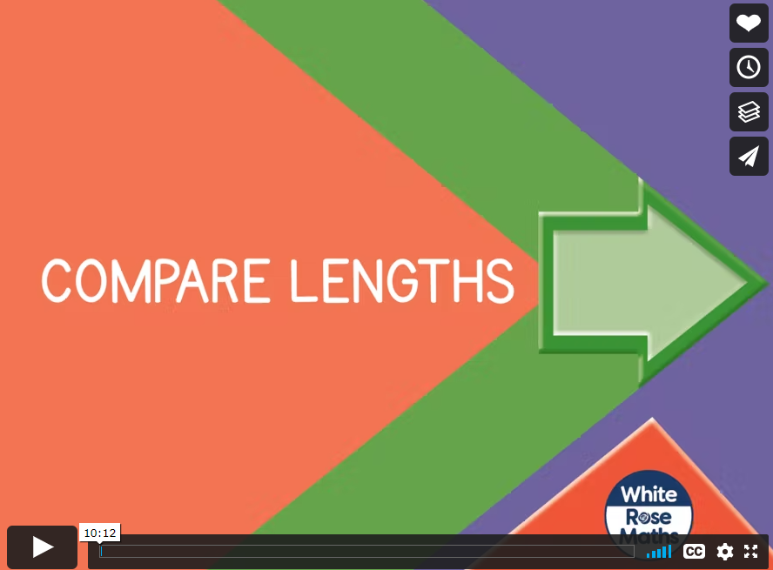
Today we are comparing lengths thinking about how long or short and object is compared to another object.
Notes:
https://vimeo.com/531648284

Slide 9
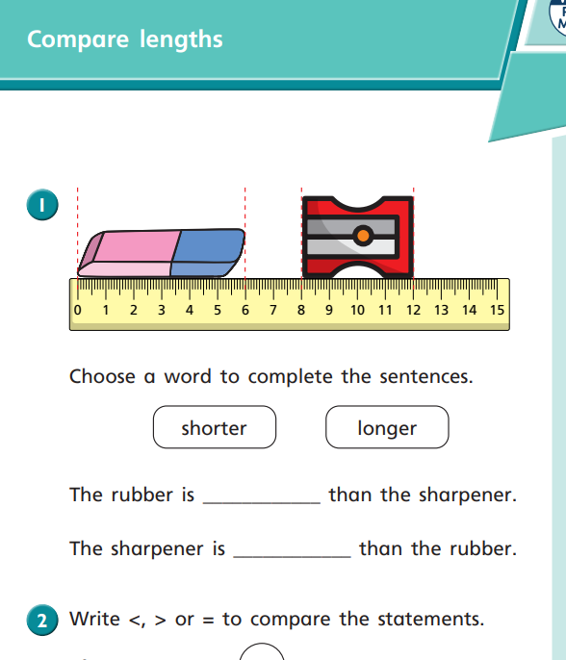
Year 2 task:
First complete the WhiteRose sheet.
Then, choose the differentiated RPS sheet that matches your ability to complete.
EXS: GD discussion problem.

