Slide 1
Length – Lesson 1
28.02.22

Slide 2
Y2 LO:To measure objects accurately (cm and m).
Y3 LO: To measure objects accurately (mm and cm).
I know which units I can measure in.
I can select an appropriate tool to measure length.
I can accurately read measurements to the nearest cm.
I know which units I can measure in.
I can select an appropriate tool to measure length.
I can accurately read measurements to the nearest mm or cm.

Slide 3
How long do you think my objects are?
Metric units of length/height:
Millimeters (mm)
Centimeters (cm)
Meters (m)
Kilometers (km)
Imperial units of length/height:
Inches (in)
Yards (yd)
Feet (ft)
Miles (mi)
Notes:
Show any random object e.g. an exercise book and ask the children to guess how long it is. Pay attention to the language the children use. Do they use mm/cm/m or do they use objects e.g. 2 hands long.
Explain that we are using Metric units. Imperial lengths are mainly used in America.

Slide 4
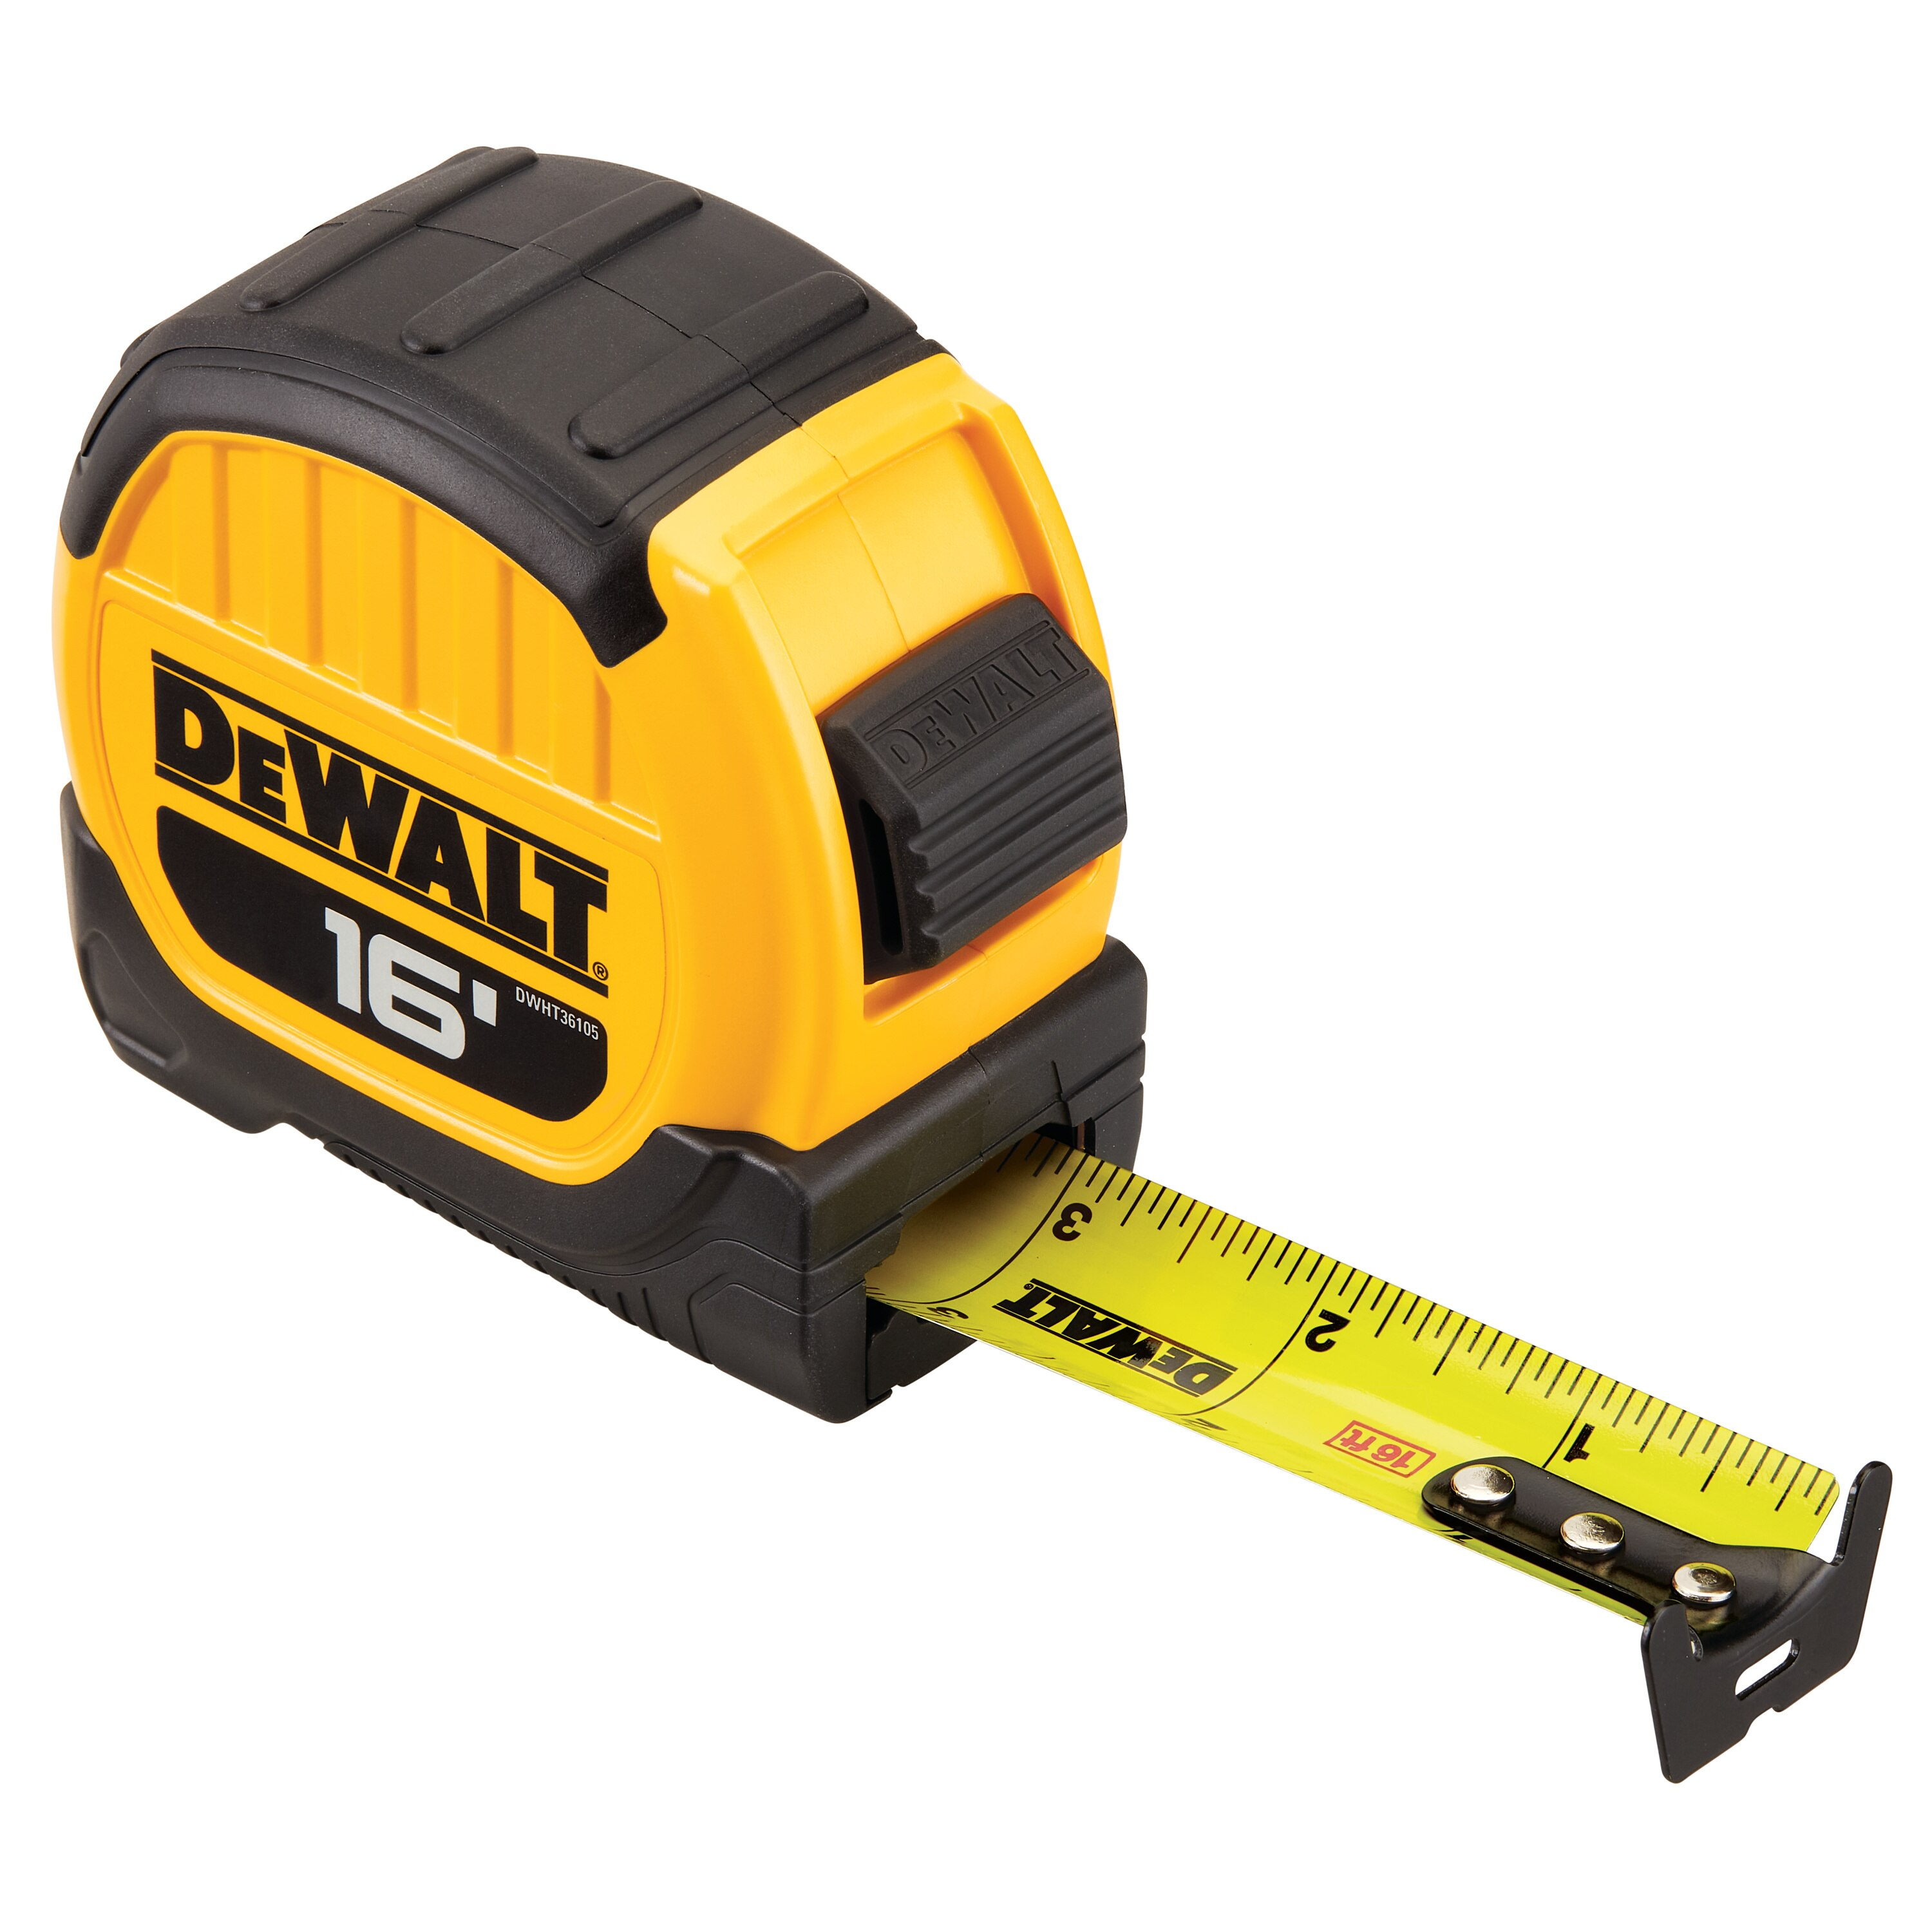
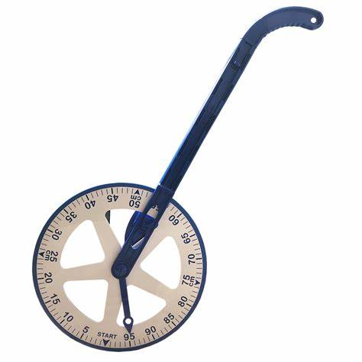
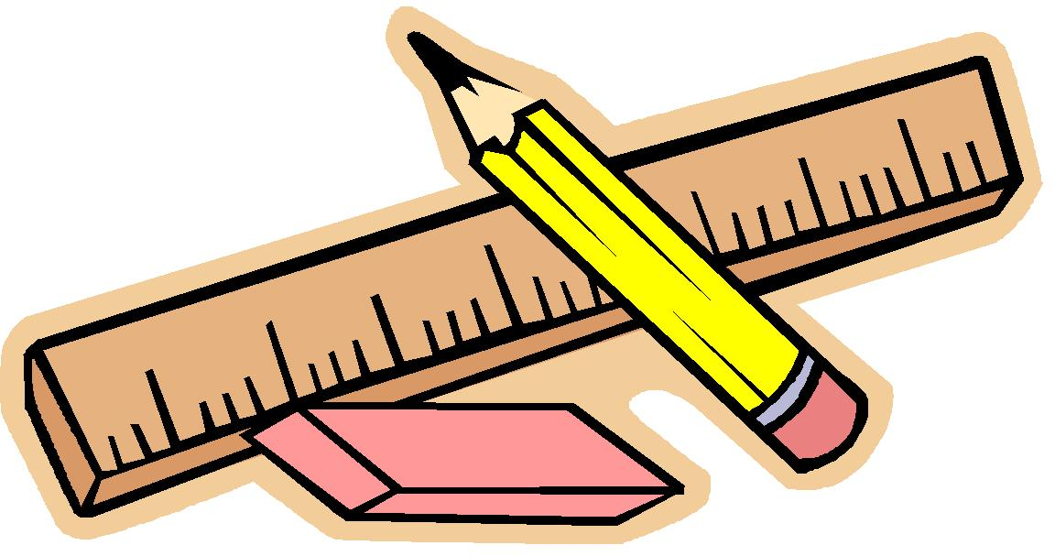
What can I measure with these tools?
Notes:
Explain that when we are measuring, we usually use a measuring tool. Show children some of the tools we can use to measure length – easiest to show are ruler, meter stick, tape measure, measuring wheel.

Slide 5
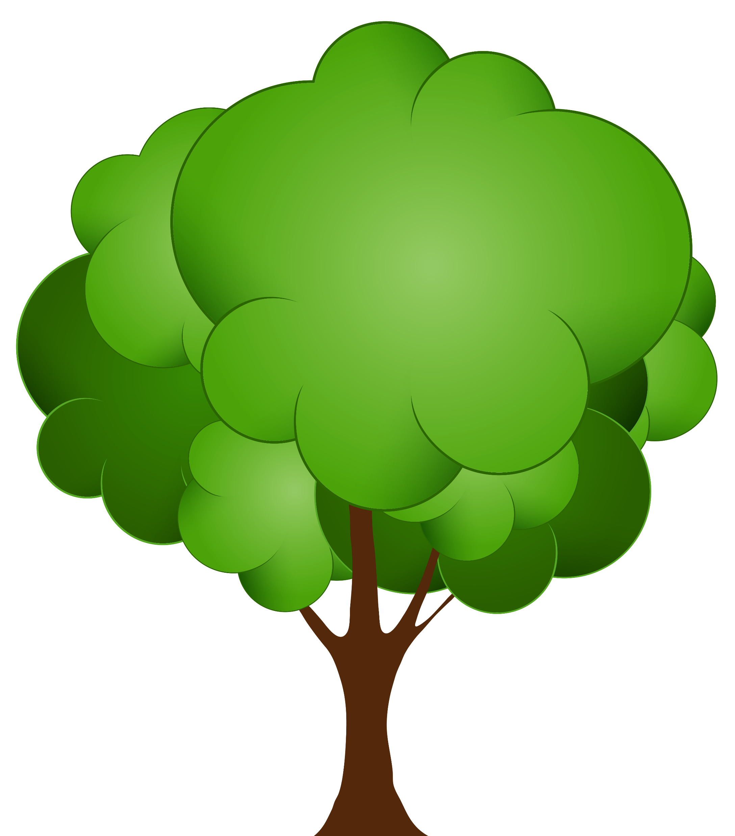
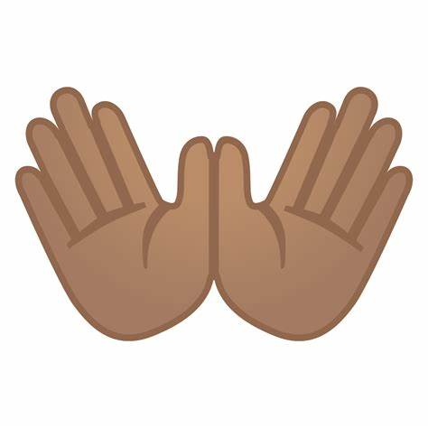

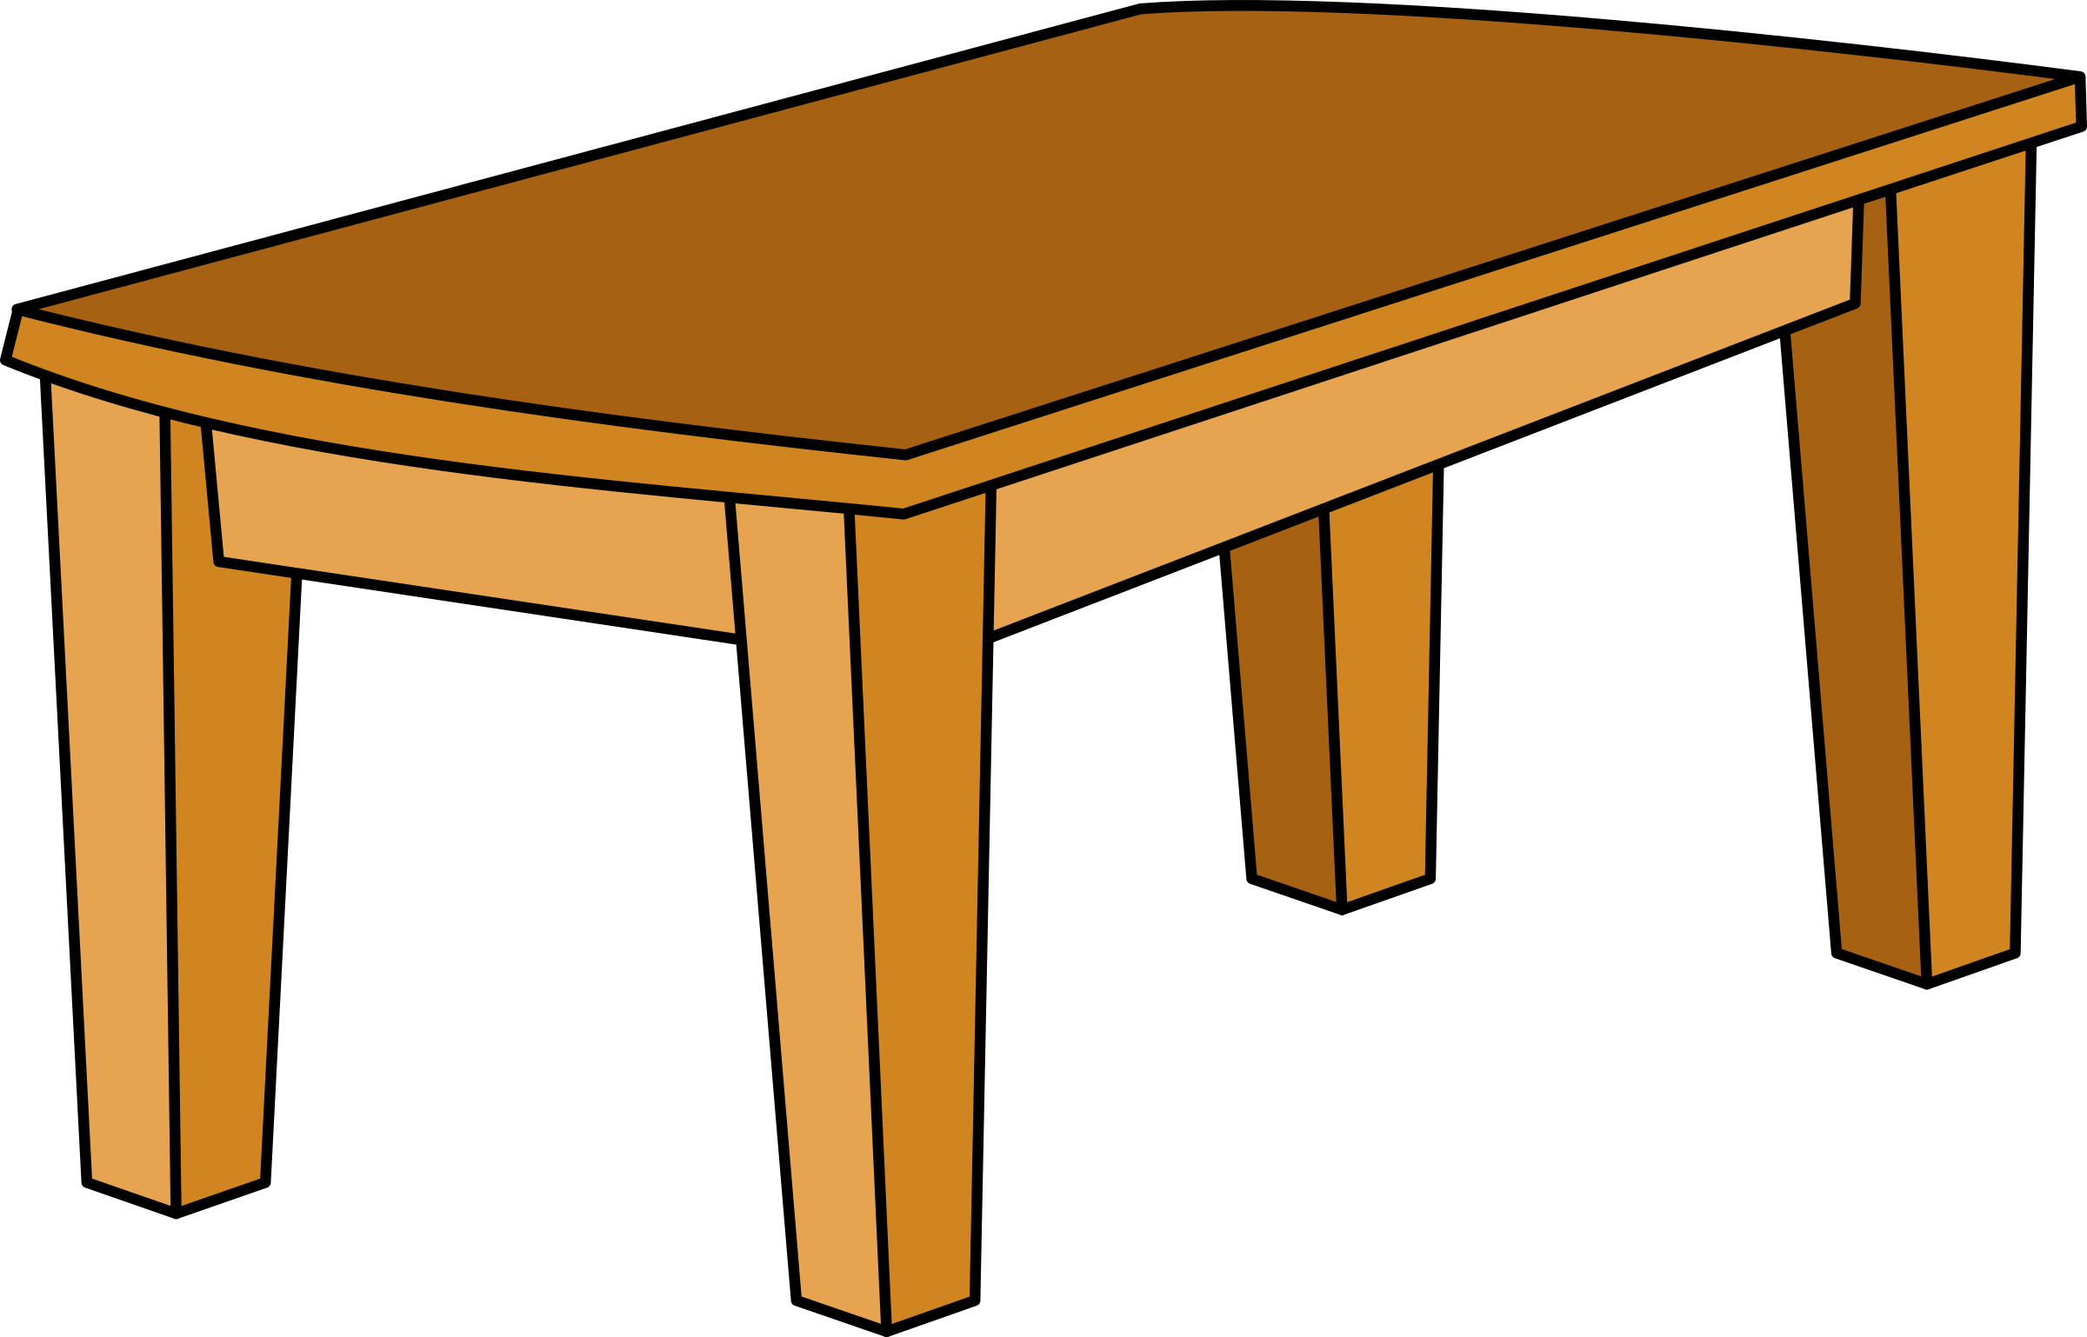
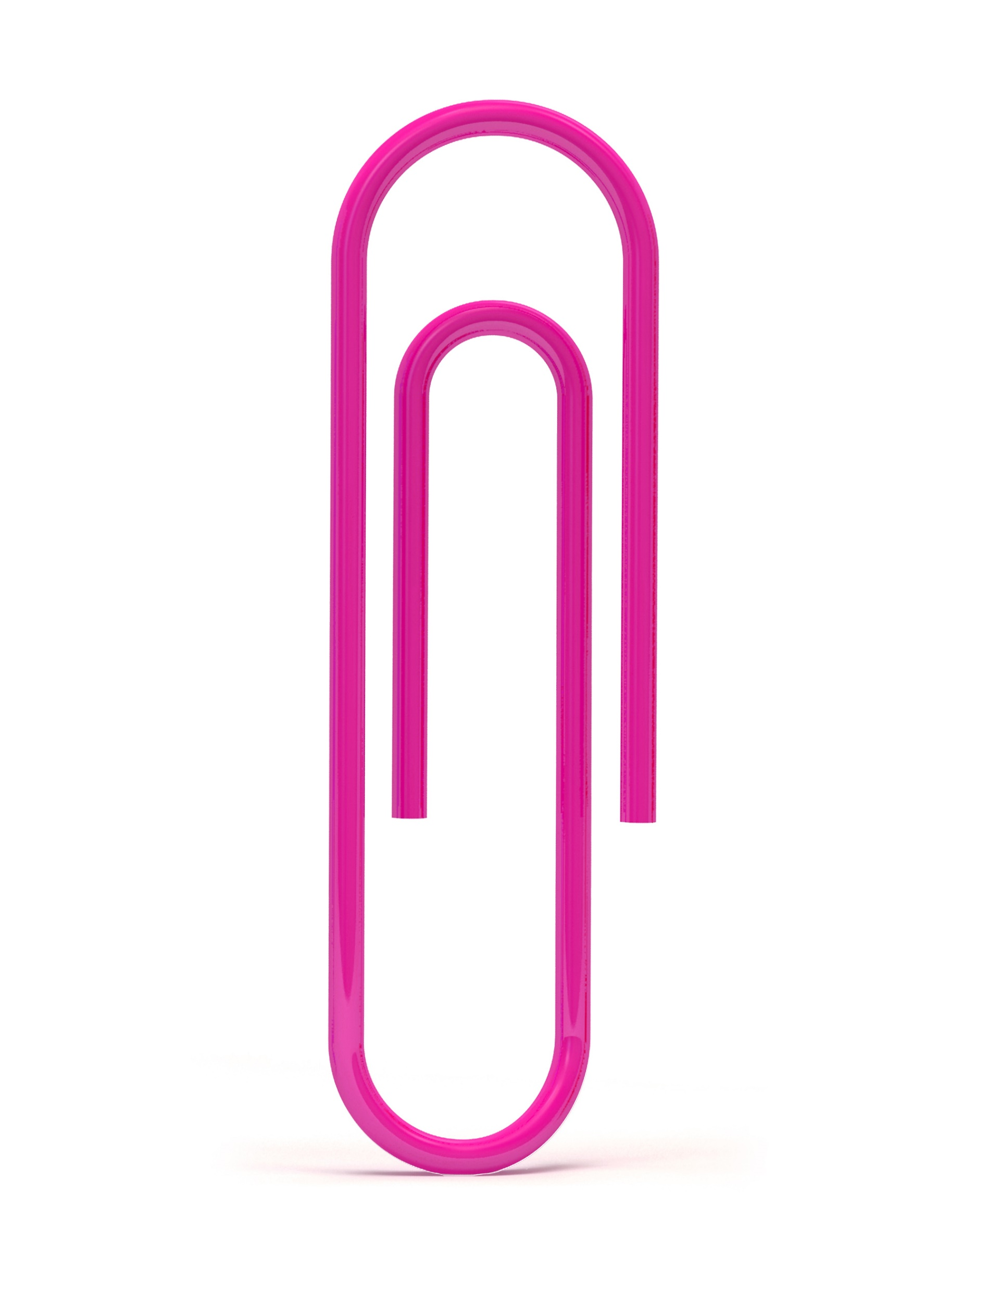
What would I use to measure? Draw a line to the right measuring tool.
Ruler (mm/cm)
Meter stick/tape measure (cm/m)
Notes:
Explain that when we are measuring, we usually use a measuring tool. Show children some of the tools we can use to measure length – easiest to show are ruler, meter stick, tape measure, measuring wheel. Explain that we don’t use the same tool for everything that we measure, we need to choose an appropriate tool using the PPT examples.

Slide 6
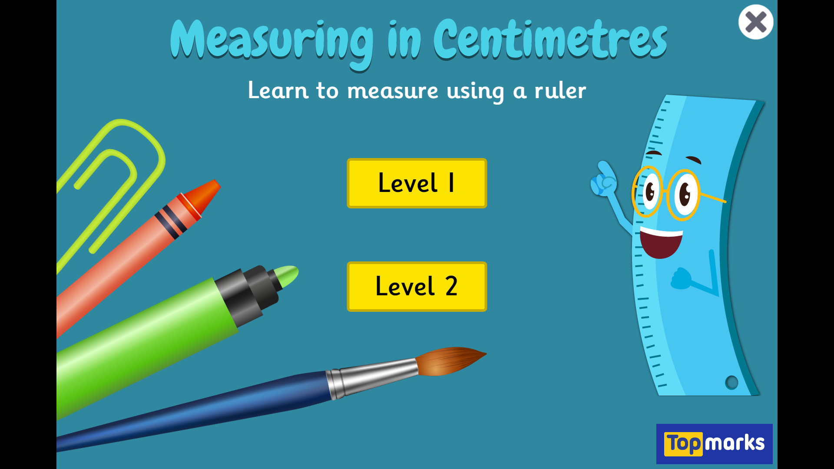
Measuring in Centimetres (topmarks.co.uk)
Notes:
Emphasise starting measuring on 0.
Ask chn to practice reading the ruler using the online ruler. Explain to chn that the smaller lines on the ruler are mm. When we are measuring an object which is not exactly a cm, we say the cm.mm

Slide 7
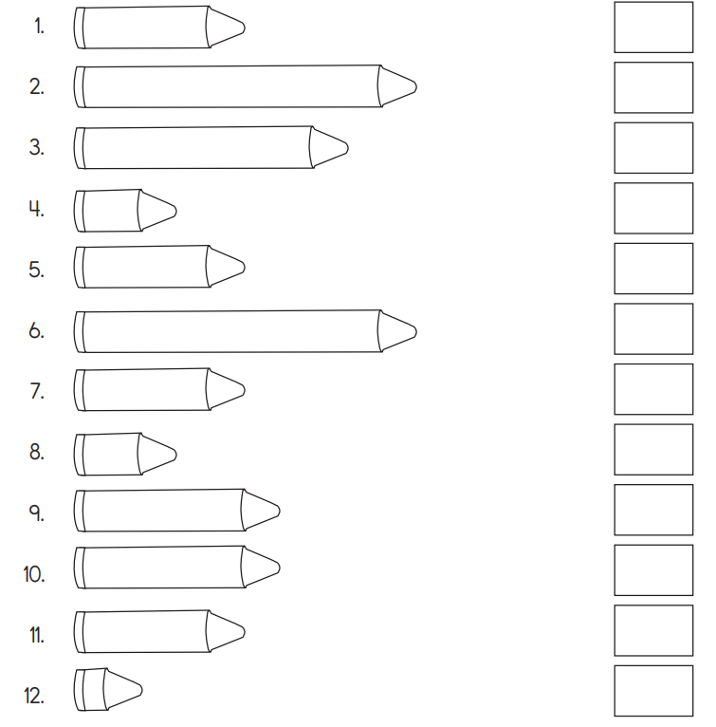
Your turn!
With the ruler that you have been given, can you measure the lines in cm. Remember to start on 0cm and end at the longest point (the point of the crayon).
Notes:
Provide chn with a ruler each, ensure that YR3 chn have a ruler with mm on it as well. Ask chn to have a look at the lines and demonstrate using PPT how to read a ruler if unsure.
Explain to YR2 chn that we might need to round to the nearest cm or m when we are measuring. GD chn can start to think about decimals at this point e.g. 3.3cm.

Slide 8
YR2 practical lesson:
Start by measuring the length of different sized tape/lines on tabletops. Look at the number of the line so you can put the measurements in the table.
Then, find objects around the classroom smaller than a ruler and measure them. YR2 children, find things and measure to the nearest cm e.g if it measures closest to 2cm than 3cm.
Then, go outside with meter stick/measuring wheel and see if you can find the lengths of different things in m e.g. length of the playground, height of a tree. Record ideas in table.

Slide 9
YR3 practical lesson:
Start by measuring the length of different sized tape/lines on tabletops. Look at the number of the line so you can put the measurements in the table. Remember that we are measuring in cm and mm.
Then, find objects around the classroom, smaller than a ruler, and measure them. YR3 will be measuring to the nearest mm which means we will be using mixed measurements.

