Slide 1
Equal groups
10.01.22

Slide 2
Y3 LO: To be able to use multiplication to calculate equal groups.
Y2 LO: To be able to recognise and make equal groups.
I can recognise equal groups.
I can make equal groups.
I can describe how groups can be made equal.
I can recognise equal groups (recap)
I can discuss how groups are equal.
I can discuss the link between equal groups and multiplication.

Slide 3
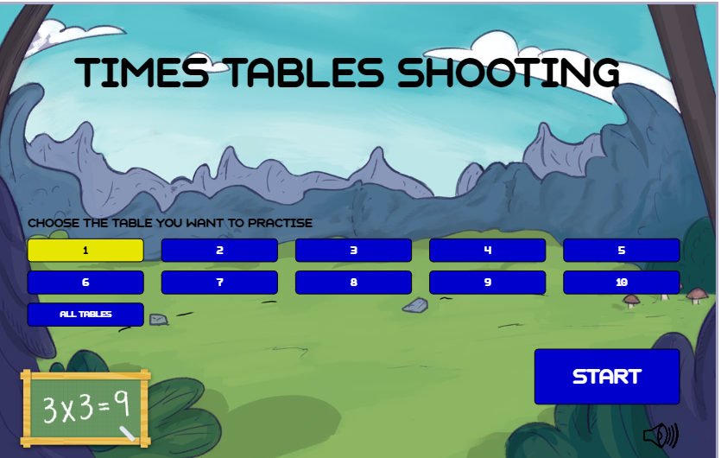
https://www.timestables.co.uk/times-tables-shooting.html
Notes:
Starter

Slide 4
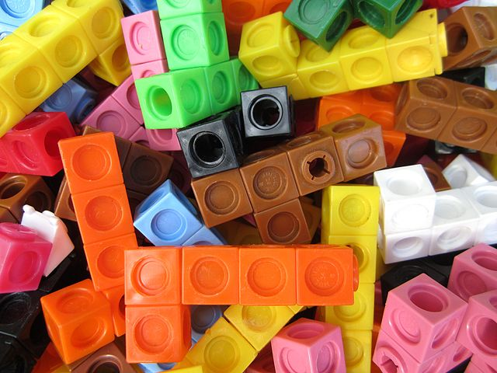
With the cubes on your table, can you and your partner put them into equal groups?
How do you know the groups are equal?
Notes:
Give partners cubes or pencils. Ask them to put them into equal groups, allowing them to choose the multiplication to focus on for now. Ask chd:
How do I know if the groups are equal / unequal?
Then have them make unequal groups and ask them How can we make these groups equal?

Slide 5
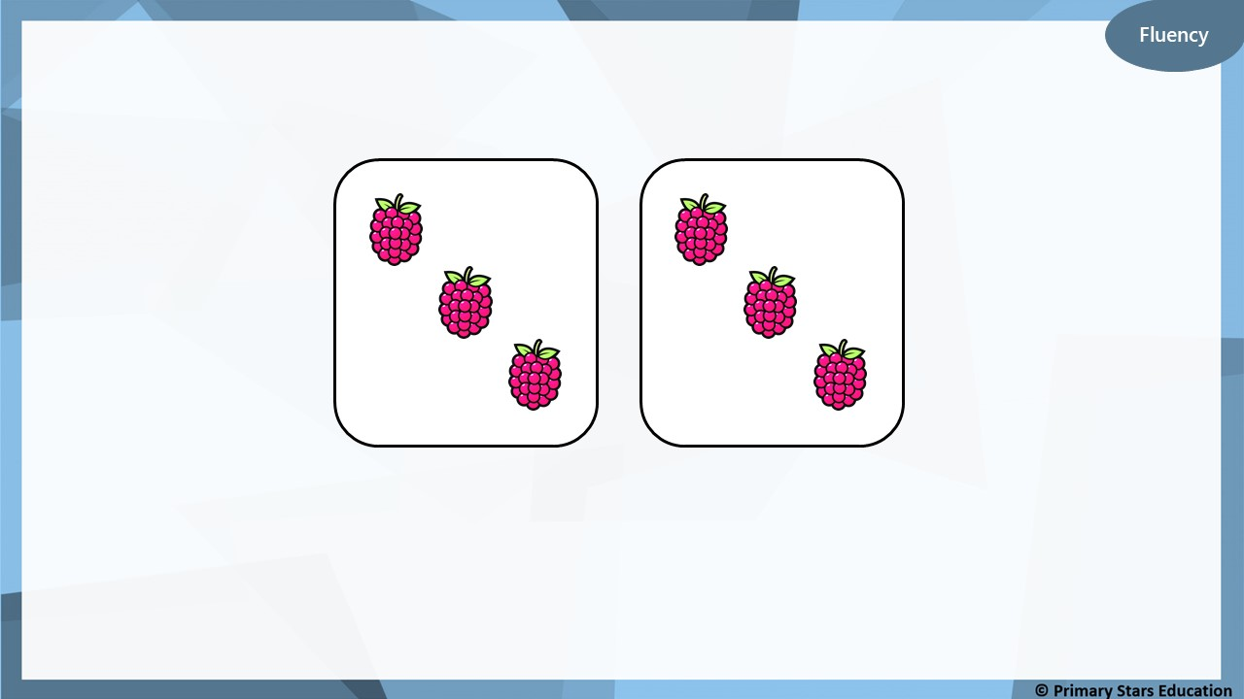
Complete the sentences.
There are ________ equal groups with ________ in each group.
2
3

Slide 6
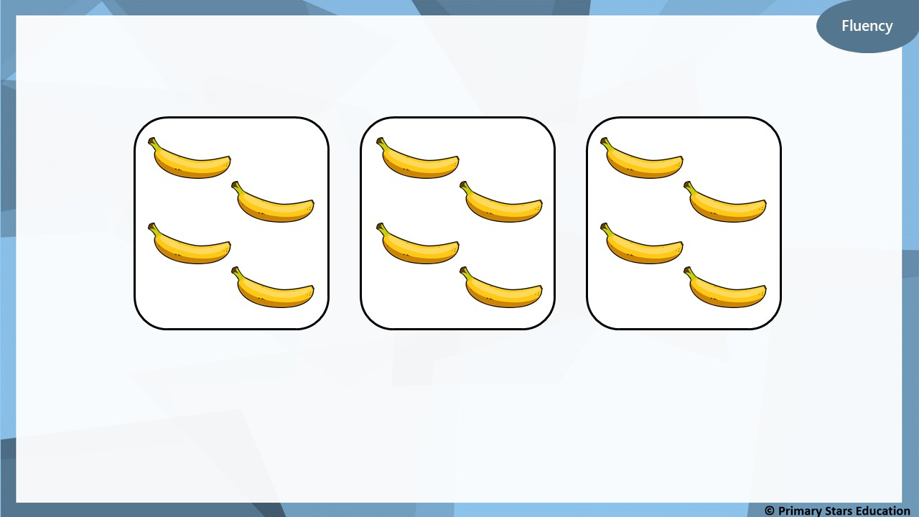
Complete the stem sentences.
3
4
There are ________ equal groups with ________ in each group.

Slide 7


Fluency
Complete the sentences.
There are ________ equal groups with ________ in each group.
3
10

Slide 8


Reasoning
The groups below are equal.
True or false? Explain how you know.
False. The middle tree shows 9 apples. The other two trees show 10 apples.

Slide 9

Problem solving
Create equal groups using the pictures below.

Slide 10
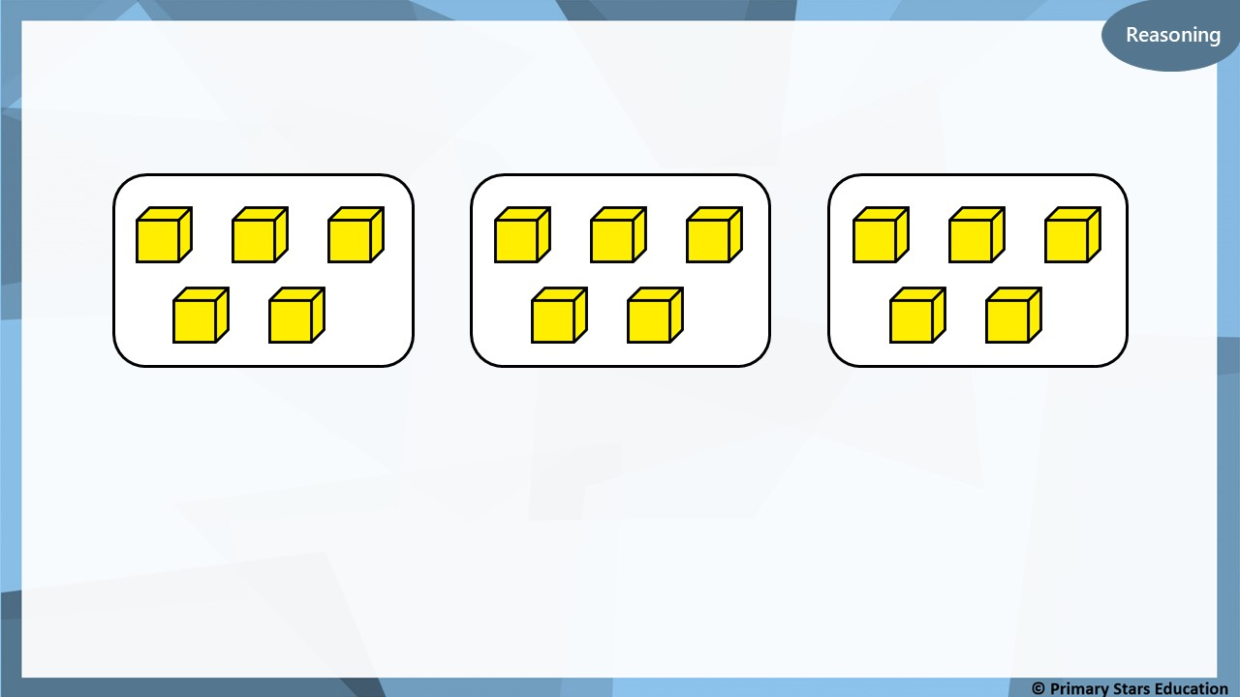
Fluency
Tick (✓) the sentences that describes the groups below.
a) There are 5 equal groups with 3 in each group.
b) There are 3 equal groups with 5 in each group.
✓

Slide 11
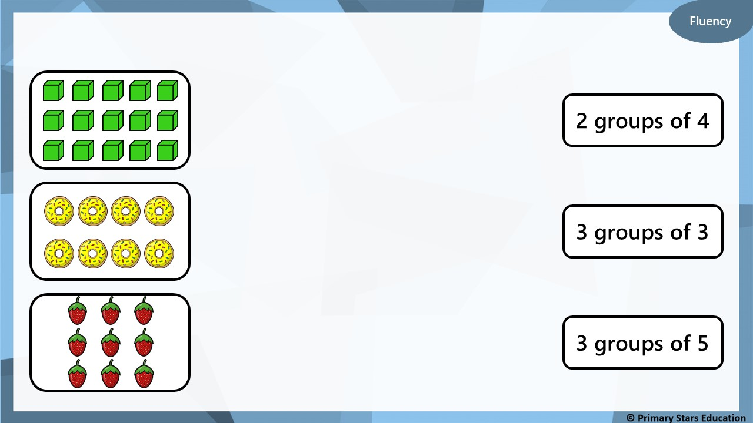
Match the pictures to the correct group number.
2 groups of 4
3 groups of 3
3 groups of 5

Slide 12
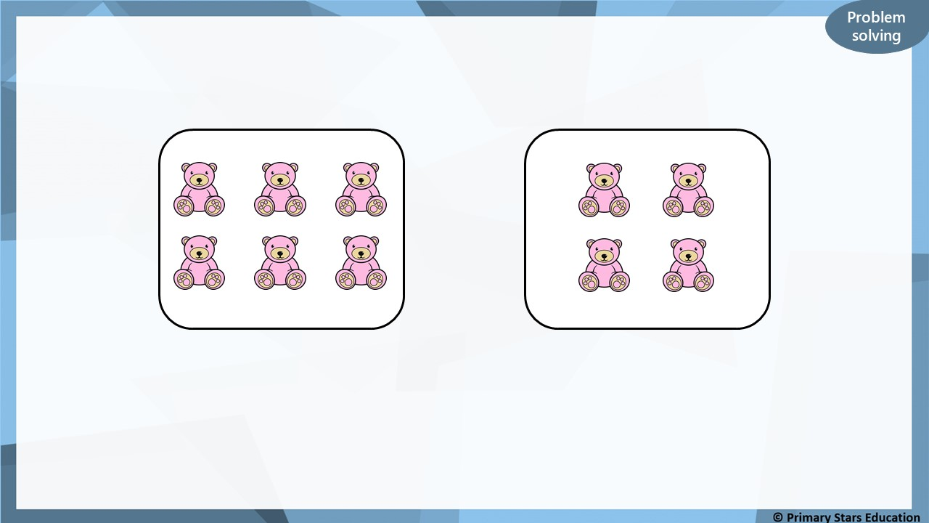
How can you make the groups equal?
Move one bear from the group on the left to the group on the right.
This will make 2 equal groups of 5.

Slide 13
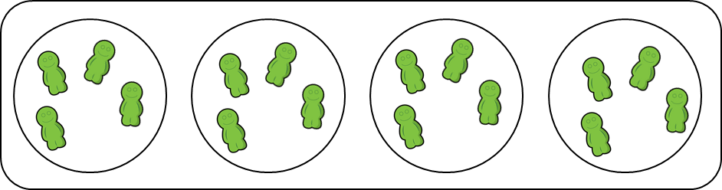
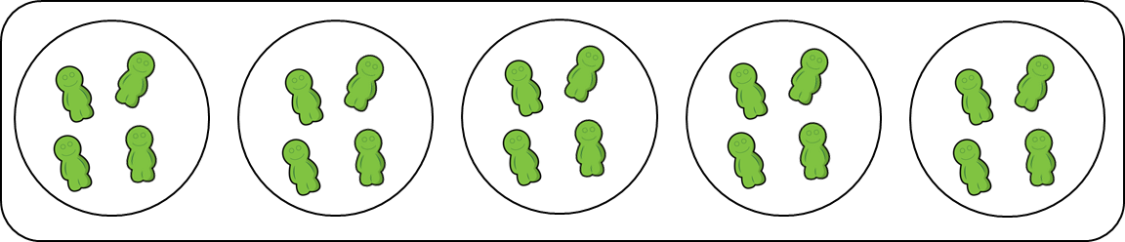
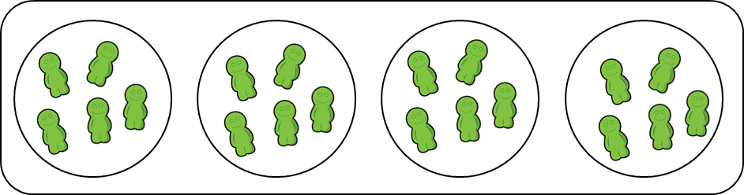
4 groups of 5
4 groups of 4
5 groups of 4

Slide 14


Describe these equal groups.
3
4
groups of .
4
3
groups of .

Slide 15




Represent three groups with eight in each – ‘three 8s’.
How many ways can you think of?
8 | 8 | 8
Did you think of any others?

Slide 16

Complete this table.
 | Describe it There are groups of . In total, there are .
Write it as a calculation | Add it

Slide 17
Learn it - Fluency
Complete this table.
 | Describe it There are groups of . In total, there are .
Write it as a calculation 6 x 2 = 12 | Add it 2 + 2 + 2 + 2 + 2 + 2 = 12
6
2
12

Slide 18

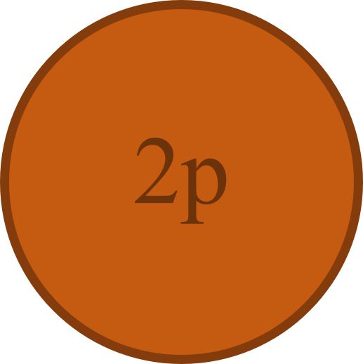

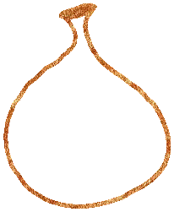



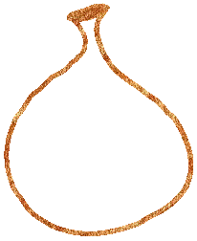




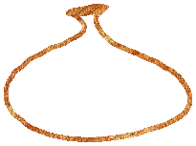

Which group of money is the odd one out? Explain your answer.
A
B
C

Slide 19
Learn it - Reasoning and problem solving
Which group of money is the odd one out? Explain your answer.
A
Group A is the odd one out because it has three bags of 5p whereas the others have three bags of 6p.

Slide 20




Match the equal groups together.
Six 3s
Three 5s
4 | 4 | 4 | 4
Four 4s

Slide 21
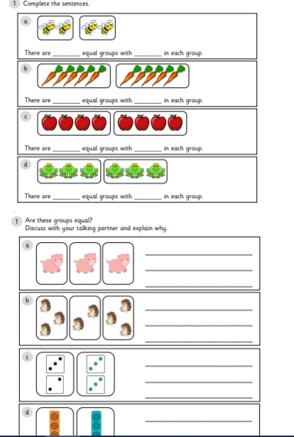
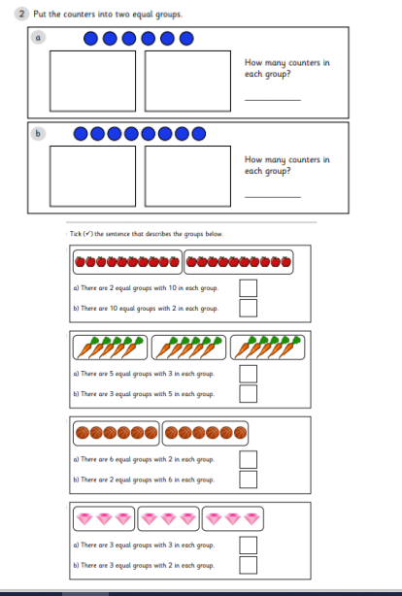
Y2 Activity one:
Complete the worksheet, you have two sheets to complete.

Slide 22



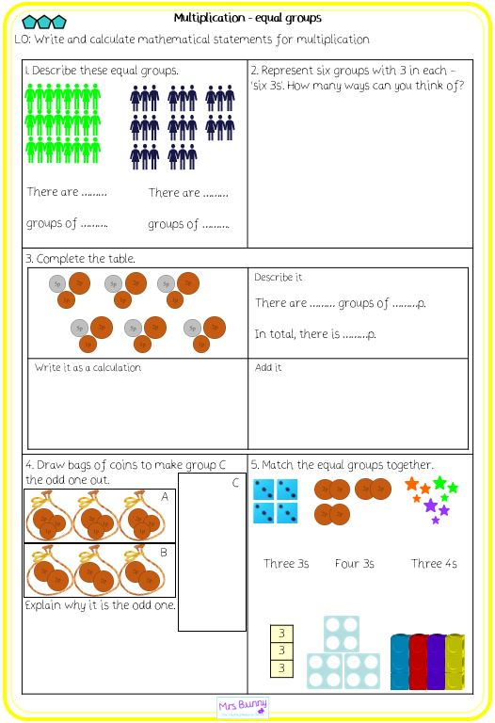
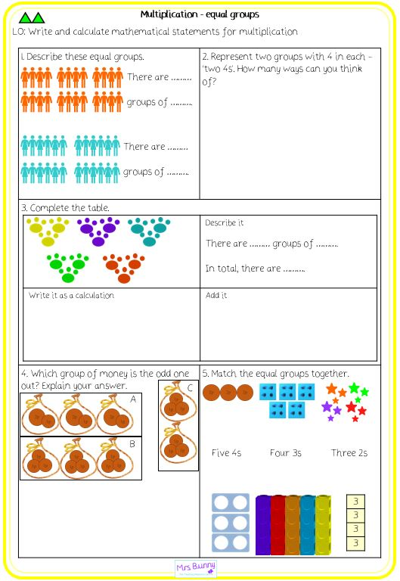
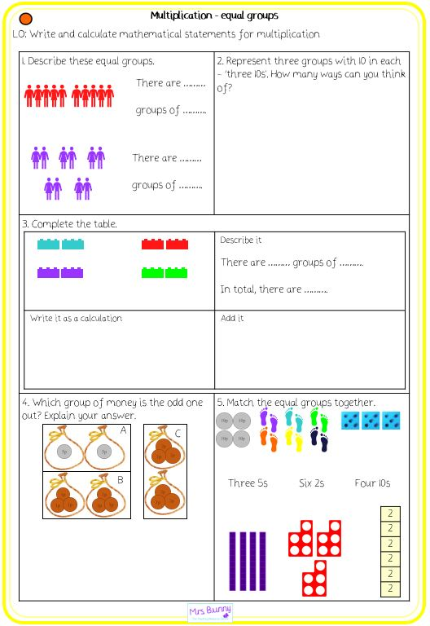
Y3 Activity:

