Slide 1
Arrays
11.01.22

Slide 2
Y2 LO: To use arrays to represent multiplication.
Y3 LO: To recap using arrays to represent multiplication.
I can explain the link between an array and a repeated addition expression.
I can write a multiplication sum to match an array.
I know that multiplication is commutative.
I can write a multiplication sum to match an array.

Slide 3
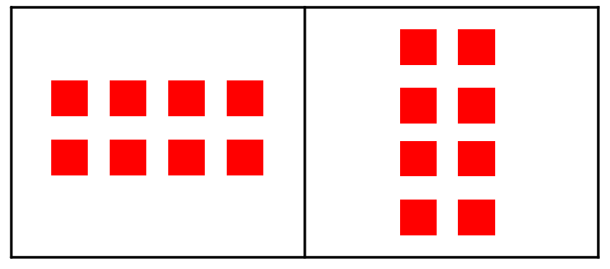
Notes:
What is the same / different about the arrays? Who can remember what an array is? What is it showing us?

Slide 4


Fluency
What is a row?
5
How many in each row? ________
How many rows are there? ________
2

Slide 5

Fluency
Complete the sentences.
2
There are _____ in each row.
There are _____ rows.
_____ + _____ + _____ = _____
There are _____ altogether.
3
2
2
2
6
6

Slide 6

Fluency
Complete the sentences.
5
There are _____ in each row.
There are _____ rows.
_____ + _____ = _____
There are _____ altogether.
2
5
5
10
10

Slide 7
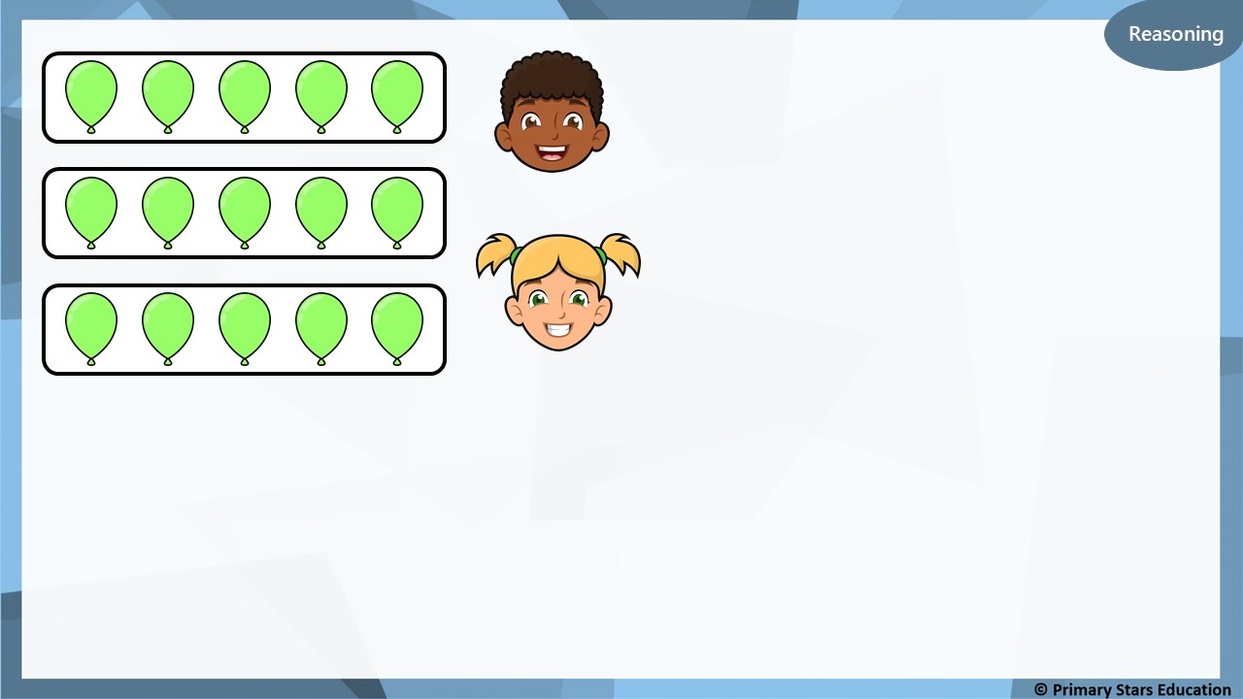
The matching number sentence is 5 + 5 + 5.
Dom
The matching number sentence is 3 + 3 + 3.
Kat
Who do you agree with?
Explain your answer.
Dom is correct.
There are 5 in each row and there are 3 rows.

Slide 8
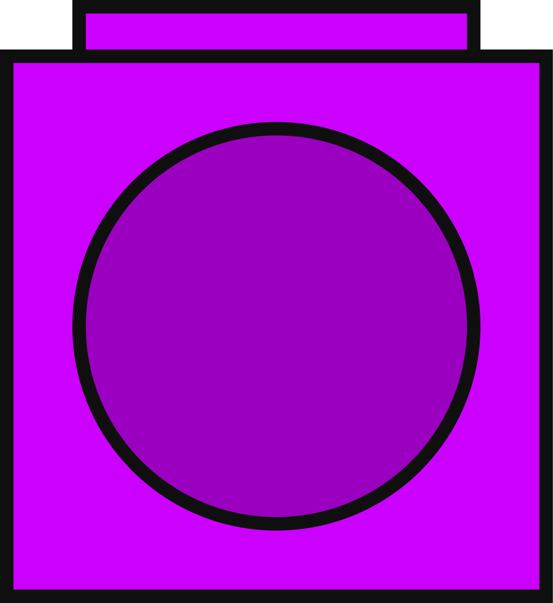
Problem solving
What array could be built with 6 cubes?
Build, draw and describe the array.
or
2 in each row. 3 rows.
3 in each row. 2 rows.

Slide 9



Fluency
Match the array to its number sentence.
2 + 2 + 2
2 + 2
2 + 2 + 2 + 2

Slide 10

Fluency
Complete the sentences.
2
There are _____ in each row.
There are _____ rows.
_____ + _____ + _____ + _____ = _____
There are _____ altogether.
4
2
2
2
2
8
8

Slide 11
Reasoning
What mistake has been made in the array above?
There are an unequal amount of squares in the array.
One of the row contains 4 instead of 5.

Slide 12
Problem solving
Build and draw an array to match the description.
There are 5 rows.
There are 2 on each row.

Slide 13
Fluency
What is the difference between a row and column?
Rows go across
Columns go down
2
5
There are _______ rows. _______ in each row.
There are _______ columns. _______ in each column.
5
2

Slide 14
Fluency
Complete the sentences.
4
_______ rows.
_______ in each row.
_______ columns.
_______ in each column.
2
2
4

Slide 15
Fluency
Complete the sentences.
3
_______ rows.
_______ in each row.
_______ columns.
_______ in each column.
10
10
3

Slide 16
Fluency
Complete the table.
Array | Describe: Rows | Describe: Columns | Number sentence
 | _____ rows. _____ in each row. | _____ columns. _____ in each column.
 | _____ rows. _____ in each row. | _____ columns. _____ in each column.
3
2
2 + 2 + 2
3+ 3
2
3
2
5
5 + 5
2 + 2 + 2 + 2 + 2
5
2

Slide 17
Fluency
Write number sentences to match the array.
2
3
3
2
________ x ________ and ________ x ________

Slide 18
Fluency
Draw an array that will show 5 x 3.
3
5
How else could you describe this array? ________ x ________

Slide 19

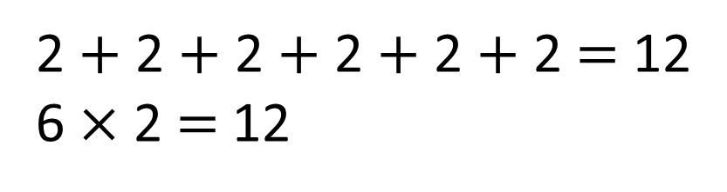
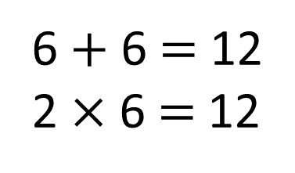
What is an array?
6 columns
2 rows
6 $+$ 6 $=$ 12
2 $×$ 6 $=$12
2 $+$ 2 $+$ 2 $+$ 2 $+$ 2 $+$ 2 $=$ 12
6 $×$ 2 $=$12

Slide 20


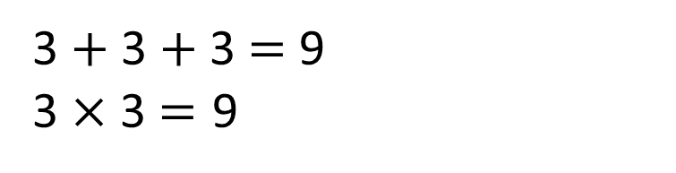
You can’t make an array because 9 is an odd number
3 $+$ 3 $+$ 3 $=$ 9
3 $×$ 3 $=\text{9}$

Slide 21

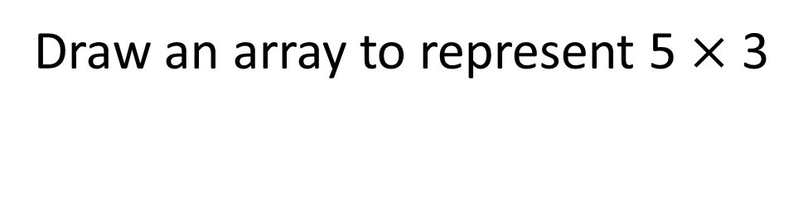
Draw an array to represent 5 $×$ 3

Slide 22





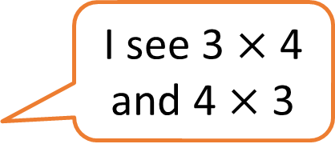
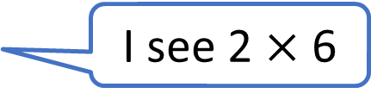
What do you see?
I see 6 $×$ 2
I see 2 $×$ 6
I see one 12 and twelve 1s
I see 3 $×$ 4
and 4 $×$ 3

Slide 23
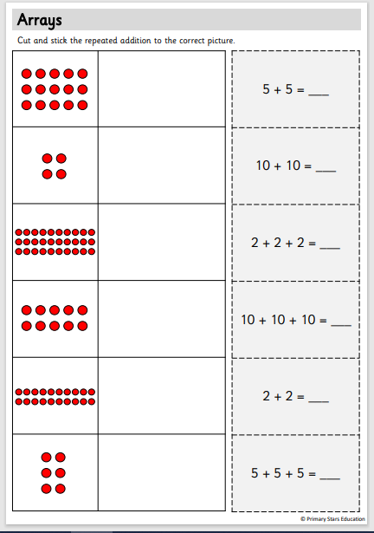
Y2 Activity one:
With your partner, match the array to the correct repeated addition.

Slide 24
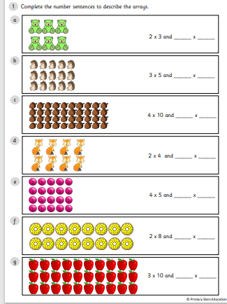
Y2 Activity two:
Complete the worksheet.

Slide 25
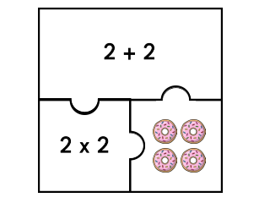
Y3 Activity one:
With a partner, have a go at the array jigsaws.

Slide 26
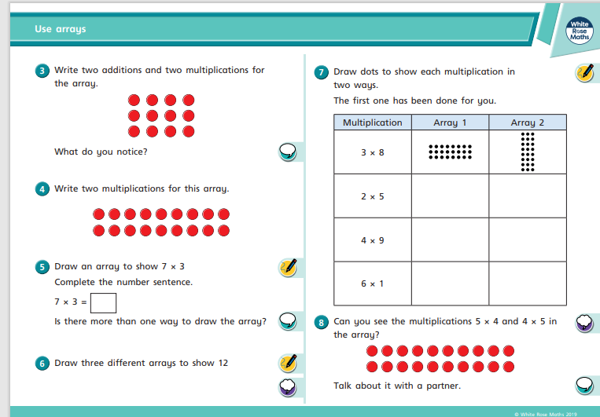
Y3 Activity two:
Complete the worksheets.

