Slide 1
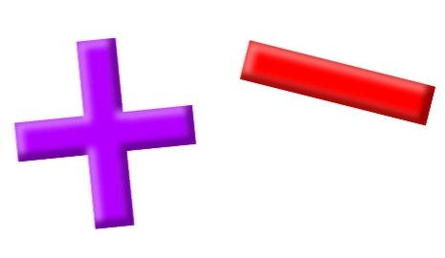
Add and Subtract
Lesson 9

Slide 2
YR2 LO: To add by making 10. (recap)
I can recall number bonds to 10
I can partition 1-digit numbers to make bonds
I can use this knowledge to add numbers together crossing 10.

Slide 3
YR3 LO: To Add 3-digit and 2-digit numbers - crossing 100.
I can understand how to carry when adding using column method.
To use concrete objects and pictorial representations to check my answers.
I can use my knowledge to solve reasoning questions.

Slide 4
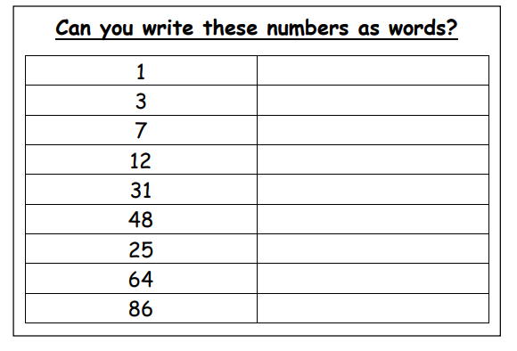
Starter:
Work through the sheet to write the numbers in written format e.g.
9 would be nine.
Some children will have a word mat to support them.

Slide 5
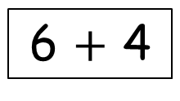
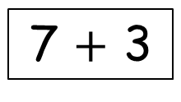
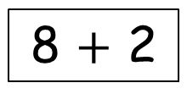
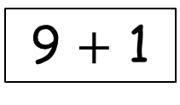
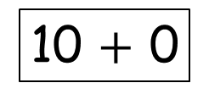
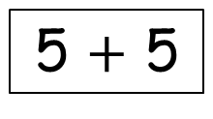
Can you complete the pattern?
5 $+$ 5
The numbers on the left increase (go up) by 1 each time.
The numbers on the right decrease (go down) by 1 each time.
6 $+$ 4
7 $+$ 3
8 $+$ 2
9 $+$ 1
10 $+$ 0
Notes:
What is the pattern. Chn should notice that the numbers on the left are increasing by 1,numbers on right are decreasing by 1. All numbers equal 10.

Slide 6
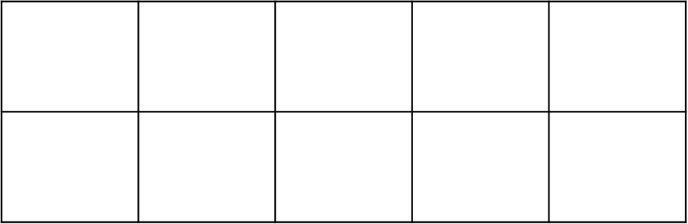
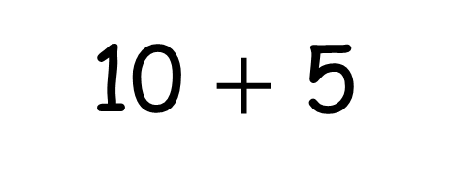
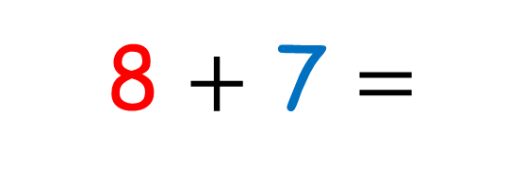
Making 10 is one of the most important strategies.
8 $+$ 7 $=$
10 $+$ 5
Notes:
We need to be able to partition numbers to make 10. For example here, we can partition 7 into 5 and 2 because we know that 8 + 2 makes 10. This makes it easier to add.

Slide 7
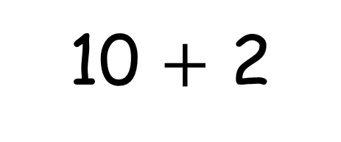
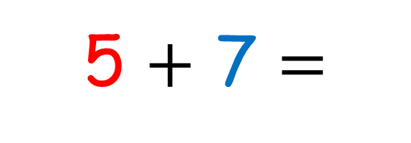
Making 10 is one of the most important strategies.
5 $+$ 7 $=$
10 $+$ 2
Notes:
How else could I make 10? Chn should recognize that they could partition 5 into 3 and 2 and add 3 to the 7 to make 10.

Slide 8

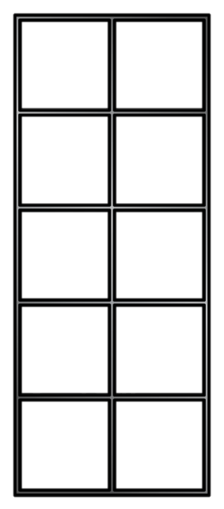










Number bonds to 10
Have a think
10
$$+$$
0
0
$$+$$
10
9
$$+$$
1
1
$$+$$
9
8
$$+$$
2
2
$$+$$
8
7
$$+$$
3
3
$$+$$
7
6
$$+$$
4
4
$$+$$
6
5
$$+$$
5
Notes:
On whiteboards, ask chn to show you a number bond. They can colour one number of circles in and just use an outline for the other amount.

Slide 9
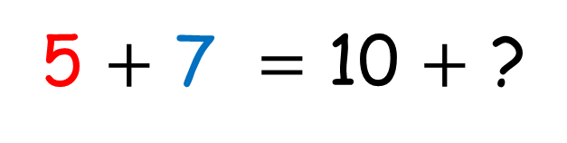
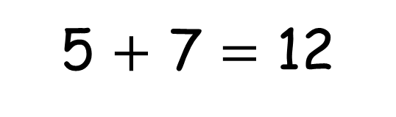
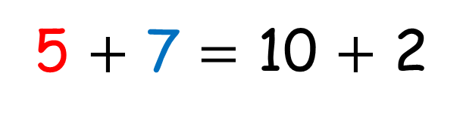
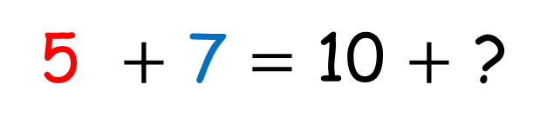
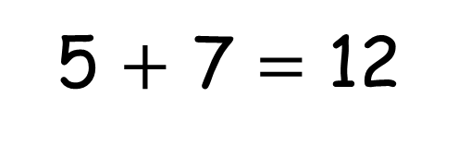
Let’s compare!
5 $+$ 7 $=$ 12
5 $+$ 7 $=$ 12
5 $+$ 7 $=$ 10 $+$ ?
5 $+$ 7 $=$ 10 $+$ ?
5
2
2
3
5 $+$ 7 $=$ 10 $+$ 2
Notes:
We are starting on 5 first. We know that we need 5 more to make 10. We can partition 7 into 5 and 2. We add 5 to 5 to make 10 and have 2 left. That means we add 10 and 2 to get 12.
The second time, we are starting on 7. We know that we need 3 more to make 10. We can partition 5 into 3 and 2. We add 7 and 3 to make 10 and have 2 left. That means we add 10 and 2 to get 12.

Slide 10


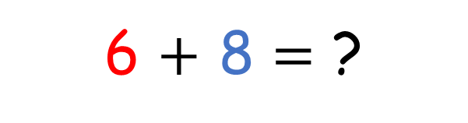
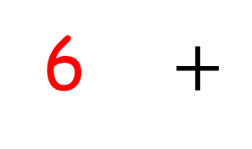
Have a think
6 $+$
8
4
4
6 $+$ 8 $=$ ?
6 $+$ 4 $=$ 10
10 $+$ 4 $=$ 14
Notes:
We are starting with 6. What could we partition 8 into to help make 10 with 6. Should recognize we need 4 to make 10 and that leaves 4 left. 10 plus 4 gives us 14.

Slide 11

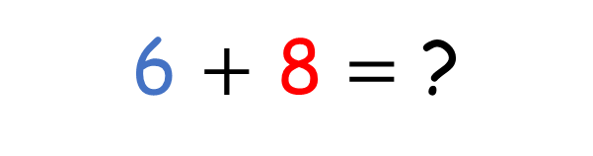
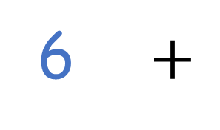
Have a think
6 $+$
8
4
2
6 $+$ 8 $=$ ?
8 $+$ 2 $=$ 10
10 $+$ 4 $=$ 14
Notes:
We are starting with 8. What could we partition 6 into to help make 10 with 8. Should recognize we need 2 to make 10 and that leaves 4 left. 10 plus 4 gives us 14.

Slide 12


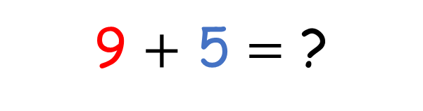
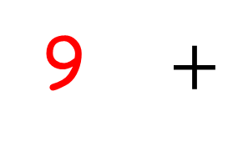
Have a think
9 $+$
5
1
4
9 $+$ 5 $=$ ?
9 $+$ 1 $=$ 10
10 $+$ 4 $=$ 14
Notes:
What could we do this time if we start with 9?

Slide 13



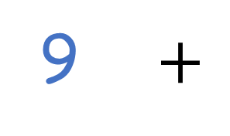
9 $+$
5
4
5
9 $+$ 5 $=$ ?
5 $+$ 5 $=$ 10
10 $+$ 4 $=$ 14
Notes:
What could we do this time if we start with 5?

Slide 14
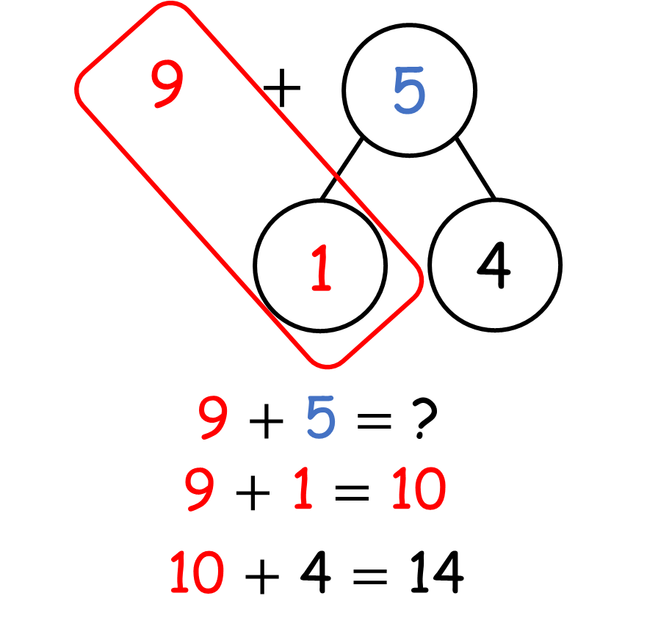
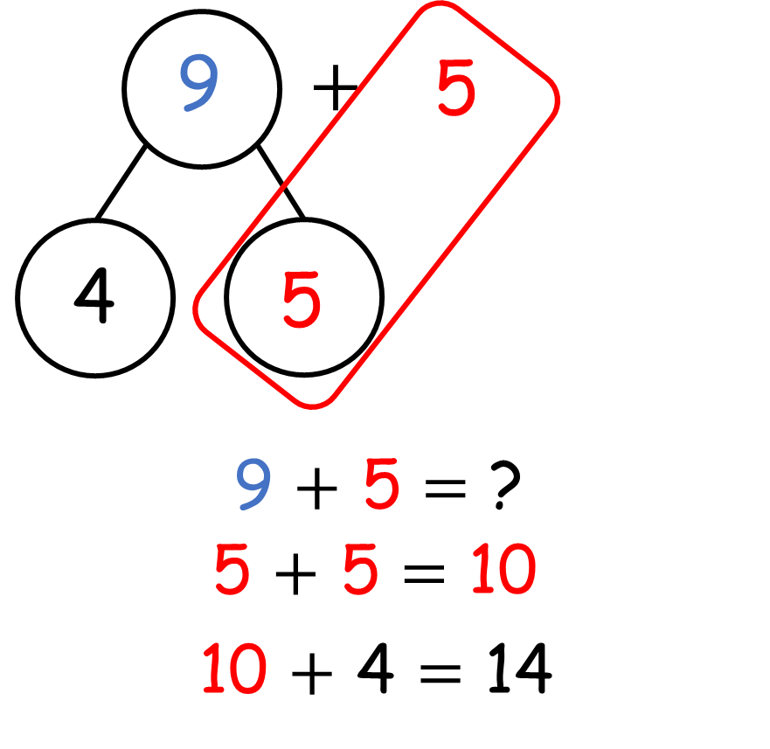

Slide 15
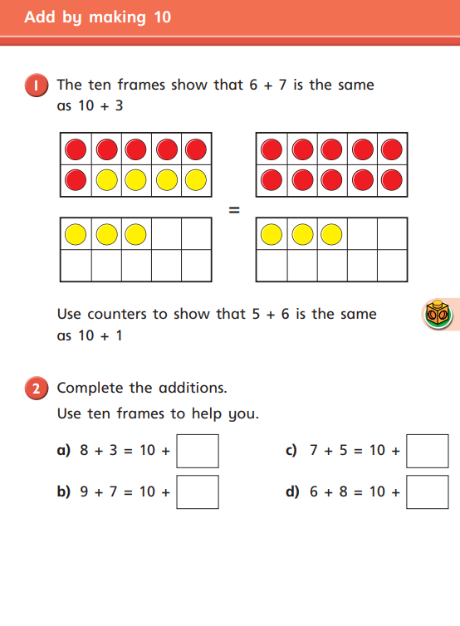
Year 2 Activity one:
Please complete the first activity as independently as you can. If your teacher tells you, you can use a tens frame to help you. If not, you need to work your answers out mentally (in your head).

Slide 16
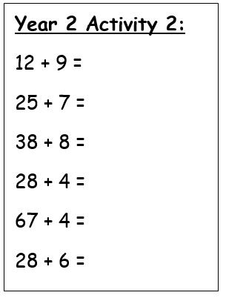
Year 2 Activity two:
Once you have completed your first sheet, see if you can work out these addition questions by making 10 first.
If you have finished, ask your teacher for the column addition extension.

Slide 17
Recap
Last week, we looked at adding 2-digit and 3-digit numbers using column method. We looked at adding the 1s first, then the 10s, then the 100s.
On your whiteboards, can you work out the answer to each question and show your working out using column method.

Slide 18
 | H | T | O
 | 4 | 7 | 9
+ | 2 | 4 | 5
Notes:
Ask child to demonstrate working out on the board and talk through answer.

Slide 19
 | H | T | O
 | 3 | 1 | 7
+ | 5 | 8 | 4
Notes:
Ask child to demonstrate working out on the board and talk through answer.

Slide 20
 | H | T | O
 | 2 | 7 | 8
+ | 4 | 6 | 5
Notes:
Ask child to demonstrate working out on the board and talk through answer.

Slide 21
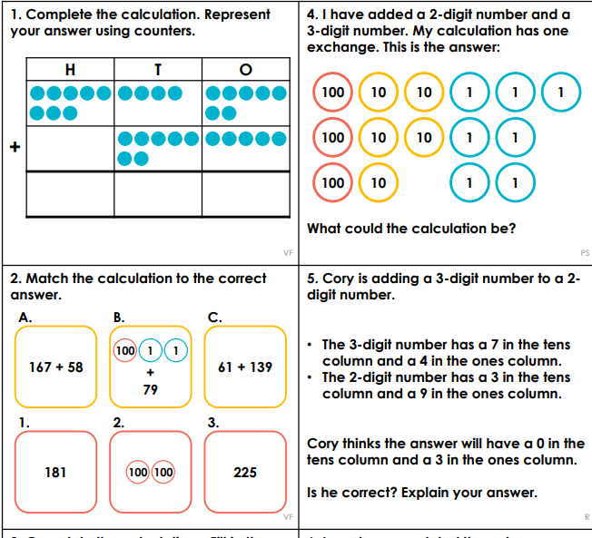
Year 3 Activity:
Year 3, work in mixed ability pairs to complete the sheet. Once you have completed this and had your answers checked by an adult, have a look at the discussion problems.

Slide 22
Plenary
one
three
seven
twelve
thirty-one
forty-eight
twenty-five
sixty-four
eighty-six

