Slide 1
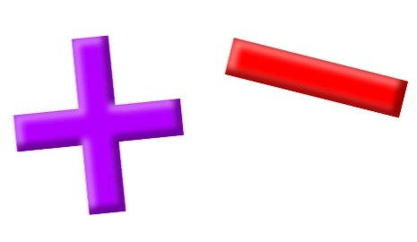
Add and Subtract
Lesson 8

Slide 2
YR2 LO: To add and subtract 10s from a given number.
I can understand which unit changes when I add and subtract 10.
I can complete calculations mentally with a few jottings.
I could use the column method to help work out my answer.

Slide 3
YR3 LO: To add 3-digit and 2-digit numbers (crossing 100).
I can understand how to carry when adding using column method.
To use concrete objects and pictorial representations to check my answers.
I can use my knowledge to solve reasoning questions.

Slide 4
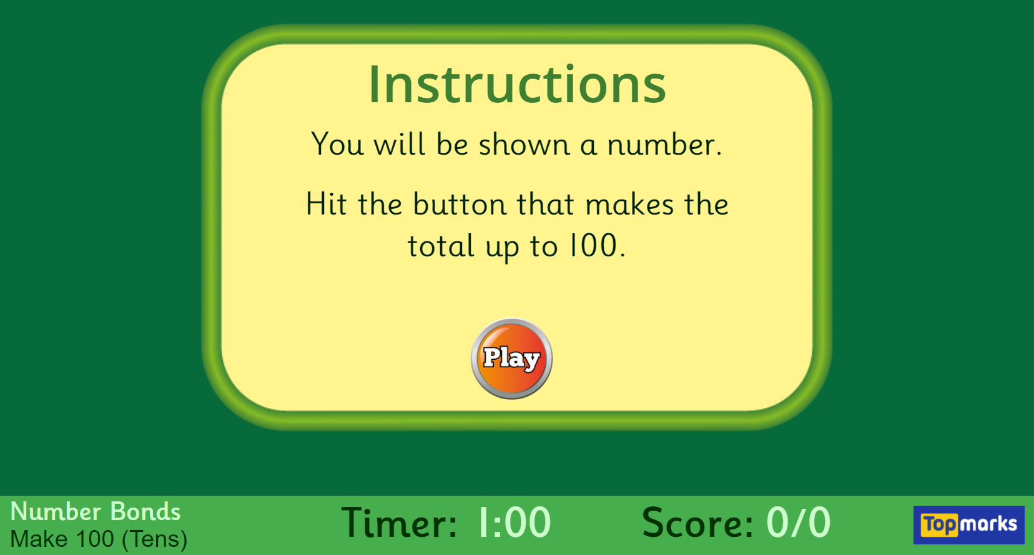
Starter: Hit the Button - Quick fire maths practise for 6-11 year olds (topmarks.co.uk)

Slide 5
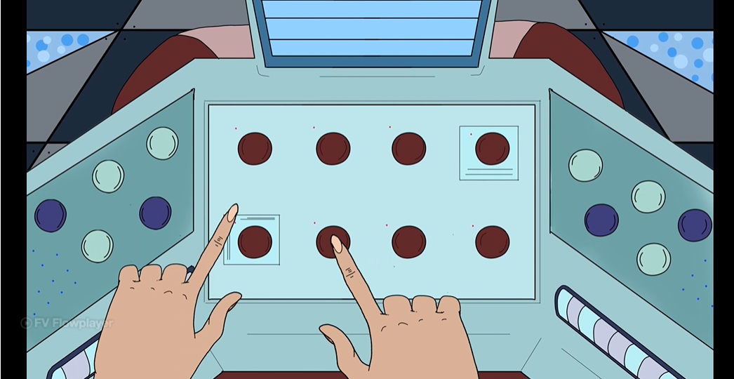
Add and Subtract 10s Year 2 Addition and Subtraction Learning Video Clip | Classroom Secrets

Slide 6
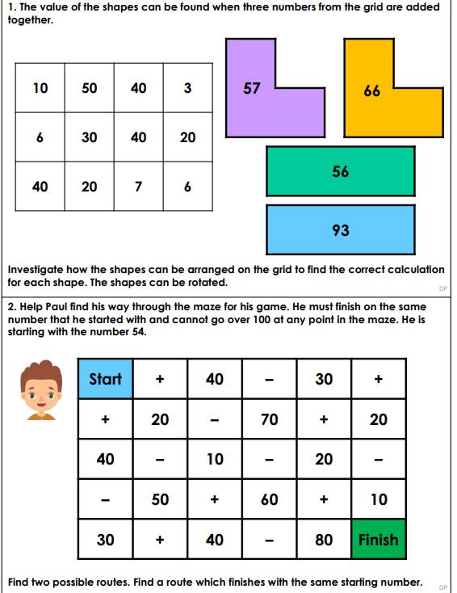
Year 2 Activity:
In mixed ability pairings, work through the two discussion problems. How did you work out your answers? Is there only one solution for each answer? Which method did you use to work out your answer?
YR2 – Independently work through Year-2-Add-and-Subtract-10s-Maths-Recovery-Main-Activity.pdf

Slide 7
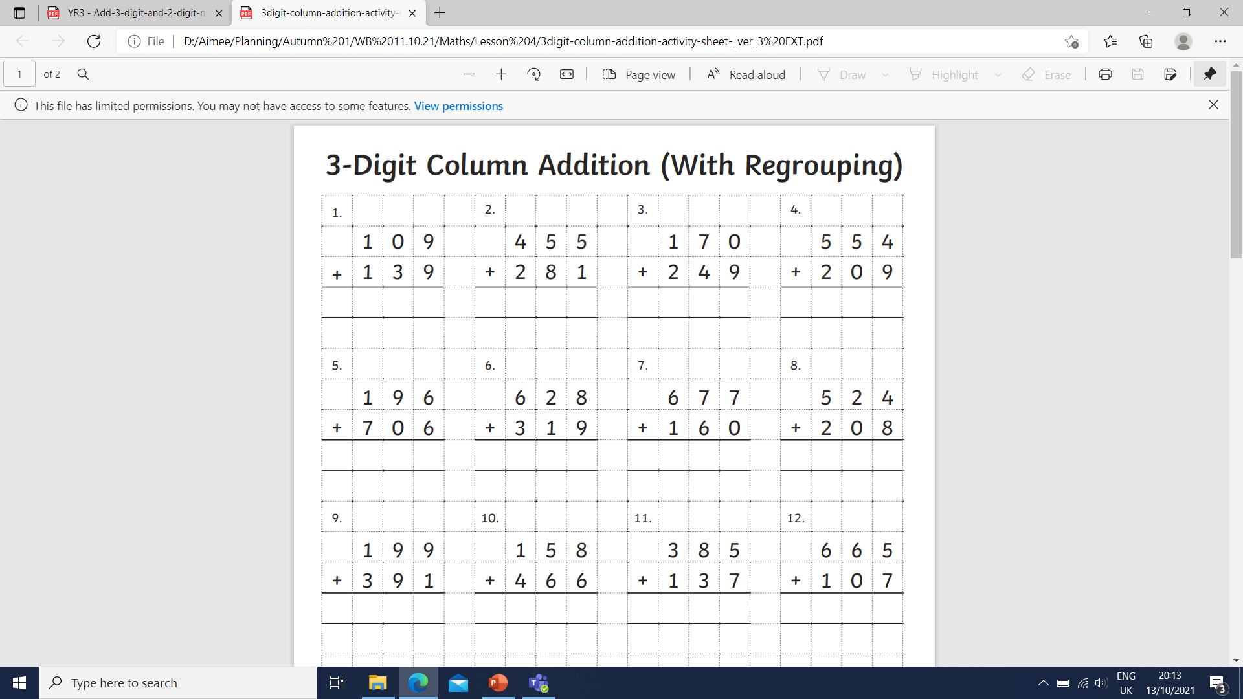
Year 3 – Let’s work through some examples together.

Slide 8
Year 3 – Let’s work through some examples together.

Slide 9
Year 3 – Let’s work through some examples together.

Slide 10
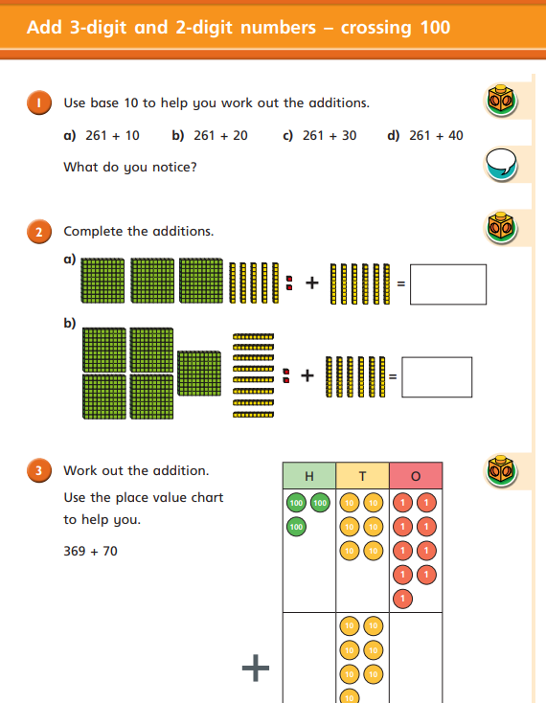
Year 3 Activity:
Complete the WhiteRose sheet. Remember to use a whiteboard to help you with some addition using column method. If you finish early, you can use your time to practice your timetables on TTRockstars.

