Slide 1
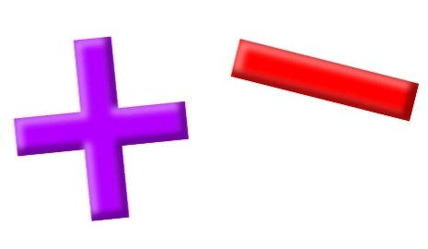
Add and Subtract
Lesson 7

Slide 2
YR2 LO: To add and subtract 10s.
To add and subtract numbers mentally.
To understand which digit changes when adding or subtracting 10s.
To use concrete objects and pictorial representations to check my answers.

Slide 3
YR3 LO: To add and subtract 3-digit and 2-digit numbers (not crossing 100).
I can understand the place value of each digit in 2- and 3-digit numbers.
I can exchange and carry place value to work out addition and subtraction questions.
I can show my working out using column method.

Slide 4
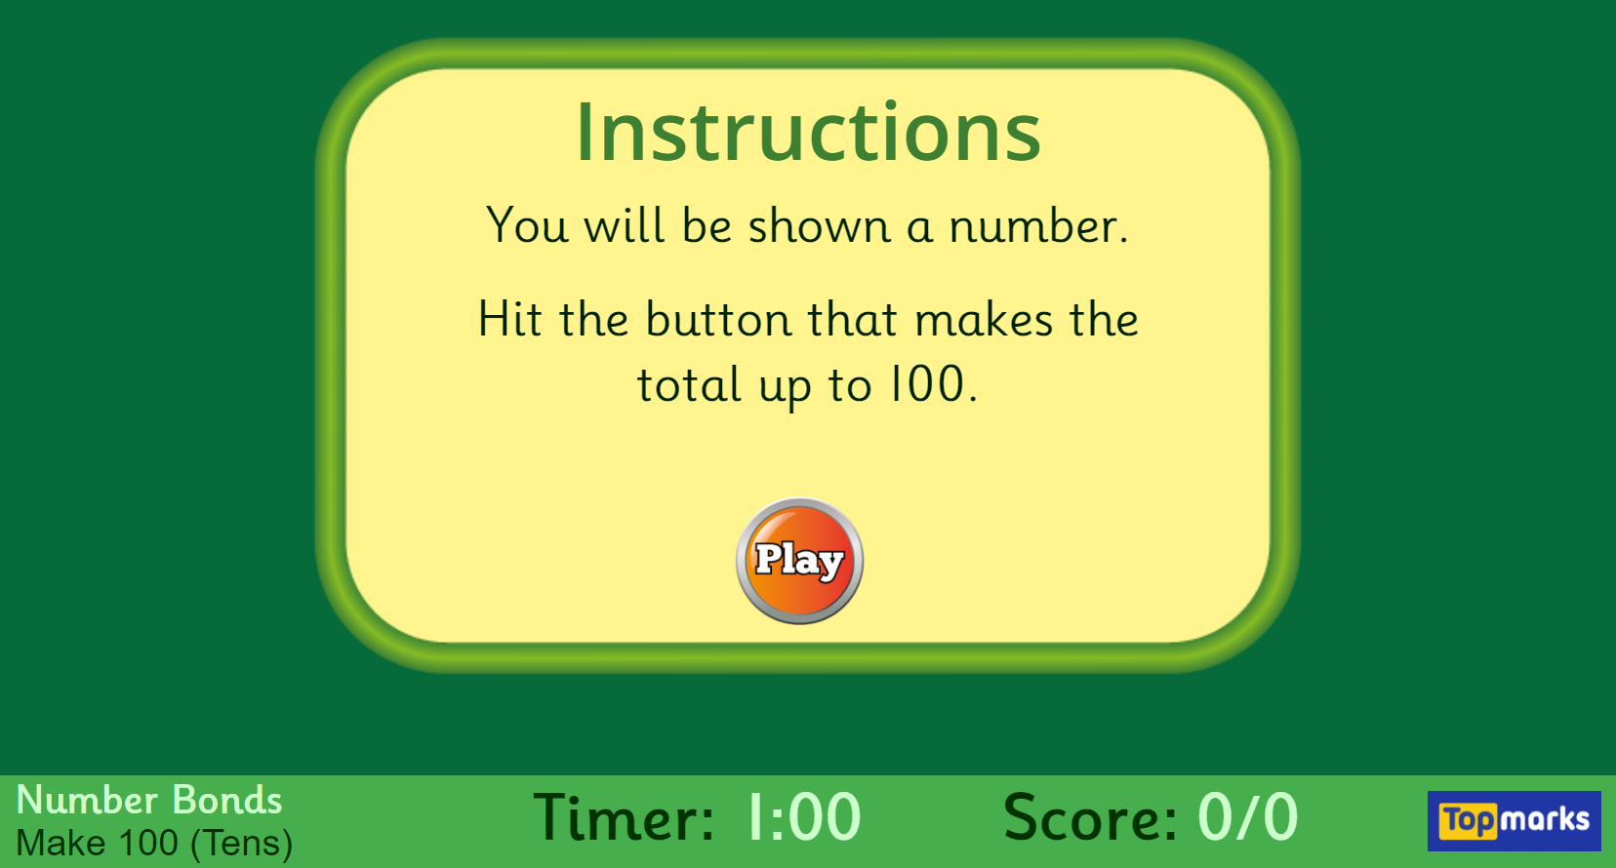
Starter: Hit the Button - Quick fire maths practise for 6-11 year olds (topmarks.co.uk)

Slide 5


Amount of bread rolls available today:
20
30
40
Notes:
At a bakery, a baker has made some bread. The bread comes out in batches of 10. SO far he has made 2 batches of 10. The baker bakes another batch of 10. How many will he have now? What about if he adds another batch of 10?

Slide 6
Amount of bread rolls available today:
50
40
30
Notes:
He eventually make 5 batches of 10 making 50 bread rolls. The local shop sells a bun to 10 different people each hour. How many rolls will be left after 1 hour? 2 hours?

Slide 7


66
76
76
86
86
Notes:
By lunch time, the baker has 66 bread rolls left. He decided to bake another batch of 10 for the lunch time rush. How many will he have? What about if he makes another batch of 10? Did we need to change the 1s in our calculation? Why/Why not? We will be adding and taking away 10 today so we are only changing the tens column (most of the time)

Slide 8

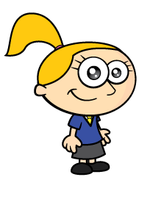

When you’re colouring 10 more or 10 fewer you simply colour the squares above and below
1 | 2 | 3 | 4 | 5 | 6 | 7 | 8 | 9 | 10
11 | 12 | 13 | 14 | 15 | 16 | 17 | 18 | 19 | 20
21 | 22 | 23 | 24 | 25 | 26 | 27 | 28 | 29 | 30
31 | 32 | 33 | 34 | 35 | 36 | 37 | 38 | 39 | 40
41 | 42 | 43 | 44 | 45 | 46 | 47 | 48 | 49 | 50
51 | 52 | 53 | 54 | 55 | 56 | 57 | 58 | 59 | 60
61 | 62 | 63 | 64 | 65 | 66 | 67 | 68 | 69 | 70
71 | 72 | 73 | 74 | 75 | 76 | 77 | 78 | 79 | 80
81 | 82 | 83 | 84 | 85 | 86 | 87 | 88 | 89 | 90
91 | 92 | 93 | 94 | 95 | 96 | 97 | 98 | 99 | 100
Because when we add ten the ones digit stays the same.
Notes:
We have 35 and 2 more
Our number line this times starts at 30
We jump on 2 from 37
Do you notice a pattern here?
Each time we don’t have to worry about the tens.
All we do it add the ones and the tens are staying the same. We can just add the ones.

Slide 9
10 more
10 more than 23 is 33
10 less
10 less
10 less than 23 is 13
10 more
10 more than 33 is 43
10 less
Have a think
10 less than 83 is 73
10 more
Notes:
Why don’t you Pause the video here and have a go at these, before you have a go at the Worksheet

Slide 10
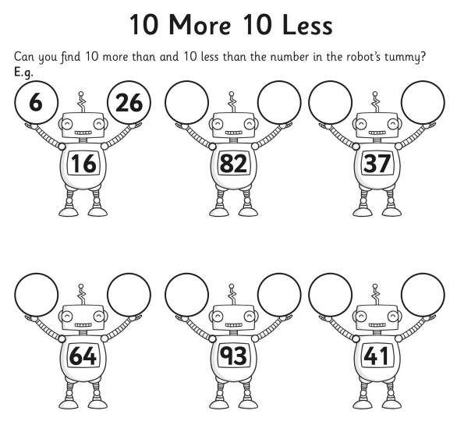
Year 2 activity
Complete the robot to work out 10 more and 10 less than a given number.
Mild – Complete the 1-star sheet focusing on multiples of 10.
Medium – Complete the 1- and 2-star sheets.
Spicy – Complete the 2- and 3-star sheets.
Can you work out what happens when a number has 0 tens?

Slide 11
Do we remember how to add using column method?
T O
3
4
____
+

Slide 12
Do we remember how to subtract using column method?
T O
4
2 1
____
-

Slide 13
Today we are going to be using the same technique but with larger numbers
H T O
3 6
4 2
______
+

Slide 14
Today we are going to be using the same technique but with larger numbers
H T O
4 4
2 1 8
_______
-
Notes:
Challenge – prior learning

Slide 15
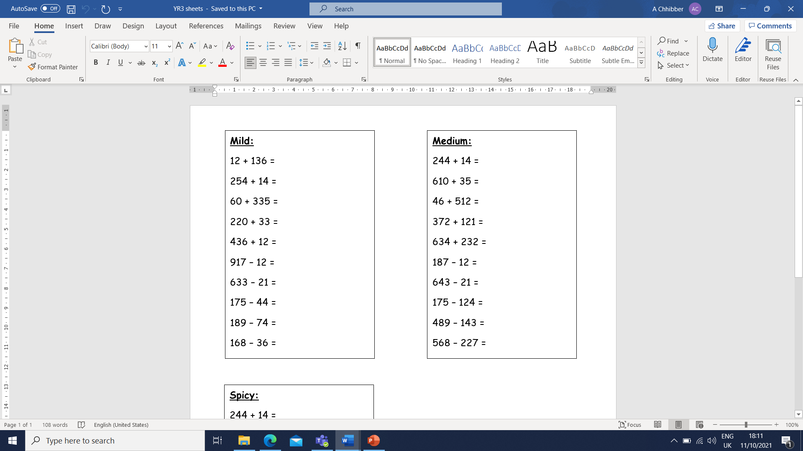
Year 3 activity
Choose the sheet that matches your understanding of this lesson.
Show your working out in your book using column method. If you need to, you can draw a PVC on a whiteboard or use dienes.
Remember for addition, you can write either number first.
For subtraction, you must write the numbers as they are shown.

