Slide 1
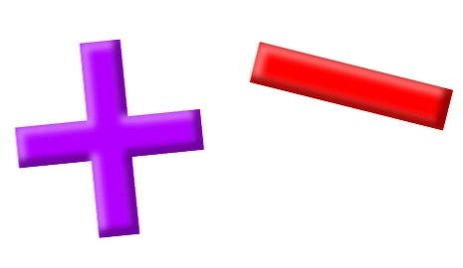
Add and Subtract
Lesson 6

Slide 2
YR2 LO: To add and subtract 1s.
I can add and subtract numbers mentally.
I can use number facts up to 20 fluently and use related facts up to 100.
I can use the inverse to check my answers.

Slide 3
YR3 LO: To subtract a 1-digit number from a 3-digit number (crossing 10).
I can accurately make 3-digit numbers, showing the place value of each digit.
I can exchange place value to work out subtraction questions.
I can show my working out using a place value chart.

Slide 4
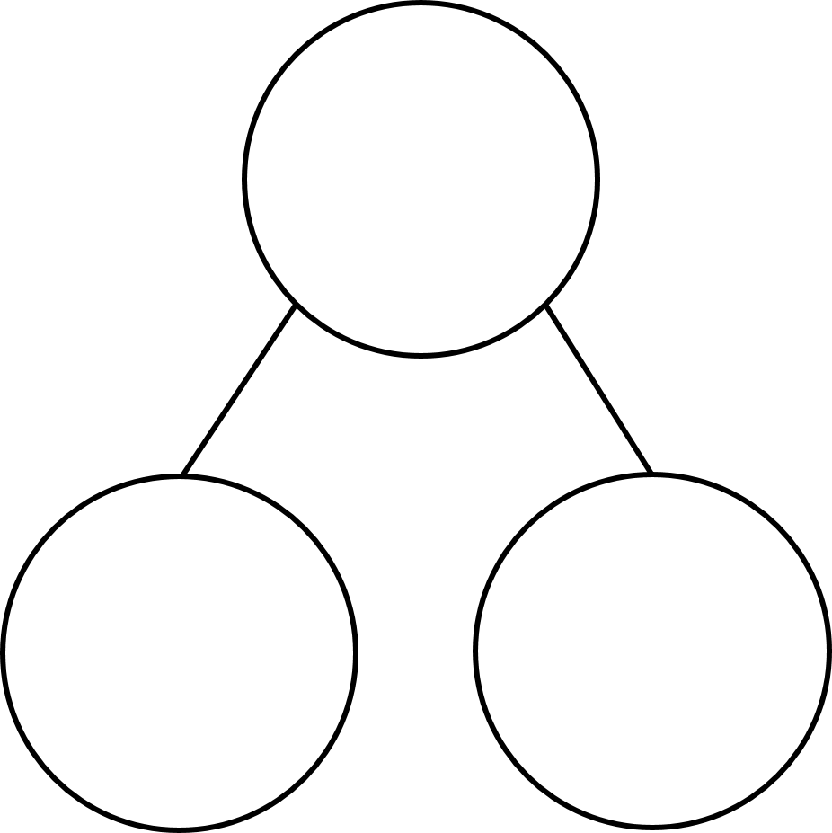
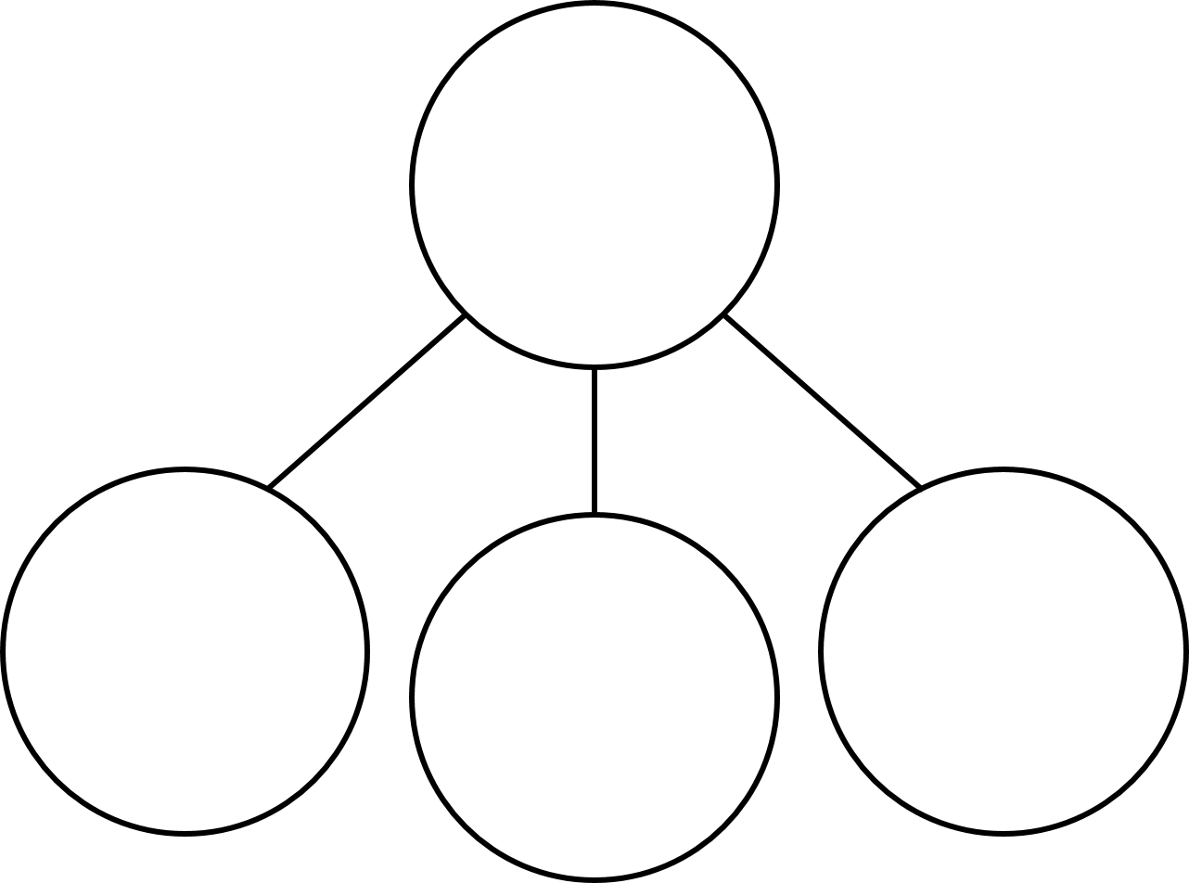
YR2 starter: Complete the part-whole models
2)
3) 4)
2
9
6
4
4
1
2
4
3
8

Slide 5
Complete the part-whole models
2)
3) 4)
10
2
9
6
4
7
9
3
4
1
2
4
3
8

Slide 7


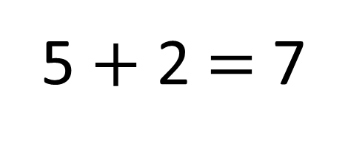
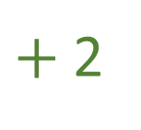
How many cakes has Ron baked in total?
5 $+$ 2 $=$ 7
$+$2
0
1
2
3
4
5
6
7
8
9
10
Notes:
Start with 5 cakes. Demonstrate drawing a number line with 5 at one end. And adding on 2 more.

Slide 8
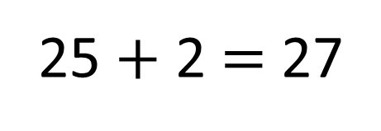

How many cakes has Ron baked in total?
25 $+$ 2 $=$ 27
$+$2
20
21
22
23
24
25
26
27
28
29
30
Notes:
Start with 25 cakes. Demonstrate drawing a number line with 25 at one end. And adding on 2 more.

Slide 9



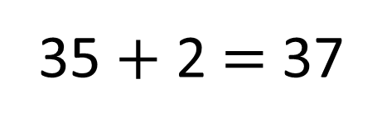
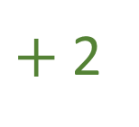
How many cakes has Ron baked in total?
Have a think
35 $+$ 2 $=$ 37
$+$2
\
30
31
32
33
34
35
36
37
38
39
40
Notes:
Start with 35 cakes. Demonstrate drawing a number line with 35 at one end. And adding on 2 more.

Slide 10
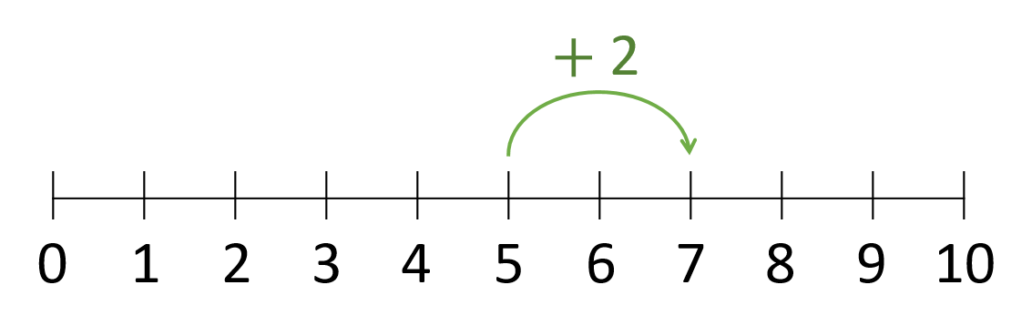
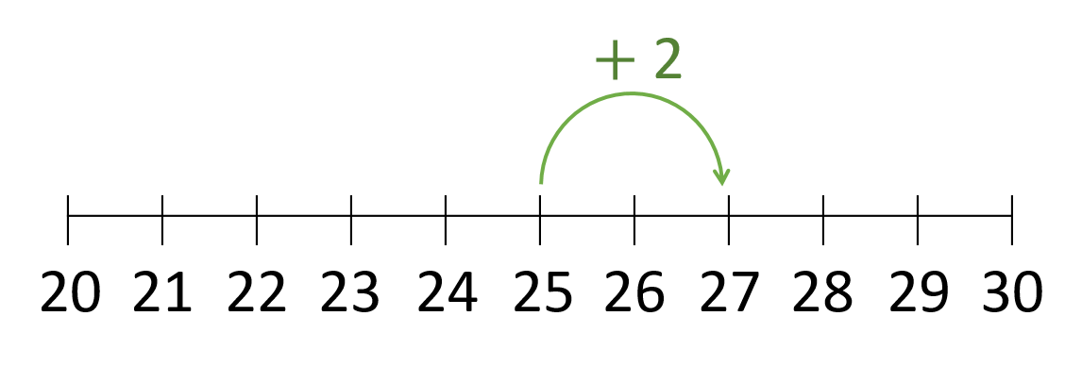
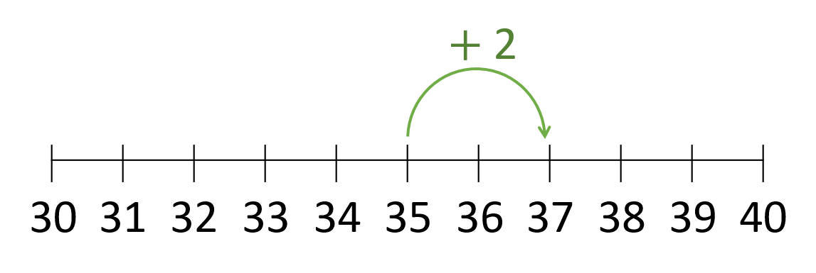
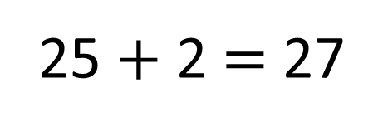
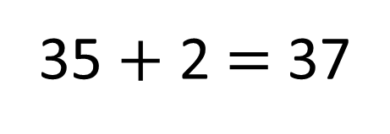
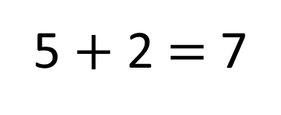
5 $+$ 2 $=$ 7
25 $+$ 2 $=$ 27
35 $+$ 2 $=$ 37
Notes:
Remind chn that my ones have not crossed over 10 and I am only adding 1 digit numbers so I can use my knowledge of number bonds to 10 to help me. What stayed the same with the numbers? What changed?

Slide 11
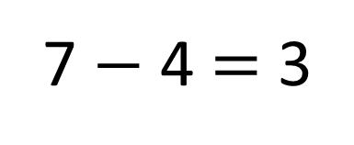
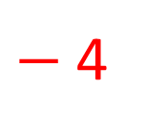
Ron has baked 7 cakes.
He gives 4 to his family.
How many cakes does he have left?
$−$4
0
1
2
3
4
5
6
7
8
9
10
7 $−$ 4 $=$ 3
Notes:
Demonstrate that this works the same backwards. Draw a number line with 7 at one end and count backward 4.

Slide 12

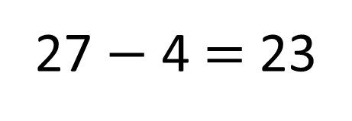
27 $−$ 4 $=$ 23
$−$4
20
21
22
23
24
25
26
27
28
29
30
Notes:
Demonstrate that this works the same backwards. Draw a number line with 27 at one end and count backward 4.

Slide 13
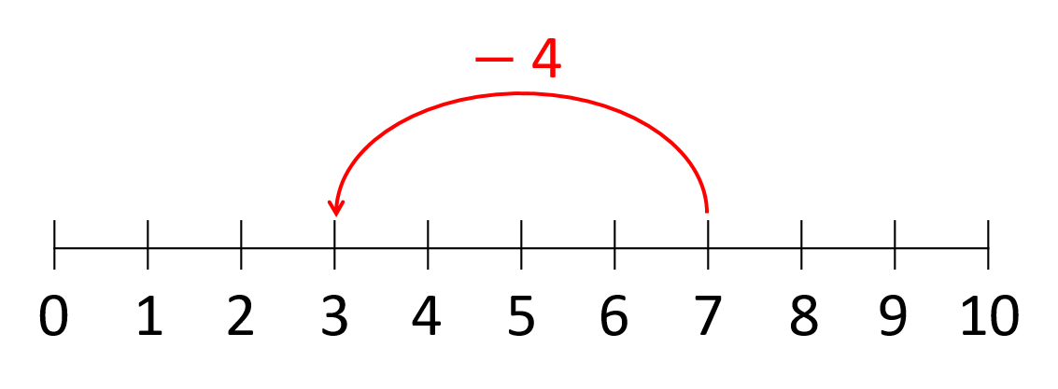
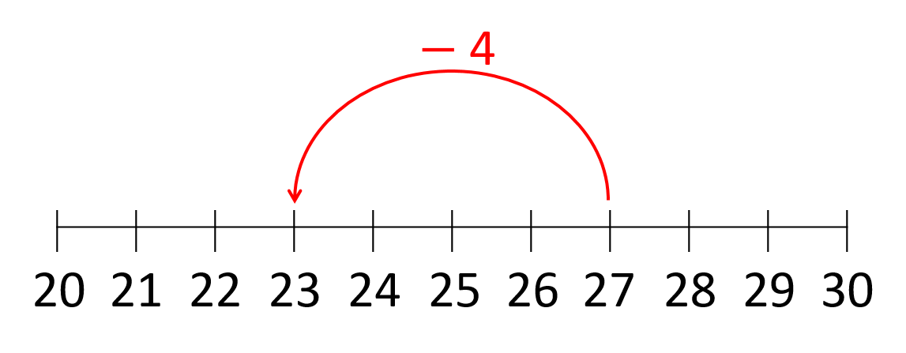

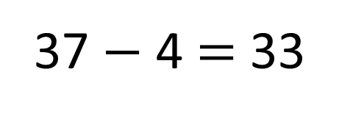
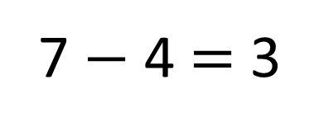
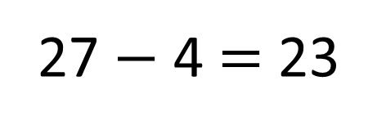
7 $−$ 4 $=$ 3
27 $−$ 4 $=$ 23
37 $−$ 4 $=$ 33

Slide 14
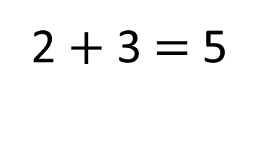
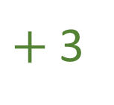
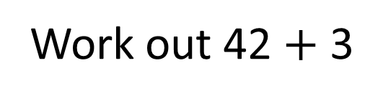
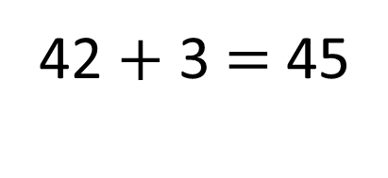
Work out 42 $+$ 3
2 $+$ 3 $=$ 5
42 $+$ 3 $=$ 45
$+$3
40
41
42
43
44
45
46
47
48
49
50
Notes:
Ask chn to work out the answer to this by partitioning the tens and ones. Add the 1s first.

Slide 15
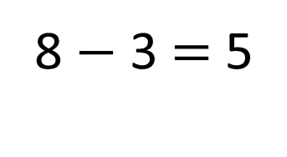
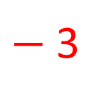
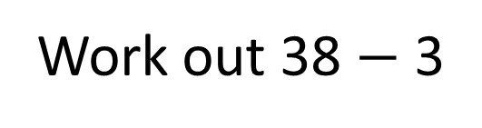
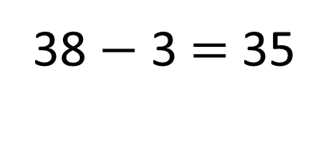
Work out 38 $−$ 3
8 $−$ 3 $=$ 5
38 $−$ 3 $=$ 35
$−$3
30
31
32
33
34
35
36
37
38
39
40
Notes:
Ask chn to work out the answer to this by partitioning the tens and ones. Add the 1s first.

Slide 16
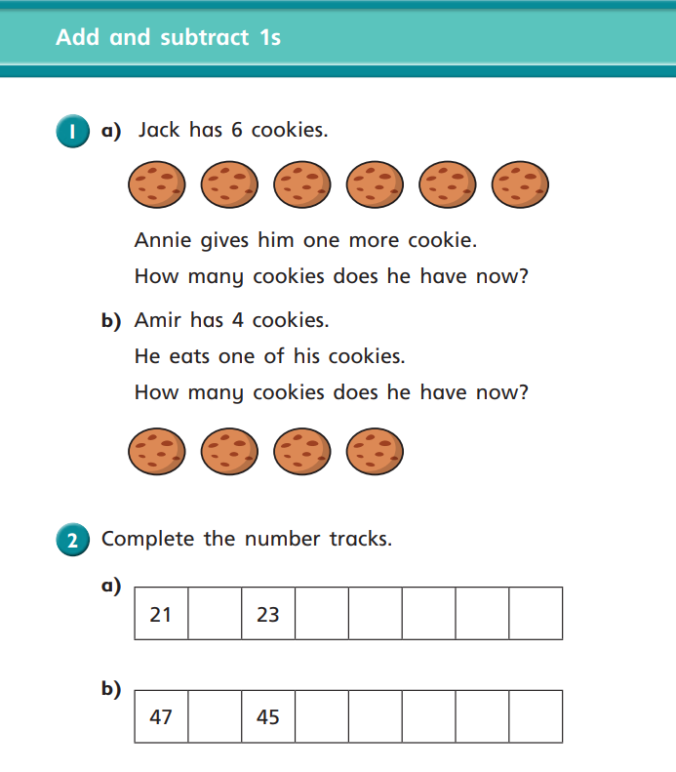
Year 2 activity
Complete the WhiteRose question sheet. Some children will be writing on the sheet, most children will be writing the question number in your books and writing your answers in full.
Try to use mental calculations to work out your answers.

Slide 17

Q 1. Jack has 7 cookies now. 6 + 1 = 7
Amir has 3 cookies. 4 – 1 = 3

Slide 18
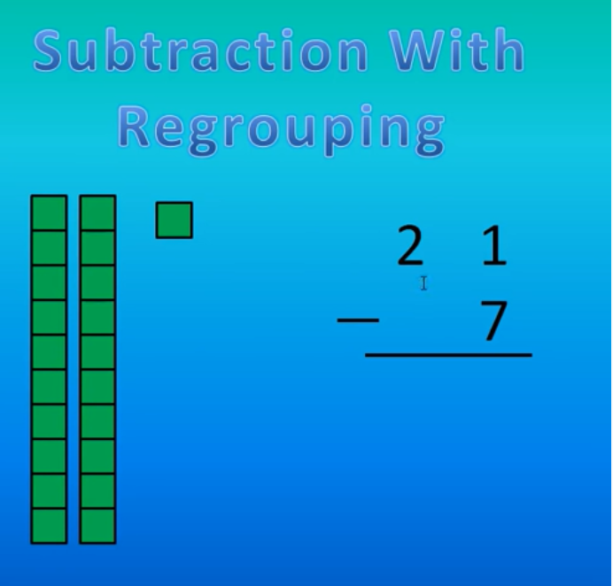
YR3 recap video: Subtraction With Regrouping Tutorial - YouTube

Slide 19
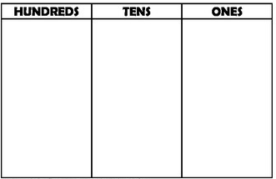
Let’s practice:
321-8 =
Can you complete the place value chart on your whiteboard.
Notes:
Explain that we do not have enough 1s in the ones column to take away 8 so we have to exchange.

Slide 20
Let’s practice:
321-8 =
Can you complete the place value chart on your whiteboard.
Notes:
How much do we have left?

Slide 21
Let’s practice:
284-7 =
Can you complete the place value chart on your whiteboard.
Notes:
Explain that we do not have enough 1s in the ones column to take away 8 so we have to exchange.

Slide 22
Let’s practice:
284-7 =
Can you complete the place value chart on your whiteboard.
Notes:
Explain that we do not have enough 1s in the ones column to take away 8 so we have to exchange.

Slide 23
Let’s practice:
503-6 =
Can you complete the place value chart on your whiteboard.
Notes:
What happens when we need to exchange a 10 but there aren’t any?

Slide 24
Let’s practice:
503-6 =
Can you complete the place value chart on your whiteboard.
Notes:
What happens when we need to exchange a 10 but there aren’t any?

Slide 25
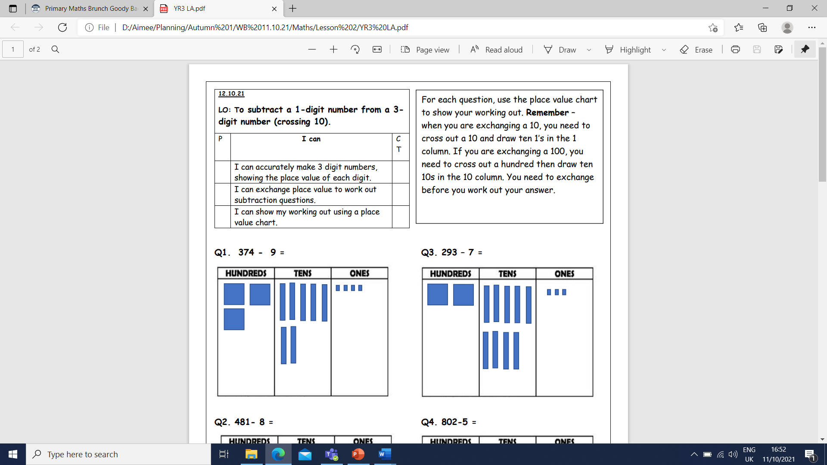
Year 3 activity
Using the completed place value chart, practice exchanging to work out subtraction of 1-digit. Some questions will already have their place value chart completed, but some will have to complete the PVC first. You can use dienes alongside activity to show exchanging.

