Slide 1

Add and Subtract
Lesson 5

Slide 2
YR2 LO: To work out questions using number bonds to 100
I can use my knowledge of number bonds to 10.
I can use number facts up to 10 fluently and use related facts up to 100.
I can use my knowledge to problem solve.

Slide 3
YR3 LO: To subtract a 1-digit number from 2-digits (crossing 10).
I can accurately make 2-digit numbers, showing their place value.
I can exchange place value to work out subtraction questions.
I can use different methods to work out my answer.

Slide 4
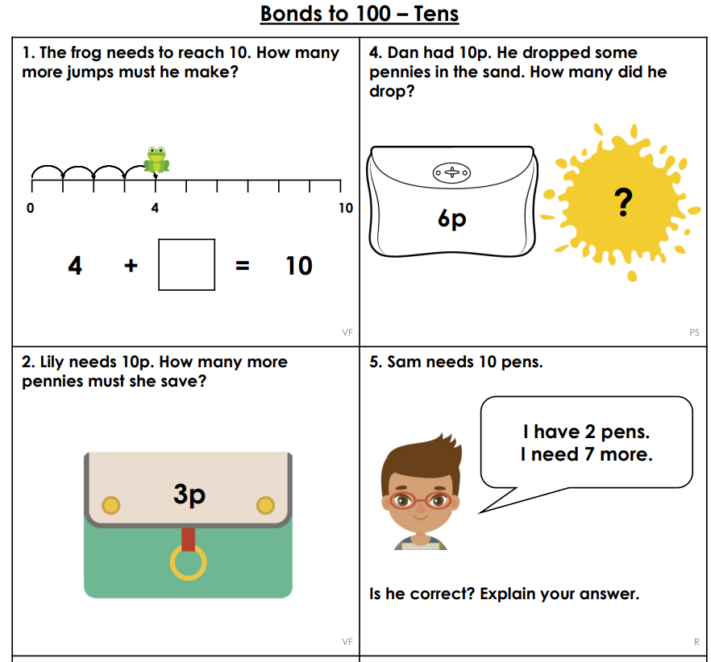
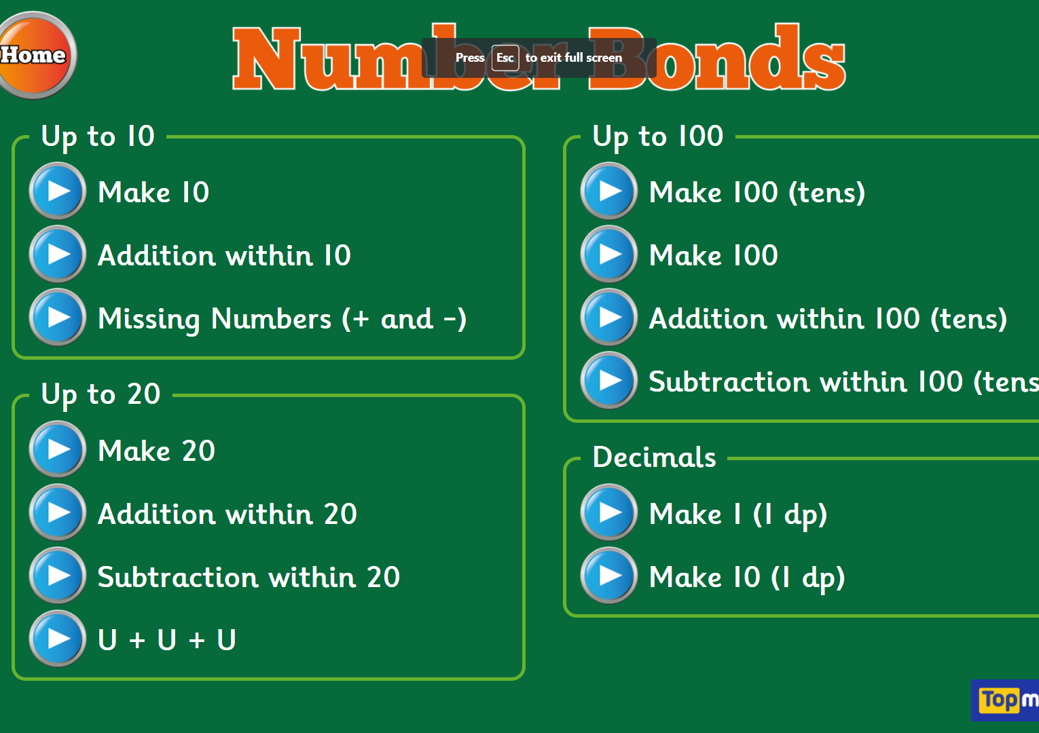
YR2 Starter : Hit the Button - Quick fire maths practise for 6-11 year olds (topmarks.co.uk)
Notes:
Chn to complete the prior learning sheet first. Then, with a laptop or ipad 1 between 2, who can get the most points.

Slide 5
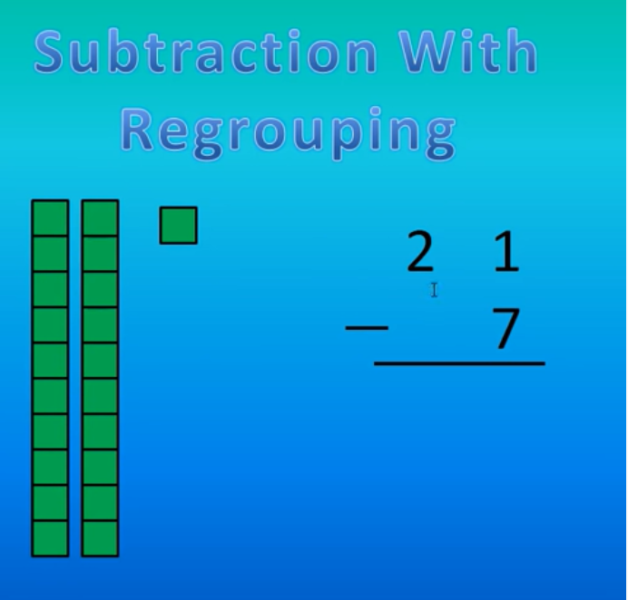
Subtraction With Regrouping Tutorial - YouTube

Slide 6
Year 3 activity
Using dienes and number lines, we are going to work through these questions practically. For every question, I want you to show me three different ways of working it out.
Physically using dienes
Using a number line
On a place value chart
Then, take a picture using an ipad.
Work through the questions using the resources. Be sure to show your working out and take a picture.
23 – 7 =
12 – 4 =
58 – 9 =
32 – 8 =
60 – 2 =
94 – 6 =
32 – 5 =
80 – 3 =
25 – 6 =
30 – 4 =
20 – 1 =
Notes:
Working in mixed ability pairs.

Slide 7
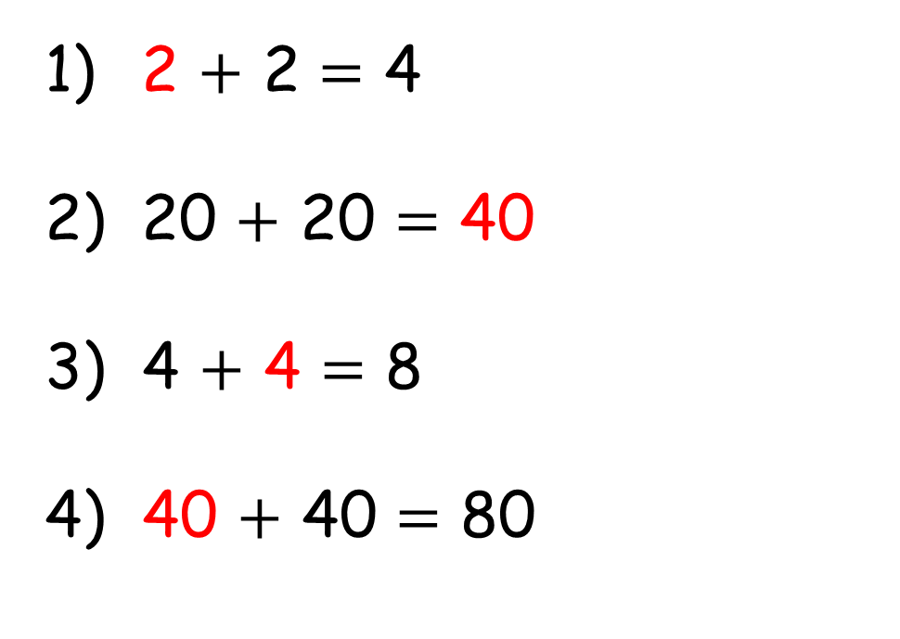
2 $+$ 2 $=$ 4
20 $+$ 20 $=$ 40
3) 4 $+$ 4 $=$ 8
4) 40 $+$ 40 $=$ 80

Slide 8
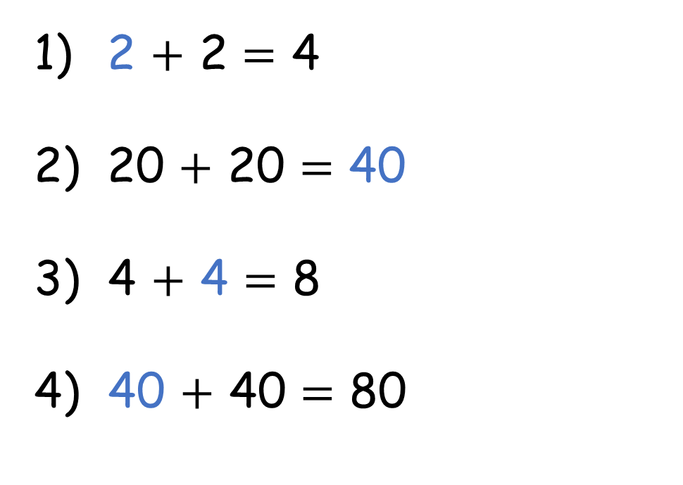
2 $+$ 2 $=$ 4
20 $+$ 20 $=$ 40
3) 4 $+$ 4 $=$ 8
4) 40 $+$ 40 $=$ 80

Slide 9




2
$+$ 8 $=$
$=$ 10

Slide 10



2
$+$ 8 $=$
10
20
$+$ 80 $=$
100
Notes:
Using moving across in place value language rather than just add a 0.

Slide 11



3 tens $+$ 7 tens $=$ 10 tens
30 $+$ 70 $=$ 100

Slide 12



3 tens $+$ 7 tens $=$ 10 tens
4 tens $+$ 6 tens $=$ 10 tens
4 tens $+$ 7 tens $=$ 10 tens
4 $+$ 7 $=$ 11
Notes:
Spot the mistake

Slide 13




3
$$+$$
4
$$=$$
7
3
0
$$+$$
4
0
$$=$$
7
0

Slide 14
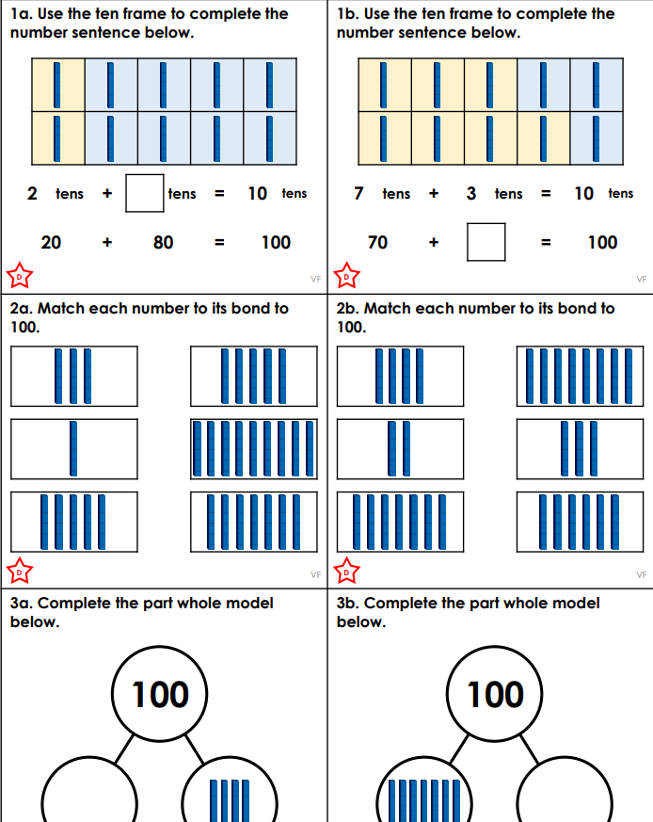
Year 2 activity LA
Completely independently, complete the Developing sheet for bonds to 100. Ask a friend to read the questions to you if you are stuck.
Try to work as independently as possible so that your teacher can see how much you know.

Slide 15
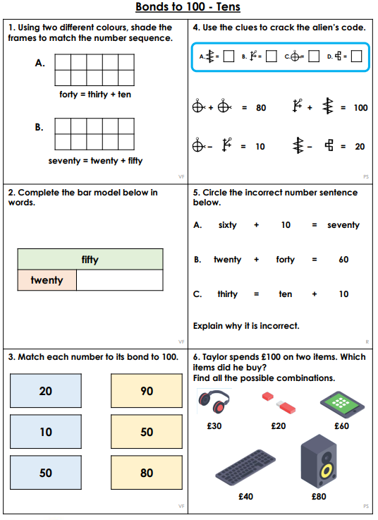
Year 2 activity MA and HA
Completely the classroom secrets sheet with a partner. Some of the questions include problem solving. Remember – if a question says to explain why, you need to write your answer in your book in a full sentence.
EXT – RPS questions.

Slide 16
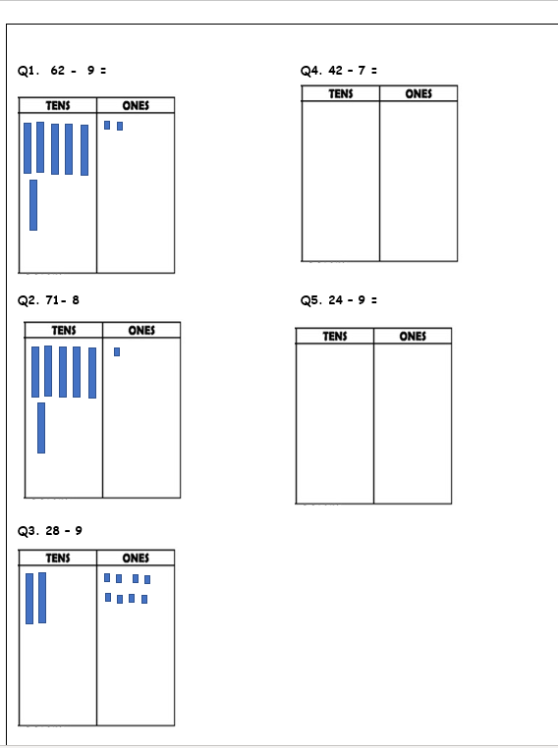
Year 3 plenary
Complete the sheet by exchanging. Remember to cross out a 10 when you are exchanging and replace it with ten 1s in the right column.
For Q4 and Q5, draw the whole number that you start with first.

