Slide 1
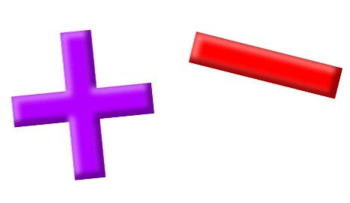
Add and Subtract
Lesson 4

Slide 2
YR2 LO: To recall and use familiar number facts.
I can recall and use addition and subtraction facts to 20 fluently.
I can derive and use related facts up to 100.
I can use my knowledge to answer problems.

Slide 3
YR3 LO: To add and 2-digit and 1-digit number by crossing 10. (recap)
I can use my knowledge of number bonds to 10 to work out addition and subtraction questions.
I can carry a number across place value.
I can show my working out using column method.

Slide 4
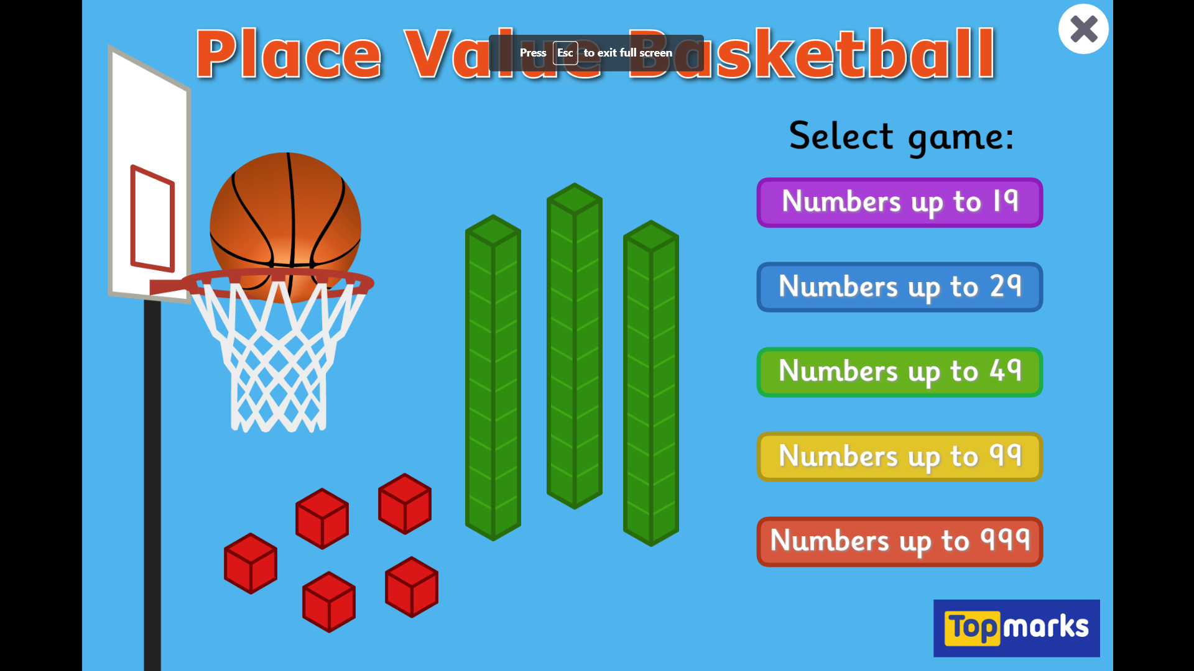
Starter : Place Value Basketball - Dienes Game for 5 to 8 Year Olds (topmarks.co.uk)

Slide 6


Introduction
Match calculations that have the same answer.
5 + 2
10 – 2
9 – 2
4 + 4
3 + 4
5 + 3
10 – 1
2 + 8
3 + 7
6 + 4
6 + 3
2 + 7
© Classroom Secrets Limited 2018

Slide 7
Introduction
Match calculations that have the same answer.
5 + 2
10 – 2
9 – 2
4 + 4
3 + 4
5 + 3
10 – 1
2 + 8
3 + 7
6 + 4
6 + 3
2 + 7
© Classroom Secrets Limited 2018

Slide 8
Varied Fluency 1
Write the calculations represented below.
1
1
1
1
1
1
1
1
1
 | – |  | =
10
10
10
10
10
10
10
10
10
 |  | – |  |  | =
© Classroom Secrets Limited 2018

Slide 9
Varied Fluency 1
Write the calculations represented below.
1
1
1
1
1
1
1
1
1
9 | – | 4 | = | 5
10
10
10
10
10
10
10
10
10
9 | 0 | – | 4 | 0 | = | 5 | 0
© Classroom Secrets Limited 2018

Slide 10
Varied Fluency 2
True or false?
– 60
30
90
© Classroom Secrets Limited 2018

Slide 11
Varied Fluency 2
True or false?
True
– 60
30
90
© Classroom Secrets Limited 2018

Slide 12
Varied Fluency 3
Complete the bar models below:
10
6
100
40
© Classroom Secrets Limited 2018

Slide 13
Varied Fluency 3
Complete the bar models below:
10
6 | 4
100
40 | 60
© Classroom Secrets Limited 2018

Slide 14
Varied Fluency 4
Fill in the missing numbers.
6 + 4
60 + 40
=
9 – 2
90 – 20
© Classroom Secrets Limited 2018

Slide 15
Varied Fluency 4
Fill in the missing numbers.
6 + 4
10
60 + 40
=
100
9 – 2
7
90 – 20
70
© Classroom Secrets Limited 2018

Slide 16

Reasoning 1
Solomon says,
Is he correct? Explain why.
I know that 9 – 7 = 2, so
90 – 70 = 20.
© Classroom Secrets Limited 2018

Slide 17
Reasoning 1
Solomon says,
Is he correct? Explain why.
Solomon is correct because . . .
I know that 9 – 7 = 2, so
90 – 70 = 20.
© Classroom Secrets Limited 2018

Slide 18
Reasoning 1
Solomon says,
Is he correct? Explain why.
Solomon is correct because 90 – 70 is the same as 9 tens – 7 tens.
9 – 7 = 2, so 90 – 70 = 20.
I know that 9 – 7 = 2, so
90 – 70 = 20.
© Classroom Secrets Limited 2018

Slide 19
Problem Solving 1
Using only 3 numbers, complete the related fact calculations below.
 |  | = |  | – | 3
 | 3 | + |  | =
8 | 0 | – |  | 0 | = | 5 | 0
5 | 0 | + |  | 0 | = |  | 0
© Classroom Secrets Limited 2018

Slide 20
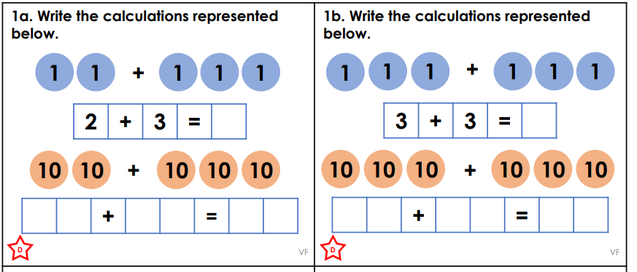
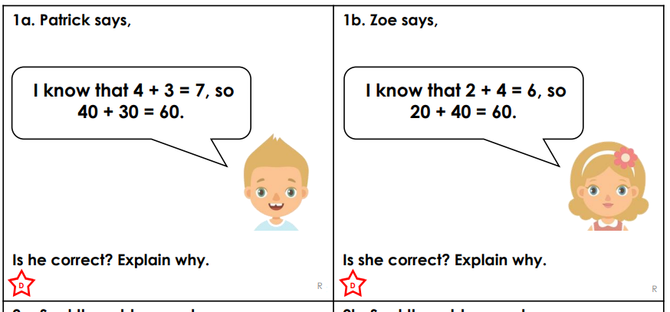
Year 2 activity
Pick the sheet that matches your understanding (D or E). Complete one varied fluency sheet and one problem solving sheet. If you complete your problem-solving sheet, try to work out the next sheet up (E or GD).

Slide 21
Can we work out these answers:
3 4
+ 4 8
_____
2 5
+ 6 6
_____
1 2 8
+ 3 2 6
_____
Notes:
Work out as a group practically using dienes.

Slide 22
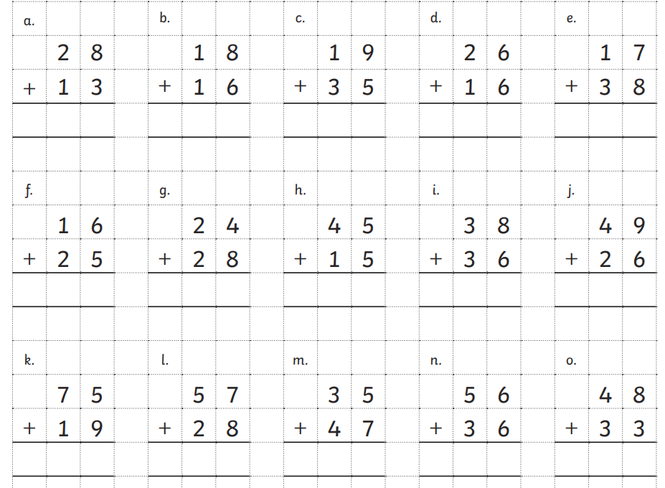
Year 3 activity
Complete the crossing 10 sheet at your own pace. Use dienes to help you if you are unsure and remember to show where you have carried or exchanged.

Slide 23

Q 1. 3 4
+ 2 7
____
0 7

