Slide 1

Add and Subtract
Lesson 3

Slide 2
YR2 LO: To recap number bonds up to 20.
I can use mental and written method to work out number bonds.
I understand that addition is commutative.
I could create fact families for number bonds to 20.

Slide 3
YR3 LO: To add and subtract 3-digit and 2-digit numbers, not crossing 10.
I understand the place value of each digit in a 2-digit and 3-digit number.
I can use my knowledge of number bonds to 10 to work out addition and subtraction questions.
I can show my working out using column method.

Slide 4
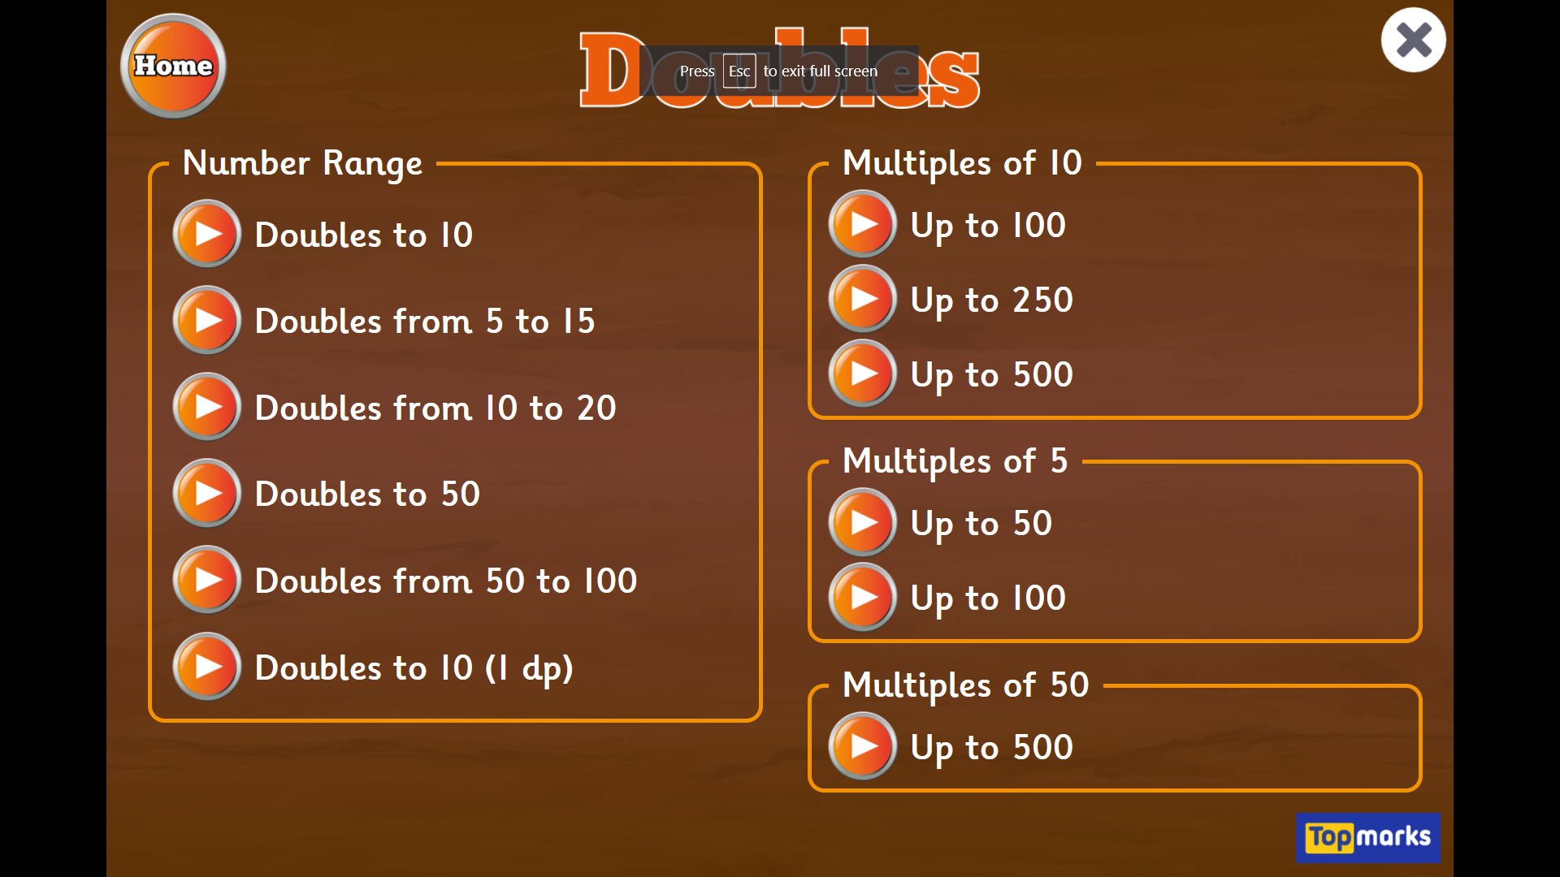
Starter: Hit the Button - Quick fire maths practise for 6-11 year olds (topmarks.co.uk)
Notes:
Remind chn about starting with the biggest number in their head if they are unsure and counting on.

Slide 5
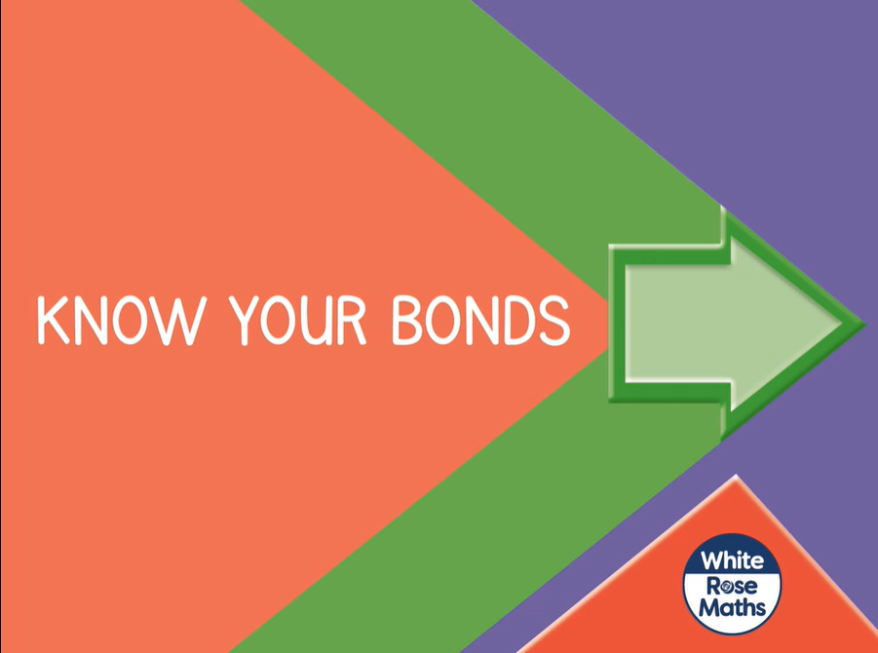
Aut2.5.4 - Know your bonds on Vimeo

Slide 6
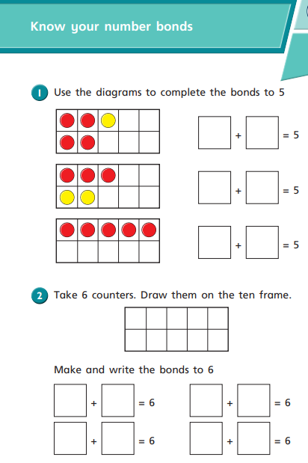
Year 2 activity
Complete the worksheet using mental addition and using the tens frame to help you.
Once you have finished, could you write fact families for the bonds you have found.
e.g.
7 + 2 = 9 2 + 7 = 9
9 – 2 = 7 9 – 7 = 2

Slide 7
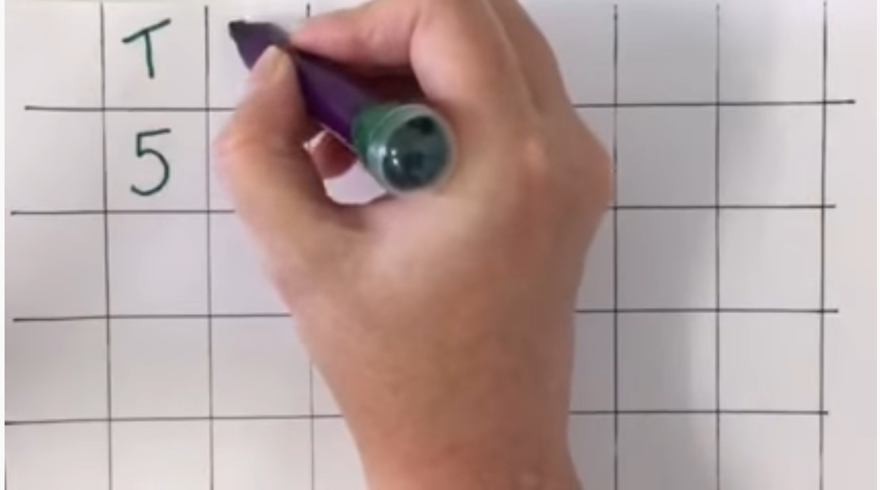
https://www.youtube.com/watch?v=2J7P4cKPtKc

Slide 8
Can we work out these answers:
3 4
+ 4 5
_____
2 5
+ 6 3
_____
1 2 3
+ 3 2 6
_____

Slide 9
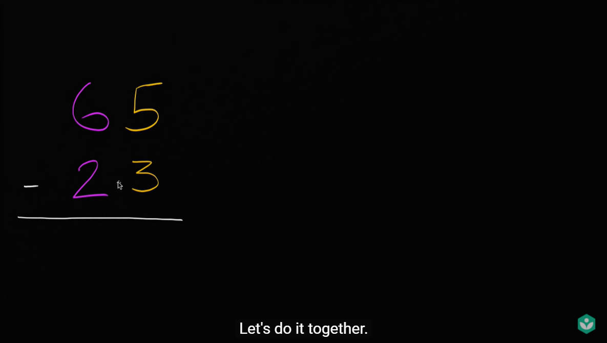
Subtracting two digit numbers without regrouping | Early Math | Khan Academy - YouTube

Slide 10
Can we work out these answers:
7 4
- 4 1
_____
8 5
- 6 3
_____
8 2 3
- 3 1 2
_____

Slide 11
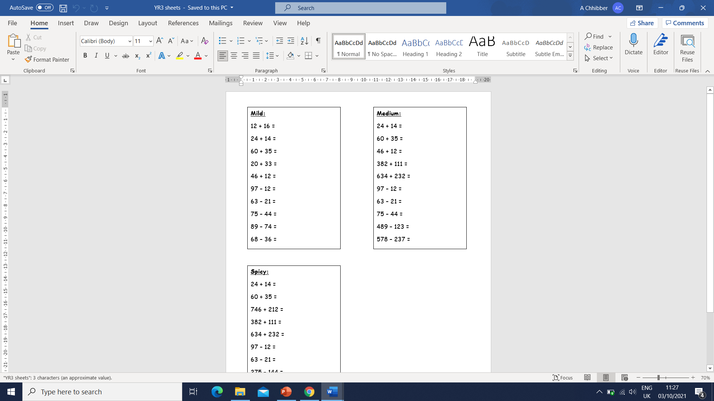
Year 3 activity
Choose the question sheet that matches your understanding and glue it into the left hand side of your book. Then answer the questions using column method. Lay out your work as shown on the next slide.

Slide 12

Q 1. 3 4
+ 2 1
____
5 5

