Slide 1
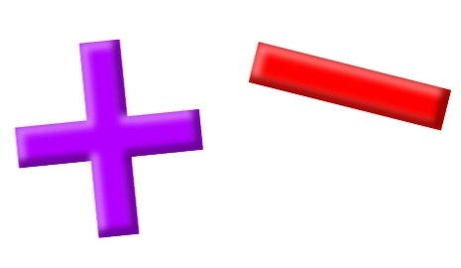
Add and Subtract
Lesson 11

Slide 2
YR2 LO: To add a 2-digit and 1-digit numbers (crossing 10)
I can recognize the value of each digit in a 2-digit number.
I can exchange place value to work out addition questions.
I can use column method to work out my answer.

Slide 3
YR3 LO: To subtract a 2-digit number from a 3-digit number (Crossing 100).
I understand that numbers decrease when I subtract.
I can subtract numbers using formal methods.
I can borrow from the tens and hundred when I need to.

Slide 4
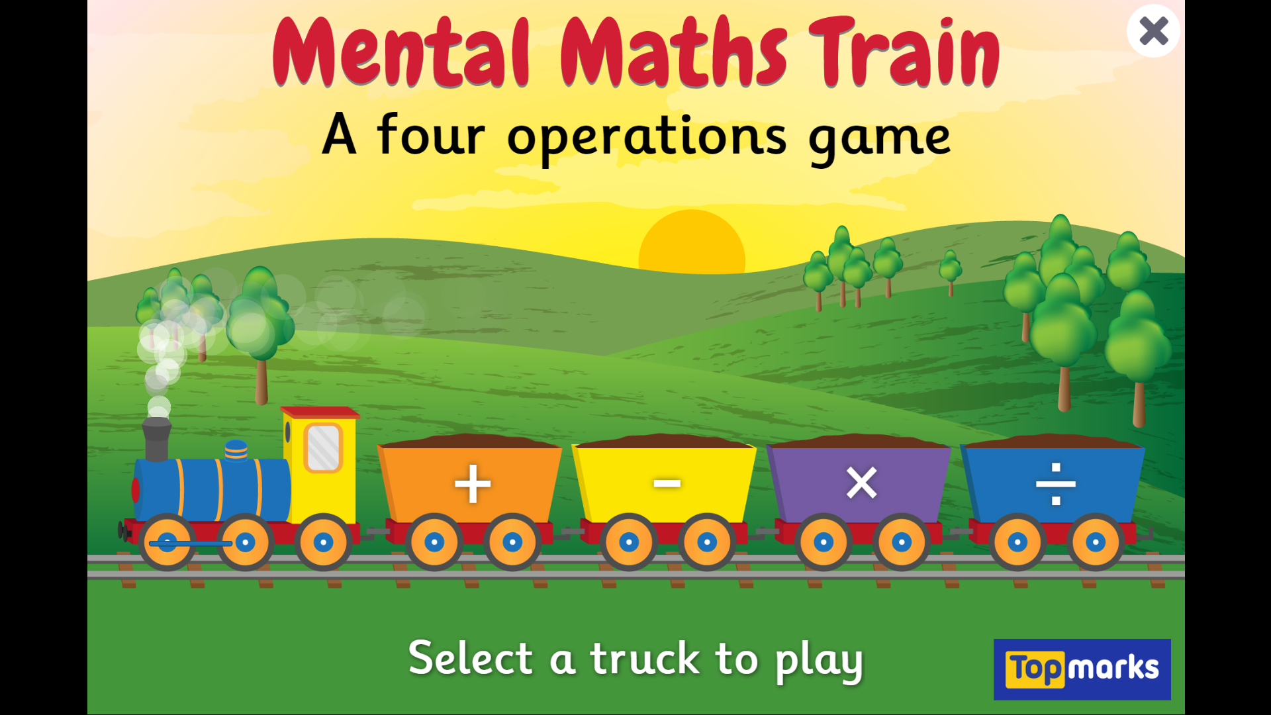
Notes:
Mental Maths Train - A Four Operations Game (topmarks.co.uk)

Slide 5
Recap:
Last lesson, we all practically tried to work out our answers using either a place value chart or dienes.
Let’s see if we can remember what we need to do on our whiteboards.

Slide 6
How might I show my answer using column method?
Year 2
Year 3
T O
5
0 8
H T O
2 5
0 1 8
+
-
Notes:
YR2:
5 + 8 = 13. Demonstrate how to show 13 on the column method. Then add 10s. Remind chn to start at the 1s first.
YR3:
You can’t take away 5 from 8 so we need to borrow a 10. 15 take away 8 is 7 so we should have 117 left at this point. Then take away the last 10. 107 answer.

Slide 7
How might I show my answer using column method?
Year 2
Year 3
T O
1 7
0 5
H T O
4 3
0 2 5
+
-
Notes:
YR2:
5 + 7 = 12. Demonstrate how to show 12 on the column method. Then add 10s. Remind chn to start at the 1s first.
YR3:
You can’t take away 5 from 3 so we need to borrow a 10. 13 take away 5 is 8 so we should have 128 left at this point. Then take away the last 20. 118 answer.

Slide 8
How might I show my answer using column method?
Year 2
Year 3
T O
3 4
0 9
H T O
2 0 5
0 2 7
+
-
Notes:
YR2:
4 + 9 = 13. Demonstrate how to show 13 on the column method. Then add 10s. Remind chn to start at the 1s first.
YR3:
You can’t take away 7 from 5 so we need to borrow a 10. Do we have a 10 to take? No, so we need to exchange the hundred for some tens. We now have 1 hundred, 10 tens and 5 ones.
Can we borrow a 10 now? Yes. So we have 1 hundred, 9 tens and 15 ones. 15 – 7 is 8. we have 1 hundred, 9 tens and 8 ones. Take away 20 is 178.

Slide 9
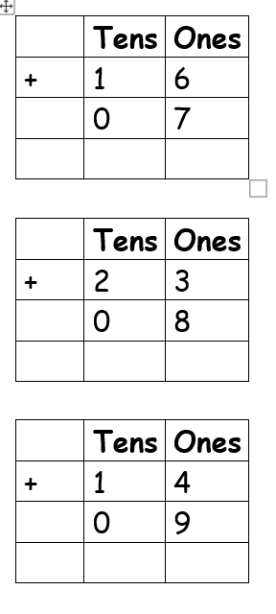
Year 2 Activity:
Please complete either the mild medium or spicy sheet. Remember you may need to carry a 10 when you are adding.
If you need to, you can partition the 1-digit number next to each question to help make the next 10.

Slide 10
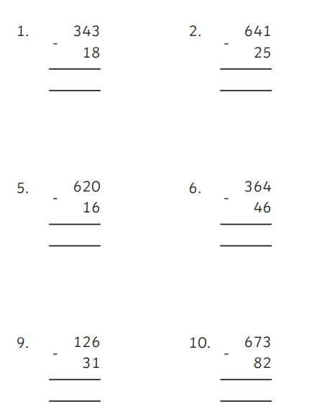
Year 3 Activity:
Complete either the 1 star, 2 star or 3 star activity sheet. Remember that you are exchanging so you will need to ‘borrow’ a ten or a hundred to solve your questions.
If you find it tricky, remember to partition your 1s to make the nearest 10.

