Slide 1
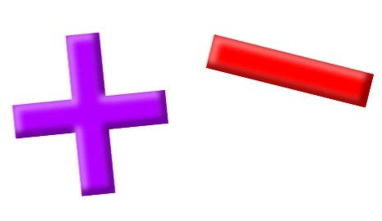
Add and Subtract
Lesson 10

Slide 2
YR2 LO: To add 2-digit and 1-digit numbers (Crossing 10). Practical
I can accurately make 2-digit numbers, showing their place value.
I can exchange place value to work out addition questions.
I can use different methods to work out my answer.

Slide 3
YR3 LO: To subtract a 2-digit number from a 3-digit number (Crossing 100). Practical
I can accurately make 3-digit numbers, showing the place value of each digit.
I can exchange place value to work out subtraction questions.
I can show my working out using physical resources and a PVC.

Slide 4
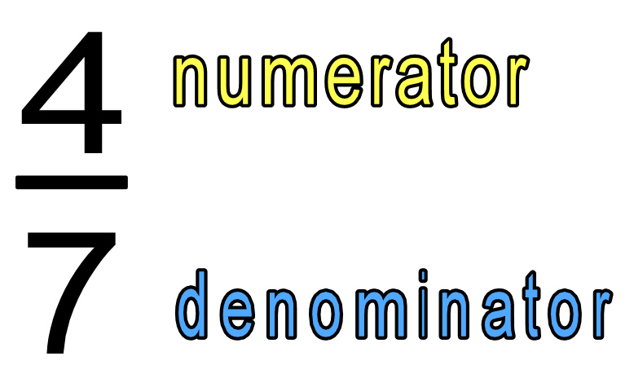
Fractions starter
When I am looking at fractions, the top numbers (the numerator) shows me how many parts are shaded.
The bottom number (the denominator) shows me how many parts there are altogether.

Slide 5
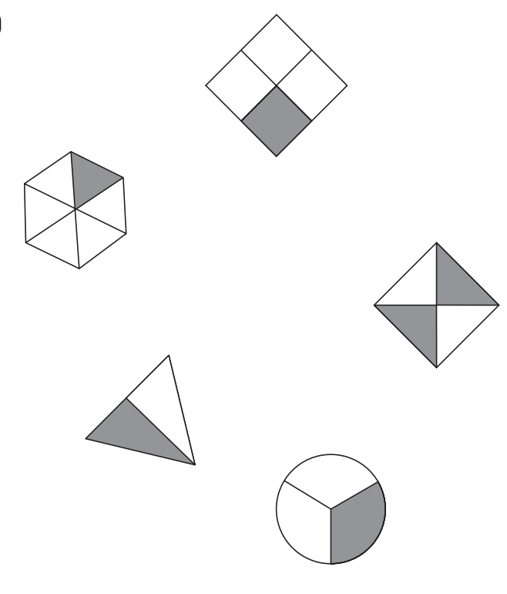
Which shape shows ¼?
1.
5.
2.
4.
3.

Slide 6
Which shape shows 1/3?
1.
5.
2.
4.
3.

Slide 7
Which shapes show 1/2?
1.
5.
2.
4.
3.

Slide 9
Making a 2-digit number
When we are working out addition questions practically, we first need to make the biggest number using dienes.
Can you make 37 using dienes?
Remember that means 3 ten sticks and 7 one cubes.

Slide 10
Adding a 1-digit number
We already have 37 and now we want to add 8.
37 + 8 =

Slide 11
Adding a 1-digit number
When we have more than 10 ones, we need to exchange them for a 10. We wouldn’t say our answer is 30 and 15, it would be 45.
37 + 8 =

Slide 12
Column method:
We can show this exchange using column method.
3 7
+ 8
We can add the ones together and make sure we show where we exchanged a 10.
Notes:
Demonstrate on IWB.

Slide 13
Adding a 1-digit number
We already have 28 and now we want to add 9.
28 + 9 =

Slide 14
Adding a 1-digit number
When we have more than 10 ones, we need to exchange them for a 10. We wouldn’t say our answer is 20 and 17, it would be 37.
28 + 9 =

Slide 15
Column method:
We can show this exchange using column method.
2 8
+ 9
We can add the ones together and make sure we show where we exchanged a 10.
Notes:
Demonstrate on IWB.

Slide 16
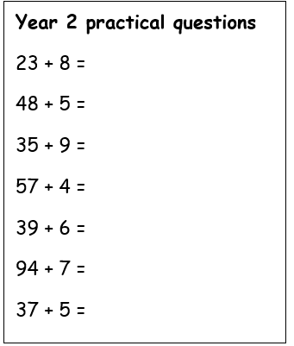
Year 2 Activity:
Using the question sheet, can you practically make the numbers and remember to exchange ten 1s for a 10s stick.
On your whiteboard, can you try to show this using column method.

Slide 17
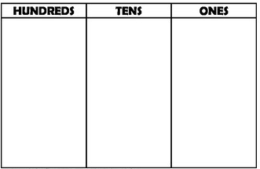
Let’s practice:
321-38 =
Can you complete the place value chart on your whiteboard.
Notes:
Explain that we do not have enough 1s in the ones column to take away 8 so we have to exchange.

Slide 18
Let’s practice:
321-38 =
Can you complete the place value chart on your whiteboard.
Notes:
Do we have enough 10s to take away 30? No, so we have to exchange.

Slide 19
Let’s practice:
321-38 =
Can you complete the place value chart on your whiteboard.
Notes:
Do we have enough 10s to take away 30? No, so we have to exchange.

Slide 20
Let’s practice:
321-38 =
Can you complete the place value chart on your whiteboard.
Notes:
How much is left?

Slide 21
Let’s practice:
284-97 =
Can you complete the place value chart on your whiteboard.
Notes:
Explain that we do not have enough 1s in the ones column to take away 8 so we have to exchange.

Slide 22
Let’s practice:
284-97 =
Can you complete the place value chart on your whiteboard.
Notes:
Explain that we do not have enough 1s in the ones column to take away 8 so we have to exchange.

Slide 23
Let’s practice:
284-97 =
Can you complete the place value chart on your whiteboard.
Notes:
Explain that we do not have enough 1s in the ones column to take away 8 so we have to exchange.

Slide 24

Year 3 Activity:
Using the question sheet, can you practically make the numbers to work out your answers. Remember to borrow ten 1s for a 10s stick.
On your whiteboard, can you try to show this using column method.

