Slide 1
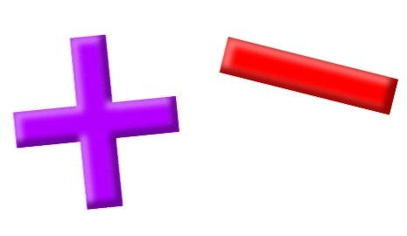
Add and Subtract
Lesson 1

Slide 2
YR2 LO: To add and subtract numbers up to 20.
I can recognize and use the addition and subtraction symbols correctly.
I understand how to use parts and whole numbers.
I can use my knowledge to make fact families up to 10/20.

Slide 3
YR3 LO: To add and subtract multiples of 100.
I can recognize and use the addition and subtraction symbols correctly.
I can add and subtract mentally
I can use my knowledge of adding and subtracting 1 digit numbers to subtract multiples of 100.

Slide 4
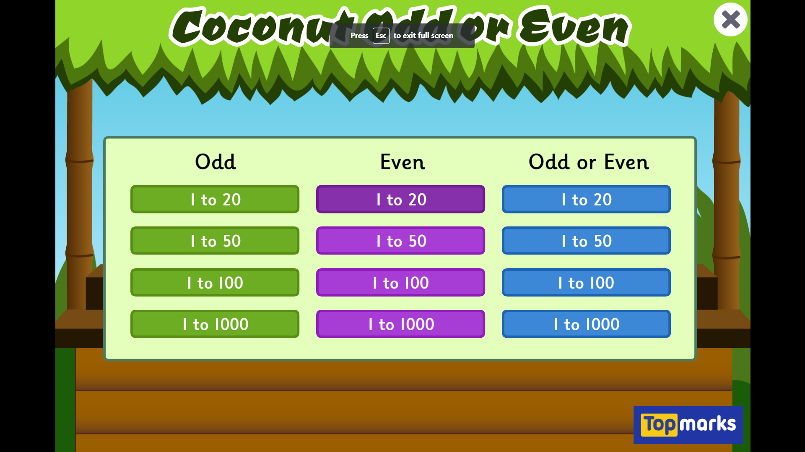
Starter: Coconut Odd or Even - Topmarks
Notes:
Remind chn that odd numbers end in 1,3,5,7 or 9. Even numbers end in 0,2,4,6 or 8.

Slide 5
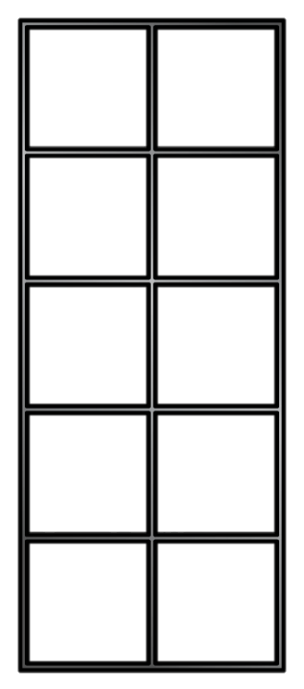
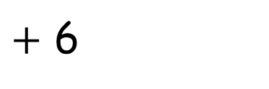
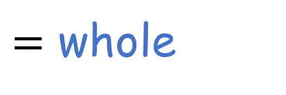
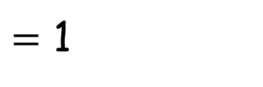
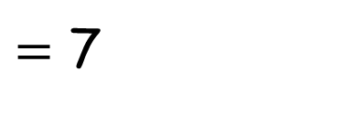
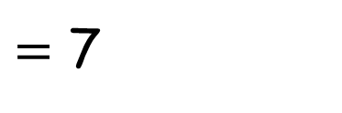
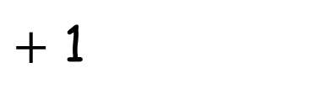
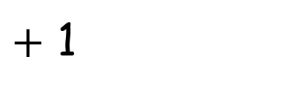
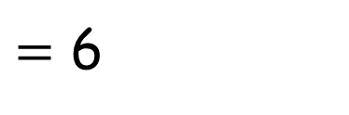
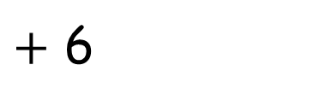



What is being represented here?
$=$ 6
7
$+$ 1
whole $=$
part
$$+$$
part
$+$ 6
$=$ 1
7
$+$ 1
$=$ 7
6
part
$$+$$
part
$=$ whole
$+$ 6
$=$ 7
1
Notes:
Here we have a 10s frame. Chn should be familiar with it. Should know that top line is 5 so don’t need to count from 0, but could count from 5. Slide demonstrates 7 split into 6 and 1 and making addition sentences.

Slide 6









What is being represented here?
Have a think
8
$$+$$
6
$$=$$
14
6
$$+$$
8
$$=$$
14
14
$$=$$
8
$$+$$
6
14
$$=$$
6
$$+$$
8
Notes:
Can chn write addition sentences on whiteboards to show counters on the board. Remind chn that we can see a whole 10s frame so we can count on from 10.

Slide 7


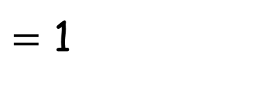

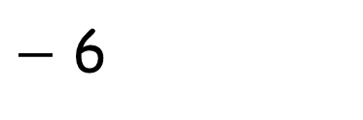
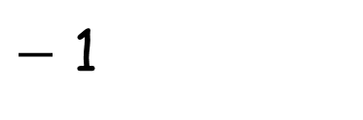
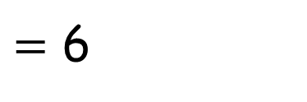
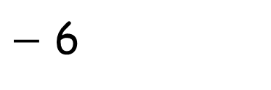
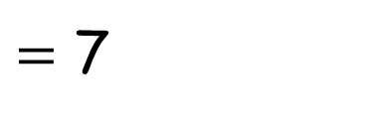
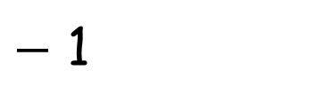

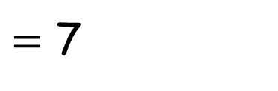
What is being represented here?
$−$ 1
7
$=$ 6
whole $−$
part
$$=$$
part
$=$ 1
$−$ 6
7
$=$ 7
$−$ 1
6
part
$=$ whole
$$−$$
part
$=$ 7
$−$ 6
1

Slide 8















8
$$+$$
6
$$=$$
14
part $+$ part $=$ whole
6
$$+$$
8
$$=$$
14
14
$$=$$
8
$$+$$
6
whole $=$ part $+$ part
14
$$=$$
6
$$+$$
8
14
$$−$$
8
$$=$$
6
whole $−$ part $=$ part
14
$$−$$
6
$$=$$
8
Have a think
6
$$=$$
14
$$−$$
8
part $=$ whole $−$ part
8
$$=$$
14
$$−$$
6

Slide 9
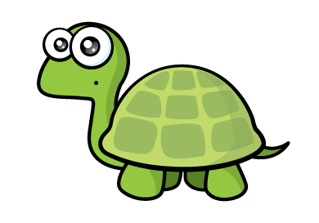














Have a think
3
$$+$$
6
$$=$$
9
3
$$+$$
9
$$=$$
6
9
$$−$$
3
$$=$$
6
part $+$ part $=$ whole
6
$$+$$
3
$$=$$
9
6
$$−$$
3
$$=$$
9
whole $−$ part $=$ part

Slide 10
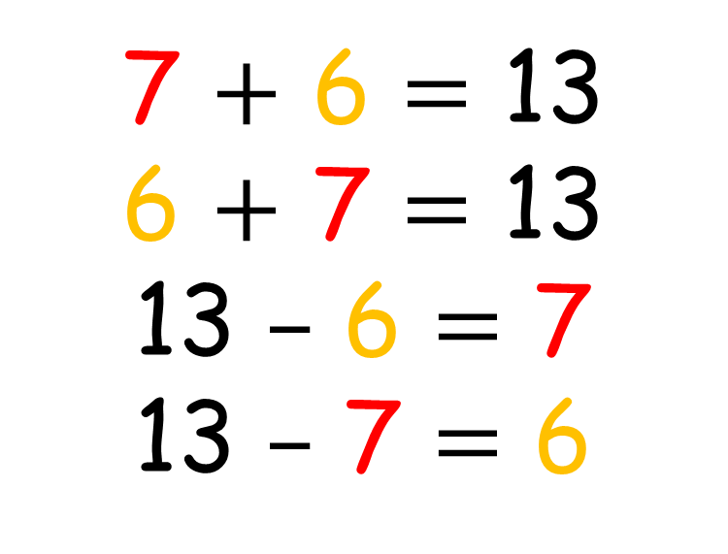
7 $+$ 6 $=$ 13
6 $+$ 7 $=$ 13
13 $–$ 6 $=$ 7
13 $–$ 7 $=$ 6
7
13
6

Slide 11
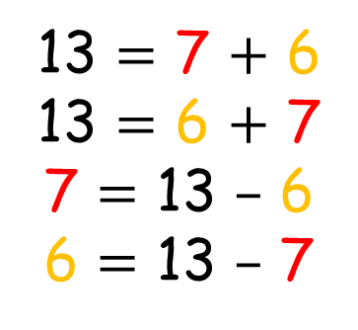
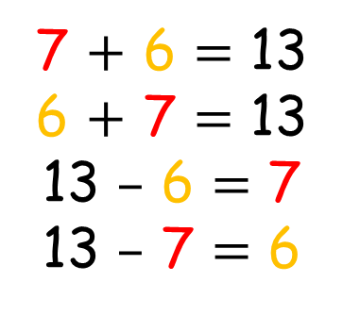
Have a think
7
7
13
13
7 $+$ 6 $=$ 13
6 $+$ 7 $=$ 13
13 $–$ 6 $=$ 7
13 $–$ 7 $=$ 6
13 $=$ 7 $+$ 6
13 $=$ 6 $+$ 7
7 $=$ 13 $–$ 6
6 $=$ 13 $–$ 7
6
6

Slide 12
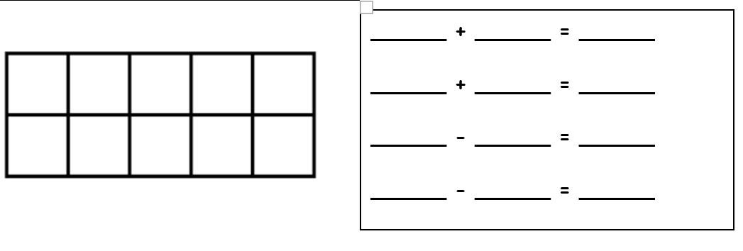
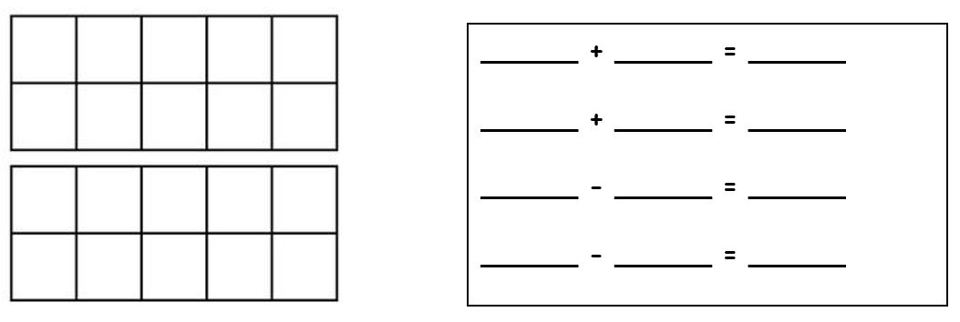
Year 2 activity
1 star – Using two colouring pencils, fill in the 10s frame. Then, complete your number sentences. Remember to include two addition and two subtraction sentences.
2 star - Using two colouring pencils, fill in the 20s frame. Then, complete your number sentences. Remember to include two addition and two subtraction sentences.
3 star – Glue in a 20 frame in your book and write the matching fact families next to it.

Slide 13


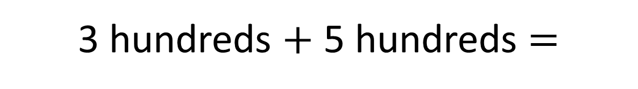
3 $+$ 5 $=$
8
3 hundreds $+$ 5 hundreds $=$
8 hundreds
300 $+$ 500 $=\text{800}$

Slide 14

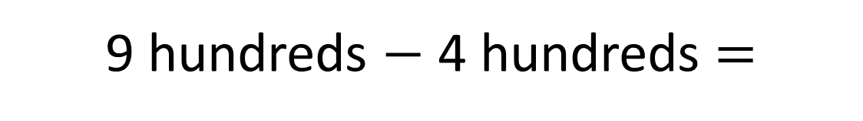

9 $−$ 4 $=$
5
9 hundreds $−$ 4 hundreds $=$
5 hundreds
900 $−$ 400 $=$ 500

Slide 15




Complete the calculations.
Have a think
600
200 $+$ 400 $=$
700
$=$ 300 $+$ 400
500
800 $−$ 300 $=$
$=$ 800 $−$ 400
400

Slide 16








Use the bar model to write 8 different calculations.
Whole
Part
Part
part $+$ part $=$ whole
whole $−$ part $=$ part
part $+$ part $=$ whole
whole $−$ part $=$ part
whole $=$ part $+$ part
part $=$ whole $−$ part
whole $=$ part $+$ part
part $=$ whole $−$ part

Slide 17








Use the bar model to write 8 different calculations.
900
Have a think
700
200
700 $+$ 200 $=$ 900
900 $−$ 200 $=$ 700
200 $+$ 700 $=$ 900
900 $−$ 700 $=$ 200
900 $=$ 700 $+$ 200
700 $=$ 900 $−$ 200
900 $=$ 200 $+$ 700
200 $=$ 900 $−$ 700

Slide 18
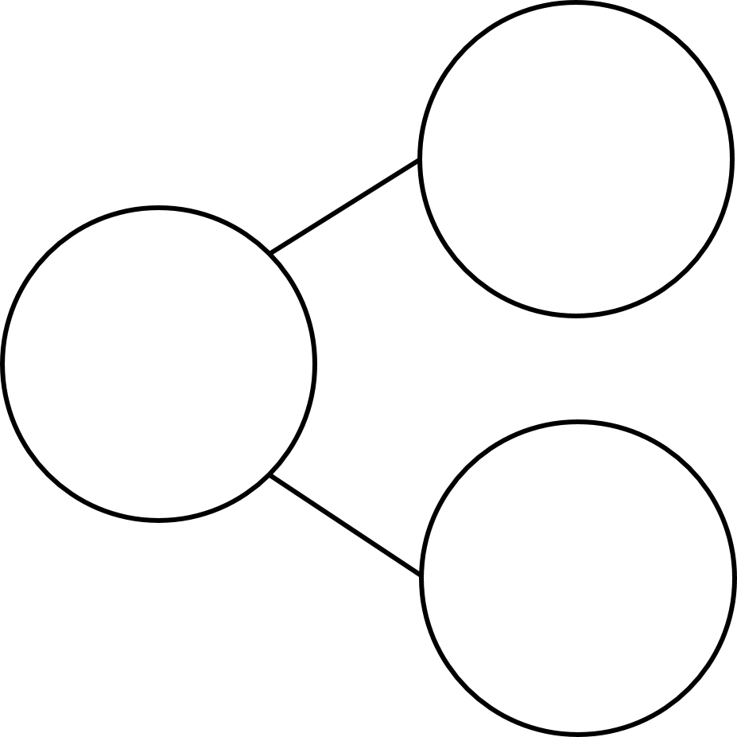






Have a think
Which calculations match the model?
200 $+$ 700 $=$ 500
500
700 $=$ 500 $+$ 200
200 $=$ 700 $−$ 500
700
700 $=$ 500 $−$ 200
200
500 $−$ 200 $=$ 700
500 $=$ 700 $−$ 200
part $+$ part $=$ whole
whole $−$ part $=$ part

Slide 19
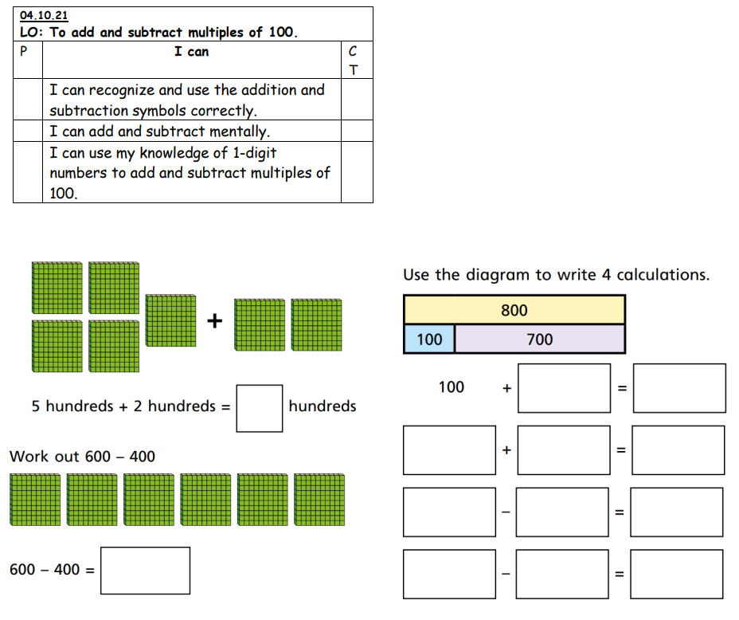
Year 3 activity
1 star – Complete the 1-page counting in 100s question sheet with adult support.
2 star - Complete the counting in 100s question sheet independently. There are 3 pages to complete.

