Slide 1
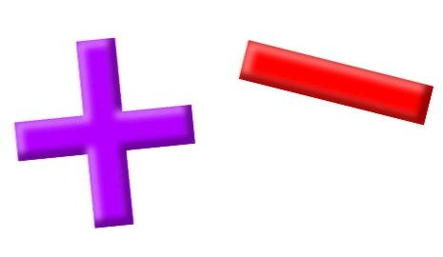
Add and Subtract

Slide 2
YR2 LO: To add two 2-digit numbers (crossing 10).
- I can recognize the value of each digit in a 2-digit number.
- I can exchange place value to work out addition questions.
- I can use column method to work out my answer.

Slide 3
YR3 LO: To add two 3-digit numbers (crossing 10 and 100).
I can understand how to carry when adding using column method.
To use concrete objects and pictorial representations to check my answers.
I can use my knowledge to solve reasoning questions.

Slide 4
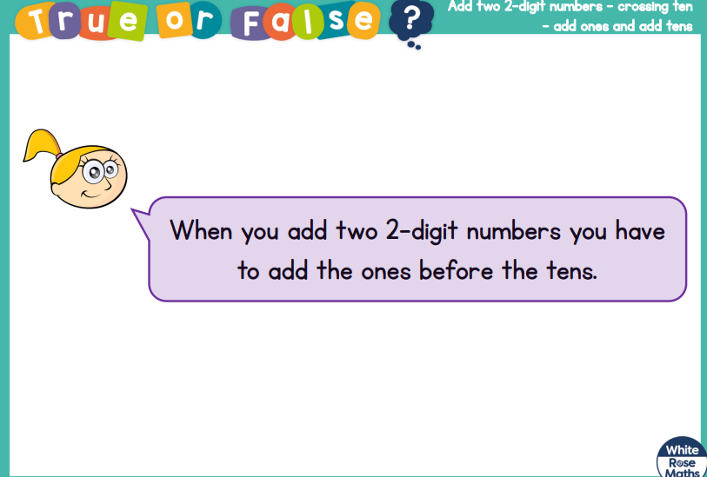
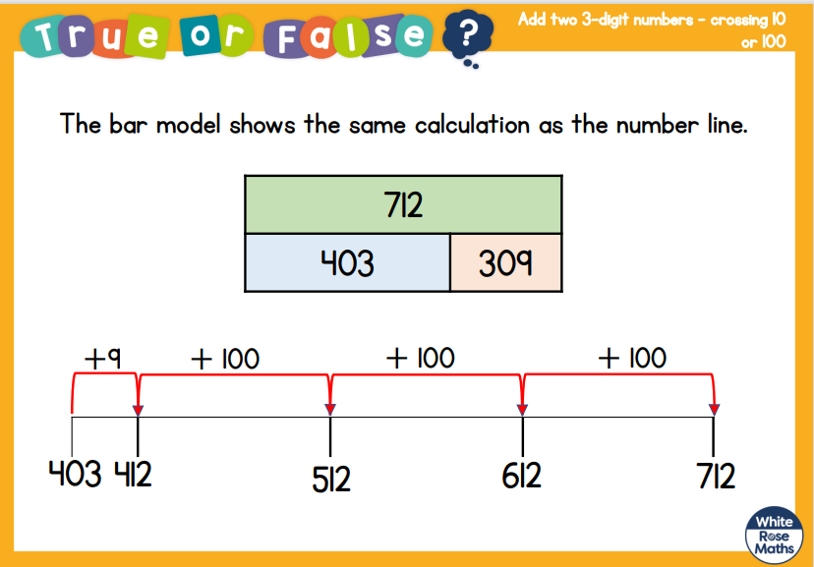

Slide 5
Recap:
Last lesson, we all practically tried to work out our answers using dienes and practicing column method.
Let’s see if we can remember what we need to do on our whiteboards.

Slide 6
Year 2
Year 3
T O
5
3 8
H T O
2 5
2 1 8
+
+

Slide 7
Year 2
Year 3
T O
1 7
4 5
H T O
4 3
4 7 5
+
+

Slide 8
Year 2
Year 3
T O
3 4
5 9
H T O
2 0 5
4 2 7
+
+

Slide 9


Varied Fluency 3
True or false?
 | T | O
 | 3 | 8
+ | 4 | 4
 | 7 | 2
1
1
© Classroom Secrets Limited 2018

Slide 10
Varied Fluency 3
True or false?
False
 | T | O
 | 3 | 8
+ | 4 | 4
 | 8 | 2
1
© Classroom Secrets Limited 2018

Slide 11
Varied Fluency 4
Circle the incorrect sum that does not equal the answer shown below.
T | O
A. 28 + 45
B. 37 + 36
C. 29 + 42
© Classroom Secrets Limited 2018

Slide 12
Varied Fluency 4
Circle the incorrect sum that does not equal the answer shown below.
T | O
A. 28 + 45
B. 37 + 36
C. 29 + 42
© Classroom Secrets Limited 2018

Slide 13
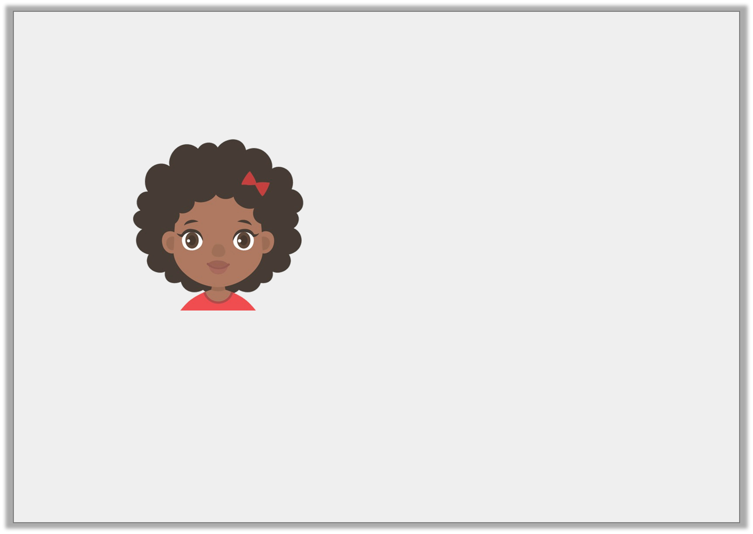
Reasoning 1
Tanya says,
Is she correct? Prove it.
 | T | O
 | 4 | 7
+ | 3 | 6
 | 8 | 2
1
© Classroom Secrets Limited 2018

Slide 14
Reasoning 1
Tanya says,
Is she correct? Prove it.
Tanya is incorrect because…
 | T | O
 | 4 | 7
+ | 3 | 6
 | 8 | 2
1
© Classroom Secrets Limited 2018

Slide 15
Reasoning 1
Tanya says,
Is she correct? Prove it.
Tanya is incorrect because although she has exchanged the ten ones for one ten, she has added the ones together incorrectly. The correct answer should be 83.
 | T | O
 | 4 | 7
+ | 3 | 6
 | 8 | 3
1
© Classroom Secrets Limited 2018

Slide 16
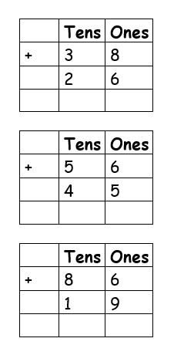
Year 2 Activity:
Please complete either the mild medium or spicy sheet. Remember you may need to carry a 10 when you are adding.
Don’t forget to use dienes if you need to check your answers.

Slide 17
Varied Fluency 2
Complete the column addition below.
 | H | T | O
 |  | 4 | 7
+ |  | 8
© Classroom Secrets Limited 2018

Slide 18
Varied Fluency 2
Complete the column addition below.
347 + 281 = 628
 | H | T | O
 |  | 4 | 7
+ |  | 8
 | 6 | 2 | 8
1
© Classroom Secrets Limited 2018

Slide 19
Varied Fluency 3
Libby has 286 marbles. Grace has 155 marbles.
How many marbles do they have altogether?
 | 2 | 8 | 6
+ | 1 | 5 | 5
© Classroom Secrets Limited 2018

Slide 20
Varied Fluency 3
Libby has 286 marbles. Grace has 155 marbles.
How many marbles do they have altogether?
 | 2 | 8 | 6
+ | 1 | 5 | 5
 | 4 | 4 | 1
1
1
© Classroom Secrets Limited 2018

Slide 21
Varied Fluency 4
True or false? The answer to the addition below is correct.
 | H | T | O
 | 3 | 8 | 5
+ | 4 | 6 | 2
 | 8 | 5 | 7
1
1
1
© Classroom Secrets Limited 2018

Slide 22
Varied Fluency 4
True or false? The answer to the addition below is correct.
False because the digits in the tens columns have been added incorrectly. 385 + 462 = 847.
 | H | T | O
 | 3 | 8 | 5
+ | 4 | 6 | 2
 | 8 | 5 | 7
1
1
1
© Classroom Secrets Limited 2018

Slide 23
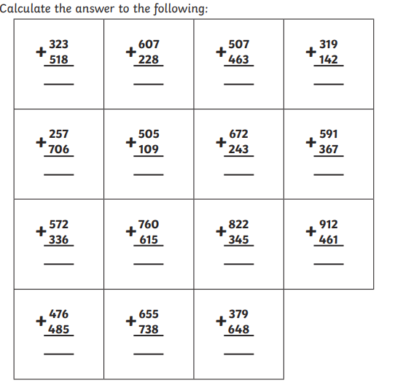
Year 3 Activity:
Complete the activity sheet. Remember to carry your tens.
Once you have had your sheet check, move onto the problem solving sheet.

