Slide 1
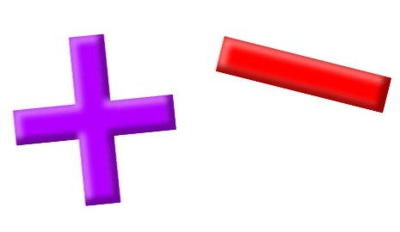
Add and Subtract

Slide 2
YR2 LO: To add two 2-digit numbers (Practical).
I can accurately make 2-digit numbers, showing their place value.
I can exchange place value to work out addition questions.
I can show my working out using physical resources and a PVC.

Slide 3
YR3 LO: To add two 3-digit numbers (Practical).
I can accurately make 3-digit numbers, showing the place value of each digit.
I can exchange place value to work out addition questions.
I can show my working out using physical resources and a PVC.

Slide 4
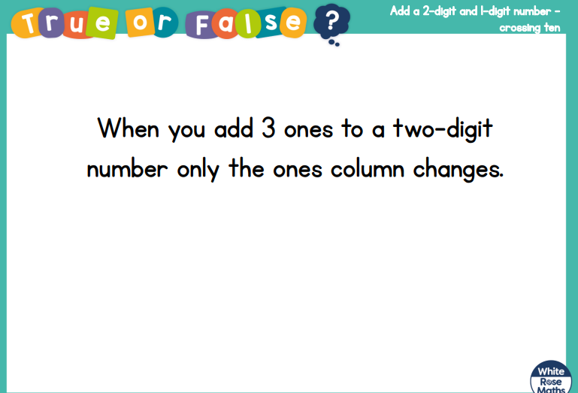
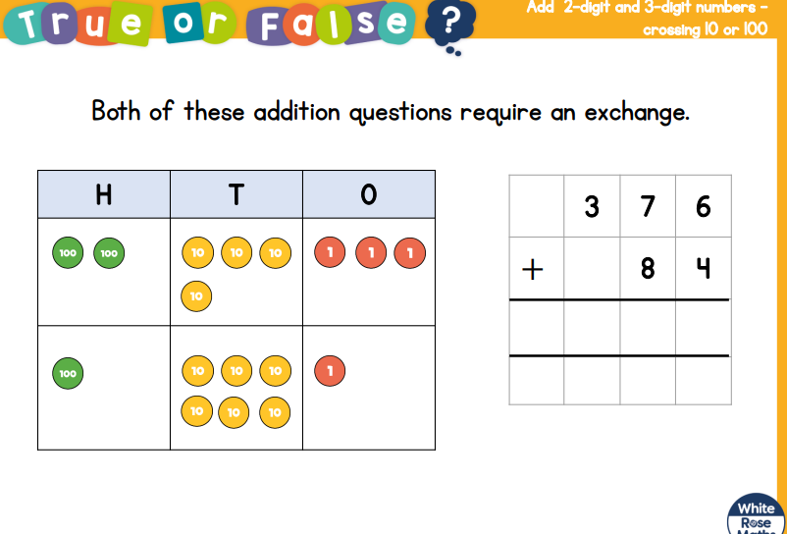

Slide 5
Recap- Making a 2-digit number
When we are working out addition questions practically, we first need to make the biggest number using dienes.
Can you make 28 using dienes?
Remember that means 2 ten sticks and 8 one cubes.

Slide 6
Adding another 2-digit number
We already have 28 and now we want to add 17.
28 + 17 =

Slide 7
Adding another 2-digit number
When we have more than 10 ones, we need to exchange them for a 10. We wouldn’t say our answer is 30 and 15, it would be 45.
28 + 17 =

Slide 8
Column method:
We can show this exchange using column method.
2 8
+ 1 7
We can add the ones together and make sure we show where we exchanged a 10.
Notes:
Demonstrate on IWB.

Slide 9
Adding two 2-digit numbers
We already have 48 and now we want to add 19.
48 + 19 =

Slide 10
Adding two 2-digit numbers
When we have more than 10 ones, we need to exchange them for a 10. We wouldn’t say our answer is 50 and 17, it would be 67.
48 + 19 =

Slide 11
Column method:
We can show this exchange using column method.
4 8
+ 1 9
We can add the ones together and make sure we show where we exchanged a 10.
Notes:
Demonstrate on IWB.

Slide 12
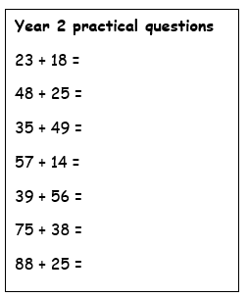
Year 2 Activity:
Using the question sheet, can you practically make the numbers and remember to exchange ten 1s for a 10s stick.
On your whiteboard, can you try to show this using column method.

Slide 13
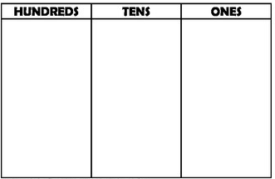
Today we’re going to be adding two 3-digit numbers
321 + 138 =
Can you have a go at this using column method?

Slide 14
Column method:
We can show this using column method.
3 2 1
+ 1 3 8
Did we have to carry any then?
Notes:
Demonstrate on IWB.

Slide 15
Column method:
We can show this using column method.
5 4 6
+ 1 3 8
Did we have to carry any then?
Notes:
Demonstrate on IWB.

Slide 16
Column method:
We can show this using column method.
7 6 8
+ 1 7 4
Did we have to carry any then?
Notes:
Demonstrate on IWB.

Slide 17
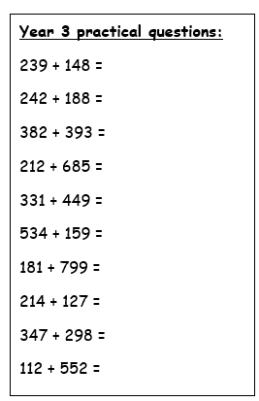
Year 3 Activity:
Using the question sheet, can you practically make the numbers to work out your answers.
On your whiteboard, can you try to show this using column method.

