Slide 1
Y3 LO: To be able to complete scaling problems.
Y2 LO: To consolidate what we have learnt so far.
I can recall my times tables.
I can make links between scaling up, multiplication and repeated addition.
I can discuss how to scale up and scale down.

Slide 2
Year 2:
In pairs, you are going to try and complete the investigations. You are using what you have learnt so far this term.
What have we learnt so far?

Slide 3
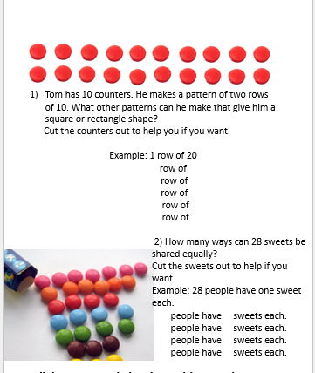
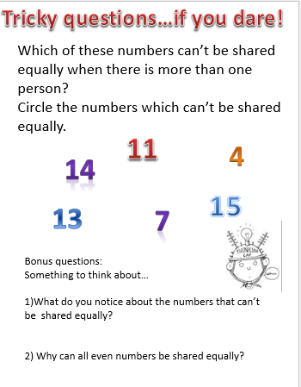

Slide 4
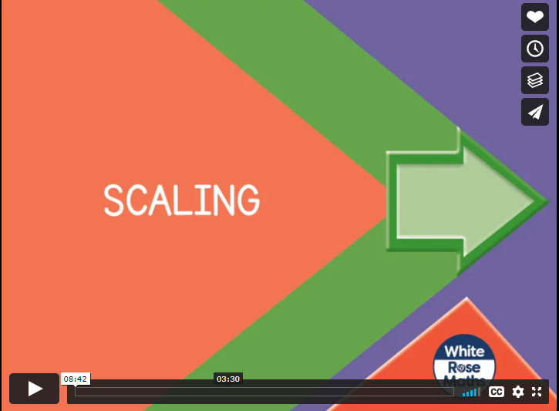
Notes:
Spr3.3.3 - Scaling on Vimeo
Discuss vocab such as double the amount, twice as much, four times etc.

Slide 5


Varied Fluency 1
Match the pair of numbers with the correct bar model.
16
and
2
A.
1.
25
and
5
B.
2.
© Classroom Secrets Limited 2018

Slide 6
Varied Fluency 1
Match the pair of numbers with the correct bar model.
16
and
2
A.
1.
25
and
5
B.
2.
© Classroom Secrets Limited 2018

Slide 7
Varied Fluency 2
How many times bigger than 3 is 36?
Circle the correct answer.
9 | 12 | 10 | 11
© Classroom Secrets Limited 2018

Slide 8
Varied Fluency 2
How many times bigger than 3 is 36?
Circle the correct answer.
9 | 12 | 10 | 11
© Classroom Secrets Limited 2018

Slide 9
Varied Fluency 3
True or false?
32 is 4 times bigger than 9.
© Classroom Secrets Limited 2018

Slide 10
Varied Fluency 3
True or false?
32 is 4 times bigger than 9.
False.
32 is 4 times bigger than 8.
36 is 4 times bigger than 9.
© Classroom Secrets Limited 2018

Slide 11
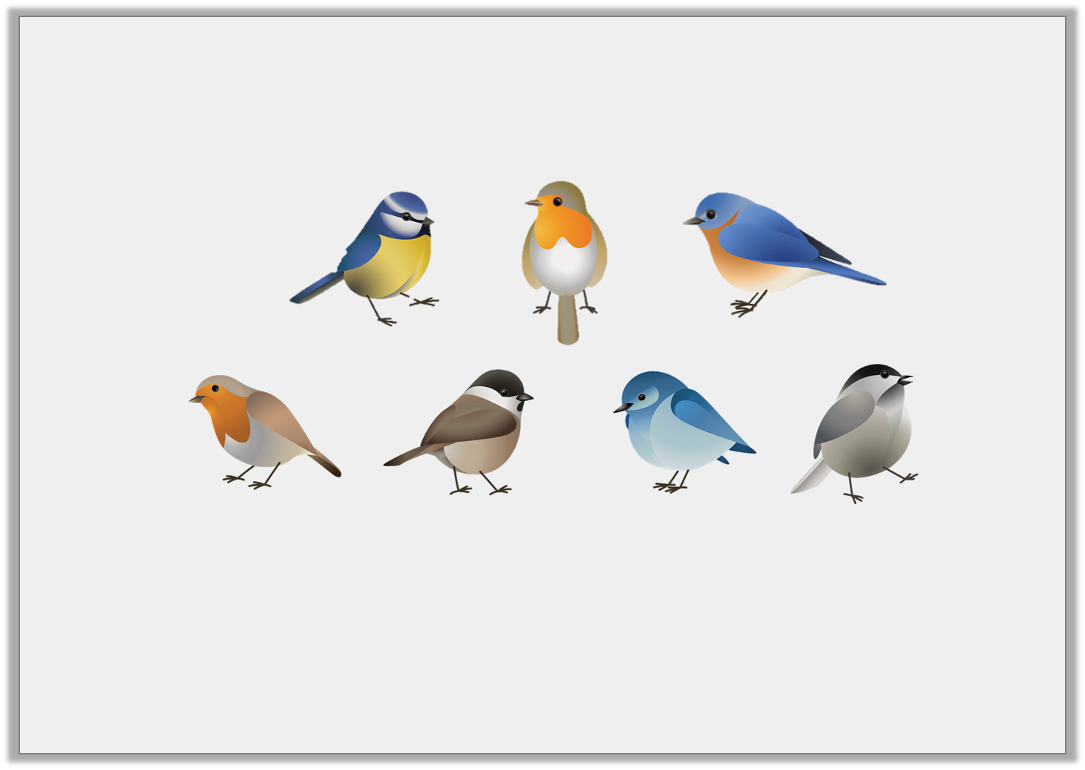
Varied Fluency 4
Andy saw 7 birds at the park.
Sadia saw 4 times as many birds than him.
How many birds did Sadia see?
© Classroom Secrets Limited 2018

Slide 12
Varied Fluency 4
Andy saw 7 birds at the park.
Sadia saw 4 times as many birds than him.
How many birds did Sadia see?
28 birds.
© Classroom Secrets Limited 2018

Slide 13
Problem Solving 1
Choose from the number cards below to complete the sentence.
Find 2 possibilities.
4
8
12
48
 | is |  | times bigger than
© Classroom Secrets Limited 2018

Slide 14
Problem Solving 1
Choose from the number cards below to complete the sentence.
Find 2 possibilities.
48 is 4 times bigger than 12.
4
8
12
48
48 | is | 12 | times bigger than | 4
© Classroom Secrets Limited 2018

Slide 15
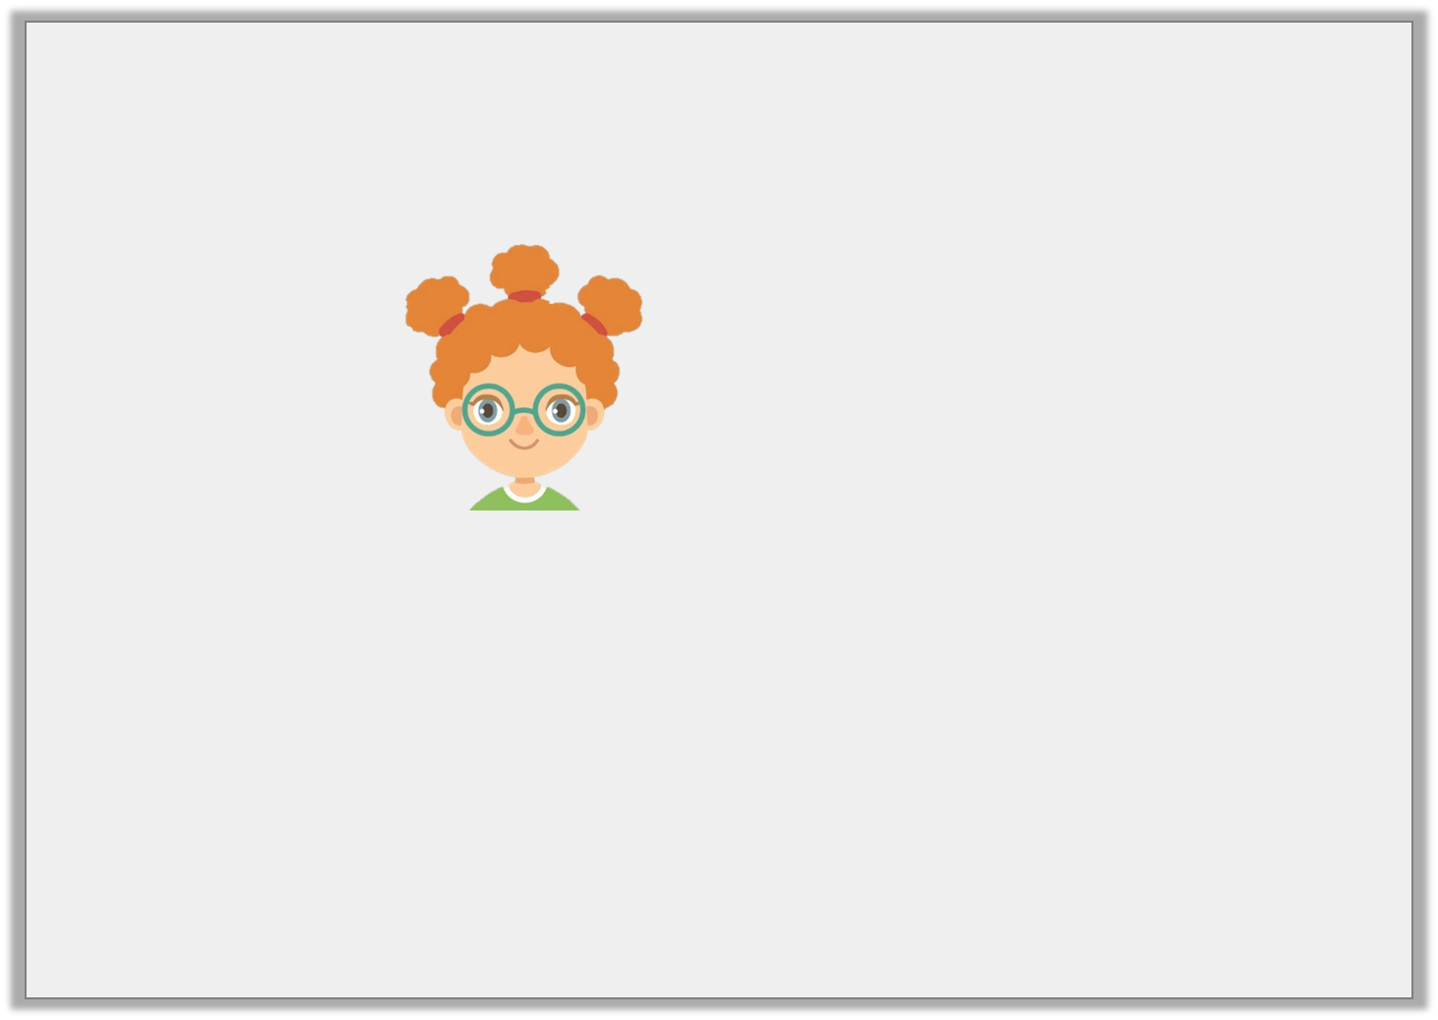
Reasoning 1
Lila says,
Explain the mistake that she has made.
28 is 4 times bigger than 32.
© Classroom Secrets Limited 2018

Slide 16
Reasoning 1
Lila says,
Explain the mistake that she has made.
Lila has worked out the difference…
Her sentence should be…
28 is 4 times bigger than 32.
© Classroom Secrets Limited 2018

Slide 17
Reasoning 1
Lila says,
Explain the mistake that she has made.
Lila has worked out the difference between 28 and 32.
Her sentence should be 28 is 4 times bigger than 7.
28 is 4 times bigger than 32.
© Classroom Secrets Limited 2018

Slide 18
Problem Solving 2
Solve the word problem below.
I am thinking of a number.
It is 3 times smaller than 30.
What number am I thinking of?
?
30
© Classroom Secrets Limited 2018

Slide 19
Problem Solving 2
Solve the word problem below.
I am thinking of a number.
It is 3 times smaller than 30.
What number am I thinking of?
10
30
© Classroom Secrets Limited 2018

Slide 20
Year 3:
You need to complete the scaling problems.
Then you need to have a go at scaling up a recipe.

