Slide 1
Y3 LO: To be able to complete division where there are remainders.
Y2 LO: To be able to divide by ten.
I can recall my ten times tables.
I can discuss efficient methods.
I can complete division calculations using numbers and pictorial representations.
I can understand not all numbers can be shared equally.
I can use a variety of methods to divide.
I can understand how to show remainders.

Slide 2
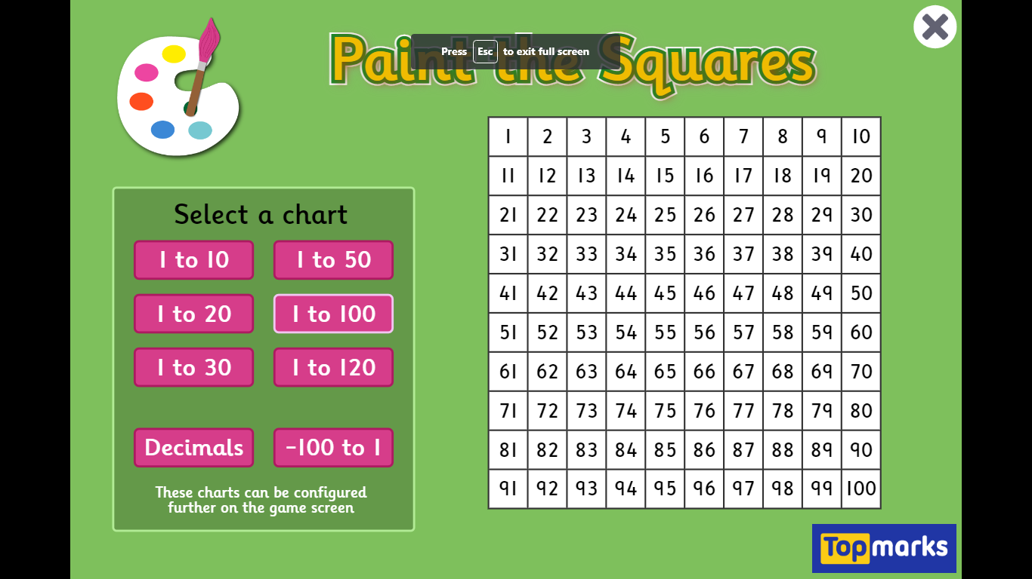
Starter:
Notes:
Highlight all multiples of times tables learnt so far.
What pattern can we spot?

Slide 3
What is division?
Dividing is sharing into equal groups. You might see it written differently in questions e.g.
divided by
share equally
equal groups of
divided into
share
Notes:
Recap

Slide 4
Can we say our ten times tables?

Slide 5

Fluency
How many 10s in 30?
10
10
10
÷
10
=
3
30
10
3
_____ ÷ _____ = _____
3
There are _____ tens in 30.

Slide 6
Fluency
How many 10s in 60?
10
10
10
10
10
10
÷
10
=
6
60
10
6
_____ ÷ _____ = _____
6
There are _____ tens in 60.

Slide 7
Fluency
How many 10s in 70?
10
10
10
10
10
10
10
÷
10
=
7
70
10
7
_____ ÷ _____ = _____
7
There are _____ tens in 70.

Slide 8
Fluency
How many 10s in 90?
10
10
10
10
10
10
10
10
10
÷
10
=
9
90
10
9
_____ ÷ _____ = _____
9
There are _____ tens in 90.

Slide 9
Fluency
How many 10s in 40?
10
10
10
10
÷
10
=
4
40
10
4
_____ ÷ _____ = _____
4
There are _____ tens in 40.

Slide 10
This representation shows there are 5 tens in 50.
True or false?
Reasoning
10
10
10
10
10
÷
10
=
50
False
The answer should be 5 (not 50).
50 ÷ 10 = 5 tens.

Slide 11
Problem solving
Use the counters below to make division calculations: ______ ÷ 10 = ____
How many calculations can you make? List them.
10
10
10
10
10
10
60 ÷ 10 = 6
50 ÷ 10 = 5
40 ÷ 10 = 4
30 ÷ 10 = 3
20 ÷ 10 = 2
10 ÷ 10 = 1
0 ÷ 10 = 0

Slide 12
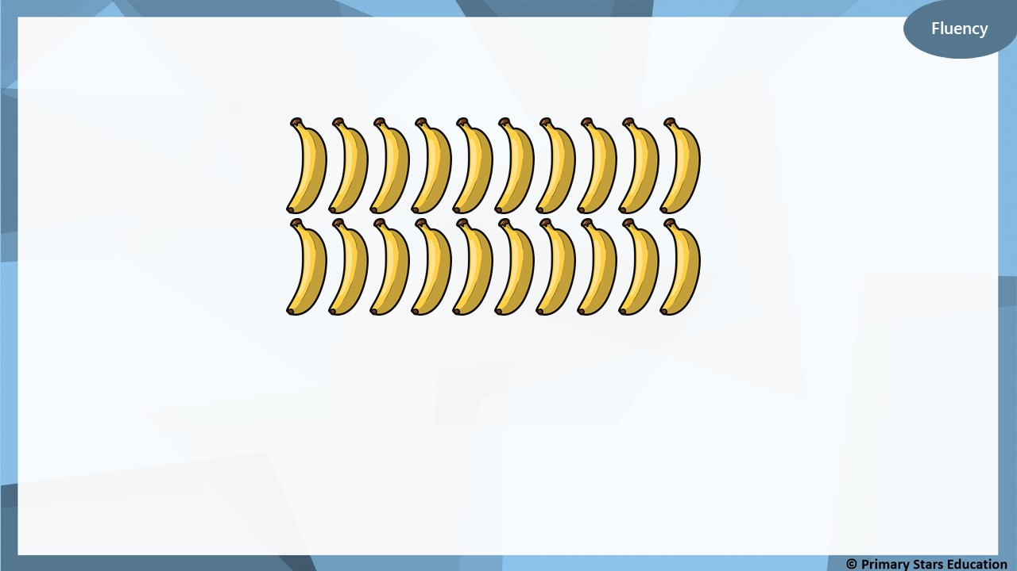
Bananas can be sold in packs of 10. How many packs can be made?
2
When 20 bananas are sold in packs of 10, _____ packs of bananas can be made.
20
10
10

Slide 13
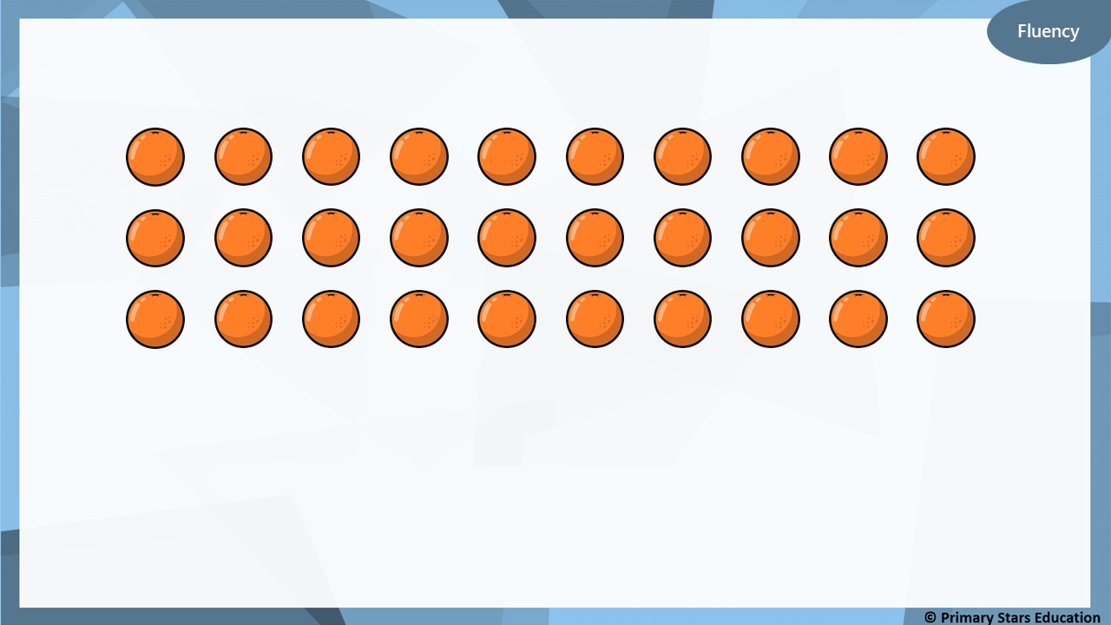
Oranges can be sold in packs of 10
How many packs can be made?
3
When 30 oranges are sold in packs of 10, _____ packs of
bananas can be made. Complete the bar model.
30
10
10
10

Slide 14
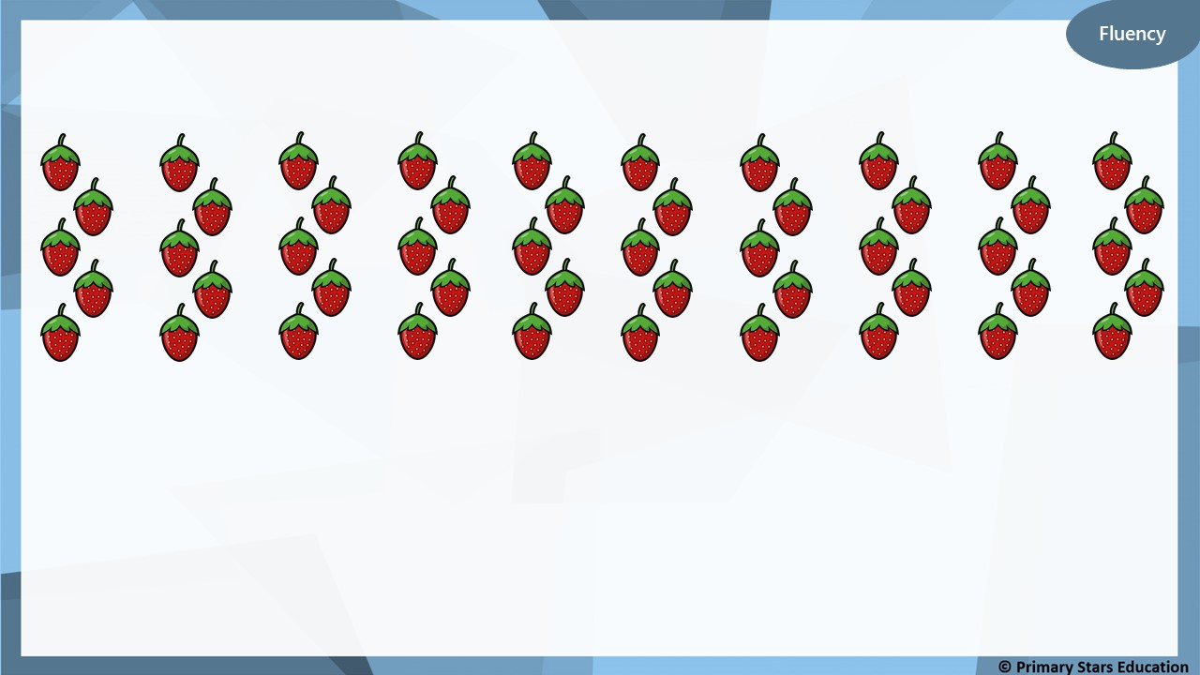
Strawberries can be sold in packs of 10
How many packs can be made?
5
When 50 strawberries are sold in packs of 10, _____ packs of
bananas can be made. Complete the bar model.
50
10
10
10
10
10

Slide 15
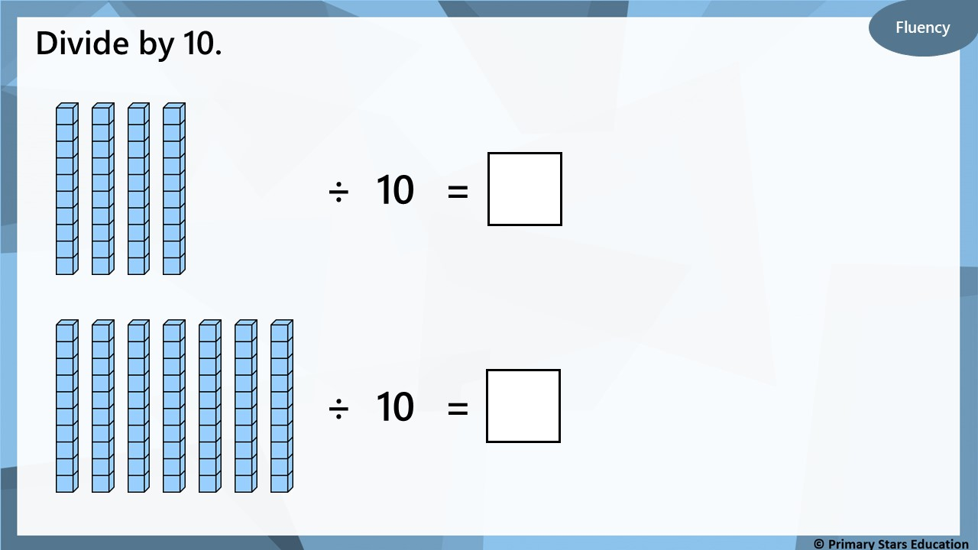
4
7

Slide 16
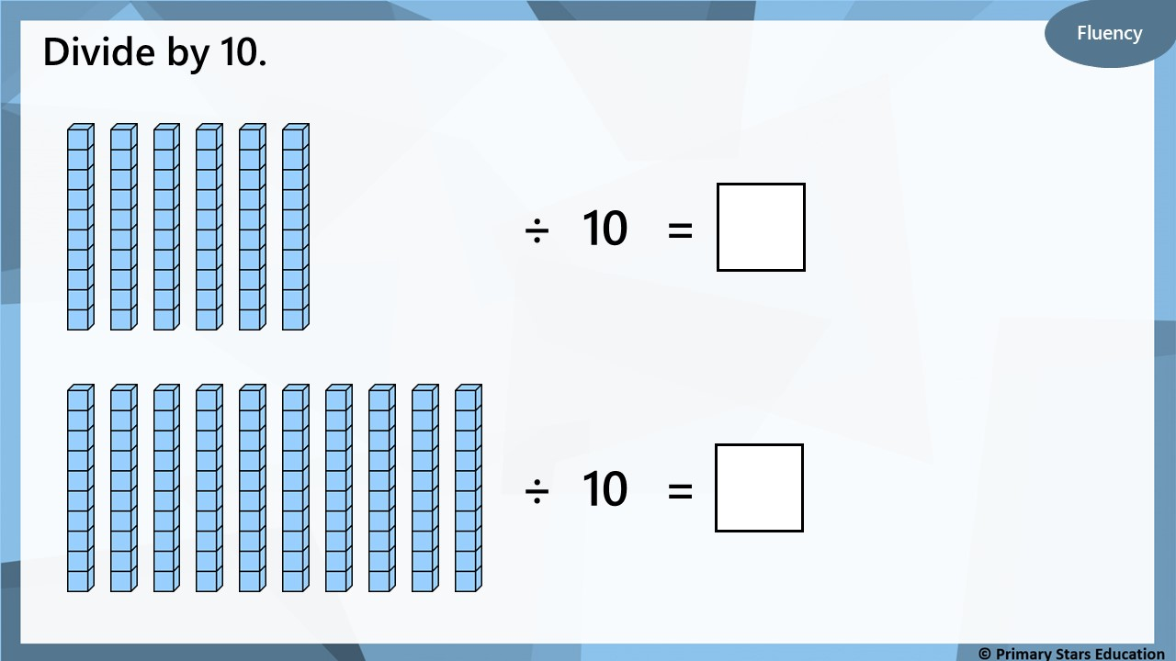
6
10

Slide 17
Fluency
Use the multiplication calculation to create a division
calculation.
3
x
10
=
30
9
x
10
=
90
30
÷
10
=
3
90
÷
10
=
9

Slide 18
Fluency
Use the multiplication calculation to create a division
calculation.
1
x
10
=
10
10
x
10
=
100
10
÷
1
=
10
100
÷
10
=
10

Slide 19

Which number sentence is incorrect and how do you know?
A) 4 x 10 = 40
B) 4 lots of 10 = 40
C) 40 ÷ 10 = 4
D) Forty ÷ ten = three
D is incorrect. Forty divided by ten is 4 (not 3).

Slide 20
Problem solving
How many multiplication and division calculations can you make?
List your calculations.
4
10
40
40 ÷ 10 = 4 40 ÷ 4 = 10
4 x 10 = 40
10 x 4 = 40
Notes:
What can we use to represent __?
How does knowing your 10 times table help you to divide by 10? How many 10s in ____? How many groups of 10 are there in ___ tens? How many 10s make ___? ___ make ___ tens.

Slide 21
Year 2 Activity:
Complete the worksheet.
Use resources to support you and check your answers.
Could you use multiplication to help you check your answers?

Slide 22
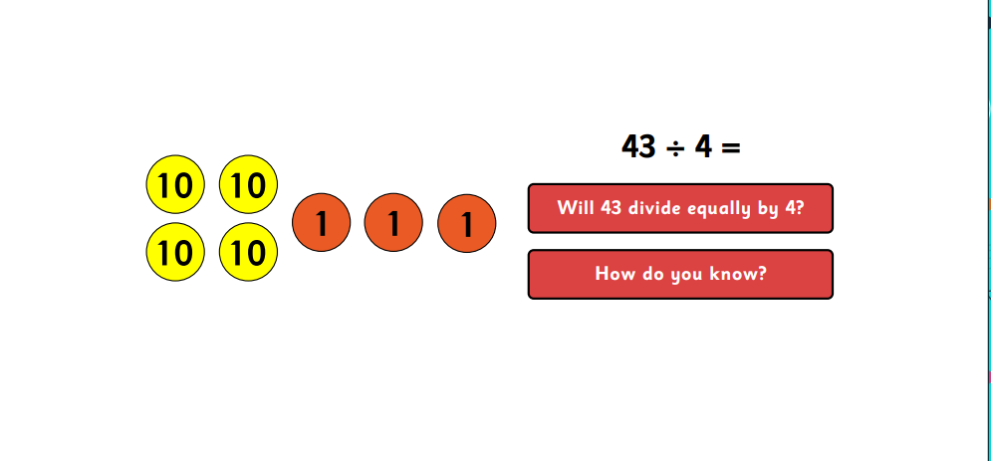

Slide 23
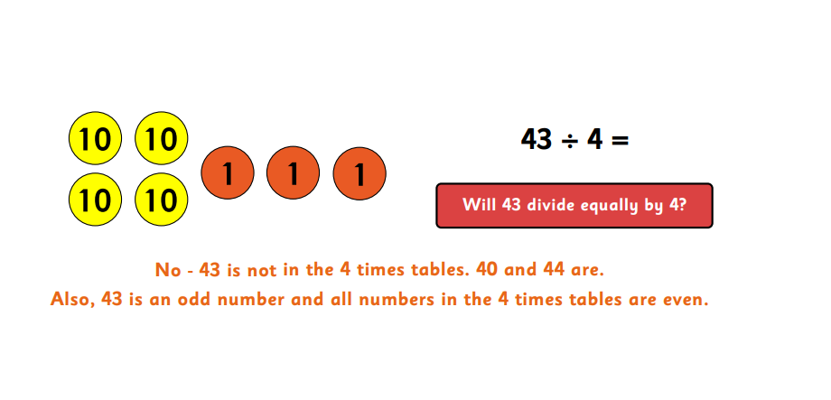

Slide 24
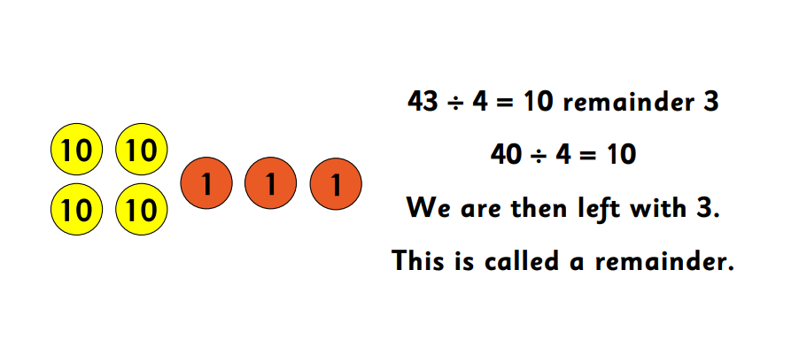

Slide 25
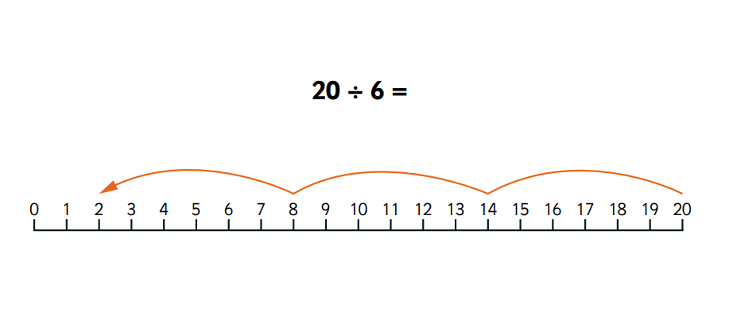

Slide 26
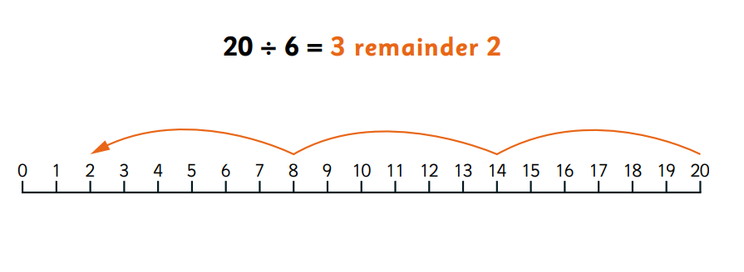

Slide 27

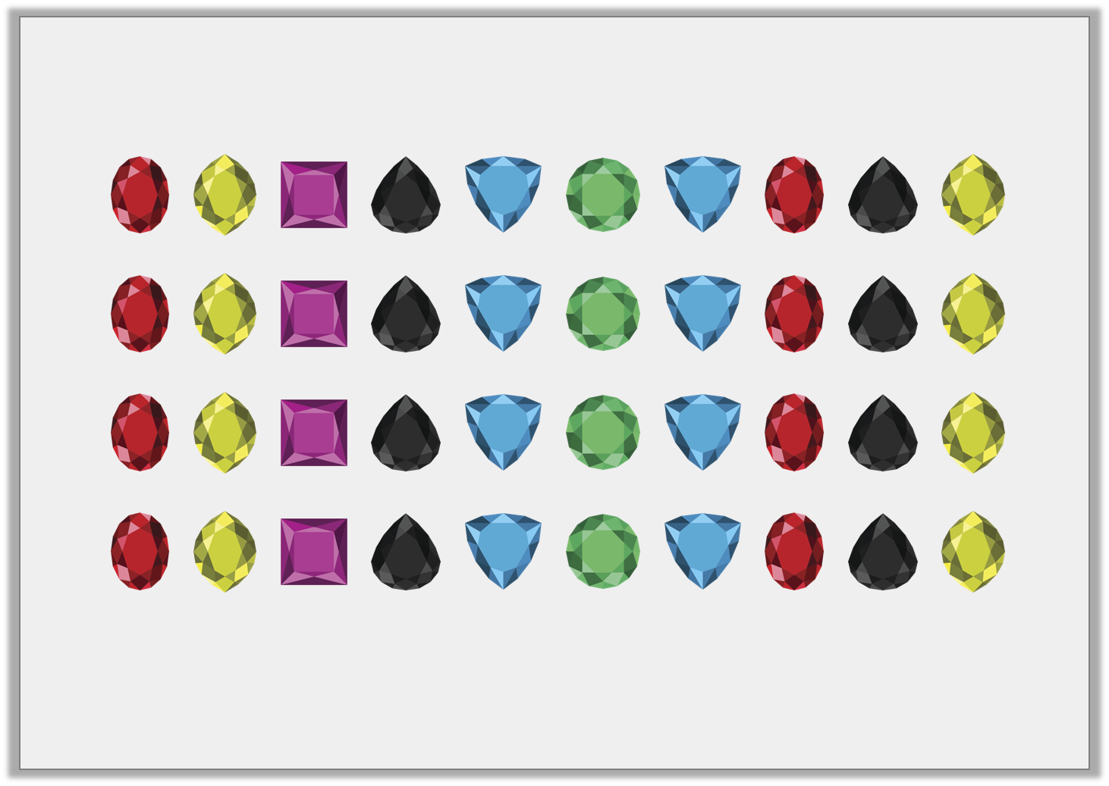

Varied Fluency 1
Put the jewels into three equal groups to calculate 40 ÷ 3.
How many jewels are left over?
© Classroom Secrets Limited 2018

Slide 28
Varied Fluency 1
Put the jewels into three equal groups to calculate 40 ÷ 3.
How many jewels are left over?
40 ÷ 3 = 13 r1 so as shown above, there are 3 equal groups of 13 jewels and one jewel is left over.
© Classroom Secrets Limited 2018

Slide 29
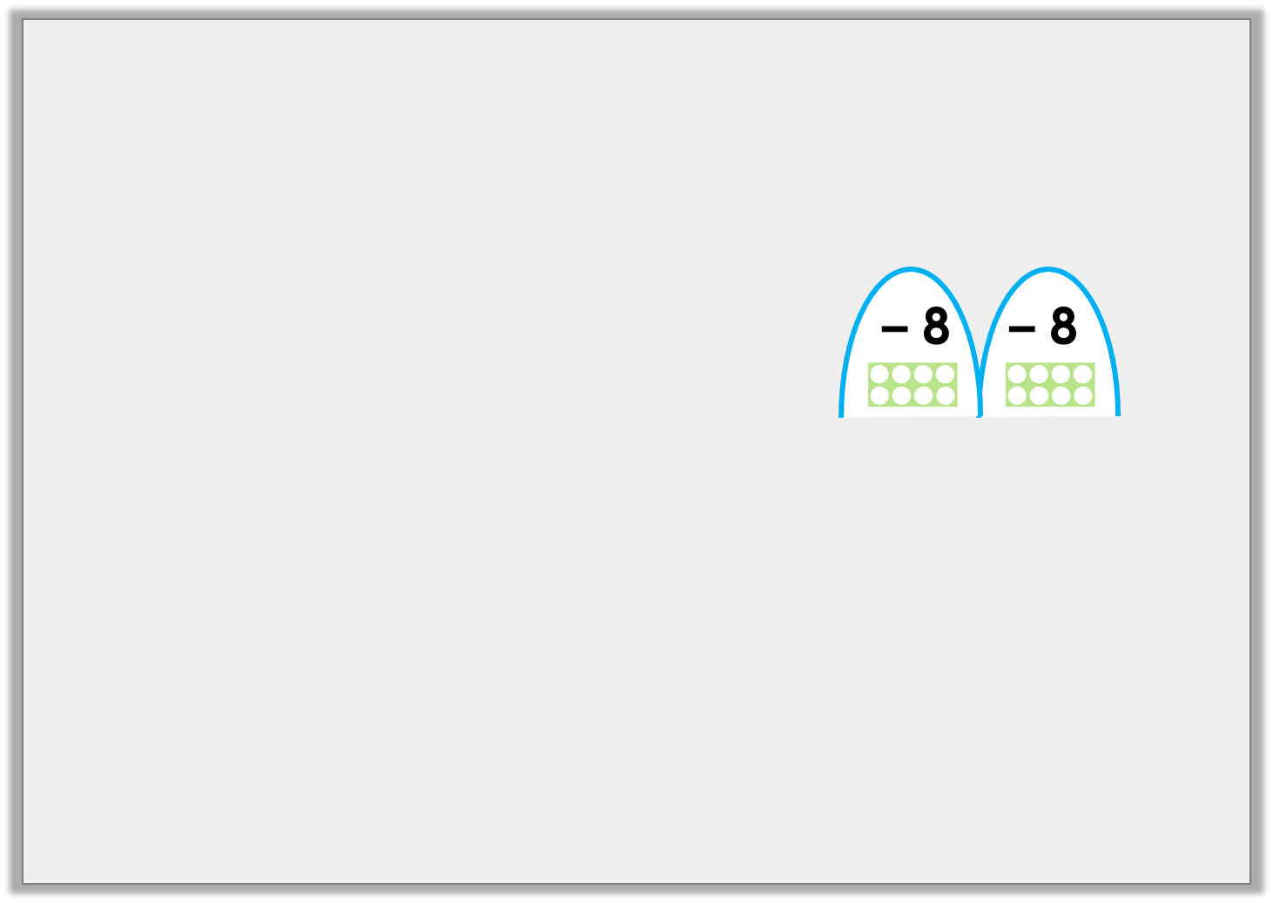
Varied Fluency 2
Complete the number line using repeated subtraction to
calculate 58 ÷ 8.
Hint: you may have a remainder.
0 | 2 | 10 | 18 | 26 | 34 | 42 | 50 | 58
5 | 8 | ÷ | 8 | = |  | r
© Classroom Secrets Limited 2018

Slide 30
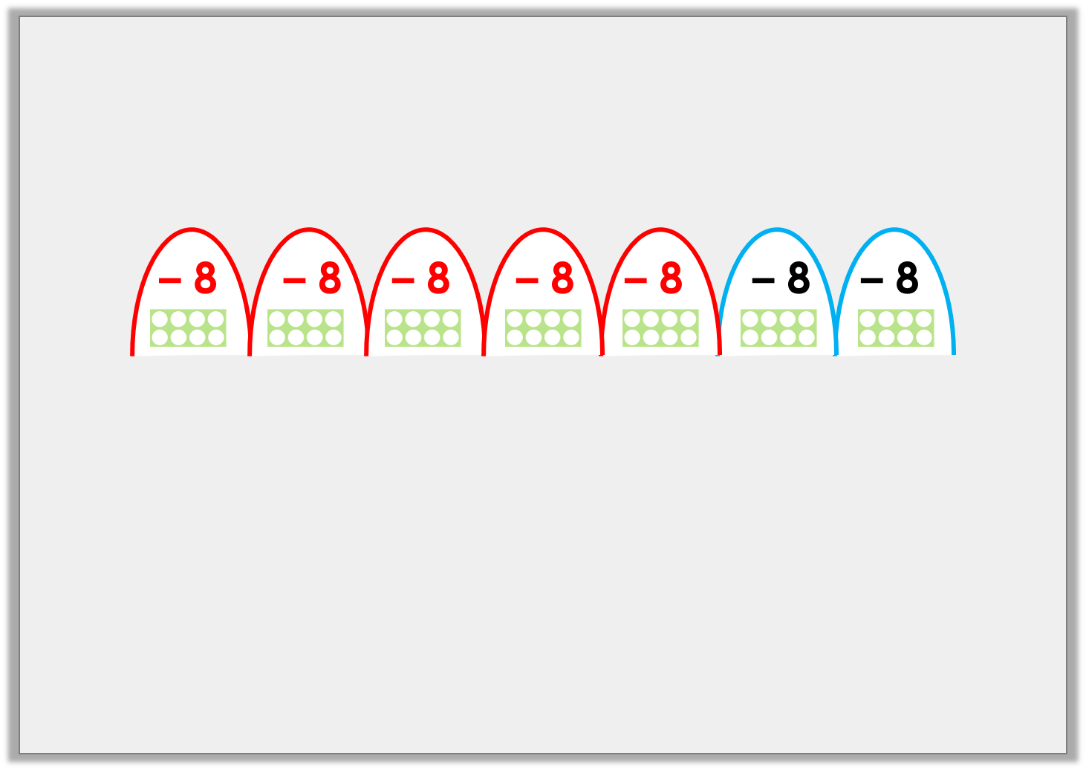
Varied Fluency 2
Complete the number line using repeated subtraction to
calculate 58 ÷ 8.
Hint: you may have a remainder.
0 | 2 | 10 | 18 | 26 | 34 | 42 | 50 | 58
5 | 8 | ÷ | 8 | = | 7 | r | 2
© Classroom Secrets Limited 2018

Slide 31
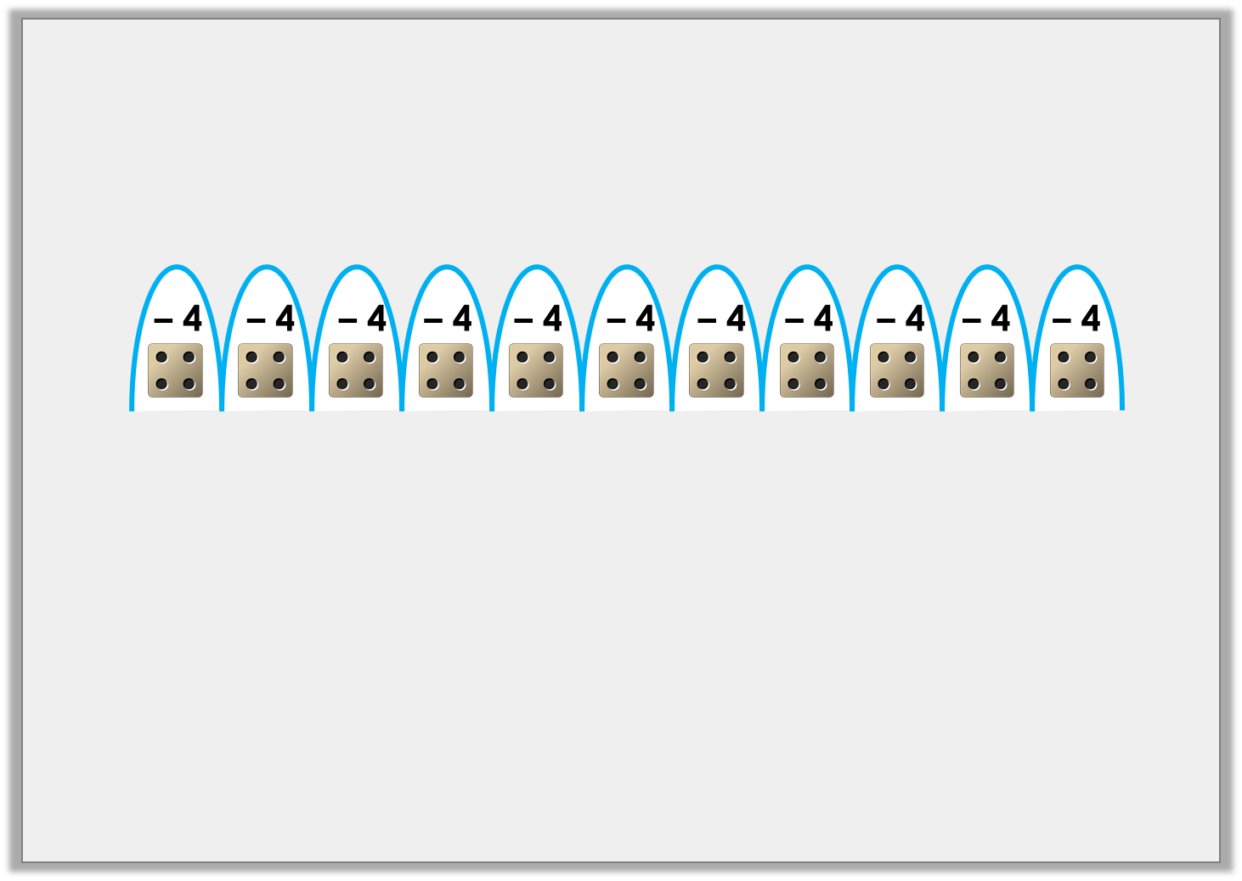
Varied Fluency 3
Complete the division below using information from the
number line.
0 | 3 | 7 | 11 | 15 | 19 | 23 | 27 | 31 | 35 | 39 | 43 | 47
 | ÷ |  | = |  | r
© Classroom Secrets Limited 2018

Slide 32
Varied Fluency 3
Complete the division below using information from the
number line.
0 | 3 | 7 | 11 | 15 | 19 | 23 | 27 | 31 | 35 | 39 | 43 | 47
47 | ÷ | 4 | = | 11 | r | 3
© Classroom Secrets Limited 2018

Slide 33
Varied Fluency 4
Write the division shown on the place value chart below.
Tens | Ones
10
10
1
1
1
10
10
1
1
10
10
1
1
© Classroom Secrets Limited 2018

Slide 34
Varied Fluency 4
Write the division shown on the place value chart below.
The place value chart shows 67 ÷ 3 = 22 r1.
Tens | Ones
10
10
1
1
1
10
10
1
1
10
10
1
1
© Classroom Secrets Limited 2018

Slide 35
Reasoning 1
Lexie is calculating 58 ÷ 5.
Method A gives her an answer of 11 r3. Method B gives her an answer of 11.
Explain which solution is correct.
Tens | Ones
A.
– 5
– 5
– 5
– 5
– 5
– 5
– 5
– 5
– 5
– 5
– 5
B.
0 | 10 | 15 | 20 | 25 | 30 | 35 | 40 | 45 | 50 | 55 | 58
© Classroom Secrets Limited 2018

Slide 36
Reasoning 1
Lexie is calculating 58 ÷ 5.
Method A gives her an answer of 11 r3. Method B gives her an answer of 11.
Explain which solution is correct.
Method A gives the correct answer because…
Tens | Ones
A.
– 5
– 5
– 5
– 5
– 5
– 5
– 5
– 5
– 5
– 5
– 5
B.
0 | 10 | 15 | 20 | 25 | 30 | 35 | 40 | 45 | 50 | 55 | 58
© Classroom Secrets Limited 2018

Slide 37
Reasoning 1
Lexie is calculating 58 ÷ 5.
Method A gives her an answer of 11 r3. Method B gives her an answer of 11.
Explain which solution is correct.
Method A gives the correct answer because 58 ÷ 5 = 11 r3.
In Method B, Lexie’s jumps were not always accurately calculated so her repeated subtractions were not equal.
Tens | Ones
A.
– 5
– 5
– 5
– 5
– 5
– 5
– 5
– 5
– 5
– 5
– 5
B.
0 | 10 | 15 | 20 | 25 | 30 | 35 | 40 | 45 | 50 | 55 | 58
© Classroom Secrets Limited 2018

Slide 38
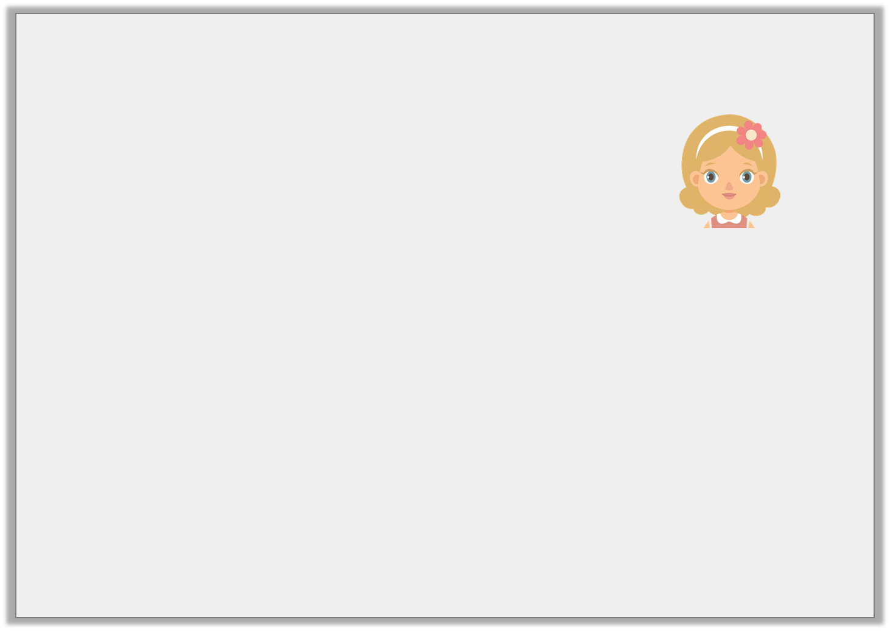
Reasoning 2
Jemima thinks that 39 conkers can be shared equally between 4 of her friends and she will have 2 left for herself.
Is she correct? Prove it.
Tens | Ones
1
1
1
1
1
1
1
1
1
1
1
1
1
1
1
1
1
1
1
1
1
1
1
1
1
1
1
1
1
1
1
1
1
1
1
1
1
1
© Classroom Secrets Limited 2018

Slide 39
Reasoning 2
Jemima thinks that 39 conkers can be shared equally between 4 of her friends and she will have 2 left for herself.
Is she correct? Prove it.
Jemima is incorrect because…
Tens | Ones
1
1
1
1
1
1
1
1
1
1
1
1
1
1
1
1
1
1
1
1
1
1
1
1
1
1
1
1
1
1
1
1
1
1
1
1
1
1
© Classroom Secrets Limited 2018

Slide 40
Reasoning 2
Jemima thinks that 39 conkers can be shared equally between 4 of her friends and she will have 2 left for herself.
Is she correct? Prove it.
Jemima is incorrect because 39 ÷ 4 = 9 r3 so she will have 3 conkers left for herself.
Tens | Ones
1
1
1
1
1
1
1
1
1
1
1
1
1
1
1
1
1
1
1
1
1
1
1
1
1
1
1
1
1
1
1
1
1
1
1
1
1
1
1
© Classroom Secrets Limited 2018

Slide 41

Problem Solving 1
The number line below is linked to the calculation underneath.
Complete the number line and calculation above.
0 | 1 |  | 9 |  | 17 | 21 | 25 | 29 | 33 | 37 |  | 45 |  | 53 | 57 | 61 | 65 | 69
 | ÷ | 4 | = |  | r
© Classroom Secrets Limited 2018

Slide 42
Problem Solving 1
The number line below is linked to the calculation underneath.
Complete the number line and calculation above.
– 4
– 4
– 4
– 4
– 4
– 4
– 4
– 4
– 4
– 4
– 4
– 4
– 4
– 4
– 4
– 4
– 4
0 | 1 | 5 | 9 | 13 | 17 | 21 | 25 | 29 | 33 | 37 | 41 | 45 | 49 | 53 | 57 | 61 | 65 | 69
69 | ÷ | 4 | = | 17 | r | 1
© Classroom Secrets Limited 2018

Slide 43
Year 3 Activity:
Complete the worksheet.
Use resources to support you and check your answers.
Could you use multiplication to help you check your answers?

