Slide 1
Early Reading and Phonics Workshop

Slide 2
What is Phonics?
‘Phonics refers to a method for teaching speakers of English to read and write their language’
The National Literacy Trust

Slide 3
Phonics at Great Staughton.
We follow the DfES Letters and Sounds phonics programme.
The phonics programme is divided into six phases and each phase builds upon the previous one.

Slide 4
Phase One.
Your child has been learning to:
  Have fun with sounds
  Listen carefully
  Develop their vocabulary
  Speak confidently to you, other adults and children
  Tune into sounds
  Listen and remember sounds
  Talk about sounds
  Understand that spoken words are made up of different sounds

Slide 5
Phase Two.
Children begin to formally learn the sounds in the English language.
Phonics sessions are fun sessions involving lots of speaking, listening and games.
Sounds are taught in sets of four over a week.
The aim of phase 2 is to recognise letters and their sounds and then use them when reading and writing simple words, e.g. pan, sit, mom and leg.

Slide 6
Phase Two.
Every letter of the alphabet has a sound.
We teach the letter sounds first.
We teach the names of the letters of the alphabet later.
Our language system consists of 26 letter of the alphabet which are used to form the 44 phonemes (sounds).
These phonemes can be written in over 120 combinations, e.g. i-e (side), ie (pie), igh (high) and y (fly).

Slide 7
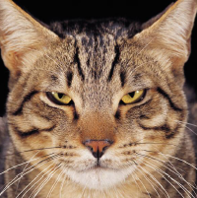
Synthetic Phonics.
Teaching the letter sounds helps children to read and write.
Children are taught to segment to read, e.g. c-a-t.
If you segment then blend the sounds together they make the word ‘cat’. If you try to blend the letter names together, it does not help you to hear the word.

Slide 8
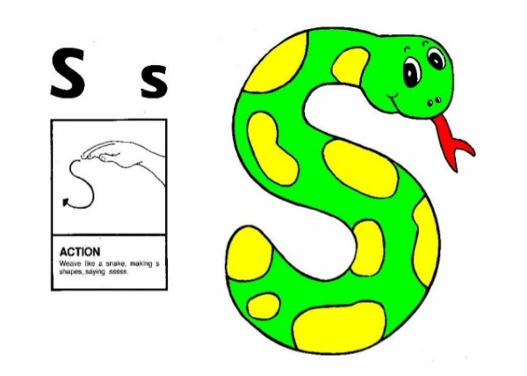
How to Say the Sounds.
Saying the sounds correctly with your child is extremely important.
The way we say sounds may well be different from when you were at school.
The way we say sounds may also be different in various parts of the country depending on accents and dialects.
We also use Jolly Phonics actions to support the children.

Slide 9
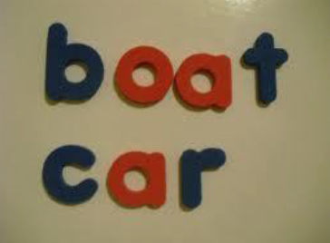
Segmenting and Blending.
Segmenting is identifying the individual sounds in a word (him = h-i-m) and writing down letters for each sound to form the word.
Blending is recognising the letter sounds in a written word (c-u-p) and merging or synthesising them in the order in which they are written to pronounce the word (cup).

Slide 10
Phase Three.
The aim of phase three phonics is to recognise digraphs (this is when two letters make one sound) and use them when they are reading and writing more complex words, e.g. toad, feet, farm and pain.
Children are expected to read and write these words in simple sentences.

Slide 11
Daily Phonics.
Lessons are daily for 15-20 minutes.
We revise old sounds and teach new sounds each week as well as high frequency or common words.
Children are given lots of opportunities to practise their sounds in both reading and writing in both indoor and outdoor play.
We use real objects to support learning as well as flashcards with pictures to help children to remember.
We teach the letter sounds first as sounds help children to become better early readers and writers.

Slide 12
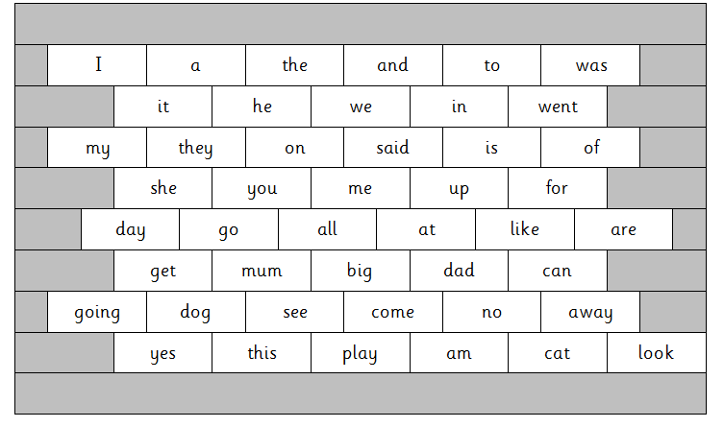
My First Word Wall.
Notes:
Word walls will be sent how allowing you to practise recognising high frequency words.

Slide 13
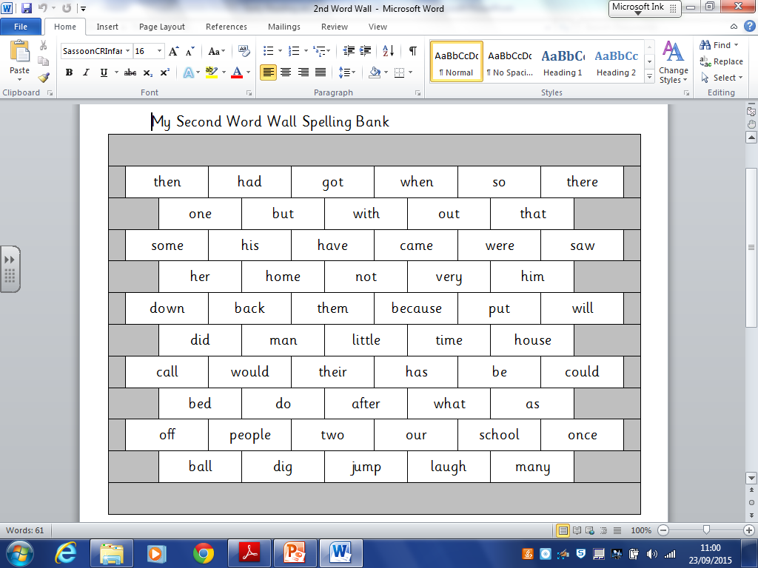
My Second Word Wall.

Slide 14
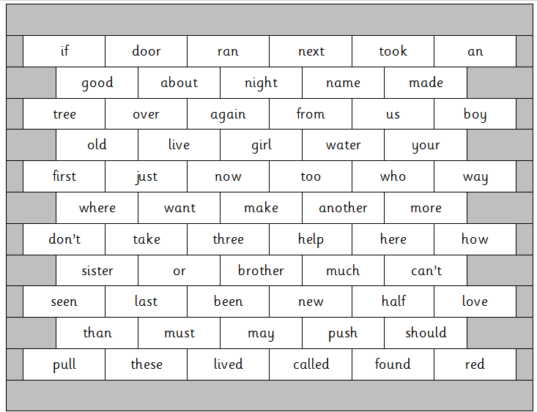
My Third Word Wall.

Slide 15
Getting Started with Reading.
Book talk – talk about the front cover.
Show and encourage your child to point at every word.
  Encourage your child to look at the pictures, never cover them up.
Don’t leave your child to struggle – count to three in your head and support your child by …
  Encouraging your child to look at the pictures.
  Ask what sound does the word start with?
  Re-read the sentence up to the point your child is stuck.
  Give the child the word.
  Write any words your child struggles with and needs to learn in their reading diary.

Slide 16
Reading at Great Staughton.
Different types of reading undertaken within school:
Shared reading
Guided reading
1:1 reading
Independent reading

Slide 17
Phonics for Writing.
Words are segmented into sounds orally, and a letter (grapheme) written to represent each sound (phoneme).
We call this sound talking:
t-i-p
r-ai-n
What is the first sound?
What is the second sound?
What is the last/final sound?

Slide 18
Terminology.
Children are taught from the beginning to use phonic terminology that may be unfamiliar to us.
A phoneme is the smallest unit of sound in a word.
A grapheme is the letter, or letters, representing a phoneme (e.g. t, ai and igh).

Slide 19
Digraphs, Trigraphs and Split Digraphs.
Some phonemes have more than one letter.
Digraphs have two letters (e.g. sh, ck, th and ll).
A vowel digraph contains at least one vowel (e.g. ai, ee, ar and oy).
Trigraphs have three letters (e.g. igh).
A split digraph (e.g. slide and like).

Slide 20
Handwriting.
Please ensure that you use lower case letters, unless it is for the capital letter of a person’s name or at the start of a sentence.
Encourage name writing.
Letters need to be correctly formed (left to right and top to bottom).
Use a variety of media, e.g. whiteboard pens, felt tip pens, crayons, chalks, pencils and paint brushes.

Slide 21
What you can do at home.
Sharing a book with your child every day. Look at the pictures and talk about the book.
Practising phonics flashcards everyday.
Encouraging your child to form their letters correctly.
Play reading and writing games (see leaflet)

Slide 22
Useful Websites.
www.bbc.co.uk/cbeebies/funwithphonics
www.phonicsplay.co.uk
www.twinkl.co.uk/resource/T-L-022-High-Frequency-Word-Flashcards
Support with how to say the sounds can also be found if you type the word phonics into YouTube.

Slide 23
Any questions?

